Slide 1
Computação Gráfica
Aula 12: Revisão 2 Interpolação, MipMap, Visibilidade

Slide 2
Interpolação em Triângulos

Slide 3
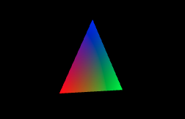
Triângulo com vértices de cores diferentes
<Scene>
<Viewpoint position="0 0 10"/>
<Transform rotation="0 1 0 0.52">
<Shape>
<IndexedFaceSet colorPerVertex='true' coordIndex='0 1 2 -1'>
<Coordinate point='-1 -1 0 1 -1 0 0 1 0'/>
<Color color='1 0 0 0 1 0 0 0 1'/>
</IndexedFaceSet>
</Shape>
</Transform>
</Scene>
30°
15
P₂
VIEW(0, 1, -10)
SCREEN(30, 16.65)
P₀
P₁
VIEW(-0.87, -1, -9.5)
VIEW(0.87, -1, -10.5)
SCREEN(26.95, 23.52)
SCREEN(32.77, 23.18)
26
21
39

Slide 4
Triângulo com vértices de cores diferentes
<Scene>
<Viewpoint position="0 0 10"/>
<Transform rotation="0 1 0 0.52">
<Shape>
<IndexedFaceSet colorPerVertex='true' coordIndex='0 1 2 -1'>
<Coordinate point='-1 -1 0 1 -1 0 0 1 0'/>
<Color color='1 0 0 0 1 0 0 0 1'/>
</IndexedFaceSet>
</Shape>
</Transform>
</Scene>
Distâncias do ponto(28, 22) as arestas
L(x, y) = (x – x0)(y1 – y0) – (y – y0)(x1 – x0)
L₀ = (28.5 - 32.77)(16.65 - 23.18) - (22.5 - 23.18)(30 - 32.77)
L₀ = (-4.27)(-6.53) - (-0.68)(-2.77)
L₀ = 27.8831 - 1.8836
L₀ = 25.9995
L₁ = (28.5 - 30)(23.52 - 16.65) - (22.5 – 16.65)(26.95 - 30)
L₁ = (-1.5)(6.87) - (5.85)(-3.05)
L₁ = -10.305 + 17.8425
L₁ = 7.5375
L₂ = (28.5 - 26.95)(23.18 - 23.52) - (22.5 - 23.52)(32.77 - 26.95)
L₂ = (1.55)(-0.34) - (-1.02)(5.82)
L₂ = -0.527 + 5.9364
L₂ = 5.4094
30°
centro do pixel
É triângulo?
Qual a cor?
Pixel (28, 22)
15
P₂
· | · | · | · | · | · | · | · | · | · | · | · | · | · | · | · | · | ·
· | · | · | · | · | · | · | · | · | · | · | · | · | · | · | · | · | ·
· | · | · | · | · | · | · | · | · | · | · | · | · | · | · | · | · | ·
· | · | · | · | · | · | · | · | · | · | · | · | · | · | · | · | · | ·
· | · | · | · | · | · | · | · | · | · | · | · | · | · | · | · | · | ·
· | · | · | · | · | · | · | · | · | · | · | · | · | · | · | · | · | ·
· | · | · | · | · | · | · | · | · | · | · | · | · | · | · | · | · | ·
· | · | · | · | · | · | · | · | · | · | · | · | · | · | · | · | · | ·
· | · | · | · | · | · | · | · | · | · | · | · | · | · | · | · | · | ·
· | · | · | · | · | · | · | · | · | · | · | · | · | · | · | · | · | ·
· | · | · | · | · | · | · | · | · | · | · | · | · | · | · | · | · | ·
VIEW(0, 1, -10)
SCREEN(30, 16.65)
P₀
P₁
VIEW(-0.87, -1, -9.5)
VIEW(0.87, -1, -10.5)
Todos positivos: Dentro !!!
SCREEN(26.95, 23.52)
SCREEN(32.77, 23.18)
26
21
39

Slide 5
Triângulo com vértices de cores diferentes
<Scene>
<Viewpoint position="0 0 10"/>
<Transform rotation="0 1 0 0.52">
<Shape>
<IndexedFaceSet colorPerVertex='true' coordIndex='0 1 2 -1'>
<Coordinate point='-1 -1 0 1 -1 0 0 1 0'/>
<Color color='1 0 0 0 1 0 0 0 1'/>
</IndexedFaceSet>
</Shape>
</Transform>
</Scene>
Área dos triângulos:
Area = |x₀(y₁–y₂) + x₁(y₂–y₀) + x₂(y₀–y₁)| / 2
A = |26.95(23.18-16.65)+32.77(16.65-23.52)+30(23.52-23.18)|/2
A = |26.95(6.53)+32.77(-6.87)+30(0.34)|/2
A = |175.9835-225.1299+10.2|/2
A = 19.4732
30°
É triângulo?
Qual a cor?
Pixel (28, 22)
A₀ = |28.5(23.18-16.65)+32.77(16.65-22.5)+30(22.5-23.18)|/2
A₀ = |28.5(6.53)+32.77(-5.85)+30(-0.68)|/2
A₀ = |186.105-191.7045-20.4|/2
A₀ = 12.99975
A₁ = |28.5(16.65-23.52)+30(23.52-22.5)+26.95(22.5-16.65)|/2
A₁ = |28.5(-6.87)+30(1.02)+26.95(5.85)|/2
A₁ = |-195.795+30.6+157.6575|/2
A₁ = 3.76875
A₂ = |28.5(23.52-23.18)+26.95(23.18-22.5)+32.77(22.5-23.52)|/2
A₂ = |28.5(0.34)+26.95(0.68)+32.77(-1.02)|/2
A₂ = |9.69+18.326-33.4254|/2
A₂ = 2.7047
15
P₂
VIEW(0, 1, -10)
SCREEN(30, 16.65)
A
A₁
A₀
P₀
A₂
P₁
VIEW(-0.87, -1, -9.5)
VIEW(0.87, -1, -10.5)
SCREEN(26.95, 23.52)
SCREEN(32.77, 23.18)
26
21
39

Slide 6

Triângulo com vértices de cores diferentes
<Scene>
<Viewpoint position="0 0 10"/>
<Transform rotation="0 1 0 0.52">
<Shape>
<IndexedFaceSet colorPerVertex='true' coordIndex='0 1 2 -1'>
<Coordinate point='-1 -1 0 1 -1 0 0 1 0'/>
<Color color='1 0 0 0 1 0 0 0 1'/>
</IndexedFaceSet>
</Shape>
</Transform>
</Scene>
Área dos triângulos:
A = 19.4732
A₀ = 12.99975
A₁ = 3.76875
A₂ = 2.7047
30°
É triângulo?
Qual a cor?
Pesos
α = 12.99975 / 19.4732 ~= 0.668
β = 3.76875 / 19. 4732 ~= 0.194
γ = 2.7047 / 19. 4732 ~= 0.139
ou
γ = 1 – α - β ~= 0.138
Pixel (28, 22)
15
P₂
· | · | · | · | · | · | · | · | · | · | · | · | · | · | · | · | · | ·
· | · | · | · | · | · | · | · | · | · | · | · | · | · | · | · | · | ·
· | · | · | · | · | · | · | · | · | · | · | · | · | · | · | · | · | ·
· | · | · | · | · | · | · | · | · | · | · | · | · | · | · | · | · | ·
· | · | · | · | · | · | · | · | · | · | · | · | · | · | · | · | · | ·
· | · | · | · | · | · | · | · | · | · | · | · | · | · | · | · | · | ·
· | · | · | · | · | · | · | · | · | · | · | · | · | · | · | · | · | ·
· | · | · | · | · | · | · | · | · | · | · | · | · | · | · | · | · | ·
· | · | · | · | · | · | · | · | · | · | · | · | · | · | · | · | · | ·
· | · | · | · | · | · | · | · | · | · | · | · | · | · | · | · | · | ·
· | · | · | · | · | · | · | · | · | · | · | · | · | · | · | · | · | ·
VIEW(0, 1, -10)
SCREEN(30, 16.65)
Cor do pixel:
R = αR₀ + βR₁ + γR₂ = 0.668
G = αG₀ + βG₁ + γG₂ = 0.194
B = αB₀ + βB₁ + γB₂ = 0.139
P₀
P₁
VIEW(-0.87, -1, -9.5)
VIEW(0.87, -1, -10.5)
C = (0.668, 0.194, 0.139)
SCREEN(26.95, 23.52)
SCREEN(32.77, 23.18)
26
Percebeu que só usou coordenadas 2D da tela?
21
39

Slide 7
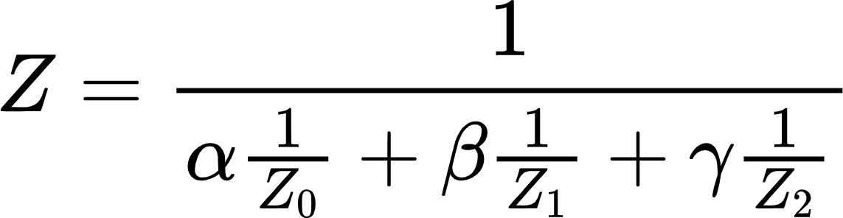
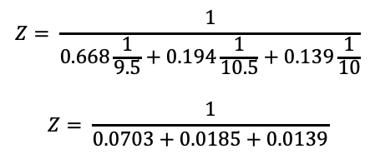
Cores do Triângulo com Correção Perspectiva
<Scene>
<Viewpoint position="0 0 10"/>
<Transform rotation="0 1 0 0.52">
<Shape>
<IndexedFaceSet colorPerVertex='true' coordIndex='0 1 2 -1'>
<Coordinate point='-1 -1 0 1 -1 0 0 1 0'/>
<Color color='1 0 0 0 1 0 0 0 1'/>
</IndexedFaceSet>
</Shape>
</Transform>
</Scene>
Pesos
α = 0.668
β = 0.194
γ = 0.139
30°
Z₀ = |-9.5|= 9.5
Z₁ = |-10.5|= 10.5
Z₂ = |-10.0|= 10
É triângulo?
Qual a cor?
Pixel (28, 22)
15
P₂
P₂
· | · | · | · | · | · | · | · | · | · | · | · | · | · | · | · | · | ·
· | · | · | · | · | · | · | · | · | · | · | · | · | · | · | · | · | ·
· | · | · | · | · | · | · | · | · | · | · | · | · | · | · | · | · | ·
· | · | · | · | · | · | · | · | · | · | · | · | · | · | · | · | · | ·
· | · | · | · | · | · | · | · | · | · | · | · | · | · | · | · | · | ·
· | · | · | · | · | · | · | · | · | · | · | · | · | · | · | · | · | ·
· | · | · | · | · | · | · | · | · | · | · | · | · | · | · | · | · | ·
· | · | · | · | · | · | · | · | · | · | · | · | · | · | · | · | · | ·
· | · | · | · | · | · | · | · | · | · | · | · | · | · | · | · | · | ·
· | · | · | · | · | · | · | · | · | · | · | · | · | · | · | · | · | ·
· | · | · | · | · | · | · | · | · | · | · | · | · | · | · | · | · | ·
VIEW(0, 1, -10)
SCREEN(30, 16.65)
$$Z= \frac{1}{0.668\frac{1}{9.5}+0.194\frac{1}{10.5}+0.139\frac{1}{10}}$$
$$Z= \frac{1}{0.0703+0.0185+0.0139}$$
P₀
P₁
Z = 9.74
VIEW(-0.87, -1, -9.5)
VIEW(0.87, -1, -10.5)
SCREEN(26.95, 23.52)
SCREEN(32.77, 23.18)
26
7
39
21
Notes:
Z

Slide 8
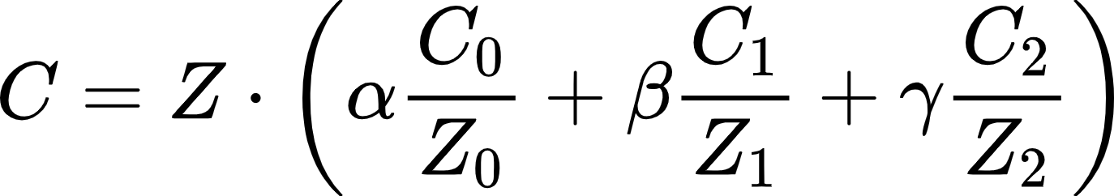

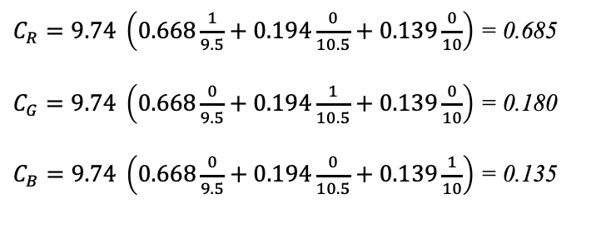
Cores do Triângulo com Correção Perspectiva
<Scene>
<Viewpoint position="0 0 10"/>
<Transform rotation="0 1 0 0.52">
<Shape>
<IndexedFaceSet colorPerVertex='true' coordIndex='0 1 2 -1'>
<Coordinate point='-1 -1 0 1 -1 0 0 1 0'/>
<Color color='1 0 0 0 1 0 0 0 1'/>
</IndexedFaceSet>
</Shape>
</Transform>
</Scene>
Pesos
α = 0.668
β = 0.194
γ = 0.139
Z₀ = |-9.5|= 9.5
Z₁ = |-10.5|= 10.5
Z₂ = |-10.0|= 10
30°
Z = 9.74
É triângulo?
Qual a cor?
Pixel (28, 22)
15
P₂
$C_{R}=9.74 \left(0.668\frac{1}{9.5}+0.194\frac{0}{10.5}+0.139\frac{0}{10}\right)$ = 0.685
$C_{G}=9.74 \left(0.668\frac{0}{9.5}+0.194\frac{1}{10.5}+0.139\frac{0}{10}\right)$ = 0.180
$C_{B}=9.74 \left(0.668\frac{0}{9.5}+0.194\frac{0}{10.5}+0.139\frac{1}{10}\right)$ = 0.135
· | · | · | · | · | · | · | · | · | · | · | · | · | · | · | · | · | ·
· | · | · | · | · | · | · | · | · | · | · | · | · | · | · | · | · | ·
· | · | · | · | · | · | · | · | · | · | · | · | · | · | · | · | · | ·
· | · | · | · | · | · | · | · | · | · | · | · | · | · | · | · | · | ·
· | · | · | · | · | · | · | · | · | · | · | · | · | · | · | · | · | ·
· | · | · | · | · | · | · | · | · | · | · | · | · | · | · | · | · | ·
· | · | · | · | · | · | · | · | · | · | · | · | · | · | · | · | · | ·
· | · | · | · | · | · | · | · | · | · | · | · | · | · | · | · | · | ·
· | · | · | · | · | · | · | · | · | · | · | · | · | · | · | · | · | ·
· | · | · | · | · | · | · | · | · | · | · | · | · | · | · | · | · | ·
· | · | · | · | · | · | · | · | · | · | · | · | · | · | · | · | · | ·
VIEW(0, 1, -10)
SCREEN(30, 16.65)
P₀
P₁
C = (0.685, 0.180, 0.135)
VIEW(-0.87, -1, -9.5)
VIEW(0.87, -1, -10.5)
SCREEN(26.95, 23.52)
SCREEN(32.77, 23.18)
Antes C = (0.668, 0.194, 0.139)
Obs: esses número podem variar conforme sua implementação
26
8
39
21
Notes:
Z

Slide 9
Aplicando Texturas

Slide 10

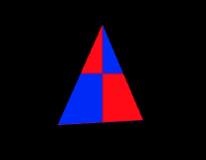
Triângulo com Texturas
Pesos
α = 0.668
β = 0.194
γ = 0.139
U = αU₀ + βU₁ + γU₂
U = 0.668*0.0 + 0.194*1.0 + 0.139*0.5
U = 0.2635
V = αV₀ + βV₁ + γV₂
V = 0.668*0.0 + 0.194*0.0 + 0.139*1.0
V = 0.139
<Scene>
<Viewpoint position="0 0 10"/>
<Transform rotation="0 1 0 0.52">
<Shape>
<IndexedFaceSet coordIndex='0 1 2 -1'>
<Coordinate point='-1 -1 0 1 -1 0 0 1 0'/>
<TextureCoordinate point='0.0 0.0 1.0 0.0 0.5 1.0'/>
</IndexedFaceSet>
<Appearance>
<ImageTexture url=' "chess.png" '/>
</Appearance>
</Shape>
</Transform>
</Scene>
chess.png (32x32)
1
UV = (0.264, 0.139)
Pixel (28, 22)
P₂
uv(0.5, 1.0)
v
P₁
P₀
uv(1.0, 0.0)
uv(0.0, 0.0)
0
u
1

Slide 11
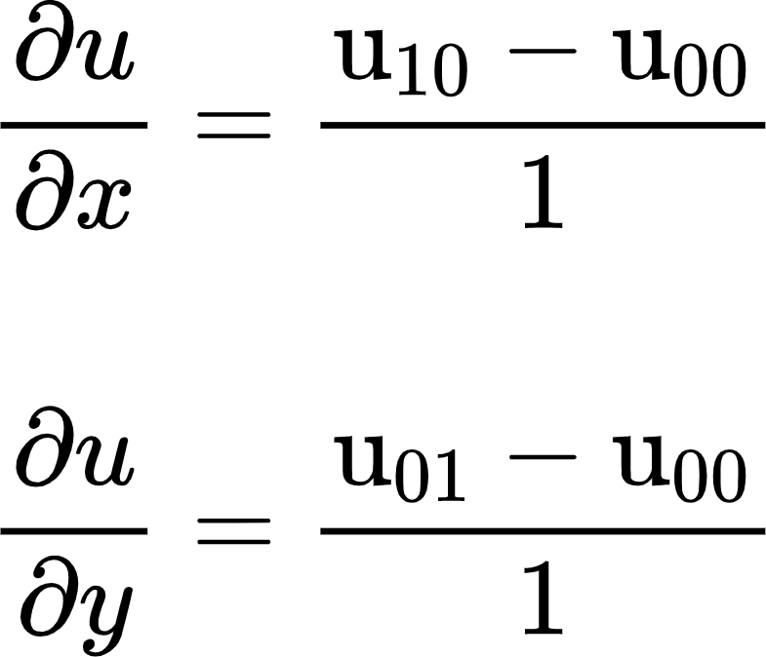
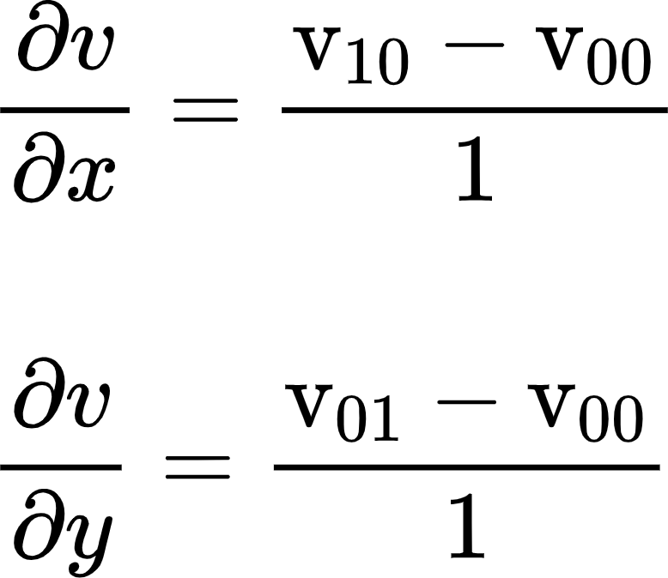
Triângulo com Texturas MipMap
<Scene>
<Viewpoint position="0 0 10"/>
<Transform rotation="0 1 0 0.52">
<Shape>
<IndexedFaceSet coordIndex='0 1 2 -1'>
<Coordinate point='-1 -1 0 1 -1 0 0 1 0'/>
<TextureCoordinate point='0.0 0.0 1.0 0.0 0.5 1.0'/>
</IndexedFaceSet>
<Appearance>
<ImageTexture url=' "chess.png" '/>
</Appearance>
</Shape>
</Transform>
</Scene>
pixel₀₀(28, 22) => UV(0.264, 0.139)
Coordenadas (u,v) Vizinhas:
pixel₁₀(29, 22) => UV(0.414, 0.129)
pixel₀₁(28, 23) => UV(0.248, -0.010)
x₁₀ − x₀₀
Pixel (28, 22)
P₂
y₀₁ − y₀₀
v
x₁₀ − x₀₀
P₁
10
P₀
00
y₀₁ − y₀₀
01
u

Slide 12





Triângulo com Texturas MipMap
U = 0.264
V = 0.139
pixel₁₀(29, 22) => UV(0.414, 0.129)
pixel₀₁(28, 23) => UV(0.248, -0.010)
= $32\left(\frac{0.414−0.264}{1}\right)=4.8$
= $32\left(\frac{0.129−0.139}{1}\right)=−0.32$
29 − 28
29 − 28
= $32\left(\frac{0.248−0.264}{1}\right)=−0.56$
= $32\left(\frac{−0.010−0.139}{1}\right)=−4.8$
23 − 22
23 − 22
chess.png (32x32)
32
Pixel (28, 22)
P₂
P₁
00
P₀
10
01
0
32

Slide 13
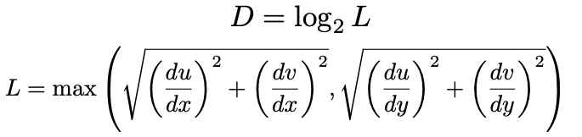


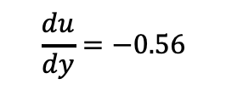

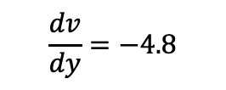
Triângulo com Texturas MipMap
chess.png (32x32)
U = 0.264
V = 0.139
pixel₁₀(29, 22) => UV(0.414, 0.129)
pixel₀₁(28, 23) => UV(0.248, -0.010)
0
$$\frac{du}{dx}=4.8$$
$$\frac{dv}{dx}=−0.32$$
$$\frac{du}{dy}=−0.56$$
$$\frac{dv}{dy}=−4.8$$
1 (16x16)
Pixel (28, 22)
P₂
$$L=\max\left(\sqrt{{\left(4.8\right)}^{2}+{\left(−0.32\right)}^{2}},\sqrt{{\left(−0.56\right)}^{2}+{\left(−4.8\right)}^{2}}\right)$$
$$L=\max\left(4.81, 4.83 \right)$$
2 (8x8)
L = 4.83
3 (4x4)
…
P₁
D = 2.27
P₀
D = 2

Slide 14
Z-Buffer

Slide 15
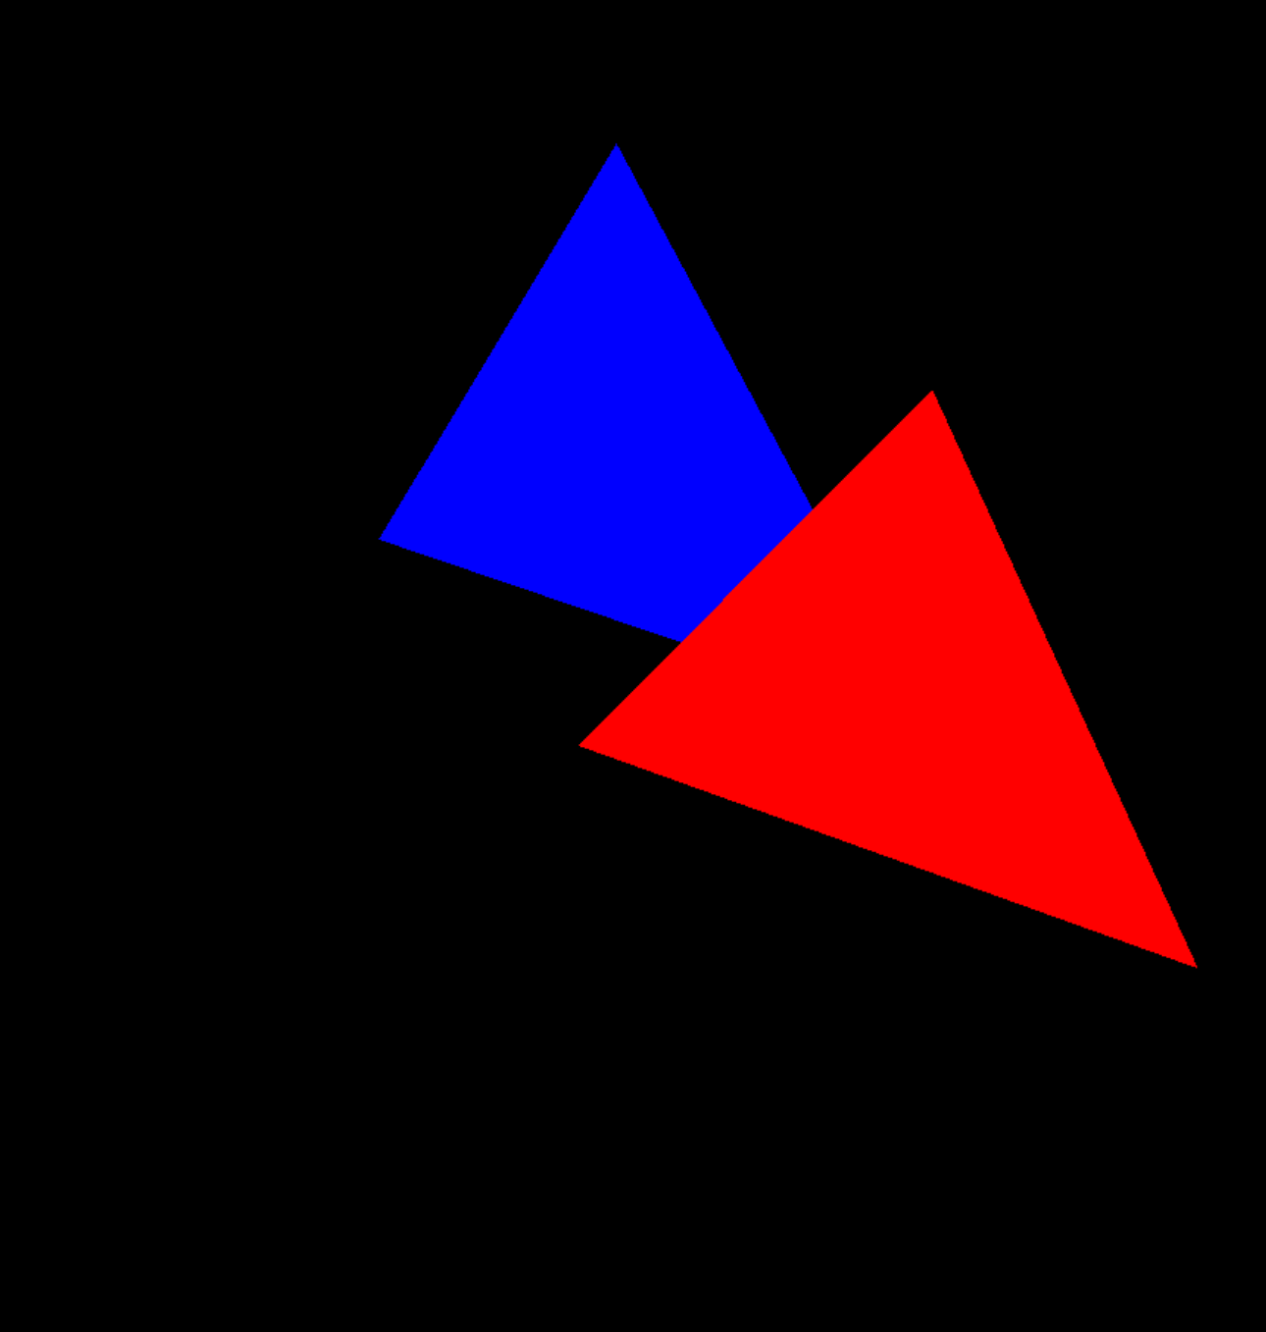
Desenhando Dois Triângulos
<Scene>
<Viewpoint position="0 0 8">
<Transform translation="1 0 0">
<Shape>
<TriangleSet>
<Coordinate point='-2 -2 0 2 -2 0 0 2 0'/>
</TriangleSet>
<Appearance>
<Material emissiveColor='1 0 0'/>
</Appearance>
</Shape>
</Transform>
<Transform translation="-1 0 0">
<Shape>
<TriangleSet>
<Coordinate point='-2 -2 -1 2 -2 -1 0 2 -1'/>
</TriangleSet>
<Appearance>
<Material emissiveColor='0 0 1'/>
</Appearance>
</Shape>
</Transform>
</Scene>
y
x
(0, 0, 8)
z

Slide 16
Desenhando SEM Z-Buffer
Cores
<Scene>
<Viewpoint position="0 0 8">
<Transform translation="1 0 0">
<Shape>
<TriangleSet>
<Coordinate point='-2 -2 0 2 -2 0 0 2 0'/>
</TriangleSet>
<Appearance>
<Material emissiveColor='1 0 0'/>
</Appearance>
</Shape>
</Transform>
<Transform translation="-1 0 0">
<Shape>
<TriangleSet>
<Coordinate point='-2 -2 -1 2 -2 -1 0 2 -1'/>
</TriangleSet>
<Appearance>
<Material emissiveColor='0 0 1'/>
</Appearance>
</Shape>
</Transform>
</Scene>

Slide 17
Desenhando SEM Z-Buffer
Cores
<Scene>
<Viewpoint position="0 0 8">
<Transform translation="1 0 0">
<Shape>
<TriangleSet>
<Coordinate point='-2 -2 0 2 -2 0 0 2 0'/>
</TriangleSet>
<Appearance>
<Material emissiveColor='1 0 0'/>
</Appearance>
</Shape>
</Transform>
<Transform translation="-1 0 0">
<Shape>
<TriangleSet>
<Coordinate point='-2 -2 -1 2 -2 -1 0 2 -1'/>
</TriangleSet>
<Appearance>
<Material emissiveColor='0 0 1'/>
</Appearance>
</Shape>
</Transform>
</Scene>
Isso está Certo?

Slide 18
Desenhando com Z-Buffer
Cores
<Scene>
<Viewpoint position="0 0 8">
<Transform translation="1 0 0">
<Shape>
<TriangleSet>
<Coordinate point='-2 -2 0 2 -2 0 0 2 0'/>
</TriangleSet>
<Appearance>
<Material emissiveColor='1 0 0'/>
</Appearance>
</Shape>
</Transform>
<Transform translation="-1 0 0">
<Shape>
<TriangleSet>
<Coordinate point='-2 -2 -1 2 -2 -1 0 2 -1'/>
</TriangleSet>
<Appearance>
<Material emissiveColor='0 0 1'/>
</Appearance>
</Shape>
</Transform>
</Scene>
Profundidade
1 | 1 | 1 | 1 | 1 | 1 | 1 | 1 | 1 | 1 | 1 | 1
1 | 1 | 1 | 1 | 1 | 1 | 1 | 1 | 1 | 1 | 1 | 1
1 | 1 | 1 | 1 | 1 | 1 | 1 | 1 | 1 | 1 | 1 | 1
1 | 1 | 1 | 1 | 1 | 1 | 1 | 1 | 1 | 1 | 1 | 1
1 | 1 | 1 | 1 | 1 | 1 | 1 | 1 | 1 | 1 | 1 | 1
1 | 1 | 1 | 1 | 1 | 1 | 1 | 1 | 1 | 1 | 1 | 1
1 | 1 | 1 | 1 | 1 | 1 | 1 | 1 | 1 | 1 | 1 | 1
1 | 1 | 1 | 1 | 1 | 1 | 1 | 1 | 1 | 1 | 1 | 1
1 | 1 | 1 | 1 | 1 | 1 | 1 | 1 | 1 | 1 | 1 | 1
1 | 1 | 1 | 1 | 1 | 1 | 1 | 1 | 1 | 1 | 1 | 1
Por praticidade estamos definindo o Z-buffer variando de 0 a 1.
Sendo o 1 para valores distantes e 0 para próximos da câmera.
Vamos mostrar na tabela só os dígitos que fazer diferença.

Slide 19
Desenhando com Z-Buffer
<Scene>
<Viewpoint position="0 0 8">
<Transform translation="1 0 0">
<Shape>
<TriangleSet>
<Coordinate point='-2 -2 0 2 -2 0 0 2 0'/>
</TriangleSet>
<Appearance>
<Material emissiveColor='1 0 0'/>
</Appearance>
</Shape>
</Transform>
<Transform translation="-1 0 0">
<Shape>
<TriangleSet>
<Coordinate point='-2 -2 -1 2 -2 -1 0 2 -1'/>
</TriangleSet>
<Appearance>
<Material emissiveColor='0 0 1'/>
</Appearance>
</Shape>
</Transform>
</Scene>
near = 0.01 # plano de corte próximo
far = 1000 # plano de corte distante
Triângulo Vermelho:
Z dos pixels no NDC ≈ 0.99751998
Normalizando ≈ 0.99875999
Int16 ≈ 65454
Int32 ≈ 4289641493
Triângulo Azul:
Z dos pixels no NDC ≈ 0.99779776
Normalizando ≈ 0.99889888
Int16 ≈ 65463
Int32 ≈ 4290238020

Slide 20
Desenhando com Z-Buffer
<Scene>
<Viewpoint position="0 0 8">
<Transform translation="1 0 0">
<Shape>
<TriangleSet>
<Coordinate point='-2 -2 0 2 -2 0 0 2 0'/>
</TriangleSet>
<Appearance>
<Material emissiveColor='1 0 0'/>
</Appearance>
</Shape>
</Transform>
<Transform translation="-1 0 0">
<Shape>
<TriangleSet>
<Coordinate point='-2 -2 -1 2 -2 -1 0 2 -1'/>
</TriangleSet>
<Appearance>
<Material emissiveColor='0 0 1'/>
</Appearance>
</Shape>
</Transform>
</Scene>
near = 5 # plano de corte próximo
far = 10 # plano de corte distante
Triângulo Vermelho:
Z dos pixels no NDC = 0.5
Normalizando = 0.75 ≈ 0.8
Int16 ≈ 49151
Int32 ≈ 3221225471
Triângulo Azul:
Z dos pixels no NDC ≈ 0.77777778
Normalizando = 0.88888888 ≈ 0.9
Int16 ≈ 58253
Int32 ≈ 3817748707

Slide 21
Desenhando com Z-Buffer
Cores
<Scene>
<Viewpoint position="0 0 8">
<Transform translation="1 0 0">
<Shape>
<TriangleSet>
<Coordinate point='-2 -2 0 2 -2 0 0 2 0'/>
</TriangleSet>
<Appearance>
<Material emissiveColor='1 0 0'/>
</Appearance>
</Shape>
</Transform>
<Transform translation="-1 0 0">
<Shape>
<TriangleSet>
<Coordinate point='-2 -2 -1 2 -2 -1 0 2 -1'/>
</TriangleSet>
<Appearance>
<Material emissiveColor='0 0 1'/>
</Appearance>
</Shape>
</Transform>
</Scene>
Profundidade (near = 5, far = 10)
1 | 1 | 1 | 1 | 1 | 1 | 1 | 1 | 1 | 1 | 1 | 1
1 | 1 | 1 | 1 | 1 | 1 | 1 | 1 | 1 | 1 | 1 | 1
1 | 1 | 1 | 1 | 1 | 1 | 1 | .8 | 1 | 1 | 1 | 1
1 | 1 | 1 | 1 | 1 | 1 | 1 | .8 | 1 | 1 | 1 | 1
1 | 1 | 1 | 1 | 1 | 1 | .8 | .8 | .8 | 1 | 1 | 1
1 | 1 | 1 | 1 | 1 | 1 | .8 | .8 | .8 | 1 | 1 | 1
1 | 1 | 1 | 1 | 1 | .8 | .8 | .8 | .8 | .8 | 1 | 1
1 | 1 | 1 | 1 | 1 | .8 | .8 | .8 | .8 | .8 | 1 | 1
1 | 1 | 1 | 1 | 1 | 1 | 1 | 1 | 1 | 1 | 1 | 1
1 | 1 | 1 | 1 | 1 | 1 | 1 | 1 | 1 | 1 | 1 | 1
Por praticidade estamos definindo o Z-buffer variando de 0 a 1.
Sendo o 1 para valores distantes e 0 para próximos da câmera.

Slide 22
Desenhando com Z-Buffer
Cores
<Scene>
<Viewpoint position="0 0 8">
<Transform translation="1 0 0">
<Shape>
<TriangleSet>
<Coordinate point='-2 -2 0 2 -2 0 0 2 0'/>
</TriangleSet>
<Appearance>
<Material emissiveColor='1 0 0'/>
</Appearance>
</Shape>
</Transform>
<Transform translation="-1 0 0">
<Shape>
<TriangleSet>
<Coordinate point='-2 -2 -1 2 -2 -1 0 2 -1'/>
</TriangleSet>
<Appearance>
<Material emissiveColor='0 0 1'/>
</Appearance>
</Shape>
</Transform>
</Scene>
Profundidade (near = 5, far = 10)
1 | 1 | 1 | 1 | 1 | 1 | 1 | 1 | 1 | 1 | 1 | 1
1 | 1 | 1 | 1 | 1 | 1 | 1 | 1 | 1 | 1 | 1 | 1
1 | 1 | 1 | 1 | 1 | 1 | 1 | .8 | 1 | 1 | 1 | 1
1 | 1 | 1 | 1 | .9 | 1 | 1 | .8 | 1 | 1 | 1 | 1
1 | 1 | 1 | 1 | .9 | 1 | .8 | .8 | .8 | 1 | 1 | 1
1 | 1 | 1 | .9 | .9 | .9 | .8 | .8 | .8 | 1 | 1 | 1
1 | 1 | 1 | .9 | .9 | .8 | .8 | .8 | .8 | .8 | 1 | 1
1 | 1 | .9 | .9 | .9 | .8 | .8 | .8 | .8 | .8 | 1 | 1
1 | 1 | 1 | 1 | 1 | 1 | 1 | 1 | 1 | 1 | 1 | 1
1 | 1 | 1 | 1 | 1 | 1 | 1 | 1 | 1 | 1 | 1 | 1
Nesses pixels o triângulo azul estava atrás do vermelho, logo os valores não mudaram e o triângulo vermelho permaneceu.

Slide 23
Transparência

Slide 24
Transparência
<Scene>
<Viewpoint position="0 0 8">
<Transform translation="-1 0 0">
<Shape>
<TriangleSet>
<Coordinate point='-2 -2 -1 2 -2 -1 0 2 -1'/>
</TriangleSet>
<Appearance>
<Material emissiveColor ='0 0 1'/>
</Appearance>
</Shape>
</Transform>
<Transform translation="1 0 0">
<Shape>
<TriangleSet>
<Coordinate point='-2 -2 0 2 -2 0 0 2 0'/>
</TriangleSet>
<Appearance>
<Material emissiveColor=‘0 1 0’
transparency=‘0.4’/>
</Appearance>
</Shape>
</Transform>
</Scene>
Vamos deixar o triângulo transparente como último no processo para evitar ter de ordenar os triângulos.

Slide 25
Transparência
Cores (Vermelho, Verde, Azul)
<Scene>
<Viewpoint position="0 0 8">
<Transform translation="1 0 0">
<Shape>
<TriangleSet>
<Coordinate point='-2 -2 -1 2 -2 -1 0 2 -1'/>
</TriangleSet>
<Appearance>
<Material emissiveColor ='0 0 1'/>
</Appearance>
</Shape>
</Transform>
<Transform translation="-1 0 0">
<Shape>
<TriangleSet>
<Coordinate point='-2 -2 0 2 -2 0 0 2 0'/>
</TriangleSet>
<Appearance>
<Material emissiveColor=“0 1 0”
transparency=“0.4”/>
</Appearance>
</Shape>
</Transform>
</Scene>
(0,0,0) | (0,0,0) | (0,0,0) | (0,0,0) | (0,0,0) | (0,0,0) | (0,0,0) | (0,0,0) | (0,0,0) | (0,0,0) | (0,0,0) | (0,0,0)
(0,0,0) | (0,0,0) | (0,0,0) | (0,0,0) | (0,0,0) | (0,0,0) | (0,0,0) | (0,0,0) | (0,0,0) | (0,0,0) | (0,0,0) | (0,0,0)
(0,0,0) | (0,0,0) | (0,0,0) | (0,0,0) | (0,0,0) | (0,0,0) | (0,0,0) | (0,0,0) | (0,0,0) | (0,0,0) | (0,0,0) | (0,0,0)
(0,0,0) | (0,0,0) | (0,0,0) | (0,0,0) | (0,0,0) | (0,0,0) | (0,0,0) | (0,0,1) | (0,0,0) | (0,0,0) | (0,0,0) | (0,0,0)
(0,0,0) | (0,0,0) | (0,0,0) | (0,0,0) | (0,0,0) | (0,0,0) | (0,0,0) | (0,0,1) | (0,0,0) | (0,0,0) | (0,0,0) | (0,0,0)
(0,0,0) | (0,0,0) | (0,0,0) | (0,0,0) | (0,0,0) | (0,0,0) | (0,0,1) | (0,0,1) | (0,0,1) | (0,0,0) | (0,0,0) | (0,0,0)
(0,0,0) | (0,0,0) | (0,0,0) | (0,0,0) | (0,0,0) | (0,0,0) | (0,0,1) | (0,0,1) | (0,0,1) | (0,0,0) | (0,0,0) | (0,0,0)
(0,0,0) | (0,0,0) | (0,0,0) | (0,0,0) | (0,0,0) | (0,0,1) | (0,0,1) | (0,0,1) | (0,0,1) | (0,0,1) | (0,0,0) | (0,0,0)
(0,0,0) | (0,0,0) | (0,0,0) | (0,0,0) | (0,0,0) | (0,0,0) | (0,0,0) | (0,0,0) | (0,0,0) | (0,0,0) | (0,0,0) | (0,0,0)
(0,0,0) | (0,0,0) | (0,0,0) | (0,0,0) | (0,0,0) | (0,0,0) | (0,0,0) | (0,0,0) | (0,0,0) | (0,0,0) | (0,0,0) | (0,0,0)
cor_anterior = framebuffer[x,y] * transparência
cor_nova = rbg * (1 – transparência)
framebuffer[x,y] = cor_anterior + cor_nova

Slide 26
Transparência
Cores (Vermelho, Verde, Azul)
<Scene>
<Viewpoint position="0 0 8">
<Transform translation="1 0 0">
<Shape>
<TriangleSet>
<Coordinate point='-2 -2 -1 2 -2 -1 0 2 -1'/>
</TriangleSet>
<Appearance>
<Material emissiveColor ='0 0 1'/>
</Appearance>
</Shape>
</Transform>
<Transform translation="-1 0 0">
<Shape>
<TriangleSet>
<Coordinate point='-2 -2 0 2 -2 0 0 2 0'/>
</TriangleSet>
<Appearance>
<Material emissiveColor=“0 1 0”
transparency=“0.4”/>
</Appearance>
</Shape>
</Transform>
</Scene>
(0,0,0) | (0,0,0) | (0,0,0) | (0,0,0) | (0,0,0) | (0,0,0) | (0,0,0) | (0,0,0) | (0,0,0) | (0,0,0) | (0,0,0) | (0,0,0)
(0,0,0) | (0,0,0) | (0,0,0) | (0,0,0) | (0,0,0) | (0,0,0) | (0,0,0) | (0,0,0) | (0,0,0) | (0,0,0) | (0,0,0) | (0,0,0)
(0,0,0) | (0,0,0) | (0,0,0) | (0,0,0) | (0,0.6,0) | (0,0,0) | (0,0,0) | (0,0,0) | (0,0,0) | (0,0,0) | (0,0,0) | (0,0,0)
(0,0,0) | (0,0,0) | (0,0,0) | (0,0,0) | (0,0.6,0) | (0,0,0) | (0,0,0) | (0,0,1) | (0,0,0) | (0,0,0) | (0,0,0) | (0,0,0)
(0,0,0) | (0,0,0) | (0,0,0) | (0,0.6,0) | (0,0.6,0) | (0,0.6,0) | (0,0,0) | (0,0,1) | (0,0,0) | (0,0,0) | (0,0,0) | (0,0,0)
(0,0,0) | (0,0,0) | (0,0,0) | (0,0.6,0) | (0,0.6,0) | (0,0.6,0) | (0,0,1) | (0,0,1) | (0,0,1) | (0,0,0) | (0,0,0) | (0,0,0)
(0,0,0) | (0,0,0) | (0,0.6,0) | (0,0.6,0) | (0,0.6,0) | (0,0.6,0) | (0,0.6,0.4) | (0,0,1) | (0,0,1) | (0,0,0) | (0,0,0) | (0,0,0)
(0,0,0) | (0,0,0) | (0,0.6,0) | (0,0.6,0) | (0,0.6,0) | (0,0.6,0.4) | (0,0.6,0.4) | (0,0,1) | (0,0,1) | (0,0,1) | (0,0,0) | (0,0,0)
(0,0,0) | (0,0,0) | (0,0,0) | (0,0,0) | (0,0,0) | (0,0,0) | (0,0,0) | (0,0,0) | (0,0,0) | (0,0,0) | (0,0,0) | (0,0,0)
(0,0,0) | (0,0,0) | (0,0,0) | (0,0,0) | (0,0,0) | (0,0,0) | (0,0,0) | (0,0,0) | (0,0,0) | (0,0,0) | (0,0,0) | (0,0,0)
cor_anterior = framebuffer[x,y] * transparência
cor_nova = rbg * (1 – transparência)
framebuffer[x,y] = cor_anterior + cor_nova

Slide 27
Computação Gráfica
Luciano Soares
<lpsoares@insper.edu.br>
Fabio Orfali
<fabioO1@insper.edu.br>

