Slide 1
Computação Gráfica
Aula 13: Revisão 3

Slide 2
Grafo de Cena

Slide 3
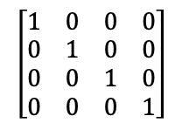
Criando Matriz Identidade
Início
<Scene>
<Transform scale="2 2 2">
<Shape>
<TriangleSet>
<Coordinate point='-1 -1 0 1 -1 0 0 1 0'/>
</TriangleSet>
<Appearance>
<Material diffuseColor='1 0 0'/>
</Appearance>
</Shape>
<Transform scale="2 1 1">
<Transform translation="0 -1 -1">
<Shape>
<TriangleSet>
<Coordinate point='-1 -1 0 1 -1 0 0 1 0'/>
</TriangleSet>
<Appearance>
<Material diffuseColor='0 1 0'/>
</Appearance>
</Shape>
</Transform>
<Transform translation="0 1 -2">
<Transform rotation="0 0 1 3.14">
<Shape>
<TriangleSet>
<Coordinate point='-1 -1 0 1 -1 0 0 1 0'/>
</TriangleSet>
<Appearance>
<Material diffuseColor='0 0 1'/>
</Appearance>
</Shape>
</Transform>
</Transform>
</Transform>
</Transform>
</Scene>
MATRIZ
PILHA
Notes:
PILHA

Slide 4
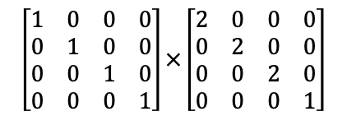
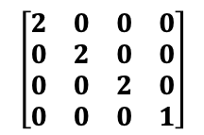
Empilhando e Atualizando Transformação
<Scene>
<Transform scale="2 2 2">
<Shape>
<TriangleSet>
<Coordinate point='-1 -1 0 1 -1 0 0 1 0'/>
</TriangleSet>
<Appearance>
<Material diffuseColor='1 0 0'/>
</Appearance>
</Shape>
<Transform scale="2 1 1">
<Transform translation="0 -1 -1">
<Shape>
<TriangleSet>
<Coordinate point='-1 -1 0 1 -1 0 0 1 0'/>
</TriangleSet>
<Appearance>
<Material diffuseColor='0 1 0'/>
</Appearance>
</Shape>
</Transform>
<Transform translation="0 1 -2">
<Transform rotation="0 0 1 3.14">
<Shape>
<TriangleSet>
<Coordinate point='-1 -1 0 1 -1 0 0 1 0'/>
</TriangleSet>
<Appearance>
<Material diffuseColor='0 0 1'/>
</Appearance>
</Shape>
</Transform>
</Transform>
</Transform>
</Transform>
</Scene>
push
MATRIZ
PILHA
Notes:
PILHA

Slide 5

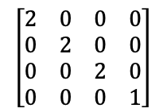
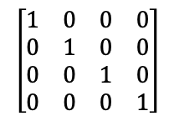
Desenhando Triângulo Vermelho
<Scene>
<Transform scale="2 2 2">
<Shape>
<TriangleSet>
<Coordinate point='-1 -1 0 1 -1 0 0 1 0'/>
</TriangleSet>
<Appearance>
<Material diffuseColor='1 0 0'/>
</Appearance>
</Shape>
<Transform scale="2 1 1">
<Transform translation="0 -1 -1">
<Shape>
<TriangleSet>
<Coordinate point='-1 -1 0 1 -1 0 0 1 0'/>
</TriangleSet>
<Appearance>
<Material diffuseColor='0 1 0'/>
</Appearance>
</Shape>
</Transform>
<Transform translation="0 1 -2">
<Transform rotation="0 0 1 3.14">
<Shape>
<TriangleSet>
<Coordinate point='-1 -1 0 1 -1 0 0 1 0'/>
</TriangleSet>
<Appearance>
<Material diffuseColor='0 0 1'/>
</Appearance>
</Shape>
</Transform>
</Transform>
</Transform>
</Transform>
</Scene>
draw
MATRIZ
PILHA
Notes:
PILHA

Slide 6
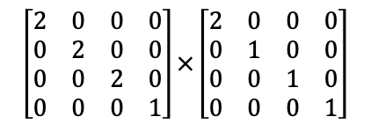
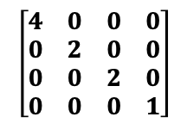
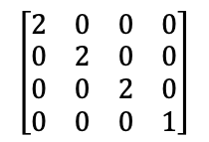
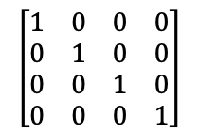
Empilhando e Atualizando Transformação
<Scene>
<Transform scale="2 2 2">
<Shape>
<TriangleSet>
<Coordinate point='-1 -1 0 1 -1 0 0 1 0'/>
</TriangleSet>
<Appearance>
<Material diffuseColor='1 0 0'/>
</Appearance>
</Shape>
<Transform scale="2 1 1">
<Transform translation="0 -1 -1">
<Shape>
<TriangleSet>
<Coordinate point='-1 -1 0 1 -1 0 0 1 0'/>
</TriangleSet>
<Appearance>
<Material diffuseColor='0 1 0'/>
</Appearance>
</Shape>
</Transform>
<Transform translation="0 1 -2">
<Transform rotation="0 0 1 3.14">
<Shape>
<TriangleSet>
<Coordinate point='-1 -1 0 1 -1 0 0 1 0'/>
</TriangleSet>
<Appearance>
<Material diffuseColor='0 0 1'/>
</Appearance>
</Shape>
</Transform>
</Transform>
</Transform>
</Transform>
</Scene>
push
MATRIZ
PILHA
Notes:
PILHA

Slide 7
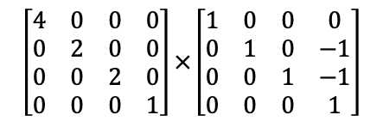
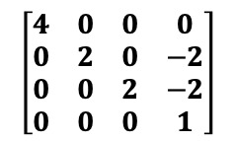
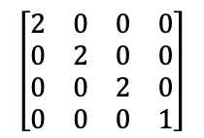
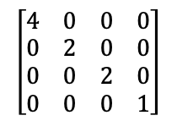
Empilhando e Atualizando Transformação
<Scene>
<Transform scale="2 2 2">
<Shape>
<TriangleSet>
<Coordinate point='-1 -1 0 1 -1 0 0 1 0'/>
</TriangleSet>
<Appearance>
<Material diffuseColor='1 0 0'/>
</Appearance>
</Shape>
<Transform scale="2 1 1">
<Transform translation="0 -1 -1">
<Shape>
<TriangleSet>
<Coordinate point='-1 -1 0 1 -1 0 0 1 0'/>
</TriangleSet>
<Appearance>
<Material diffuseColor='0 1 0'/>
</Appearance>
</Shape>
</Transform>
<Transform translation="0 1 -2">
<Transform rotation="0 0 1 3.14">
<Shape>
<TriangleSet>
<Coordinate point='-1 -1 0 1 -1 0 0 1 0'/>
</TriangleSet>
<Appearance>
<Material diffuseColor='0 0 1'/>
</Appearance>
</Shape>
</Transform>
</Transform>
</Transform>
</Transform>
</Scene>
push
MATRIZ
PILHA
Notes:
PILHA

Slide 8

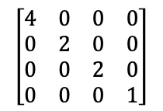
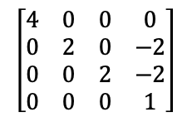
Desenhando Triângulo Verde
<Scene>
<Transform scale="2 2 2">
<Shape>
<TriangleSet>
<Coordinate point='-1 -1 0 1 -1 0 0 1 0'/>
</TriangleSet>
<Appearance>
<Material diffuseColor='1 0 0'/>
</Appearance>
</Shape>
<Transform scale="2 1 1">
<Transform translation="0 -1 -1">
<Shape>
<TriangleSet>
<Coordinate point='-1 -1 0 1 -1 0 0 1 0'/>
</TriangleSet>
<Appearance>
<Material diffuseColor='0 1 0'/>
</Appearance>
</Shape>
</Transform>
<Transform translation="0 1 -2">
<Transform rotation="0 0 1 3.14">
<Shape>
<TriangleSet>
<Coordinate point='-1 -1 0 1 -1 0 0 1 0'/>
</TriangleSet>
<Appearance>
<Material diffuseColor='0 0 1'/>
</Appearance>
</Shape>
</Transform>
</Transform>
</Transform>
</Transform>
</Scene>
draw
MATRIZ
PILHA
Notes:
PILHA

Slide 9
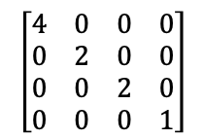
Desempilhando e Atualizando Transformação
<Scene>
<Transform scale="2 2 2">
<Shape>
<TriangleSet>
<Coordinate point='-1 -1 0 1 -1 0 0 1 0'/>
</TriangleSet>
<Appearance>
<Material diffuseColor='1 0 0'/>
</Appearance>
</Shape>
<Transform scale="2 1 1">
<Transform translation="0 -1 -1">
<Shape>
<TriangleSet>
<Coordinate point='-1 -1 0 1 -1 0 0 1 0'/>
</TriangleSet>
<Appearance>
<Material diffuseColor='0 1 0'/>
</Appearance>
</Shape>
</Transform>
<Transform translation="0 1 -2">
<Transform rotation="0 0 1 3.14">
<Shape>
<TriangleSet>
<Coordinate point='-1 -1 0 1 -1 0 0 1 0'/>
</TriangleSet>
<Appearance>
<Material diffuseColor='0 0 1'/>
</Appearance>
</Shape>
</Transform>
</Transform>
</Transform>
</Transform>
</Scene>
pop
MATRIZ
PILHA
Notes:
PILHA

Slide 10
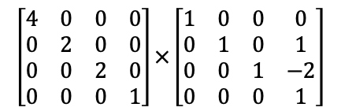
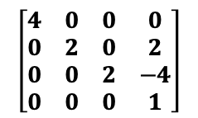
Empilhando e Atualizando Transformação
<Scene>
<Transform scale="2 2 2">
<Shape>
<TriangleSet>
<Coordinate point='-1 -1 0 1 -1 0 0 1 0'/>
</TriangleSet>
<Appearance>
<Material diffuseColor='1 0 0'/>
</Appearance>
</Shape>
<Transform scale="2 1 1">
<Transform translation="0 -1 -1">
<Shape>
<TriangleSet>
<Coordinate point='-1 -1 0 1 -1 0 0 1 0'/>
</TriangleSet>
<Appearance>
<Material diffuseColor='0 1 0'/>
</Appearance>
</Shape>
</Transform>
<Transform translation="0 1 -2">
<Transform rotation="0 0 1 3.14">
<Shape>
<TriangleSet>
<Coordinate point='-1 -1 0 1 -1 0 0 1 0'/>
</TriangleSet>
<Appearance>
<Material diffuseColor='0 0 1'/>
</Appearance>
</Shape>
</Transform>
</Transform>
</Transform>
</Transform>
</Scene>
push
MATRIZ
PILHA
Notes:
PILHA

Slide 11
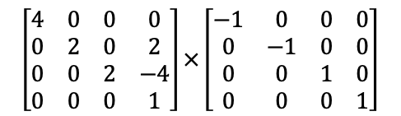
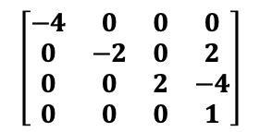
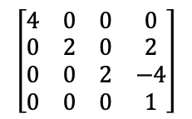
Empilhando e Atualizando Transformação
<Scene>
<Transform scale="2 2 2">
<Shape>
<TriangleSet>
<Coordinate point='-1 -1 0 1 -1 0 0 1 0'/>
</TriangleSet>
<Appearance>
<Material diffuseColor='1 0 0'/>
</Appearance>
</Shape>
<Transform scale="2 1 1">
<Transform translation="0 -1 -1">
<Shape>
<TriangleSet>
<Coordinate point='-1 -1 0 1 -1 0 0 1 0'/>
</TriangleSet>
<Appearance>
<Material diffuseColor='0 1 0'/>
</Appearance>
</Shape>
</Transform>
<Transform translation="0 1 -2">
<Transform rotation="0 0 1 3.14">
<Shape>
<TriangleSet>
<Coordinate point='-1 -1 0 1 -1 0 0 1 0'/>
</TriangleSet>
<Appearance>
<Material diffuseColor='0 0 1'/>
</Appearance>
</Shape>
</Transform>
</Transform>
</Transform>
</Transform>
</Scene>
push
MATRIZ
PILHA
Notes:
PILHA

Slide 12
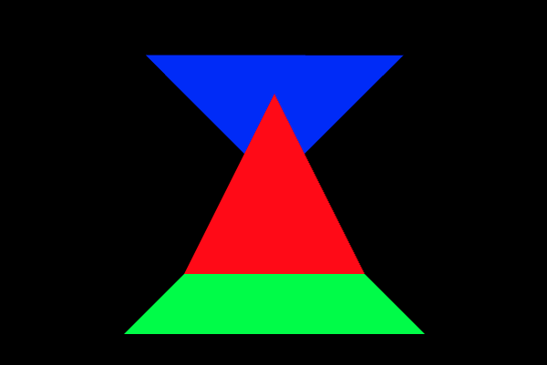
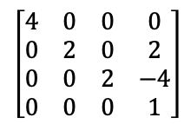
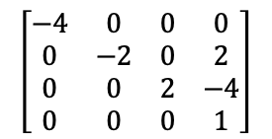
Desenhando Triângulo Azul
<Scene>
<Transform scale="2 2 2">
<Shape>
<TriangleSet>
<Coordinate point='-1 -1 0 1 -1 0 0 1 0'/>
</TriangleSet>
<Appearance>
<Material diffuseColor='1 0 0'/>
</Appearance>
</Shape>
<Transform scale="2 1 1">
<Transform translation="0 -1 -1">
<Shape>
<TriangleSet>
<Coordinate point='-1 -1 0 1 -1 0 0 1 0'/>
</TriangleSet>
<Appearance>
<Material diffuseColor='0 1 0'/>
</Appearance>
</Shape>
</Transform>
<Transform translation="0 1 -2">
<Transform rotation="0 0 1 3.14">
<Shape>
<TriangleSet>
<Coordinate point='-1 -1 0 1 -1 0 0 1 0'/>
</TriangleSet>
<Appearance>
<Material diffuseColor='0 0 1'/>
</Appearance>
</Shape>
</Transform>
</Transform>
</Transform>
</Transform>
</Scene>
draw
MATRIZ
PILHA
Notes:
PILHA

Slide 13
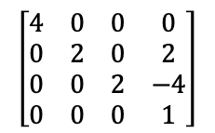
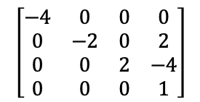
Desempilhando e Atualizando Transformação
<Scene>
<Transform scale="2 2 2">
<Shape>
<TriangleSet>
<Coordinate point='-1 -1 0 1 -1 0 0 1 0'/>
</TriangleSet>
<Appearance>
<Material diffuseColor='1 0 0'/>
</Appearance>
</Shape>
<Transform scale="2 1 1">
<Transform translation="0 -1 -1">
<Shape>
<TriangleSet>
<Coordinate point='-1 -1 0 1 -1 0 0 1 0'/>
</TriangleSet>
<Appearance>
<Material diffuseColor='0 1 0'/>
</Appearance>
</Shape>
</Transform>
<Transform translation="0 1 -2">
<Transform rotation="0 0 1 3.14">
<Shape>
<TriangleSet>
<Coordinate point='-1 -1 0 1 -1 0 0 1 0'/>
</TriangleSet>
<Appearance>
<Material diffuseColor='0 0 1'/>
</Appearance>
</Shape>
</Transform>
</Transform>
</Transform>
</Transform>
</Scene>
pop
MATRIZ
PILHA
Notes:
PILHA

Slide 14
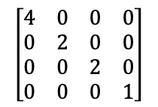
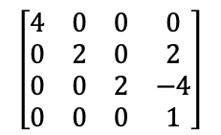
Desempilhando e Atualizando Transformação
<Scene>
<Transform scale="2 2 2">
<Shape>
<TriangleSet>
<Coordinate point='-1 -1 0 1 -1 0 0 1 0'/>
</TriangleSet>
<Appearance>
<Material diffuseColor='1 0 0'/>
</Appearance>
</Shape>
<Transform scale="2 1 1">
<Transform translation="0 -1 -1">
<Shape>
<TriangleSet>
<Coordinate point='-1 -1 0 1 -1 0 0 1 0'/>
</TriangleSet>
<Appearance>
<Material diffuseColor='0 1 0'/>
</Appearance>
</Shape>
</Transform>
<Transform translation="0 1 -2">
<Transform rotation="0 0 1 3.14">
<Shape>
<TriangleSet>
<Coordinate point='-1 -1 0 1 -1 0 0 1 0'/>
</TriangleSet>
<Appearance>
<Material diffuseColor='0 0 1'/>
</Appearance>
</Shape>
</Transform>
</Transform>
</Transform>
</Transform>
</Scene>
pop
MATRIZ
PILHA
Notes:
PILHA

Slide 15
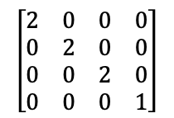
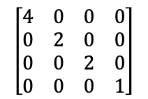
Desempilhando e Atualizando Transformação
<Scene>
<Transform scale="2 2 2">
<Shape>
<TriangleSet>
<Coordinate point='-1 -1 0 1 -1 0 0 1 0'/>
</TriangleSet>
<Appearance>
<Material diffuseColor='1 0 0'/>
</Appearance>
</Shape>
<Transform scale="2 1 1">
<Transform translation="0 -1 -1">
<Shape>
<TriangleSet>
<Coordinate point='-1 -1 0 1 -1 0 0 1 0'/>
</TriangleSet>
<Appearance>
<Material diffuseColor='0 1 0'/>
</Appearance>
</Shape>
</Transform>
<Transform translation="0 1 -2">
<Transform rotation="0 0 1 3.14">
<Shape>
<TriangleSet>
<Coordinate point='-1 -1 0 1 -1 0 0 1 0'/>
</TriangleSet>
<Appearance>
<Material diffuseColor='0 0 1'/>
</Appearance>
</Shape>
</Transform>
</Transform>
</Transform>
</Transform>
</Scene>
pop
MATRIZ
PILHA
Notes:
PILHA

Slide 16
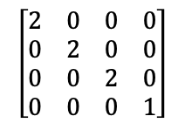
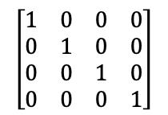
Desempilhando e Atualizando Transformação
<Scene>
<Transform scale="2 2 2">
<Shape>
<TriangleSet>
<Coordinate point='-1 -1 0 1 -1 0 0 1 0'/>
</TriangleSet>
<Appearance>
<Material diffuseColor='1 0 0'/>
</Appearance>
</Shape>
<Transform scale="2 1 1">
<Transform translation="0 -1 -1">
<Shape>
<TriangleSet>
<Coordinate point='-1 -1 0 1 -1 0 0 1 0'/>
</TriangleSet>
<Appearance>
<Material diffuseColor='0 1 0'/>
</Appearance>
</Shape>
</Transform>
<Transform translation="0 1 -2">
<Transform rotation="0 0 1 3.14">
<Shape>
<TriangleSet>
<Coordinate point='-1 -1 0 1 -1 0 0 1 0'/>
</TriangleSet>
<Appearance>
<Material diffuseColor='0 0 1'/>
</Appearance>
</Shape>
</Transform>
</Transform>
</Transform>
</Transform>
</Scene>
MATRIZ
PILHA
pop
Notes:
PILHA

Slide 17
Interpolação em Triângulos

Slide 18
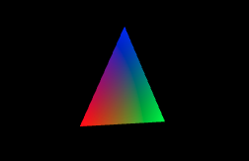
Triângulo com vértices de cores diferentes
<Scene>
<Viewpoint position="0 0 10"/>
<Transform rotation="0 1 0 0.52">
<Shape>
<IndexedFaceSet colorPerVertex='true' coordIndex='0 1 2 -1'>
<Coordinate point='-1 -1 0 1 -1 0 0 1 0'/>
<Color color='1 0 0 0 1 0 0 0 1'/>
</IndexedFaceSet>
</Shape>
</Transform>
</Scene>
Distâncias do ponto(28, 22) as arestas
L(x, y) = (x – x0)(y1 – y0) – (y – y0)(x1 – x0)
L₀ = (28.5 - 32.77)(16.65 - 23.18) - (22.5 - 23.18)(30 - 32.77)
L₀ = (-4.27)(-6.53) - (-0.68)(-2.77)
L₀ = 27.8831 - 1.8836
L₀ = 25.9995
L₁ = (28.5 - 30)(23.52 - 16.65) - (22.5 – 16.65)(26.95 - 30)
L₁ = (-1.5)(6.87) - (5.85)(-3.05)
L₁ = -10.305 + 17.8425
L₁ = 7.5375
L₂ = (28.5 - 26.95)(23.18 - 23.52) - (22.5 - 23.52)(32.77 - 26.95)
L₂ = (1.55)(-0.34) - (-1.02)(5.82)
L₂ = -0.527 + 5.9364
L₂ = 5.4094
30°
Pixel (28, 22)
P₂
VIEW(0, 1, -10)
SCREEN(30, 16.65)
P₀
P₁
VIEW(0.87, -1, -10.5)
Todos positivos: Dentro !!!
VIEW(-0.87, -1, -9.5)
SCREEN(26.95, 23.52)
SCREEN(32.77, 23.18)

Slide 19
Triângulo com vértices de cores diferentes
<Scene>
<Viewpoint position="0 0 10"/>
<Transform rotation="0 1 0 0.52">
<Shape>
<IndexedFaceSet colorPerVertex='true' coordIndex='0 1 2 -1'>
<Coordinate point='-1 -1 0 1 -1 0 0 1 0'/>
<Color color='1 0 0 0 1 0 0 0 1'/>
</IndexedFaceSet>
</Shape>
</Transform>
</Scene>
Área dos triângulos:
Area = |x₀(y₁–y₂) + x₁(y₂–y₀) + x₂(y₀–y₁)| / 2
A = |26.95(23.18-16.65)+32.77(16.65-23.52)+30(23.52-23.18)|/2
A = |26.95(6.53)+32.77(-6.87)+30(0.34)|/2
A = |175.9835-225.1299+10.2|/2
A = 19.4732
A₀ = |28.5(23.18-16.65)+32.77(16.65-22.5)+30(22.5-23.18)|/2
A₀ = |28.5(6.53)+32.77(-5.85)+30(-0.68)|/2
A₀ = |186.105-191.7045-20.4|/2
A₀ = 12.99975
A₁ = |28.5(16.65-23.52)+30(23.52-22.5)+26.95(22.5-16.65)|/2
A₁ = |28.5(-6.87)+30(1.02)+26.95(5.85)|/2
A₁ = |-195.795+30.6+157.6575|/2
A₁ = 3.76875
A₂ = |28.5(23.52-23.18)+26.95(23.18-22.5)+32.77(22.5-23.52)|/2
A₂ = |28.5(0.34)+26.95(0.68)+32.77(-1.02)|/2
A₂ = |9.69+18.326-33.4254|/2
A₂ = 2.7047
30°
Pixel (28, 22)
P₂
VIEW(0, 1, -10)
SCREEN(30, 16.65)
P₀
P₁
VIEW(-0.87, -1, -9.5)
VIEW(0.87, -1, -10.5)
SCREEN(26.95, 23.52)
SCREEN(32.77, 23.18)

Slide 20

Triângulo com vértices de cores diferentes
<Scene>
<Viewpoint position="0 0 10"/>
<Transform rotation="0 1 0 0.52">
<Shape>
<IndexedFaceSet colorPerVertex='true' coordIndex='0 1 2 -1'>
<Coordinate point='-1 -1 0 1 -1 0 0 1 0'/>
<Color color='1 0 0 0 1 0 0 0 1'/>
</IndexedFaceSet>
</Shape>
</Transform>
</Scene>
Área dos triângulos:
A = 19.4732
A₀ = 12.99975
A₁ = 3.76875
A₂ = 2.7047
30°
Pesos
α = 12.99975 / 19.4732 ~= 0.668
β = 3.76875 / 19. 4732 ~= 0.194
γ = 2.7047 / 19. 4732 ~= 0.139
ou
γ = 1 – α - β ~= 0.138
Pixel (28, 22)
P₂
VIEW(0, 1, -10)
SCREEN(30, 16.65)
Cor do pixel:
R = αR₀ + βR₁ + γR₂ = 0.668
G = αG₀ + βG₁ + γG₂ = 0.194
B = αB₀ + βB₁ + γB₂ = 0.139
P₀
P₁
VIEW(-0.87, -1, -9.5)
VIEW(0.87, -1, -10.5)
SCREEN(26.95, 23.52)
SCREEN(32.77, 23.18)
C = (0.668, 0.194, 0.139)
2D(26.95, 23.52)
2D(32.77, 23.18)

Slide 21
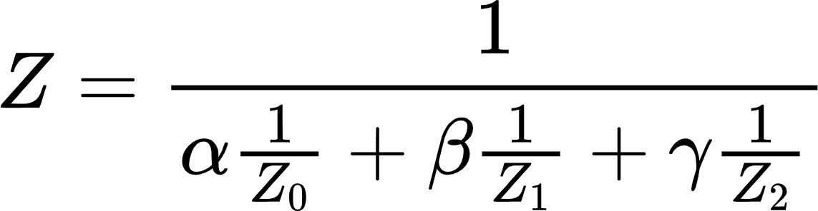
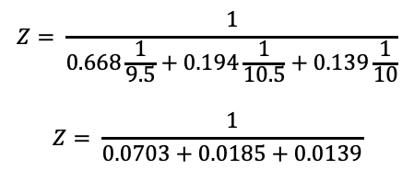
Cores do Triângulo com Correção Perspectiva
<Scene>
<Viewpoint position="0 0 10"/>
<Transform rotation="0 1 0 0.52">
<Shape>
<IndexedFaceSet colorPerVertex='true' coordIndex='0 1 2 -1'>
<Coordinate point='-1 -1 0 1 -1 0 0 1 0'/>
<Color color='1 0 0 0 1 0 0 0 1'/>
</IndexedFaceSet>
</Shape>
</Transform>
</Scene>
Pesos
α = 0.668
β = 0.194
γ = 0.139
30°
Z₀ = |-9.5|= 9.5
Z₁ = |-10.5|= 10.5
Z₂ = |-10.0|= 10
Pixel (28, 22)
P₂
VIEW(0, 1, -10)
SCREEN(30, 16.65)
$$Z= \frac{1}{0.668\frac{1}{9.5}+0.194\frac{1}{10.5}+0.139\frac{1}{10}}$$
$$Z= \frac{1}{0.0703+0.0185+0.0139}$$
P₀
P₁
Z = 9.74
VIEW(-0.87, -1, -9.5)
VIEW(0.87, -1, -10.5)
SCREEN(26.95, 23.52)
SCREEN(32.77, 23.18)
Notes:
Z

Slide 22
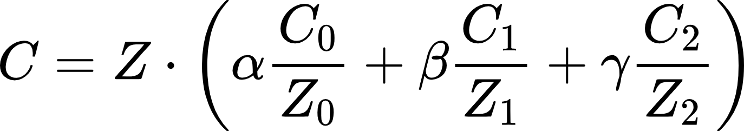

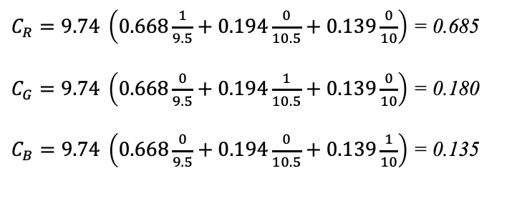
Cores do Triângulo com Correção Perspectiva
<Scene>
<Viewpoint position="0 0 10"/>
<Transform rotation="0 1 0 0.52">
<Shape>
<IndexedFaceSet colorPerVertex='true' coordIndex='0 1 2 -1'>
<Coordinate point='-1 -1 0 1 -1 0 0 1 0'/>
<Color color='1 0 0 0 1 0 0 0 1'/>
</IndexedFaceSet>
</Shape>
</Transform>
</Scene>
Pesos
α = 0.668
β = 0.194
γ = 0.139
Z₀ = |-9.5|= 9.5
Z₁ = |-10.5|= 10.5
Z₂ = |-10.0|= 10
30°
Z = 9.74
Pixel (28, 22)
P₂
$C_{R}=9.74 \left(0.668\frac{1}{9.5}+0.194\frac{0}{10.5}+0.139\frac{0}{10}\right)$ = 0.685
$C_{G}=9.74 \left(0.668\frac{0}{9.5}+0.194\frac{1}{10.5}+0.139\frac{0}{10}\right)$ = 0.180
$C_{B}=9.74 \left(0.668\frac{0}{9.5}+0.194\frac{0}{10.5}+0.139\frac{1}{10}\right)$ = 0.135
VIEW(0, 1, -10)
SCREEN(30, 16.65)
P₀
P₁
VIEW(-0.87, -1, -9.5)
VIEW(0.87, -1, -10.5)
C = (0.685, 0.180, 0.135)
SCREEN(26.95, 23.52)
SCREEN(32.77, 23.18)
Notes:
Z

Slide 23
Aplicando Texturas

Slide 24

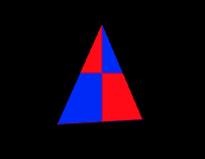
Triângulo com Texturas
Pesos
α = 0.668
β = 0.194
γ = 0.139
U = αU₀ + βU₁ + γU₂
U = 0.668*0.0 + 0.194*1.0 + 0.139*0.5
U = 0.2635
V = αV₀ + βV₁ + γV₂
V = 0.668*0.0 + 0.194*0.0 + 0.139*1.0
V = 0.139
<Scene>
<Viewpoint position="0 0 10"/>
<Transform rotation="0 1 0 0.52">
<Shape>
<IndexedFaceSet coordIndex='0 1 2 -1'>
<Coordinate point='-1 -1 0 1 -1 0 0 1 0'/>
<TextureCoordinate point='0.0 0.0 1.0 0.0 0.5 1.0'/>
</IndexedFaceSet>
<Appearance>
<ImageTexture url=' "chess.png" '/>
</Appearance>
</Shape>
</Transform>
</Scene>
chess.png (32x32)
UV = (0.264, 0.139)
P₂
uv(0.5, 1.0)
Pixel (28, 22)
v
P₁
P₀
uv(1.0, 0.0)
uv(0.0, 0.0)
u

Slide 25
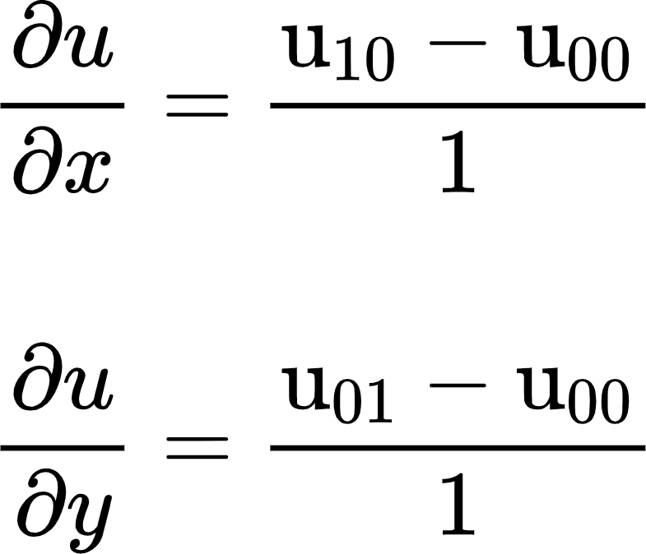
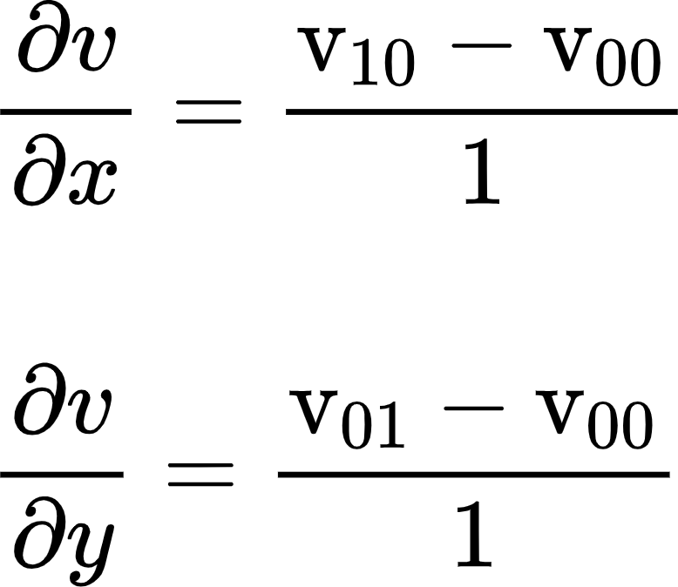
Triângulo com Texturas MipMap
<Scene>
<Viewpoint position="0 0 10"/>
<Transform rotation="0 1 0 0.52">
<Shape>
<IndexedFaceSet coordIndex='0 1 2 -1'>
<Coordinate point='-1 -1 0 1 -1 0 0 1 0'/>
<TextureCoordinate point='0.0 0.0 1.0 0.0 0.5 1.0'/>
</IndexedFaceSet>
<Appearance>
<ImageTexture url=' "chess.png" '/>
</Appearance>
</Shape>
</Transform>
</Scene>
UV = (0.264, 0.139)
Coordenadas (u,v)
pixel₁₀(29, 22) => UV(0.414, 0.129)
pixel₀₁(28, 23) => UV(0.248, -0.010)
P₂
Pixel (28, 22)
10
P₁
P₀
01

Slide 26





Triângulo com Texturas MipMap
Coordenadas (u,v)
pixel₁₀(29, 22) => UV(0.414, 0.129)
pixel₀₁(28, 23) => UV(0.248, -0.010)
U = 0.264
V = 0.139
= $32\left(\frac{0.414−0.264}{1}\right)=4.8$
= $32\left(\frac{0.129−0.139}{1}\right)=−0.32$
= $32\left(\frac{0.248−0.264}{1}\right)=−0.56$
= $32\left(\frac{−0.010−0.139}{1}\right)=−4.8$
chess.png (32x32)
P₂
Pixel (28, 22)
10
P₁
P₀
01

Slide 27
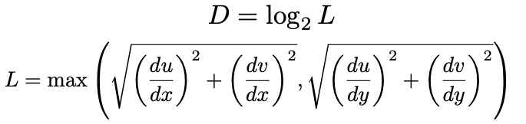


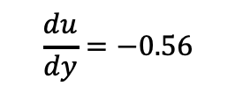

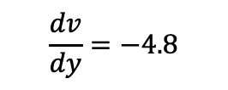
Triângulo com Texturas MipMap
chess.png (32x32)
Coordenadas (u,v)
pixel₁₀(29, 22) => UV(0.414, 0.129)
pixel₀₁(28, 23) => UV(0.248, -0.010)
U = 0.264
V = 0.139
0
$$\frac{du}{dx}=4.8$$
$$\frac{dv}{dx}=−0.32$$
$$\frac{du}{dy}=−0.56$$
$$\frac{dv}{dy}=−4.8$$
1 (16x16)
P₂
Pixel (28, 22)
$$L=\max\left(\sqrt{{\left(4.8\right)}^{2}+{\left(−0.32\right)}^{2}},\sqrt{{\left(−0.56\right)}^{2}+{\left(−4.8\right)}^{2}}\right)$$
$$L=\max\left(4.81,4,83 \right)$$
2 (8x8)
L = 4.83
P₁
D = 2.27
3 (4x4)
P₀
D = 2

Slide 28
Z-Buffer

Slide 29
Desenhando com Z-Buffer
Cores
<Scene>
<Transform translation="1 0 0">
<Shape>
<TriangleSet>
<Coordinate point='-2 -2 0 2 -2 0 0 2 0'/>
</TriangleSet>
<Appearance>
<Material emissiveColor='1 0 0'/>
</Appearance>
</Shape>
</Transform>
<Transform translation="-1 0 0">
<Shape>
<TriangleSet>
<Coordinate point='-2 -2 -1 2 -2 -1 0 2 -1'/>
</TriangleSet>
<Appearance>
<Material emissiveColor='0 0 1'/>
</Appearance>
</Shape>
</Transform>
</Scene>
Profundidade
1 | 1 | 1 | 1 | 1 | 1 | 1 | 1 | 1 | 1 | 1 | 1
1 | 1 | 1 | 1 | 1 | 1 | 1 | 1 | 1 | 1 | 1 | 1
1 | 1 | 1 | 1 | 1 | 1 | 1 | 1 | 1 | 1 | 1 | 1
1 | 1 | 1 | 1 | 1 | 1 | 1 | 1 | 1 | 1 | 1 | 1
1 | 1 | 1 | 1 | 1 | 1 | 1 | 1 | 1 | 1 | 1 | 1
1 | 1 | 1 | 1 | 1 | 1 | 1 | 1 | 1 | 1 | 1 | 1
1 | 1 | 1 | 1 | 1 | 1 | 1 | 1 | 1 | 1 | 1 | 1
1 | 1 | 1 | 1 | 1 | 1 | 1 | 1 | 1 | 1 | 1 | 1

Slide 30
Desenhando com Z-Buffer
Cores
<Scene>
<Transform translation="1 0 0">
<Shape>
<TriangleSet>
<Coordinate point='-2 -2 0 2 -2 0 0 2 0'/>
</TriangleSet>
<Appearance>
<Material emissiveColor='1 0 0'/>
</Appearance>
</Shape>
</Transform>
<Transform translation="-1 0 0">
<Shape>
<TriangleSet>
<Coordinate point='-2 -2 -1 2 -2 -1 0 2 -1'/>
</TriangleSet>
<Appearance>
<Material emissiveColor='0 0 1'/>
</Appearance>
</Shape>
</Transform>
</Scene>
Profundidade
1 | 1 | 1 | 1 | 1 | 1 | 1 | 1 | 1 | 1 | 1 | 1
1 | 1 | 1 | 1 | 0.8 | 1 | 1 | 1 | 1 | 1 | 1 | 1
1 | 1 | 1 | 0.8 | 0.8 | 0.8 | 1 | 1 | 1 | 1 | 1 | 1
1 | 1 | 1 | 0.8 | 0.8 | 0.8 | 1 | 1 | 1 | 1 | 1 | 1
1 | 1 | 0.8 | 0.8 | 0.8 | 0.8 | 0.8 | 1 | 1 | 1 | 1 | 1
1 | 1 | 0.8 | 0.8 | 0.8 | 0.8 | 0.8 | 1 | 1 | 1 | 1 | 1
1 | 1 | 1 | 1 | 1 | 1 | 1 | 1 | 1 | 1 | 1 | 1
1 | 1 | 1 | 1 | 1 | 1 | 1 | 1 | 1 | 1 | 1 | 1

Slide 31
Desenhando com Z-Buffer
Cores
<Scene>
<Transform translation="1 0 0">
<Shape>
<TriangleSet>
<Coordinate point='-2 -2 0 2 -2 0 0 2 0'/>
</TriangleSet>
<Appearance>
<Material emissiveColor='1 0 0'/>
</Appearance>
</Shape>
</Transform>
<Transform translation="-1 0 0">
<Shape>
<TriangleSet>
<Coordinate point='-2 -2 -1 2 -2 -1 0 2 -1'/>
</TriangleSet>
<Appearance>
<Material emissiveColor='0 0 1'/>
</Appearance>
</Shape>
</Transform>
</Scene>
Profundidade
1 | 1 | 1 | 1 | 1 | 1 | 1 | 1 | 1 | 1 | 1 | 1
1 | 1 | 1 | 1 | 0.8 | 1 | 1 | 0.9 | 1 | 1 | 1 | 1
1 | 1 | 1 | 0.8 | 0.8 | 0.8 | 0.9 | 0.9 | 0.9 | 1 | 1 | 1
1 | 1 | 1 | 0.8 | 0.8 | 0.8 | 0.9 | 0.9 | 0.9 | 1 | 1 | 1
1 | 1 | 0.8 | 0.8 | 0.8 | 0.8 | 0.8 | 0.9 | 0.9 | 0.9 | 1 | 1
1 | 1 | 0.8 | 0.8 | 0.8 | 0.8 | 0.8 | 0.9 | 0.9 | 0.9 | 1 | 1
1 | 1 | 1 | 1 | 1 | 1 | 1 | 1 | 1 | 1 | 1 | 1
1 | 1 | 1 | 1 | 1 | 1 | 1 | 1 | 1 | 1 | 1 | 1

Slide 32
Transparência

Slide 33
Transparência
Cores
<Scene>
<Transform translation="-1 0 0">
<Shape>
<TriangleSet>
<Coordinate point='-2 -2 -1 2 -2 -1 0 2 -1'/>
</TriangleSet>
<Appearance>
<Material emissiveColor ='0 0 1'/>
</Appearance>
</Shape>
</Transform>
<Transform translation="1 0 0">
<Shape>
<TriangleSet>
<Coordinate point='-2 -2 0 2 -2 0 0 2 0'/>
</TriangleSet>
<Appearance>
<Material emissiveColor=‘1 1 0’
transparency=‘0.2’/>
</Appearance>
</Shape>
</Transform>
</Scene>
(0,0,0) | (0,0,0) | (0,0,0) | (0,0,0) | (0,0,0) | (0,0,0) | (0,0,0) | (0,0,0) | (0,0,0) | (0,0,0) | (0,0,0) | (0,0,0)
(0,0,0) | (0,0,0) | (0,0,0) | (0,0,0) | (0,0,0) | (0,0,0) | (0,0,0) | (0,0,1) | (0,0,0) | (0,0,0) | (0,0,0) | (0,0,0)
(0,0,0) | (0,0,0) | (0,0,0) | (0,0,0) | (0,0,0) | (0,0,0) | (0,0,1) | (0,0,1) | (0,0,1) | (0,0,0) | (0,0,0) | (0,0,0)
(0,0,0) | (0,0,0) | (0,0,0) | (0,0,0) | (0,0,0) | (0,0,0) | (0,0,1) | (0,0,1) | (0,0,1) | (0,0,0) | (0,0,0) | (0,0,0)
(0,0,0) | (0,0,0) | (0,0,0) | (0,0,0) | (0,0,0) | (0,0,1) | (0,0,1) | (0,0,1) | (0,0,1) | (0,0,1) | (0,0,0) | (0,0,0)
(0,0,0) | (0,0,0) | (0,0,0) | (0,0,0) | (0,0,0) | (0,0,1) | (0,0,1) | (0,0,1) | (0,0,1) | (0,0,1) | (0,0,0) | (0,0,0)
(0,0,0) | (0,0,0) | (0,0,0) | (0,0,0) | (0,0,0) | (0,0,0) | (0,0,0) | (0,0,0) | (0,0,0) | (0,0,0) | (0,0,0) | (0,0,0)
(0,0,0) | (0,0,0) | (0,0,0) | (0,0,0) | (0,0,0) | (0,0,0) | (0,0,0) | (0,0,0) | (0,0,0) | (0,0,0) | (0,0,0) | (0,0,0)
cor_anterior = framebuffer[x,y] * transparência
cor_nova = rbg * (1 – transparência)
framebuffer[x,y] = cor_anterior + cor_nova

Slide 34
Transparência
Cores
<Scene>
<Transform translation="-1 0 0">
<Shape>
<TriangleSet>
<Coordinate point='-2 -2 -1 2 -2 -1 0 2 -1'/>
</TriangleSet>
<Appearance>
<Material emissiveColor ='0 0 1'/>
</Appearance>
</Shape>
</Transform>
<Transform translation="1 0 0">
<Shape>
<TriangleSet>
<Coordinate point='-2 -2 0 2 -2 0 0 2 0'/>
</TriangleSet>
<Appearance>
<Material emissiveColor=‘0 1 0’
transparency=‘0.4’/>
</Appearance>
</Shape>
</Transform>
</Scene>
(0,0,0) | (0,0,0) | (0,0,0) | (0,0,0) | (0,0,0) | (0,0,0) | (0,0,0) | (0,0,0) | (0,0,0) | (0,0,0) | (0,0,0) | (0,0,0)
(0,0,0) | (0,0,0) | (0,0,0) | (0,0,0) | (0,0.6,0) | (0,0,0) | (0,0,0) | (0,0,1) | (0,0,0) | (0,0,0) | (0,0,0) | (0,0,0)
(0,0,0) | (0,0,0) | (0,0,0) | (0,0.6,0) | (0,0.6,0) | (0,0.6,0) | (0,0,1) | (0,0,1) | (0,0,1) | (0,0,0) | (0,0,0) | (0,0,0)
(0,0,0) | (0,0,0) | (0,0,0) | (0,0.6,0) | (0,0.6,0) | (0,0.6,0) | (0,0,1) | (0,0,1) | (0,0,1) | (0,0,0) | (0,0,0) | (0,0,0)
(0,0,0) | (0,0,0) | (0,0.6,0) | (0,0.6,0) | (0,0.6,0) | (0,0.6,0.4) | (0,0,1) | (0,0,1) | (0,0,1) | (0,0,1) | (0,0,0) | (0,0,0)
(0,0,0) | (0,0,0) | (0,0.6,0) | (0,0.6,0) | (0,0.6,0) | (0,0.6,0.4) | (0,0,1) | (0,0,1) | (0,0,1) | (0,0,1) | (0,0,0) | (0,0,0)
(0,0,0) | (0,0,0) | (0,0,0) | (0,0,0) | (0,0,0) | (0,0,0) | (0,0,0) | (0,0,0) | (0,0,0) | (0,0,0) | (0,0,0) | (0,0,0)
(0,0,0) | (0,0,0) | (0,0,0) | (0,0,0) | (0,0,0) | (0,0,0) | (0,0,0) | (0,0,0) | (0,0,0) | (0,0,0) | (0,0,0) | (0,0,0)
cor_anterior = framebuffer[x,y] * transparência
cor_nova = rbg * (1 – transparência)
framebuffer[x,y] = cor_anterior + cor_nova

Slide 35
Computação Gráfica
Luciano Soares
<lpsoares@insper.edu.br>

