Slide 1
Computação Gráfica
Aula 22: Mapeamentos e Noise

Slide 2
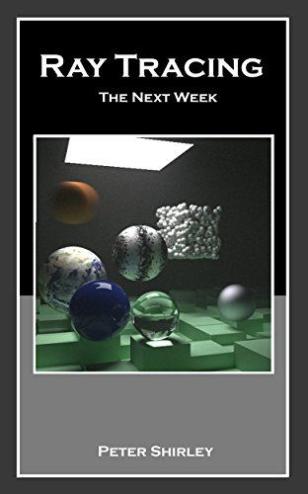
Perlin Noise no Ray Tracer
O livro do Peter Shirley descreve passo a passo a implementação do Perlin Noise no Ray Tracer. Veja o livro para maiores detalhes.

Slide 3
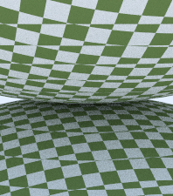
Textura 3D Xadrez
class checker_texture : public texture {
public:
checker_texture() {}
checker_texture(shared_ptr<texture> _even, shared_ptr<texture> _odd)
: even(_even), odd(_odd) {}
checker_texture(color c1, color c2)
: even(make_shared<solid_color>(c1)) , odd(make_shared<solid_color>(c2)) {}
virtual color value(double u, double v, const point3& p) const override {
auto sines = sin(10*p.x())*sin(10*p.y())*sin(10*p.z());
if (sines < 0)
return odd->value(u, v, p);
else
return even->value(u, v, p);
}
public:
shared_ptr<texture> odd;
shared_ptr<texture> even;
};
[main.cc]
[texture.h]
auto checker = make_shared<checker_texture>(color(0.2, 0.3, 0.1), color(0.9, 0.9, 0.9));
world.add(make_shared<sphere>(point3(0,-1000,0), 1000, make_shared<lambertian>(checker)));
[main.cc]

Slide 4
Blocos com valores aleatórios
#ifndef PERLIN_H
#define PERLIN_H
#include "rtweekend.h"
class perlin {
public:
perlin() {
ranfloat = new double[point_count];
for (int i = 0; i < point_count; ++i) {
ranfloat[i] = random_double();
}
perm_x = perlin_generate_perm();
perm_y = perlin_generate_perm();
perm_z = perlin_generate_perm();
}
~perlin() {
delete[] ranfloat;
delete[] perm_x;
delete[] perm_y;
delete[] perm_z;
}
double noise(const point3& p) const {
auto i = static_cast<int>(4*p.x()) & 255;
auto j = static_cast<int>(4*p.y()) & 255;
auto k = static_cast<int>(4*p.z()) & 255;
return ranfloat[perm_x[i] ^ perm_y[j] ^ perm_z[k]];
}
private:
static const int point_count = 256;
double* ranfloat;
int* perm_x;
int* perm_y;
int* perm_z;
static int* perlin_generate_perm() {
auto p = new int[point_count];
for (int i = 0; i < perlin::point_count; i++)
p[i] = i;
permute(p, point_count);
return p;
}
static void permute(int* p, int n) {
for (int i = n-1; i > 0; i--) {
int target = random_int(0, i);
int tmp = p[i];
p[i] = p[target];
p[target] = tmp;
}
}
};
#endif
[main.cc]
[perlin.h]

Slide 5
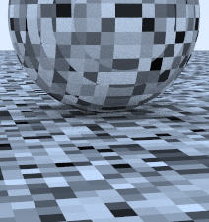
Blocos com valores aleatórios
#include "perlin.h"
class noise_texture : public texture {
public:
noise_texture() {}
virtual color value(double u, double v, const point3& p) const override {
return color(1,1,1) * noise.noise(p);
}
public:
perlin noise;
};
[texture.h]
hittable_list two_perlin_spheres() {
hittable_list objects;
auto pertext = make_shared<noise_texture>();
objects.add(make_shared<sphere>(point3(0,-1000,0), 1000, make_shared<lambertian>(pertext)));
objects.add(make_shared<sphere>(point3(0, 2, 0), 2, make_shared<lambertian>(pertext)));
return objects;
}
...
default:
case 3:
world = two_perlin_spheres();
lookfrom = point3(13,2,3);
lookat = point3(0,0,0);
vfov = 20.0;
break;
[main.cc]

Slide 6
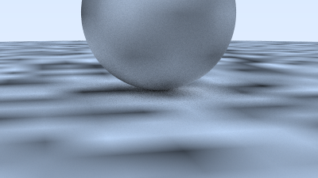
Suavizando
class perlin {
public:
...
double noise(point3 vec3& p) const {
auto u = p.x() - floor(p.x());
auto v = p.y() - floor(p.y());
auto w = p.z() - floor(p.z());
auto i = static_cast<int>(floor(p.x()));
auto j = static_cast<int>(floor(p.y()));
auto k = static_cast<int>(floor(p.z()));
double c[2][2][2];
for (int di=0; di < 2; di++)
for (int dj=0; dj < 2; dj++)
for (int dk=0; dk < 2; dk++)
c[di][dj][dk] = ranfloat[
perm_x[(i+di) & 255] ^
perm_y[(j+dj) & 255] ^
perm_z[(k+dk) & 255]
];
return trilinear_interp(c, u, v, w);
}
...
private:
...
static double trilinear_interp(double c[2][2][2], double u, double v, double w) {
auto accum = 0.0;
for (int i=0; i < 2; i++)
for (int j=0; j < 2; j++)
for (int k=0; k < 2; k++)
accum += (i*u + (1-i)*(1-u))*
(j*v + (1-j)*(1-v))*
(k*w + (1-k)*(1-w))*c[i][j][k];
return accum;
}
[perlin.h]

Slide 7
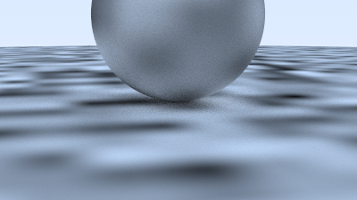
Interpolação de Hermite
class perlin (
public:
...
double noise(const point3& p) const {
auto u = p.x() - floor(p.x());
auto v = p.y() - floor(p.y());
auto w = p.z() - floor(p.z());
u = u*u*(3-2*u);
v = v*v*(3-2*v);
w = w*w*(3-2*w);
auto i = static_cast<int>(floor(p.x()));
auto j = static_cast<int>(floor(p.y()));
auto k = static_cast<int>(floor(p.z()));
...
[perlin.h]

Slide 8
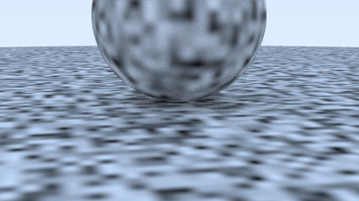
Aumentando a frequência
class noise_texture : public texture {
public:
noise_texture() {}
noise_texture(double sc) : scale(sc) {}
virtual color value(double u, double v, const point3& p) const override {
return color(1,1,1) * noise.noise(scale * p);
}
public:
perlin noise;
double scale;
};
[perlin.h]
hittable_list two_perlin_spheres() {
hittable_list objects;
auto pertext = make_shared<noise_texture>(4);
objects.add(make_shared<sphere>(point3(0,-1000,0), 1000, make_shared<lambertian>(pertext)));
objects.add(make_shared<sphere>(point3(0, 2, 0), 2, make_shared<lambertian>(pertext)));
return objects;
}
[main.cc]

Slide 9
Vetores Aleatórios
class perlin {
public:
perlin() {
ranvec = new vec3[point_count];
for (int i = 0; i < point_count; ++i) {
ranvec[i] = unit_vector(vec3::random(-1,1));
}
perm_x = perlin_generate_perm();
perm_y = perlin_generate_perm();
perm_z = perlin_generate_perm();
}
~perlin() {
delete[] ranvec;
delete[] perm_x;
delete[] perm_y;
delete[] perm_z;
}
...
private:
static const int point_count = 256;
vec3* ranvec;
int* perm_x;
int* perm_y;
int* perm_z;
...
}
[perlin.h]

Slide 10
Vetores Aleatórios
class perlin {
public:
...
double noise(const point3& p) const {
auto u = p.x() - floor(p.x());
auto v = p.y() - floor(p.y());
auto w = p.z() - floor(p.z());
auto i = static_cast<int>(floor(p.x()));
auto j = static_cast<int>(floor(p.y()));
auto k = static_cast<int>(floor(p.z()));
vec3 c[2][2][2];
for (int di=0; di < 2; di++)
for (int dj=0; dj < 2; dj++)
for (int dk=0; dk < 2; dk++)
c[di][dj][dk] = ranvec[
perm_x[(i+di) & 255] ^
perm_y[(j+dj) & 255] ^
perm_z[(k+dk) & 255]
];
return perlin_interp(c, u, v, w);
}
...
}
[perlin.h]

Slide 11
Vetores Aleatórios
class perlin {
...
private:
...
static double perlin_interp(vec3 c[2][2][2], double u, double v, double w) {
auto uu = u*u*(3-2*u);
auto vv = v*v*(3-2*v);
auto ww = w*w*(3-2*w);
auto accum = 0.0;
for (int i=0; i < 2; i++)
for (int j=0; j < 2; j++)
for (int k=0; k < 2; k++) {
vec3 weight_v(u-i, v-j, w-k);
accum += (i*uu + (1-i)*(1-uu))
* (j*vv + (1-j)*(1-vv))
* (k*ww + (1-k)*(1-ww))
* dot(c[i][j][k], weight_v);
}
return accum;
}
...
}
[perlin.h]

Slide 12
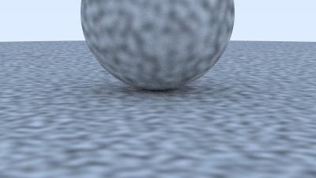
Vetores Aleatórios
class noise_texture : public texture {
public:
noise_texture() {}
noise_texture(double sc) : scale(sc) {}
virtual color value(double u, double v, const point3& p) const override {
return color(1,1,1) * 0.5 * (1.0 + noise.noise(scale * p));
}
public:
perlin noise;
double scale;
};
[texture.h]

Slide 13
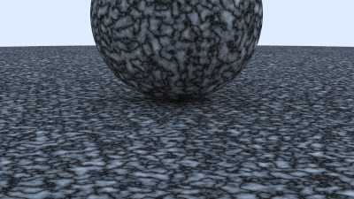
Turbulência
class perlin {
...
public:
...
double turb(const point3& p, int depth=7) const {
auto accum = 0.0;
auto temp_p = p;
auto weight = 1.0;
for (int i = 0; i < depth; i++) {
accum += weight*noise(temp_p);
weight *= 0.5;
temp_p *= 2;
}
return fabs(accum);
}
...
[perlin.h]
class noise_texture : public texture {
public:
noise_texture() {}
noise_texture(double sc) : scale(sc) {}
virtual color value(double u, double v, const point3& p) const override {
return color(1,1,1) * noise.turb(scale * p);
}
public:
perlin noise;
double scale;
};
[texture.h]

Slide 14
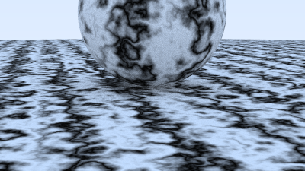
Ajustando a Fase
class noise_texture : public texture {
public:
noise_texture() {}
noise_texture(double sc) : scale(sc) {}
virtual color value(double u, double v, const point3& p) const override {
return color(1,1,1) * 0.5 * (1 + sin(scale*p.z() + 10*noise.turb(p)));
}
public:
perlin noise;
double scale;
};
[texture.h]

Slide 15
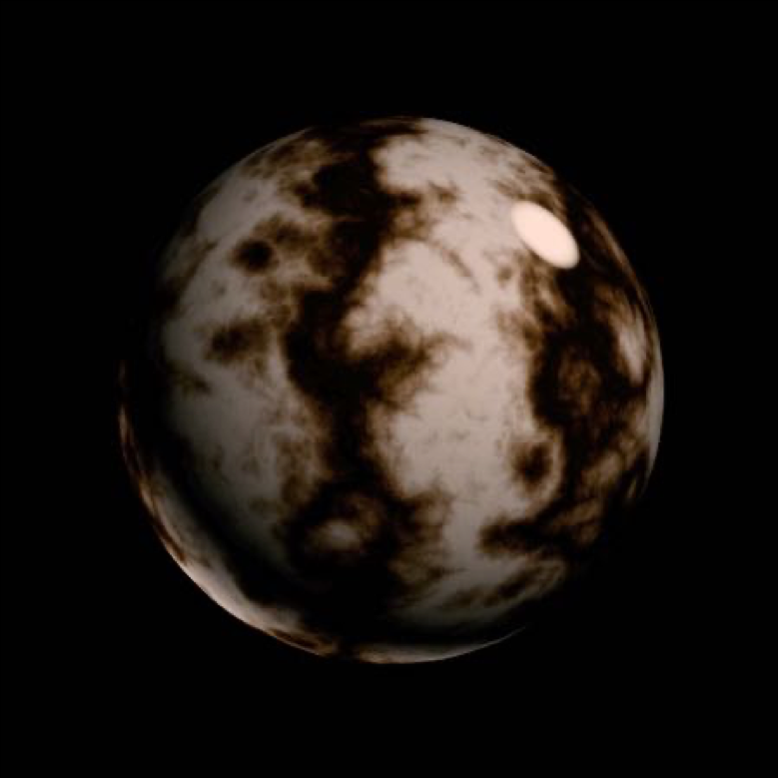
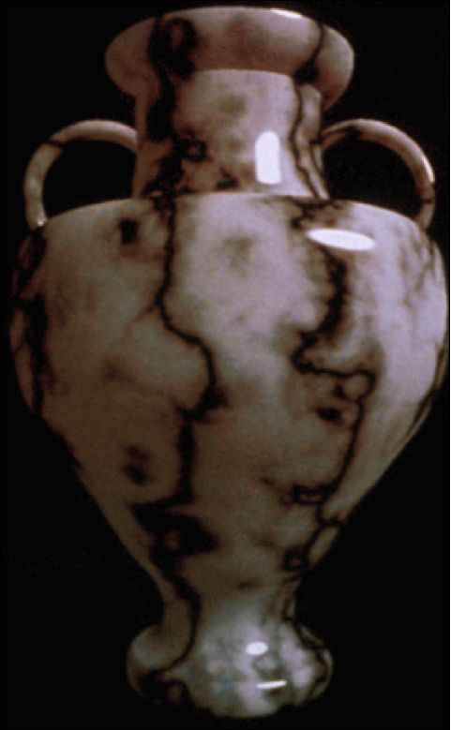
Ruído Procedural em 3D + Modelagem de Sólidos
Perlin noise, Ken Perlin

Slide 16
Próxima parte do projeto
A próxima parte do projeto tem um viés artístico.
Você deverá criar um novo material, mas esse material deve ter algum comportamento de de reflexão de luz (BRDF) criado por você e deve usar algum recurso de textura. Pode ser procedural baseado no Perlin Noise, ou usando alguma imagem bidimensional de base.

Slide 17
Computação Gráfica
Luciano Pereira Soares
<lpsoares@insper.edu.br>

