Slide 1
Computação Gráfica
Aula 20: Shaders

Slide 2
Baseado:
https://www.shadertoy.com/
Usando:
https://inspirnathan.com/posts/49-shadertoy-tutorial-part-3
VER:
https://iquilezles.org/
https://thebookofshaders.com/

Slide 3
right-hand rule.
https://en.wikipedia.org/wiki/Right-hand_rule
Para o sistema de coordenadas

Slide 4
Definir variações de Ray Tracing
path tracing, etc
Ray Casting: A simpler form of ray tracing used in games like Wolfenstein 3D and Doom that fires a single ray and stops when it hits a target.
Ray Marching: A method of ray casting that uses signed distance fields (SDF) and commonly a sphere tracing algorithm that "marches" rays incrementally until it hits the closest object.
sphere tracing: a type o ray marching
Ray Tracing: A more sophisticated version of ray casting that fires off rays, calculates ray-surface intersections, and recursively creates new rays upon each reflection.
Path Tracing: A type of ray tracing algorithm that shoots out hundreds or thousands of rays per pixel instead of just one. The rays are shot in random directions using the Monte Carlo method, and the final pixel color is determined from sampling the rays that make it to the light source.

Slide 5
Shaders
shaders run in parallel on your GPU is extremely important. Your program will independently run for every pixel in Shadertoy at the same time.
Shader languages such as the High-Level Shading Language (HLSL) and OpenGL Shading Language (GLSL) are the most common languages used to program the GPU's rendering pipeline.
Muito parecido com C

Slide 6
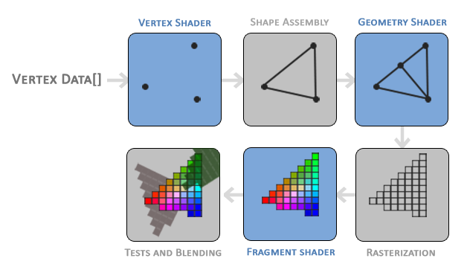
Stages of the graphics pipeline by Learn OpenGL

Slide 7
pixel shaders. The term, "fragment shader," is more accurate
You have to rely on algorithms such as ray marching and signed distance fields/functions (SDFs) to render 3D scenes which can be computationally expensive.
Shadertoy doesn't let you write vertex shaders and only lets you write pixel shaders. It essentially provides an environment for experimenting with the fragment side of shaders, so you can manipulate all pixels on the canvas in parallel.

Slide 8
void mainImage( out vec4 fragColor, in vec2 fragCoord ) {
// Normalized pixel coordinates (from 0 to 1)
vec2 uv = fragCoord/iResolution.xy;
vec3 col = 0.5 + 0.5*cos(iTime+uv.xyx+vec3(0,2,4));
// Output to screen
fragColor = vec4(col,1.0);
}

Slide 9
You may be scratching your head at the in and out. For Shadertoy, you generally have to worry about these keywords inside the mainImage function only. Remember how I said that the shaders allow us to write programs for the GPU rendering pipeline? Think of the in and out as the input and output. Shadertoy gives us an input, and we are writing a color as the output.
fragColor . 2D
uv = fragCoord/iResolution.xy
// The above is the same as:
uv.x = fragCoord.x/iResolution.x
uv.y = fragCoord.y/iResolution.y

Slide 10
iResolution.xy, the .xy portion refers to only the XY component of the vector.
vec3 col = vec3(0); // Same as vec3(0, 0, 0)
If you try to use values less than zero as the output fragment color, it will be clamped to zero. Likewise, any values greater than one will be clamped to one. This only applies to color values in the final fragment color.
vec3 col = vec3(uv, 0); // This is the same as vec3(uv.x, uv.y, 0)

Slide 11
vec3 col = vec3(0); // start with black
if (uv.x > .5) col = vec3(1); // make the right half of the canvas white
Ou igual:
vec3 col = vec3(0); // start with black
col = vec3(step(0.5, uv.x)); // make the right half of the canvas white

Slide 12
The step function accepts two inputs: the edge of the step function, and a value used to generate the step function. If the second parameter in the function argument is greater than the first, then return a value of one. Otherwise, return a value of zero.
col = vec3(step(0.5, uv), 0); // perform step function across the x-component and y-component of uv

Slide 13
The sdf part of the function refers to a concept called signed distance functions (SDF), aka signed distance fields
vec3 sdfCircle(vec2 uv, float r) {
float x = uv.x;
float y = uv.y;
float d = length(vec2(x, y)) - r;
return d > 0. ? vec3(1.) : vec3(0., 0., 1.);
}
void mainImage( out vec4 fragColor, in vec2 fragCoord )
{
vec2 uv = fragCoord/iResolution.xy; // <0,1>
vec3 col = sdfCircle(uv, .2); // Call this function on each pixel to check if the coordinate lies inside or outside of the circle
// Output to screen
fragColor = vec4(col,1.0);
}

Slide 14
uv -= 0.5; // <-0.5, 0.5>
uv.x *= iResolution.x/iResolution.y; // fix aspect ratio

Slide 15
You might be confused by the syntax in uv.xyx. This is called Swizzling.

Slide 16
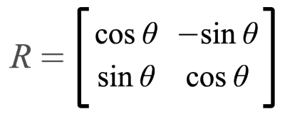
matrix column-first
vec2 rotate(vec2 uv, float th) {
return mat2(cos(th), sin(th), -sin(th), cos(th)) * uv;
}
vec2 rotated = rotate(vec2(x,y), iTime);
float d = max(abs(rotated.x), abs(rotated.y)) - size;

Slide 17
Mix / lerp
Linear interpolation for the function, mix(x, y, a), is based on the following formula:
float interpolatedValue = mix(0., 1., uv.x);

Slide 18
If the distance is greater than zero, then we know that we are outside the circle. If the distance is less than zero, then we are inside the circle. If the distance is equal to zero exactly, then we're on the edge of the circle. This is where the "signed" part of the "signed distance field" comes into play. The distance can be negative or positive depending on whether the pixel coordinate is inside or outside the shape.

Slide 19
SDFs
https://iquilezles.org/articles/distfunctions2d/
https://www.youtube.com/watch?v=s5NGeUV2EyU

Slide 20
vec3 col = getBackgroundColor(uv);
float d1 = sdCircle(uv, 0.1, vec2(0., 0.));
float d2 = sdSquare(uv, 0.1, vec2(0.1, 0));
float res; // result
res = min(d1, d2); // union
res = max(d1, d2); // intersection
res = max(-d1, d2); // subtraction - subtract d1 from d2
res = max(d1, -d2); // subtraction - subtract d1 from d2
res = max(min(d1, d2), -max(d1, d2)); // xor

Slide 21
opSymX operation. This operation will create a duplicate 2D shape along the x-axis using the SDF you provide.
If you want to draw circles along two axes instead of just one, then you can use the opSymXY operation.
float opSymXY(vec2 p, float r)
{
p = abs(p);
return sdCircle(p, r, vec2(0.2));
}

Slide 22
Sometimes, you may want to create an infinite number of 2D objects across one or more axes. You can use the opRep operation to repeat circles along the axes of your choice.
float opRep(vec2 p, float r, vec2 c)
{
vec2 q = mod(p+0.5*c,c)-0.5*c;
return sdCircle(q, r, vec2(0));
}

Slide 23
If you want to repeat the 2D objects only a certain number of times instead of an infinite amount, you can use the opRepLim operation.
float opRepLim(vec2 p, float r, float c, vec2 l)
{
vec2 q = p-c*clamp(round(p/c),-l,l);
return sdCircle(q, r, vec2(0));
}

Slide 24
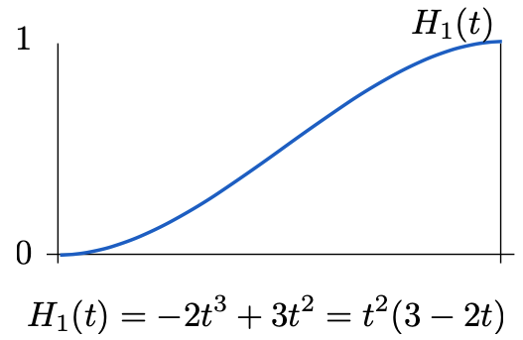
Hermite
https://thebookofshaders.com/glossary/?search=smoothstep

Slide 25
Anti-aliasing
res = smoothstep(0., 0.02, res); // antialias entire result

Slide 26
Funções
Pow
Dot
Cross
length(vec2(2,2))
normalize(vec2(2, 2));

Slide 27
sdSegment SDF
float sdSegment( in vec2 p, in vec2 a, in vec2 b ) {
vec2 pa = p-a, ba = b-a;
float h = clamp( dot(pa,ba)/dot(ba,ba), 0.0, 1.0 );
return length( pa - ba*h );
}
Currently, the segment is too thin to see in our canvas. To give the segment some thickness, we can subtract a value from the returned distance.
col = mix(vec3(1, 1, 1), col, step(0., segment - 0.02)); // Subtract 0.02 from the returned "signed distance" value of the segment

Slide 28
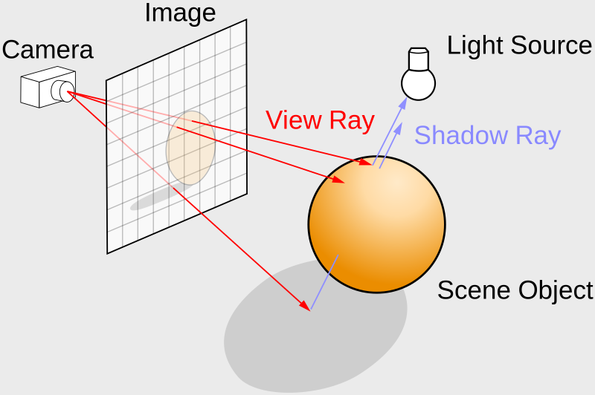
ray tracing or ray marching algorithm.
ariable in GLSL to represent an origin and direction:
vec2 rayOrigin = vec2(0, 0);
vec2 rayDirection = vec2(1, 0);

Slide 29
Ray Marching
https://jamie-wong.com/2016/07/15/ray-marching-signed-distance-functions/

Slide 30
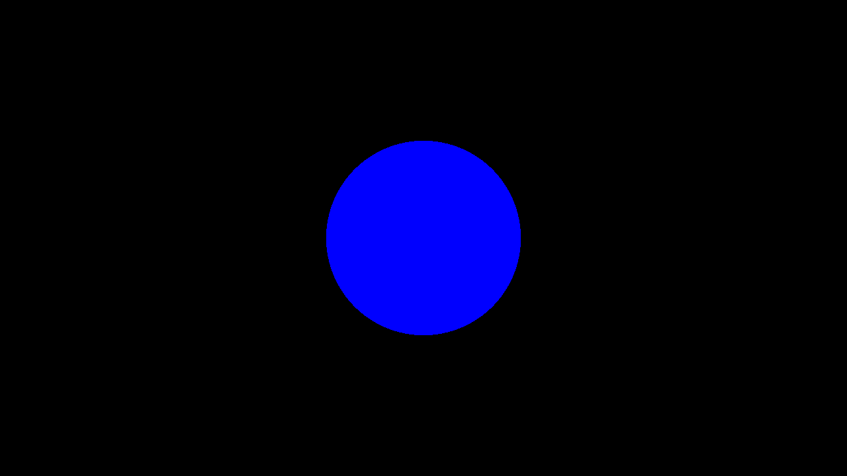
Ray Marching
const int MAX_MARCHING_STEPS = 255;
const float MIN_DIST = 0.0;
const float MAX_DIST = 100.0;
const float PRECISION = 0.001;
float sdSphere(vec3 p, float r )
{
return length(p) - r;
}
float rayMarch(vec3 ro, vec3 rd, float start, float end) {
float depth = start;
for (int i = 0; i < MAX_MARCHING_STEPS; i++) {
vec3 p = ro + depth * rd;
float d = sdSphere(p, 1.);
depth += d;
if (d < PRECISION || depth > end) break;
}
return depth;
}
void mainImage( out vec4 fragColor, in vec2 fragCoord )
{
vec2 uv = (fragCoord-.5*iResolution.xy)/iResolution.y;
vec3 col = vec3(0);
vec3 ro = vec3(0, 0, 5); // ray origin that represents camera position
vec3 rd = normalize(vec3(uv, -1)); // ray direction
float d = rayMarch(ro, rd, MIN_DIST, MAX_DIST); // distance to sphere
if (d > MAX_DIST) {
col = vec3(0.0); // ray didn't hit anything
} else {
col = vec3(0, 0, 1); // ray hit something
}
// Output to screen
fragColor = vec4(col, 1.0);
}

Slide 31
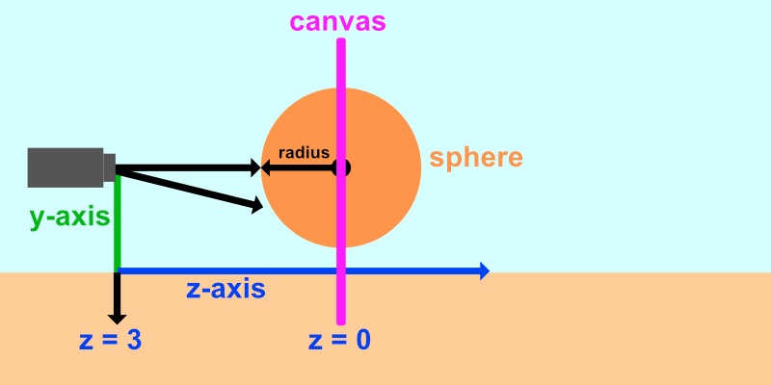

Slide 32
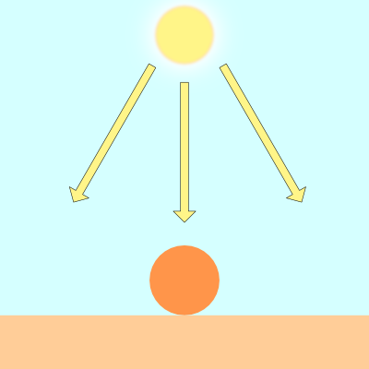
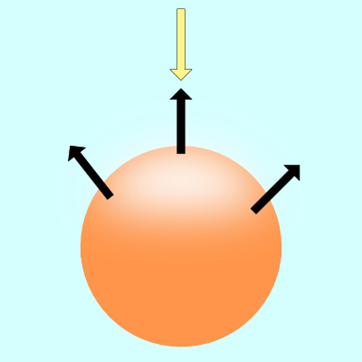
Lambert lighting to simulate diffuse reflection. This is commonly done by taking the dot product between the ray direction of a light source and the direction of a surface normal.
vec3 diffuseReflection = dot(normal, lightDirection);

Slide 33
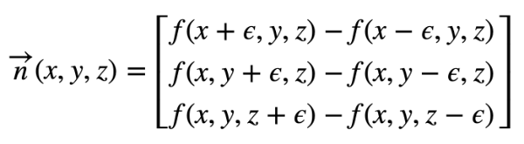
Calculando a Normal
To find the gradient of a surface, we need two points. We'll take a point on the surface of the sphere and subtract a small number from it to get the second point. That'll let us perform a cheap trick to find the gradient. We can then use this gradient value as the surface normal.
Given a surface, f(x,y,z), the gradient along the surface will have the following equation:
vec3 calcNormal(vec3 p) {
float e = 0.0005; // epsilon
float r = 1.; // radius of sphere
return normalize(vec3(
sdSphere(vec3(p.x + e, p.y, p.z), r) - sdSphere(vec3(p.x - e, p.y, p.z), r),
sdSphere(vec3(p.x, p.y + e, p.z), r) - sdSphere(vec3(p.x, p.y - e, p.z), r),
sdSphere(vec3(p.x, p.y, p.z + e), r) - sdSphere(vec3(p.x, p.y, p.z - e), r)
));
}

Slide 34
Na prática
vec3 calcNormal(vec3 p) {
vec2 e = vec2(1.0, -1.0) * 0.0005; // epsilon
float r = 1.; // radius of sphere
return normalize(
e.xyy * sdSphere(p + e.xyy, r) +
e.yyx * sdSphere(p + e.yyx, r) +
e.yxy * sdSphere(p + e.yxy, r) +
e.xxx * sdSphere(p + e.xxx, r));
}

Slide 35
Luz
vec3 lightPosition = vec3(2, 2, 4);
vec3 lightDirection = normalize(lightPosition - p);
float dif = dot(normal, lightDirection); // dif = diffuse reflection
When we take the dot product between the normal and light direction vectors, we may end up with a negative value. To keep the value between zero and one so that we get a bigger range of values, we can use the clamp function.
float dif = clamp(dot(normal, lightDirection), 0., 1.);

Slide 36
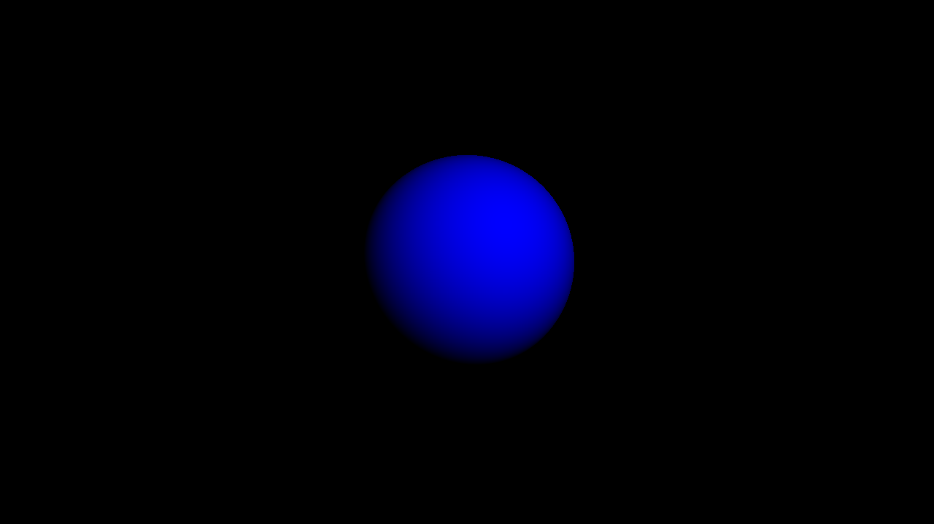
const int MAX_MARCHING_STEPS = 255;
const float MIN_DIST = 0.0;
const float MAX_DIST = 100.0;
const float PRECISION = 0.001;
float sdSphere(vec3 p, float r )
{
vec3 offset = vec3(0, 0, -2);
return length(p - offset) - r;
}
float rayMarch(vec3 ro, vec3 rd, float start, float end) {
float depth = start;
for (int i = 0; i < MAX_MARCHING_STEPS; i++) {
vec3 p = ro + depth * rd;
float d = sdSphere(p, 1.);
depth += d;
if (d < PRECISION || depth > end) break;
}
return depth;
}
vec3 calcNormal(vec3 p) {
vec2 e = vec2(1.0, -1.0) * 0.0005; // epsilon
float r = 1.; // radius of sphere
return normalize(
e.xyy * sdSphere(p + e.xyy, r) +
e.yyx * sdSphere(p + e.yyx, r) +
e.yxy * sdSphere(p + e.yxy, r) +
e.xxx * sdSphere(p + e.xxx, r));
}
void mainImage( out vec4 fragColor, in vec2 fragCoord )
{
vec2 uv = (fragCoord-.5*iResolution.xy)/iResolution.y;
vec3 col = vec3(0);
vec3 ro = vec3(0, 0, 3); // ray origin that represents camera position
vec3 rd = normalize(vec3(uv, -1)); // ray direction
float d = rayMarch(ro, rd, MIN_DIST, MAX_DIST); // distance to sphere
if (d > MAX_DIST) {
col = vec3(0.0); // ray didn't hit anything
} else {
vec3 p = ro + rd * d; // point on sphere we discovered from ray marching
vec3 normal = calcNormal(p);
vec3 lightPosition = vec3(2, 2, 4);
vec3 lightDirection = normalize(lightPosition - p);
// Calculate diffuse reflection by taking the dot product of
// the normal and the light direction.
float dif = clamp(dot(normal, lightDirection), 0., 1.);
col = vec3(0.0, 0.0, dif);
}
// Output to screen
fragColor = vec4(col, 1.0);
}

Slide 37
If you want to add a bit of ambient light color, you can adjust the clamped range, so the sphere doesn't appear completely black in the shaded regions:
float dif = clamp(dot(normal, lightDirection), 0.3, 1.);

Slide 38
Cores
There are multiple techniques people across Shadertoy use to add colors to 3D shapes. One way would be to modify our SDFs to return both the distance to our shape and a color. Therefore, we'd have to modify multiple places in our code to return a vec4 datatype instead of a float. The first value of the vec4 variable would hold the "signed distance" value we normally return from an SDF, and the last three values will hold our color value.

Slide 39
Computação Gráfica
Luciano Soares
<lpsoares@insper.edu.br>

