Slide 2
Lesson 03 -Docker-
07/2025

Slide 3

Dependency Management
Common Problems
Docker
Demo
Homework
Q&A

Slide 4

Dependency Management
Dependency management is the process of handling the external libraries, frameworks, and packages that an application requires to run correctly. It ensures that the right versions of dependencies are installed, conflicts are resolved, and the software remains stable across different environments.
Key Aspects of Dependency Management:
Version Control – Ensuring compatibility between different versions of libraries.
Isolation – Preventing conflicts between dependencies of different projects.
Automation – Using package managers (e.g., npm, pip, Maven) to simplify installation and updates.
Reproducibility – Guaranteeing that the application behaves the same across environments.

Slide 5
Common Problems
“It works on my machine” – Different environments cause unexpected issues
Conflicting dependencies – Multiple projects require different versions of the same library
Manual setup headaches – Installing dependencies manually is time-consuming and error-prone
OS Compatibility issues – Software behaves differently across Windows, macOS, and Linux

Slide 6
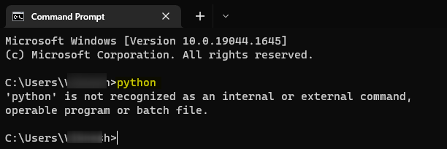

Slide 7
Docker
Docker is a platform that allows developers to package applications and their dependencies
into lightweight, portable containers. These containers ensure that applications run
consistently across different environments.
Key Concepts:
Containers → Self-contained units with everything needed to run an app.
Images → Blueprints for containers, defining what gets installed.
Docker Engine → The runtime that manages and runs containers.
Portability → Containers work the same on any system (Windows, macOS, Linux).
Isolation → Applications run independently, avoiding dependency conflicts.

Slide 8
Docker Architecture

Slide 9
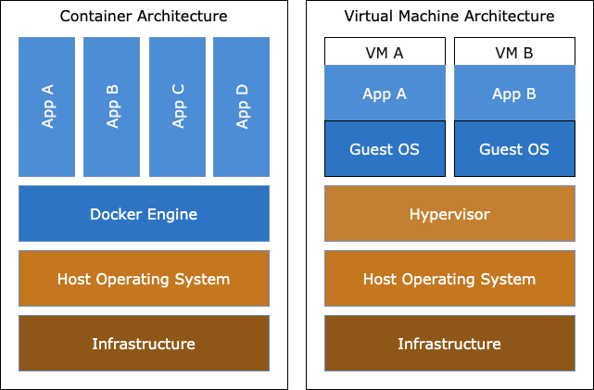

Slide 10
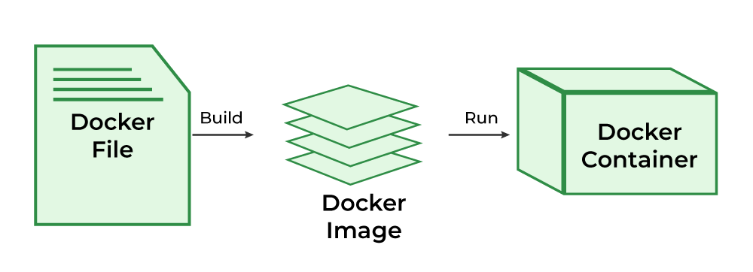

Slide 11
Demo

Slide 12
Homework
Access the Assignment: Find it here
Follow the README: Carefully read and follow the instructions from the README
Need Help?: Post any questions in the Slack group for support

Slide 13
Q&A

