Slide 2
Lesson 04 -Multi Container Apps-
07/2025

Slide 3

Single Container Management
Multi Container Management
Docker-Compose
Demo
Homework
Q&A

Slide 4

Single Container Management
Single Container Management involves handling the lifecycle of one isolated container, ensuring
it runs smoothly, is properly configured, and is efficiently maintained throughout its usage.
Key Aspects of Single Container Management:
Container Creation → Build and configure a container with the required dependencies and environment.
Starting & Stopping → Launch and shut down the container as needed.
Resource Allocation → Set limits for CPU, memory, and storage for the container.
Logs & Monitoring → Track container performance and debug using logs.
Updates & Patches → Manage updates to the container image and apply security patches.
Isolation → Keep the container isolated from other applications for security and stability.

Slide 5
Manually Managing a Single Container is Easy… But What About 100 Containers?

Slide 6
Multi Container Management
When dealing with multiple containers, coordination and automation are key to ensuring they
work together smoothly and efficiently.
Key Aspects of Multi-Container Management:
Orchestration → Coordinating the deployment, scaling, and management of multiple containers.
Networking → Ensuring containers can communicate securely and efficiently across different services.
Load Balancing → Distributing traffic evenly across containers to maintain performance.
Scaling → Automatically adjusting the number of containers based on traffic or load.
Fault Tolerance → Ensuring containers restart or are replaced in case of failure for continuous service availability.
Resource Management → Allocating resources like CPU and memory to prevent overuse and ensure optimal performance.

Slide 7
Docker Compose
Docker Compose is a tool that simplifies the management of multi-container Docker applications. It
allows you to define and run multiple containers as a single service using a YAML file.
Key Features of Docker Compose:
Define Multi-Container Environments → Use a single configuration file to define services, networks, and volumes.
Service Management → Easily start, stop, and manage multiple containers with a single command.
Networking → Automatically creates a network for containers to communicate with each other.
Scaling → Scale services up or down to match demand with a simple command.
Environment Variables → Manage environment variables for different containers in the same application.
Volumes → Easily mount persistent data volumes across containers.

Slide 8
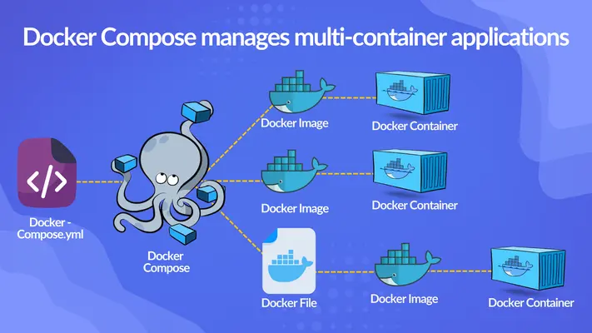

Slide 9
Volume and Port Mapping in Docker

Slide 10
Volume Mapping
What are Volumes?
Persistent Storage: Volumes are used to store data outside of containers, ensuring data persists even if the container is removed or recreated.
Data Sharing: Volumes allow multiple containers to share data and communicate effectively.
Isolation: Data in volumes is isolated from the container's filesystem, reducing the risk of data loss when containers are updated.
Why Volumes Are Needed:
Data Persistence: Ensures critical data is not lost when containers stop or are deleted.
Efficiency: Easier management of large datasets or databases that need to persist between container restarts.
Backup & Restore: Allows backup and restoration of data without affecting the container itself.

Slide 11
Port Mapping
What is Port Mapping?
Expose Ports: Port mapping connects a container’s internal ports to the host machine, making the container's services accessible externally.
Format hostPort:containerPort exposes internal container port to the host machine
Why Port Mapping is Needed:
Accessing Services: Enables external clients or users to interact with services running inside a container.
Network Isolation: Allows services in containers to be accessed in a controlled manner without exposing all container ports to the host.

Slide 12
Demo

Slide 13
Homework
Access the Assignment: Find it here
Follow the README: Carefully read and follow the instructions from the README
Need Help?: Post any questions in the Slack group for support

Slide 14
Q&A

