Slide 2
Lesson 06 -Grafana-
07/2025

Slide 3

Monitoring Dashboards
Grafana
Demo
Homework
Q&A

Slide 4

Monitoring Dashboards
Monitoring Dashboards are visual interfaces that display real-time data and metrics to track the
performance, health, and status of systems, applications, or services.
Key Features:
Real-Time Data: Continuously updates metrics and performance indicators.
Customizable: Allows users to configure which metrics to display based on their needs.
Visualizations: Uses charts, graphs, and gauges to represent complex data in an easy-to-understand format.
Alerting: Can trigger notifications when predefined thresholds are met or exceeded.

Slide 5
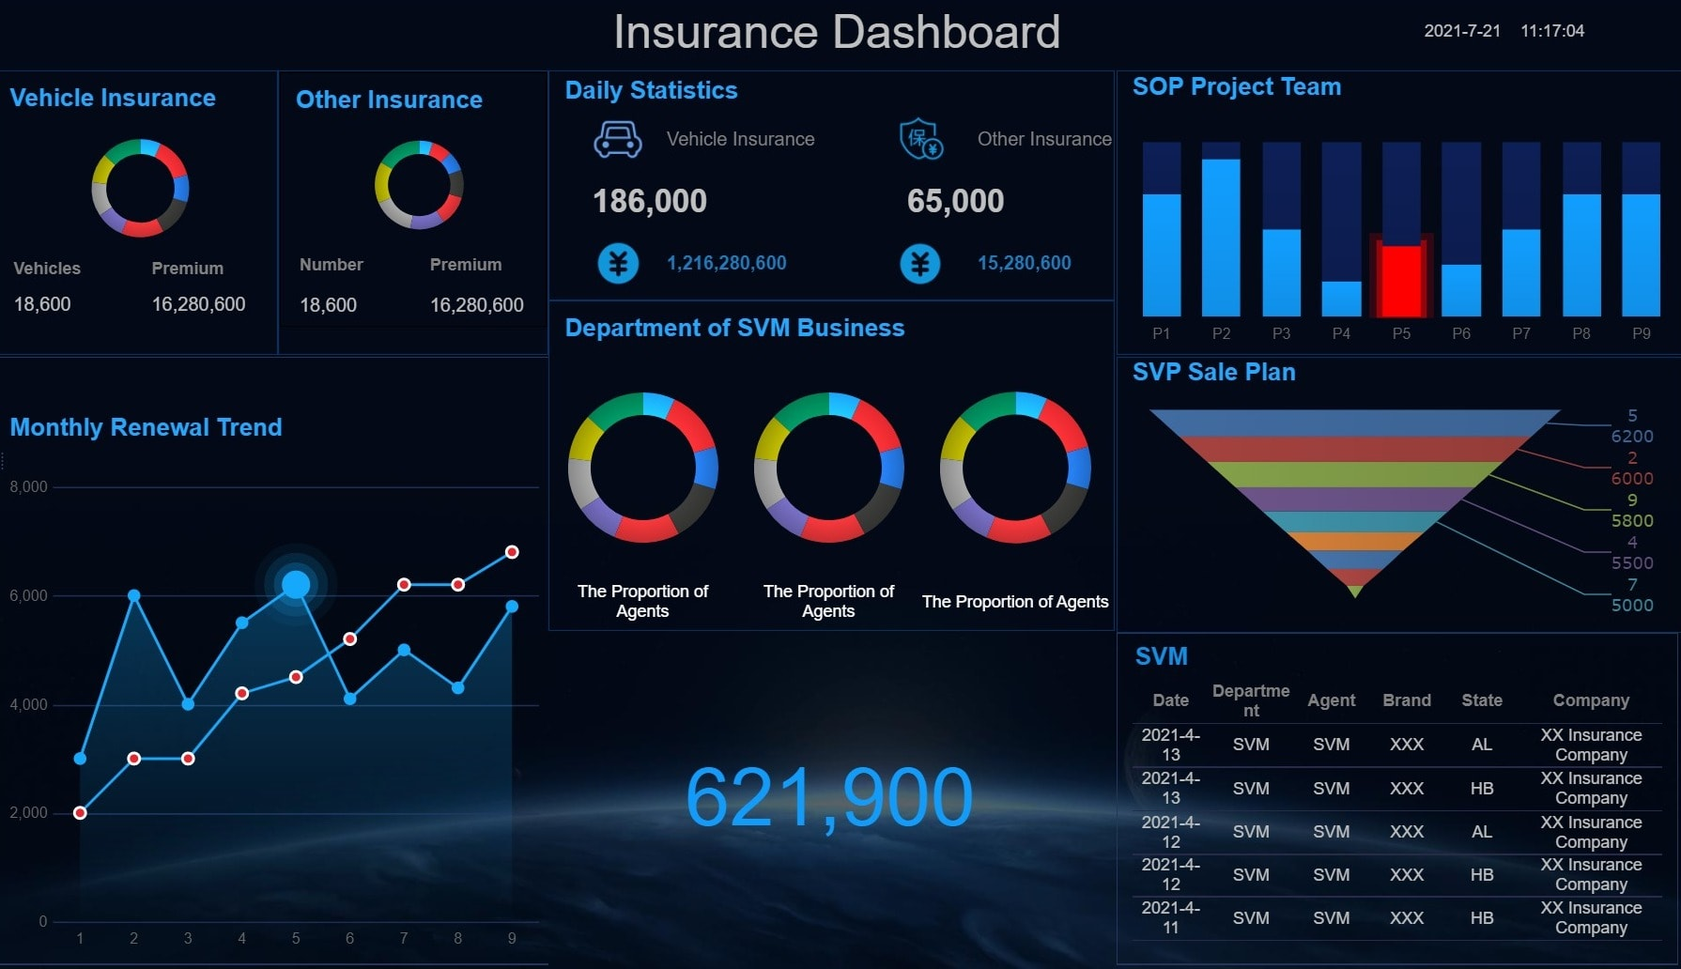

Slide 6
Grafana
Grafana is an open-source platform for creating, managing, and analyzing monitoring dashboards.
It connects with various data sources to visualize metrics in real-time.
Key Features:
Customizable Dashboards: Create interactive and visually appealing dashboards with charts, graphs, and tables.
Multiple Data Sources: Integrates with various databases like Prometheus, InfluxDB, MySQL, and more.
Alerting: Set up alerts based on metrics to notify you of potential issues
Use Cases:
Infrastructure Monitoring: Track system health, server performance, and resource usage.
Application Monitoring: Visualize and analyze application logs, performance metrics, and response times.

Slide 7
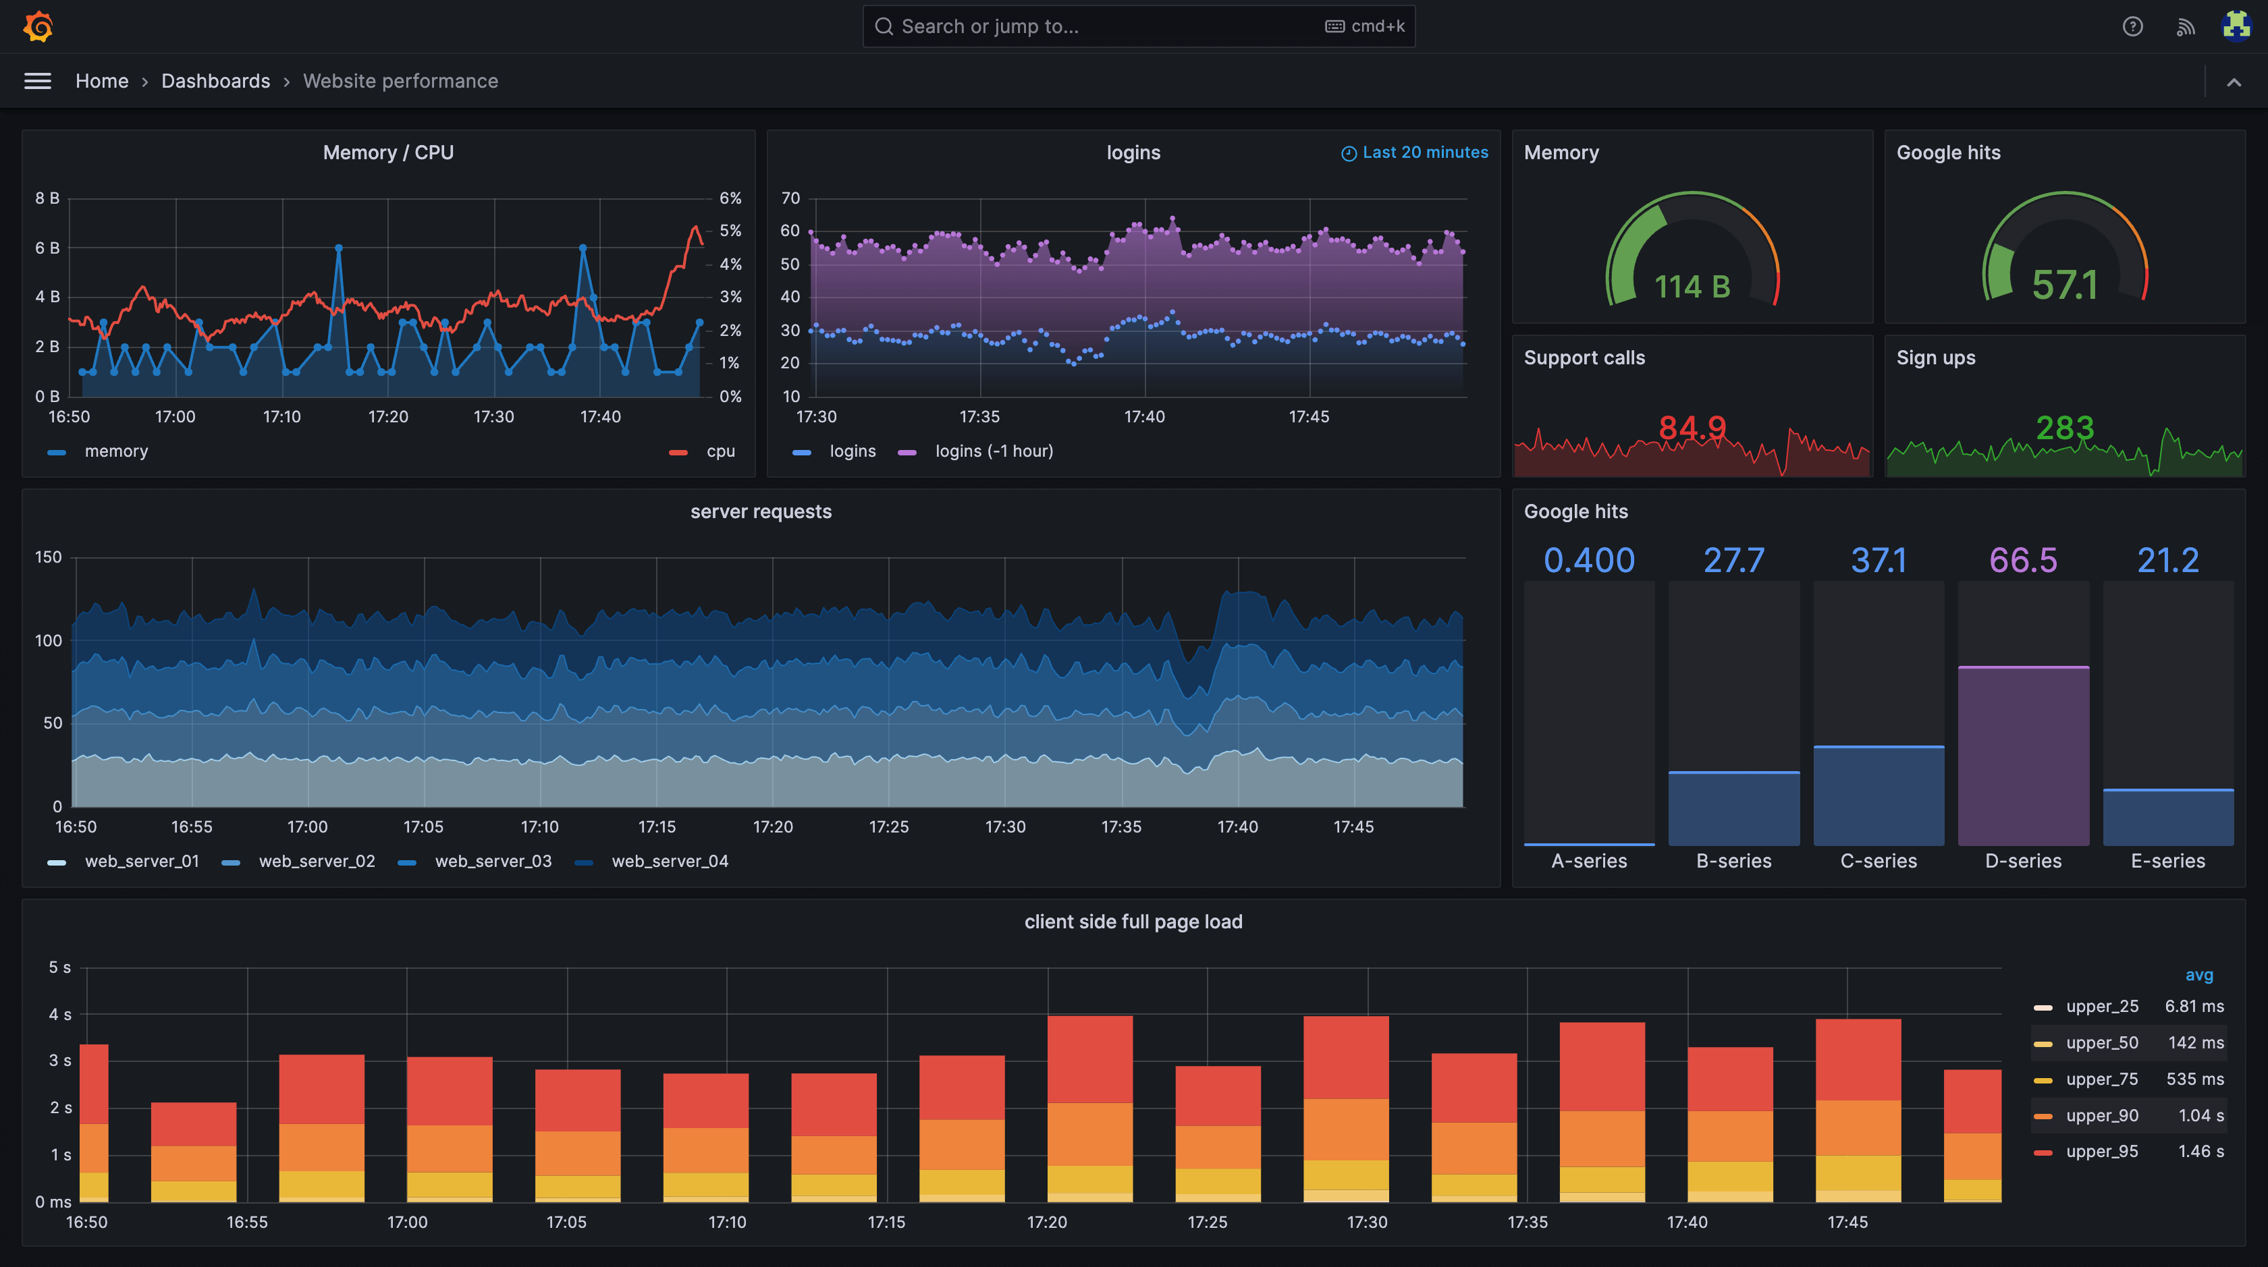

Slide 8
Demo

Slide 9
Homework
Access the Assignment: Find it here
Follow the README: Carefully read and follow the instructions from the README
Need Help?: Post any questions in the Slack group for support

Slide 10
Q&A

