Slide 2
Lesson 01 -IoT Monitoring Station-
07/2025

Slide 3

Introduction
Project Overview
System Design
Getting Started
Q&A

Slide 4

Introduction
Meet your Build Fellow
Robert-Adrian Popovici (you can call me Robert 😊)
24 years old, passionate about technology and problem-solving
Graduated with a B.E. in Computer Engineering (Class of 2024)
Currently working at Citadel as a Quantitative Research Engineer (QRE)

Slide 5
Project Overview
A system that collects, processes, and displays live metrics from IoT devices
Enables real-time monitoring of device performance and environmental data
Designed to handle multiple IoT sensors and provide a centralized dashboard

Slide 6
Internet of Things - IoT -

Slide 7
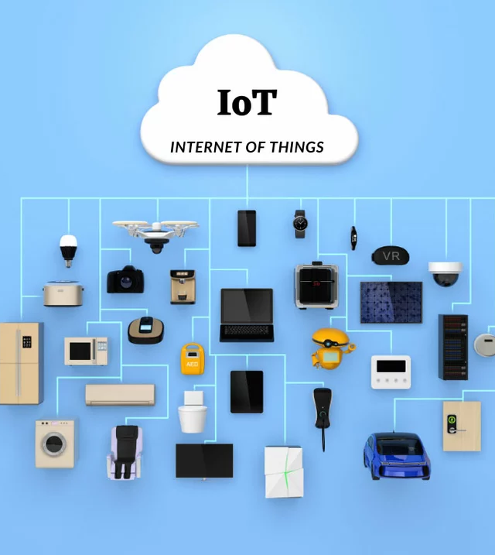
IoT (Internet of Things) refers to the network of physical devices, vehicles, appliances, and other objects that are embedded with sensors, software, and other technologies to collect and exchange data over the internet. These devices can communicate with each other and with centralized systems to automate processes, monitor environments, and provide real-time insights.

Slide 8
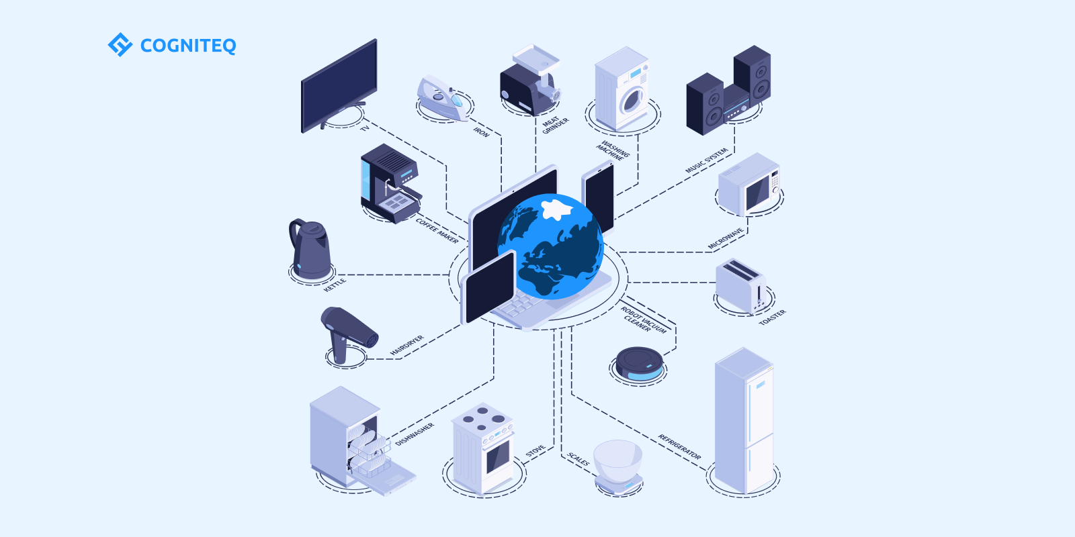

Slide 9
System Design
The architecture is structured into 4 modular components that can be developed and maintained independently.
Detailed descriptions of each component’s functionality and interaction can be found here

Slide 10
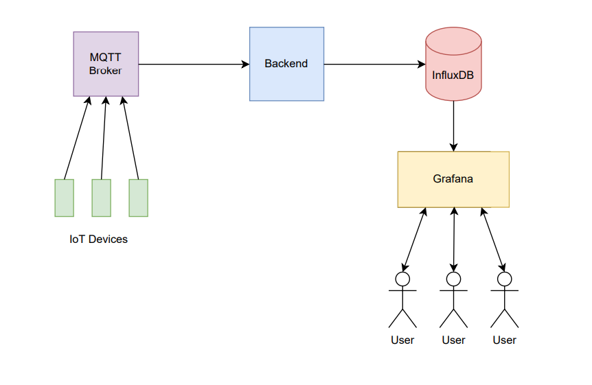

Slide 11
Demo

Slide 12
Getting Started
Share your GitHub profile with the Fellow to gain access to the project repository
Clone the repository to your local machine using the provided GitHub link
Follow the setup instructions to configure your local development environment

Slide 13
Q&A

