Slide 2
Lesson 02 -MQTT-
07/2025

Slide 3

Client-Server Architectures
MQTT
Demo
Q&A

Slide 4

Client-Server Architectures
Client-Server Model: The client requests, the server responds
Client Role: Initiates communication, sends request
Server Role: Processes requests, send responses
Protocols: HTTP, FTP, WS, etc.
Scalability: Supports multiple clients at once

Slide 5
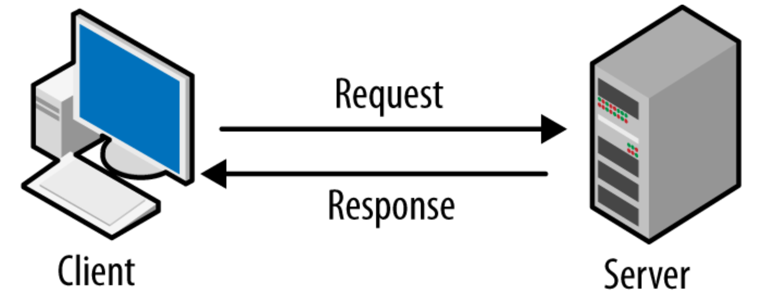

Slide 6
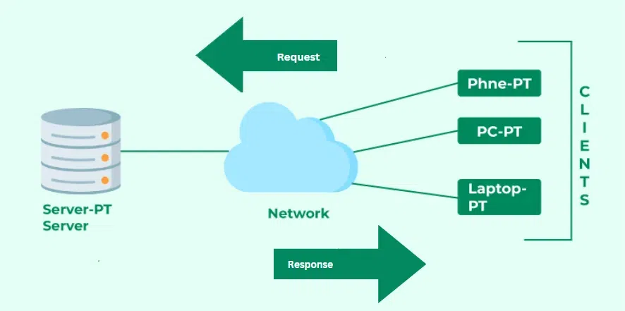

Slide 7
MQTT
Message Queuing Telemetry Transport
Publish-Subscribe Model: Clients publish messages to topics, and subscribers receive them
Lightweight & Efficient: Designed for low-bandwidth, high-latency networks (e.g. IoT)
Uses TCP/IP: Runs over TCP (usually port 1883, or 8883 for secure connections)

Slide 8
Publish-Subscribe Models

Slide 9
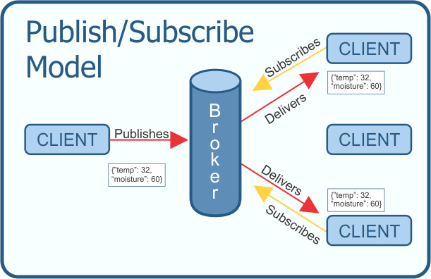
The publish-subscribe model is a messaging pattern where clients (publishers) send messages to a central server called a broker, and other clients (subscribers) receive messages based on the topics they subscribe to. The broker ensures messages are delivered to the correct subscribers without direct connections between publishers and subscribers.

Slide 10
Example: Bob & Alice using MQTT
Topics: weather/updates, news/breaking
Subscriptions: Alice subscribes to weather/updates, Bob subscribes to news/breaking
A weather stations publishes “It’s 25C outside” to weather/updates
Alice receives the message, Bob does not receive it (he is not subscribed to this topic)
A news agency publishes “Breaking: Major event!” to news/breaking
Bob receives the message, Alice does not receive it (she is not subscribed to this topic)

Slide 11
Demo

Slide 12
Q&A

