Slide 1
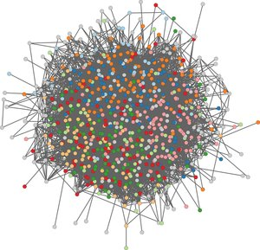
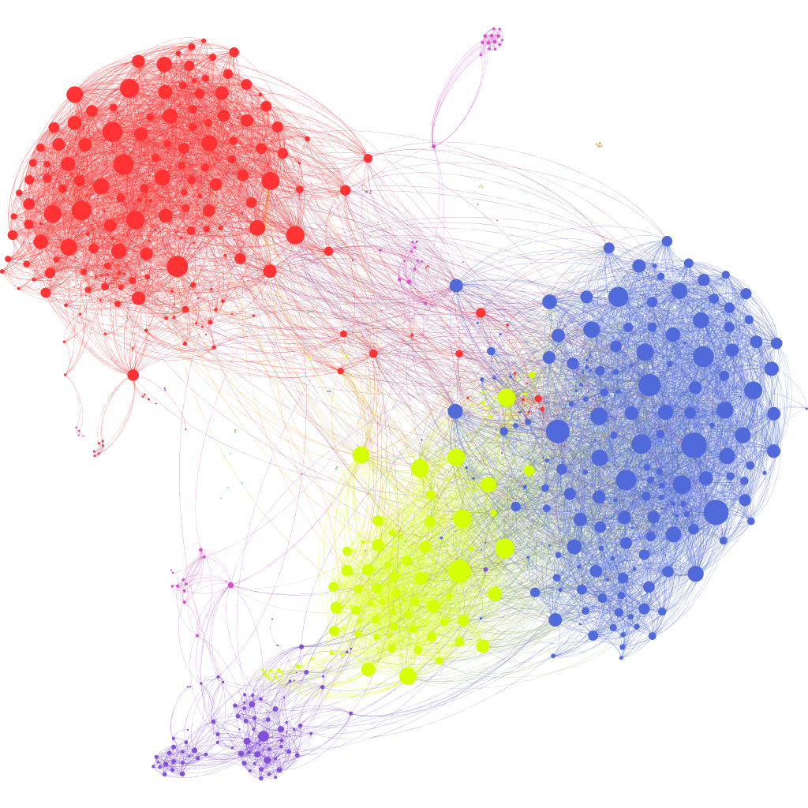
Create graph
From data frame
From database
Annotate
Graph properties
Power law
Centrality measures
igraph
Gml, gaphml, scv, rds
C++
Clustering
louvain
svg
lec
wt
fc
infomap
spectral
Consensus
Clustered graph
Consensus matrix
Bridgeness
Graph analysis
Graph entropy
Disease localization
Enrichment

