Slide 1

Brazilian E-Commerce Customer Analysis
RFM – BCG Matrix
Le Phuong Trinh

Slide 2
RFM Metrics
THEORETICAL FRAMEWORK
Recency
Frequency
Monetary
The freshness of the customer activity.
E.g: Time since last order or last engaged with the product
The frequency of customer transactions or visits.
E.g: Total number of transactions or average time between transactions/ engaged time
The intention of customer to spend or purchasing power of customer
E.g: Total or average transactions value
RFM analysis allows marketers to target specific clusters of customers with communications that are much more relevant for their particular behavior – and thus generate much higher rates of response, plus increased loyalty and customer lifetime value. Like other segmentation methods, an RFM model is a powerful way to identify groups of customers for special treatment. We scoring and grouping our customer by using the combination of these indicators.

Slide 3
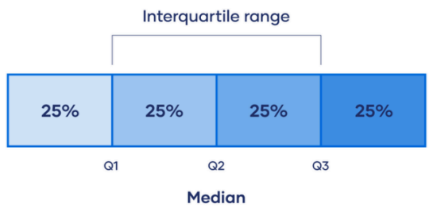
Interquartile Range (IQR)
THEORETICAL FRAMEWORK
IQR = Q3 − Q1, measures data variability in the middle 50%.
Quartiles split data into 4 equal parts:
Q1: 25% of values fall below
Q3: 75% of values fall below
This method is used to score Recency, Frequency, and Monetary from 1 to 4.

Slide 4
BCG Matrix
THEORETICAL FRAMEWORK
High
Star
Question Marks
Product that have a high growth rate and a high market share
Products that have a high growth rate but a low market share
Star
Star
Question Mark
Question Mark
Market Growth
Cash Cows
Pets
Products that have a low growth rate and a low market share
Products that have a low growth rate and a low market share
Cash Cow
Dog
Low
High
Market Share
Low
BCG matrix helps we decide how to prioritize our different customers. Its own unique symbols represent a certain degrees of profitability: question marks, stars, dog and cash cows.
By assigning customers to one of these four categories, we could then decide where to focus our resources to generate the most value. We will decide which customer belong to which group based on their RFM score

Slide 5
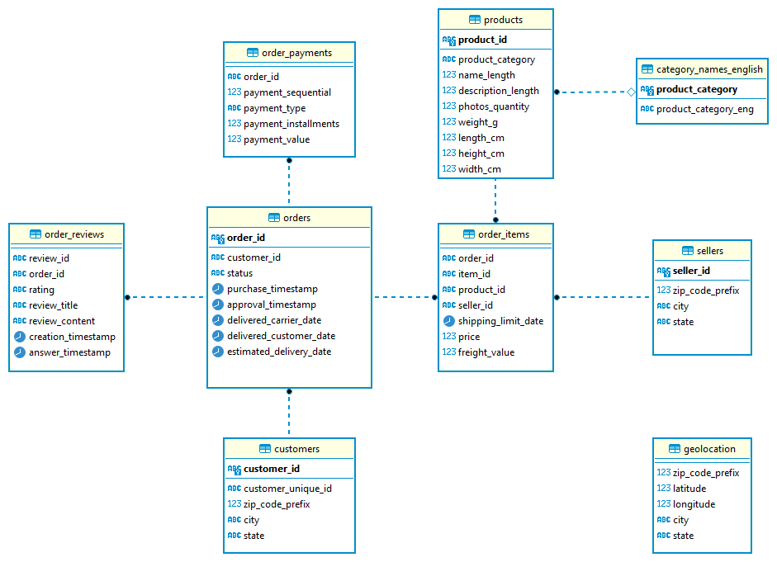
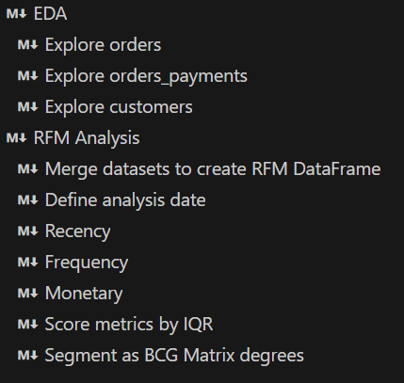
DATABASE AND METHOD
We only need to focus on tables that we use in this project:
Customers: This is a dim table which contains customers’ information.
Orders: This is a fact table which shows us our shopping history
Order_payments: This is a dim table which stores order amount
In this project, I will clean and process this dataset by Python through below steps:

Slide 6
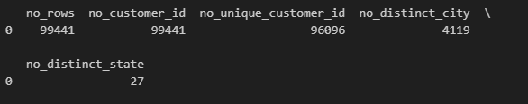
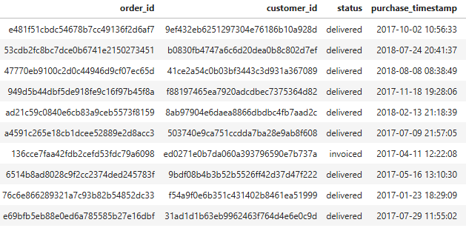
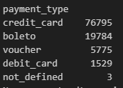
EDA
DATABASE AND METHOD
Customers has 5 columns. customer_id and customer_unique_id are categorical variables representing customers. Since both exist, one may contain duplicates — this can be checked by counting distinct values.
In the fact table, we need to set and retrieve the values ​​that have order_status as "delivered“
In the order_payments, we need to set and retrieve the values ​​that not have payment_type as “not_defined“

Slide 7
Method
DATABASE AND METHOD
To calculate recency, frequency and monetary value we will use unsupervised learning method to scoring customers.
This information can be taken from 3 tables: orders, order_payments, customers. Therefore we will join these 2 tables together based on the key column customerID.
Recency : We can calculate Recency by measure the time of the last order of minus the most recent purchase day.
Frequency: count the total time that customer buy our products.
Monetary: sum of total money that customers have spent on our products.
After calculate R, F, M values we score customers based on IQR, divide data set into 4 ranges with highest score is 4 and lowest is 1 we have these quartiles.

Slide 8
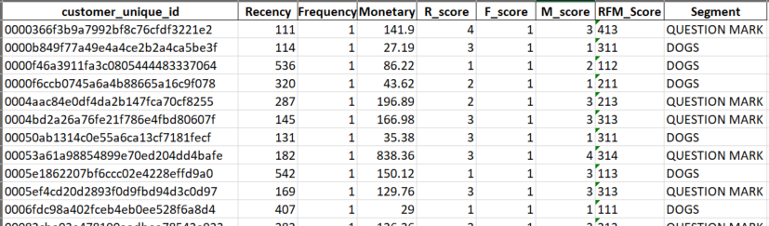
BCG Matrix
DATABASE AND METHOD
We will segment customers into 4 BCG groups based on their RFM value:
- STARS: 444, 443, 434, 344, 433, 343, 334
- QUESTION MARKS: 224, 214, , 223, 213, 323, 423, 413, 233, 243, 313, 234, 314, 244, 414, 333, 423, 324, 424
- CASH COWS: 331, 341, 431, 441, 332, 342, 432, 442, 231,322, 242, 232, 422
- PET(DOGS): 112, 121, 211, 122, 221, 212, 222, 111, 241, 141, 131, 311, 321, 312, 132, 142, 123, 113, 114, 124, 143, 133,
134, 144, 411, 412, 421

Slide 9
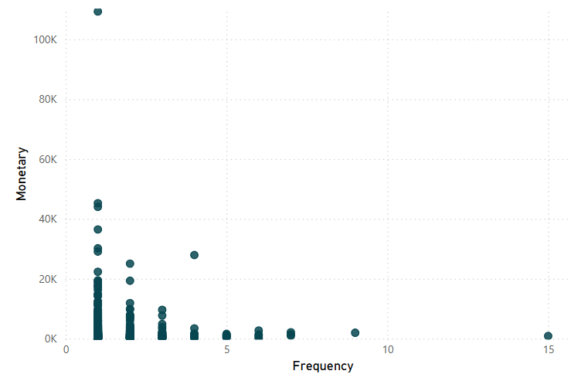
RFM Overview
ANALYSIS
237 days
Average Recency
1.03
purchases
Average Frequency
212
units price
Average Monetary
There are problem with the returning rate. On average, customers make another purchase after 237 days which is about 8 months and a customer makes purchase as the brand for 1.03 times through out their time, this is pretty low.
Inverse trend — customers who purchase more frequently often spend less per order.

Slide 10
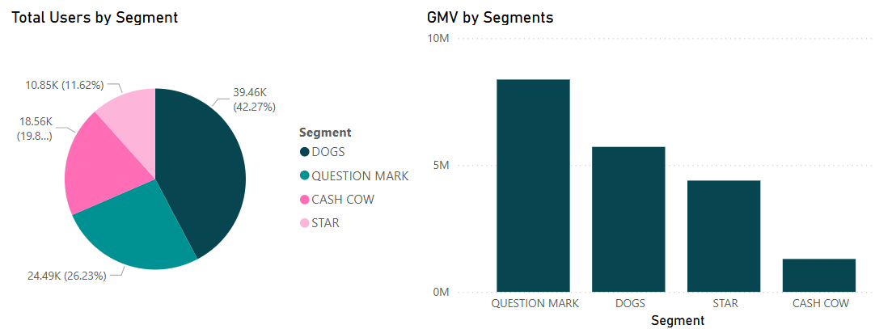
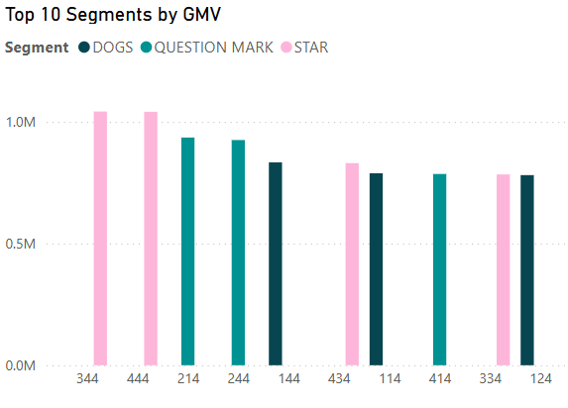
ANALYSIS
1
3
2
(1) This business has a impressive amount of QUESTION MARKs generate 42% of total GMV.
(2) The proportion of PETs is significant when compared to other segmentations, it contributes 39.5% of total GMV while Star and Cash cows those who are potential stars accounted for roughly 12% and 19% respectively.
(3) Dig deeper into RFM scores, 42.27 % of top 10 GMV is generated by ‘STARS’, showing STARs are the most valuable.
The QUESTION MARKs show potential. They may not be consistent or highly valuable yet, but with the right marketing strategies, they can be converted into loyal, high-spending customers.
PETs also appear in the top 10. These customers tend to buy infrequently or spend less, yet still contribute significantly to GMV, indicates that the business is currently relying partly on low-engagement customers

Slide 11
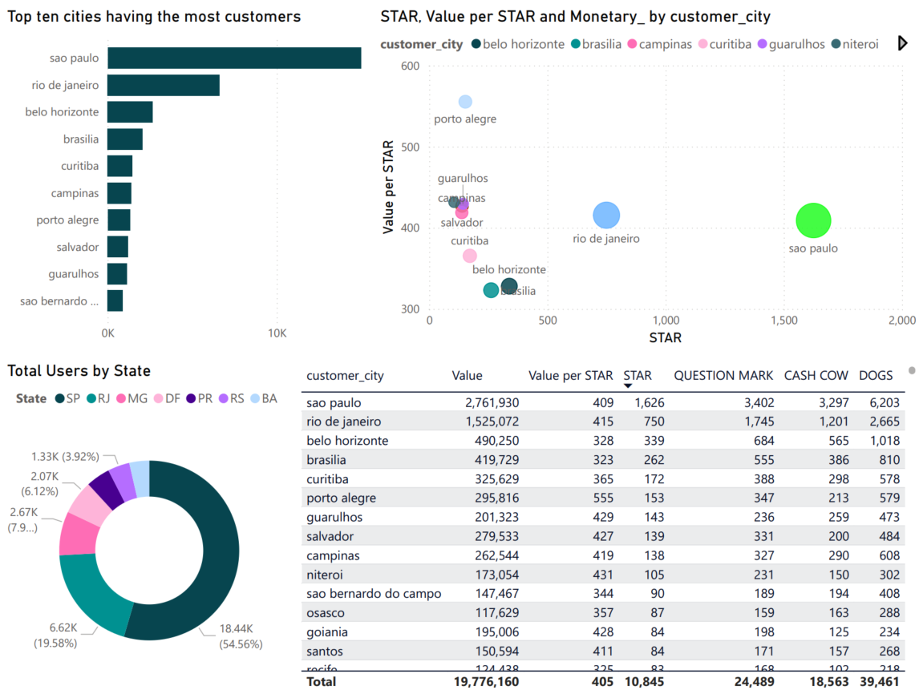
ANALYSIS
(1) Cities in the top 10 have at least 938 customers, with São Paulo and Rio de Janeiro leading in customer count and value.
(2) Any state in the top three having the most customers has east least 2.67k customers
(3) Top 3 cities accounts for 27% of total STARs, indicating higher customer value in urban regions,
making it a key segment for retention campaigns
(4) Porto Alegre, Niteroi, Guarulhos has low STARs but contributes among the highest GMV per STAR in top ten STARs, suggesting potential for VIP programs or premium campaigns.
4
1
3
2

Slide 12
SUMMARY
The business demonstrates strong potential: although STARs make up only 11.6% of the base, they contribute over 22% of GMV. However, a heavy dependence on PETs and QUESTION MARKs —who contribute a combined 64% of GMV—poses a sustainability risk if engagement remains low.
To unlock growth and retention:
Activate QUESTION MARKs through targeted marketing and incentives
Re-engage PETs with cost-effective loyalty or reactivation campaigns
Expand STARs -like behavior in high-potential cities like Guarulhos and Niteroi
Additionally, the 237-day average repurchase cycle and inverse frequency–monetary trend highlight the need for better retention strategies and order value optimization.

