Slide 1
Data Capstone Project

Slide 2
Introduction
A dog groomer in interested in opening a new dog grooming business in Toronto.
She wants to open her business that is in a neighborhood with a high density of parks, restaurants, and dog walks.
Which neighborhood should she choose for her new business venture?

Slide 3
Data Description
Toronto neighborhoods and postal codes, scraped from https://en.wikipedia.org/wiki/List_of_postal_codes_of_Canada:_M
Csv of latttude and longitude data for Toronto Postal Codes
FourSquare API for location data of nearby venues
Cleaned data contains 101 rows with 60 features
The rows represent the neighborhoods, and the features represent venue categories

Slide 4
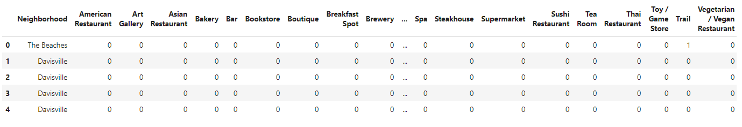
Dataset Representation

Slide 5
Methodology
Using K-means clustering, cluster the neighborhoods to determine where the business will be nearest parks, restaurants, and venues
Use the elbow method to determine the best number clusters
Use the Folium library to map the clusters

Slide 6
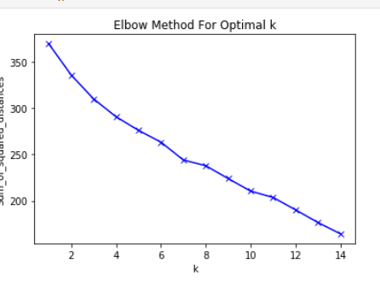
Elbow method for cluster number
The best number of clusters to use is 7

Slide 7
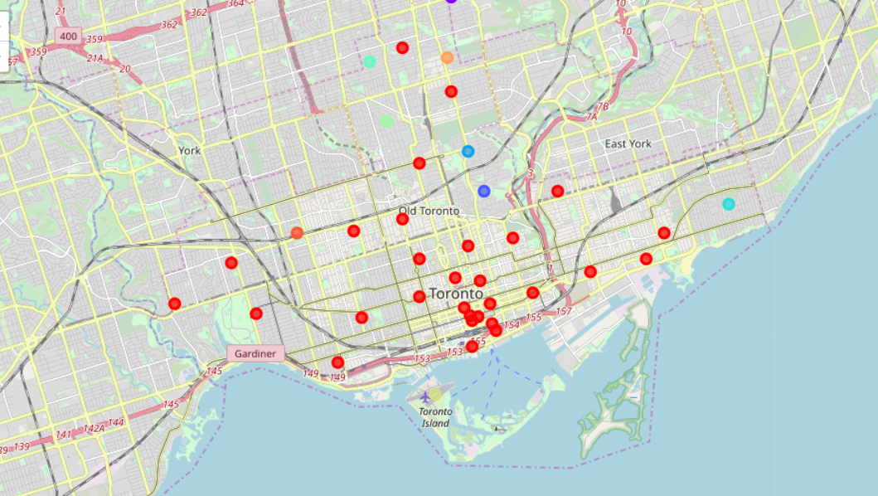
Cluster Mapping

Slide 8
Results
After cluster analysis, identify the neighborhoods that are closest to restaurants, parks and dog walks
Create a new dataframe to list them

Slide 9
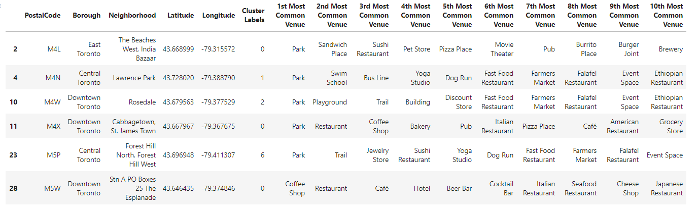
Neighborhoods closest to parks

Slide 10
Discussion
The neighborhoods that are closest to parks, restaurants and dog runs are Forest Hill, Lawrence Park, and Rosedale
These are venues that would attract dog owners, and would be an excellent place for a new dog grooming business venture to open

Slide 11
Conclusion
Build a clustering model to determine which neighborhoods would be closest to recommended venues
Identified the areas, and gave recommendations to new business owner

