Slide 1



The Shazamazons!
Digital Game Design II
IMGD 3900
Linda Puzey and Anne Higgins

Slide 2


Experience Goals
The experience goal for our modded game was to maximize the number of clicks during a game.

Slide 3

Strategy
Our hypothesis is that people will click more when because they are panicked
Timed things always make people panic

Slide 4

How we did it?
We decided to add a timer to maximize the number of clicks
We will also move the gold so they can't take the same route as the pre-test
Thus making them be more panicked

Slide 5

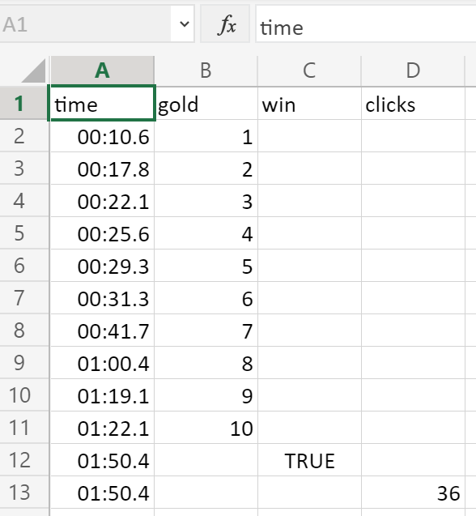
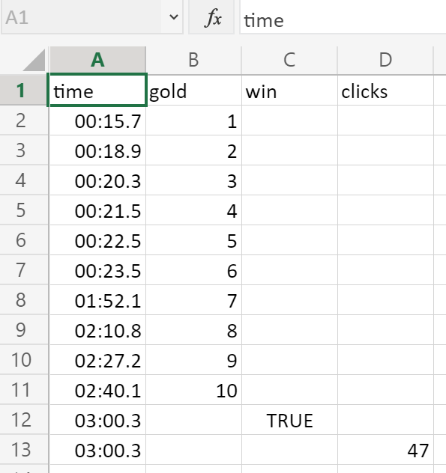
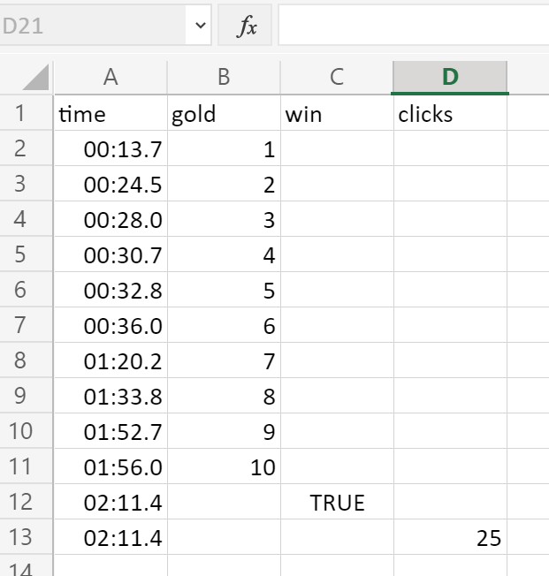
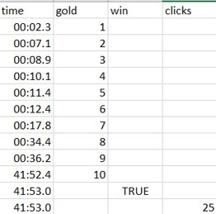
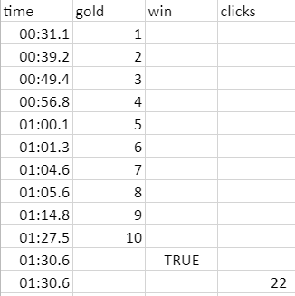
Pre-Mod Data

Slide 6
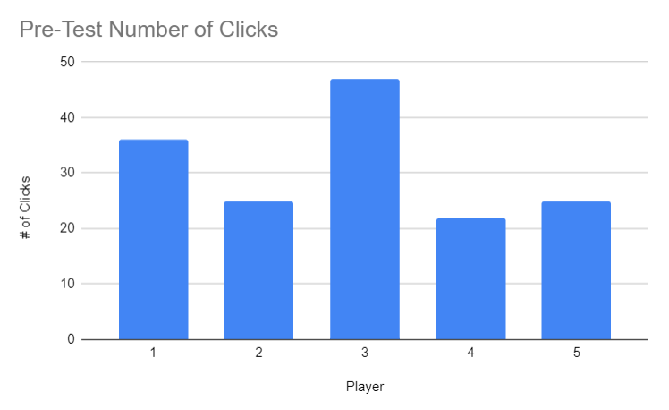
Pre-Mod Graph
Player | # of Clicks
1 (Brother) | 36
2 (Sister) | 25
3 (Mom) | 47
4 (Dad) | 22
5 (A's Bro) | 25

Slide 7
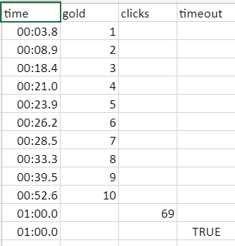
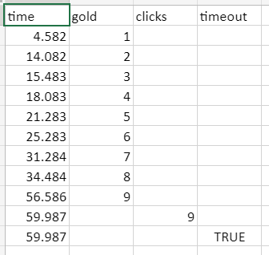
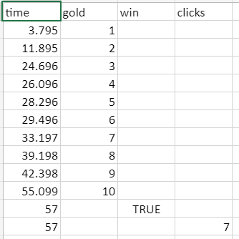
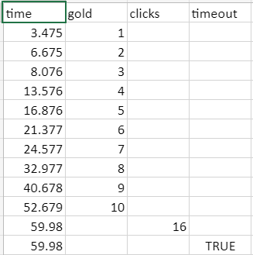
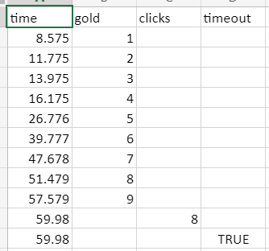
Post-Mod Data

Slide 8
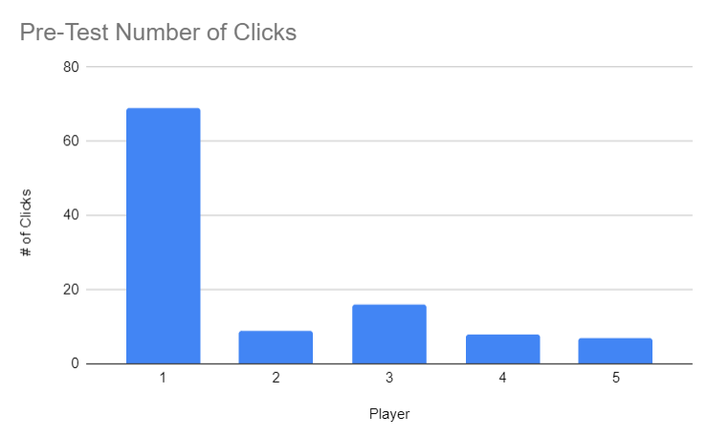
Post-Mod Graph
Player | # of Clicks
1 (Brother) | 69
2 (Sister) | 9
3 (Mom) | 16
4 (Dad) | 8
5 (A's Bro) | 7

Slide 9
Conclusion
Our modification failed to achieve our experience goal
We noticed that when people were playing with the time limit, that they made fewer and more concise moves then before when they would take their time
The testers would try to maximize the number of gold they could get per trip
The timer failed to create stress and anxiety like we thought it would
The timer also minimized the number of clicks because the majority of testers were unable to complete the game in the time limit (thus cutting them off from making more clicks)

