Slide 1
CaMERA TACKER

Slide 2
Progress update
Obtained the center coordinate of the object
Object following algorithm
Gimbal control

Slide 3
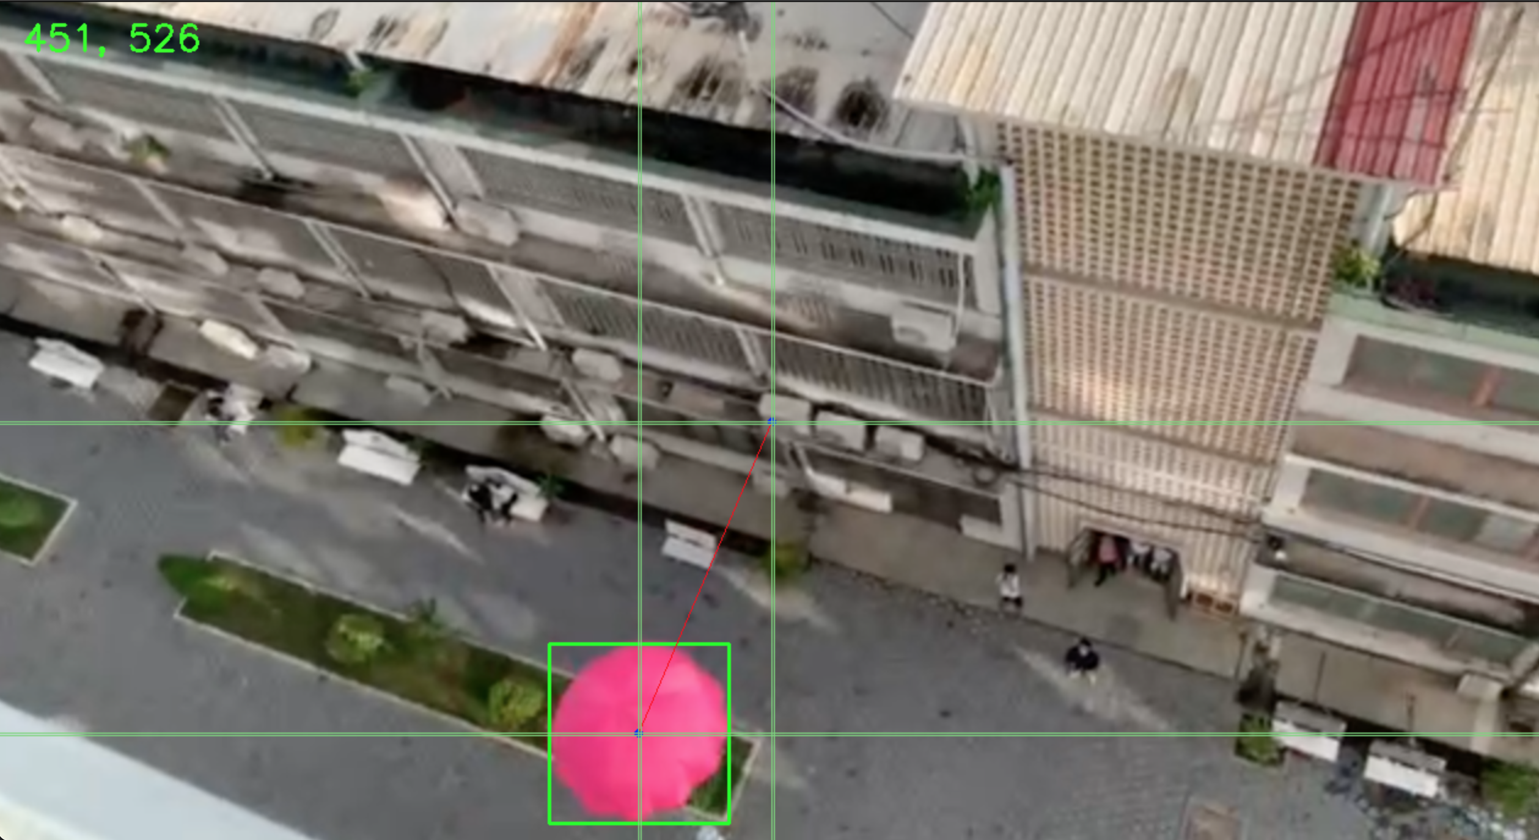
Center COORDINATE

Slide 4
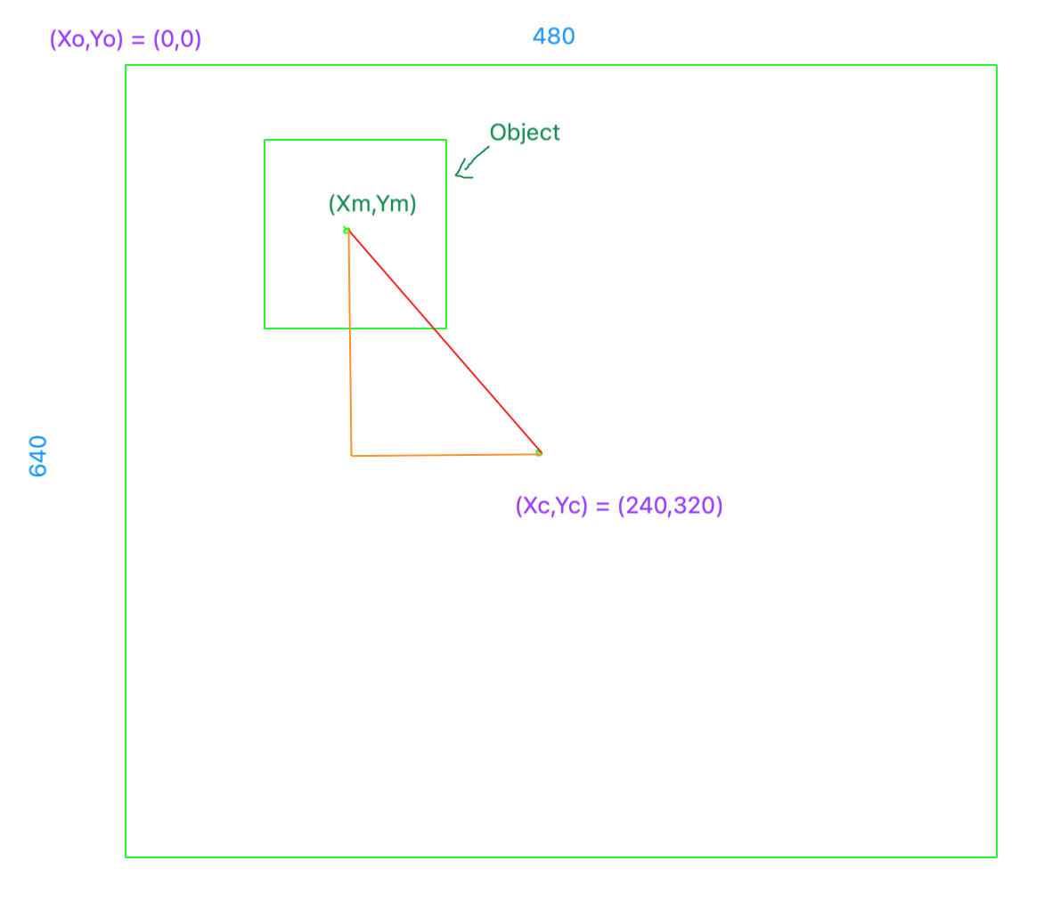
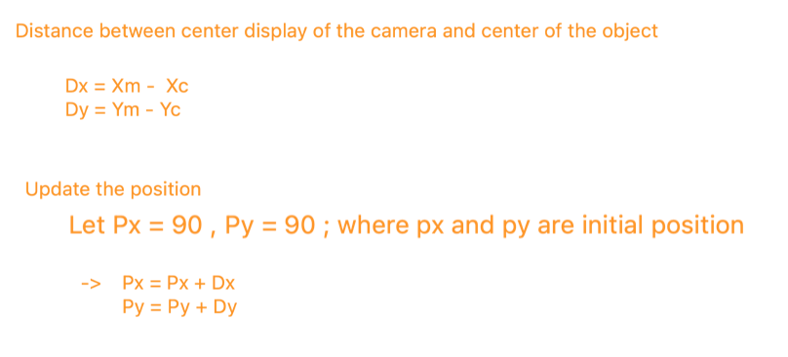
Detecting ALGORITHM

Slide 5
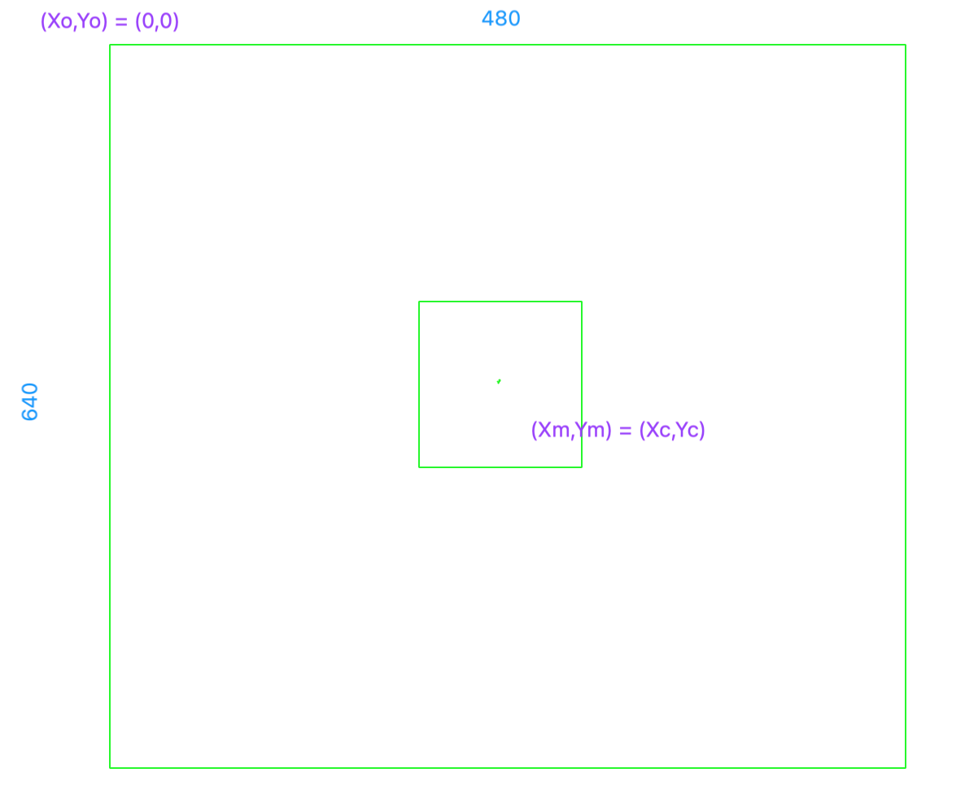
purpose

Slide 6
GIMBAL CONTROL
To get closer to the actual position, we use proportional controller.
P_out = Kp x e(t) + p0 ,
- p0 : Controller output with zero error
- P_out : Ouput of the proportional controller
- Kp : Proportional gain
- e(t) : Error at time t e(t) = setpoint – process variable

Slide 7
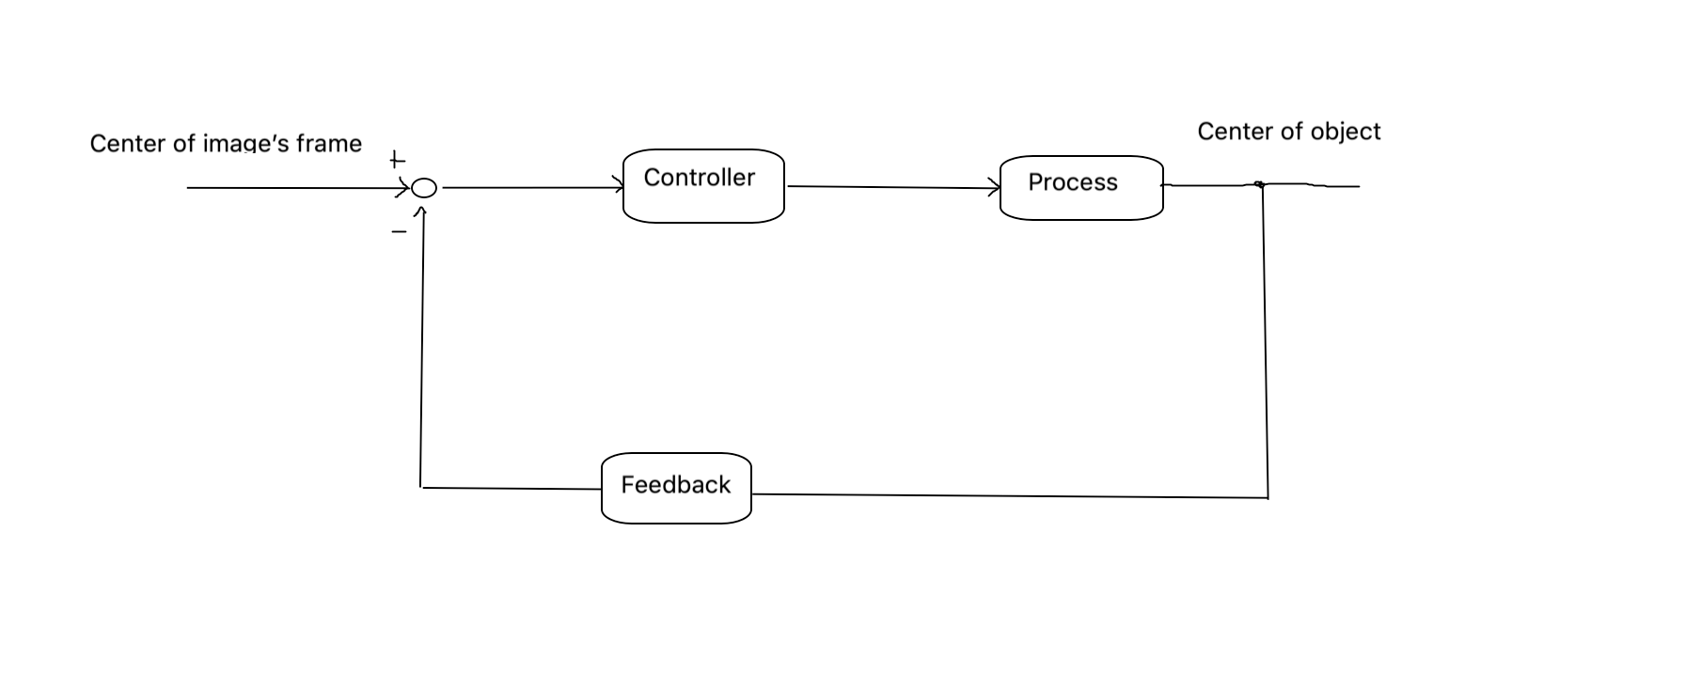
Block diagrram
Coordinate moving speed

Slide 8
STEP
Find the center coordinate of video frame cx = resolution_width/2 , cy = resolution_height/2
Find the center coordinate of object x , y
Find the error error_x = x – cx , error_y = y – cy
Predict or tune proportional gain Kp
angle1 = angleI + Kp x error_x ( rotate around vertical axis )
angleII = angleII + Kp x error_y ( rotate around horizontal axis )

