Slide 1

Cooper Nederhood, Liqiang Yu, Laurence Warner

Slide 2
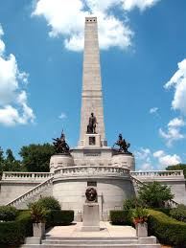

Slide 3
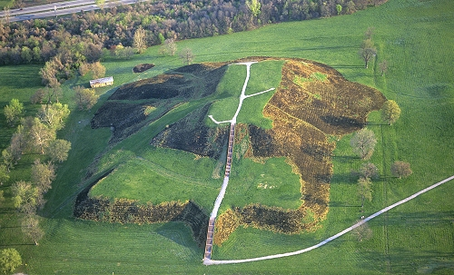

Slide 4
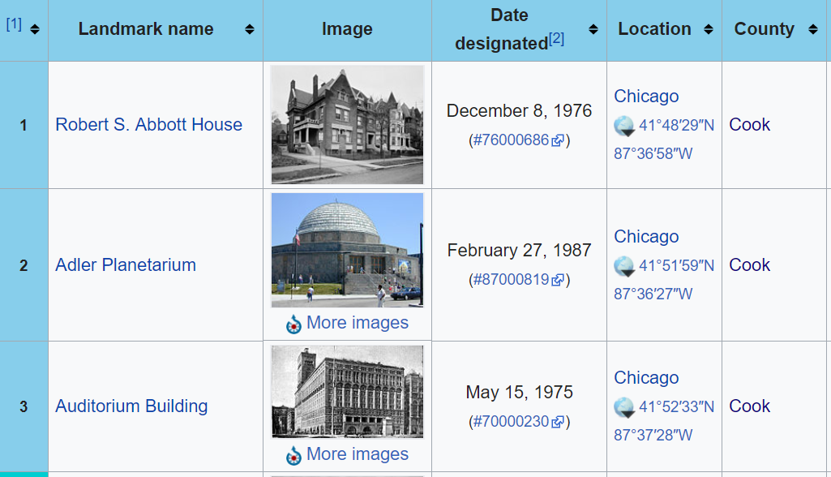
Data: National Historic Landmarks
2,596 across the United States by state (59 in Illinois)
“Designed to recognize and honor the nation's cultural and historical heritage” (link)
Diverse image type

Slide 5
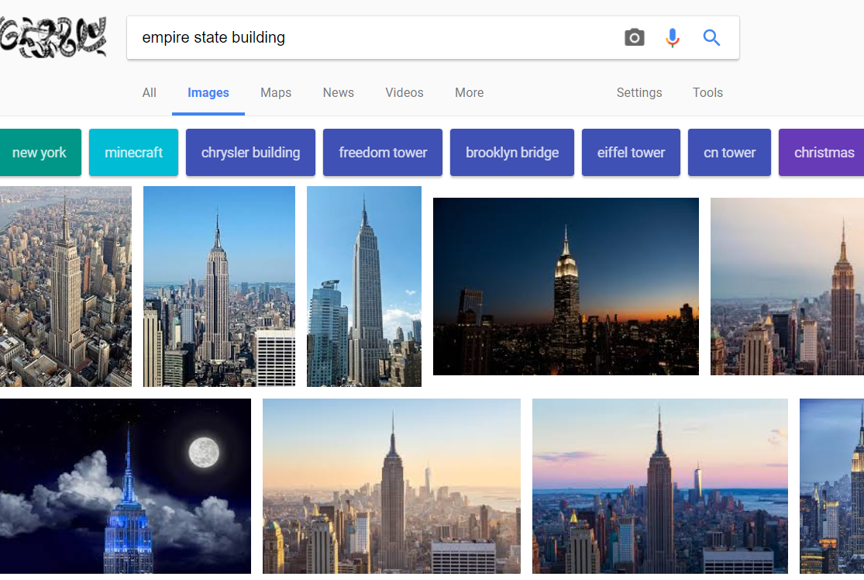
Scraping images from Google Image search
List by state with description from Wikipedia
Download images from Google Image search (as many as possible)
Training data and testing data
Possible issue with request limit from Google Images

Slide 6
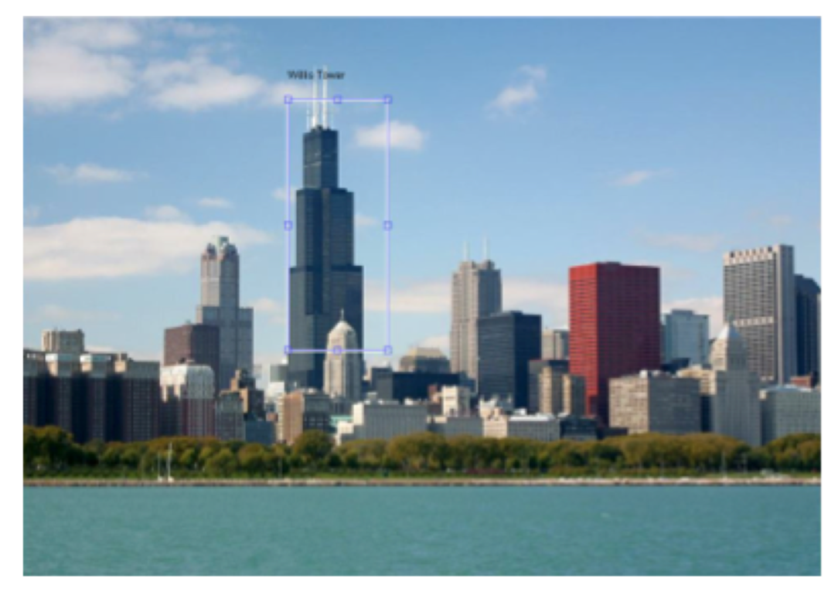
Algorithm
Goal
Detection of object
Invariant to lighting variation
Recognition of landmarks

Slide 7
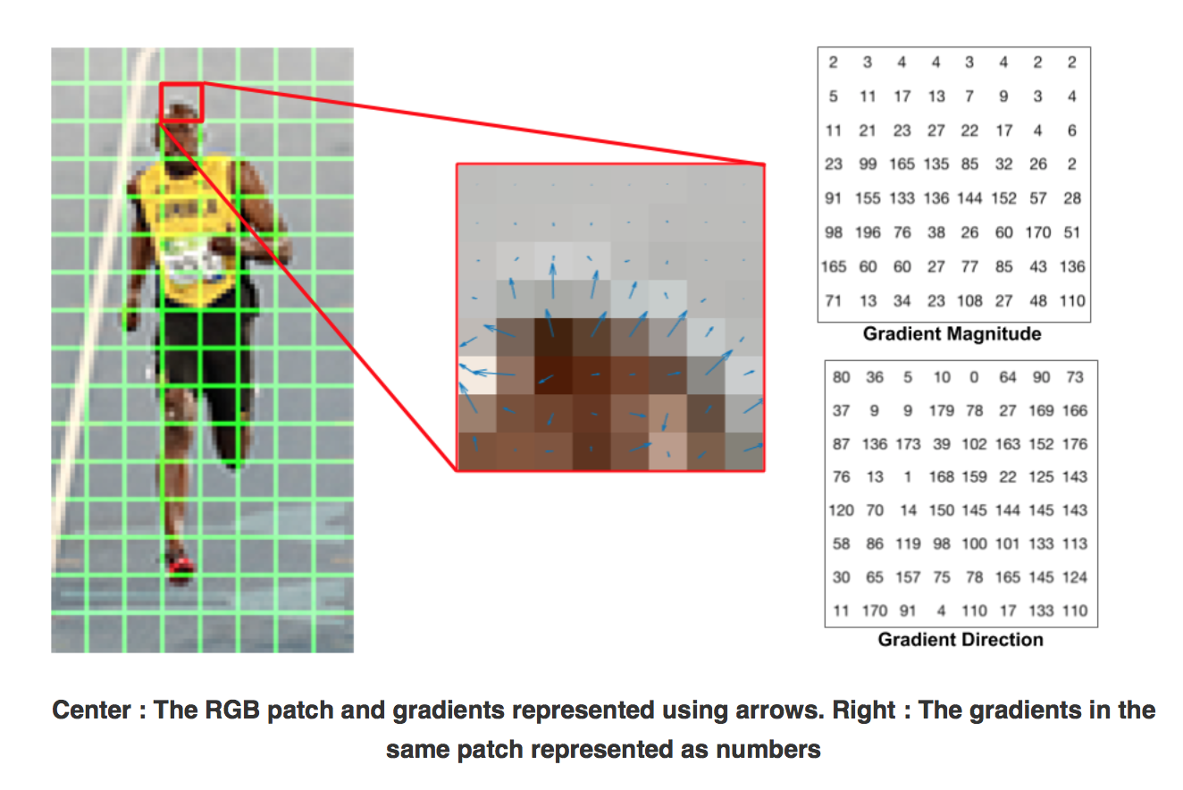
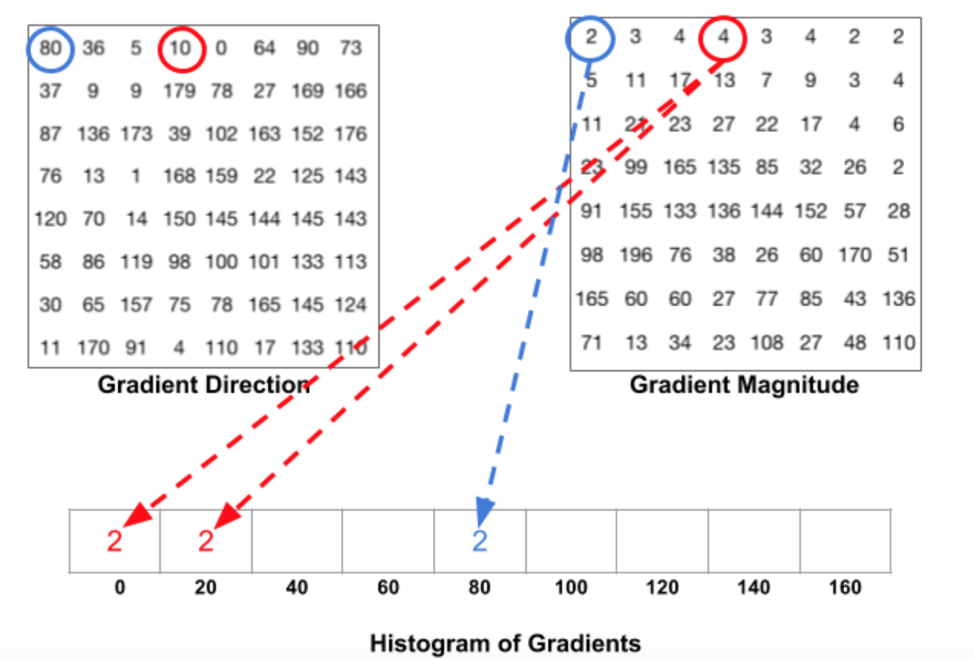
Algorithm
Solution
Histogram of oriented gradients (HOG)
Normalize
SVM
Ref: https://www.learnopencv.com/histogram-of-oriented-gradients/

Slide 8
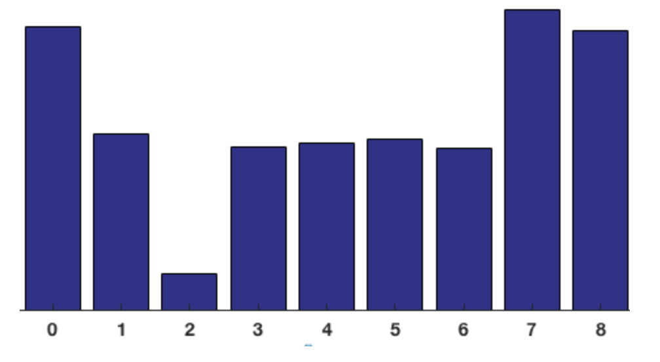
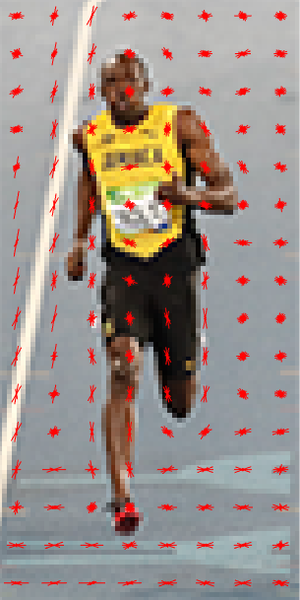
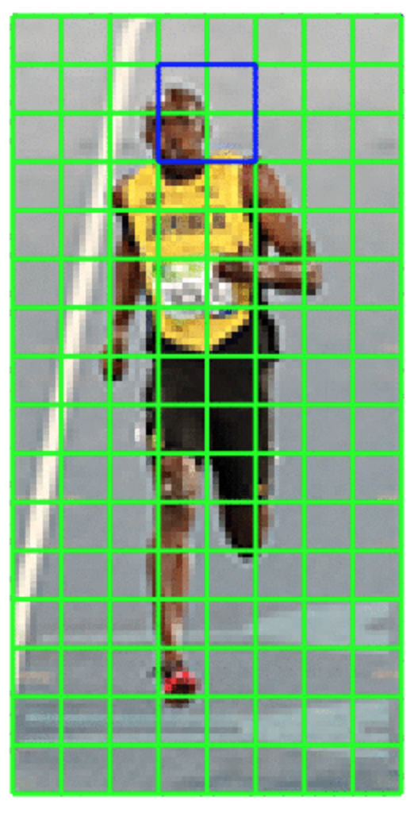
Algorithm
Solution
Histogram of oriented gradients (HOG)
Normalize
SVM
Ref: https://www.learnopencv.com/histogram-of-oriented-gradients/

Slide 9
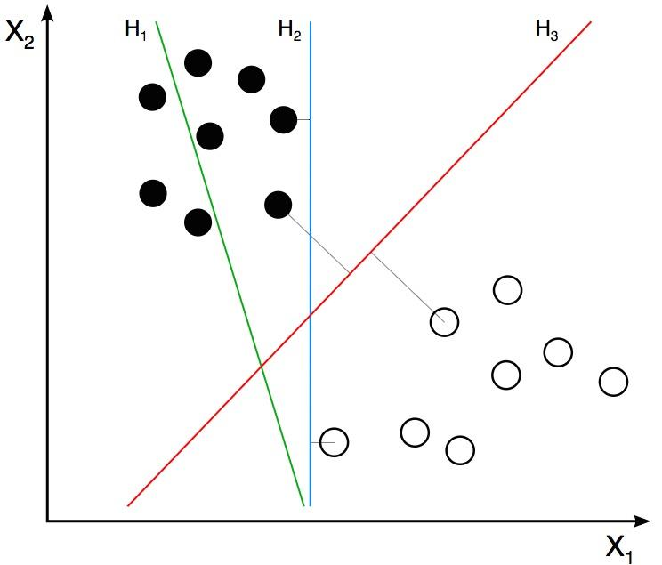
Algorithm
Solution
Histogram of oriented gradients (HOG)
Normalize
SVM
Ref: https://www.learnopencv.com/histogram-of-oriented-gradients/

Slide 10
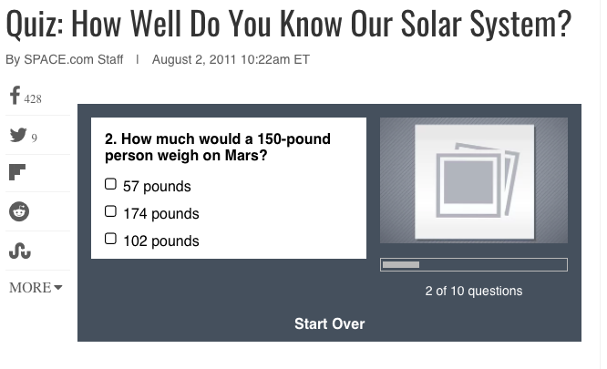
User Product:
Think you know your state?
Can you beat the algorithm?
Potential to use platform to train new datasets
Similar example:
Questions for audience:
How to build?
App vs. website?

Slide 11
Cooper Nederhood, Liqiang Yu, Laurence Warner
Questions/Suggestions?

