Slide 1
Working with APIs
Lecture #3 Text Analysis MiniLab
Laura Wolton

Slide 2
What is an API?
*Some of the material in this talk is borrowed from SICSS 2020
see Youtube and Github for lots of topics
https://www.youtube.com/playlist?list=PL9UNgBC7ODr4M1_4RLr4IYcXbHPUWYMrZ
Find a public API: any-api.com or https://www.programmableweb.com/category/all/apis

Slide 3


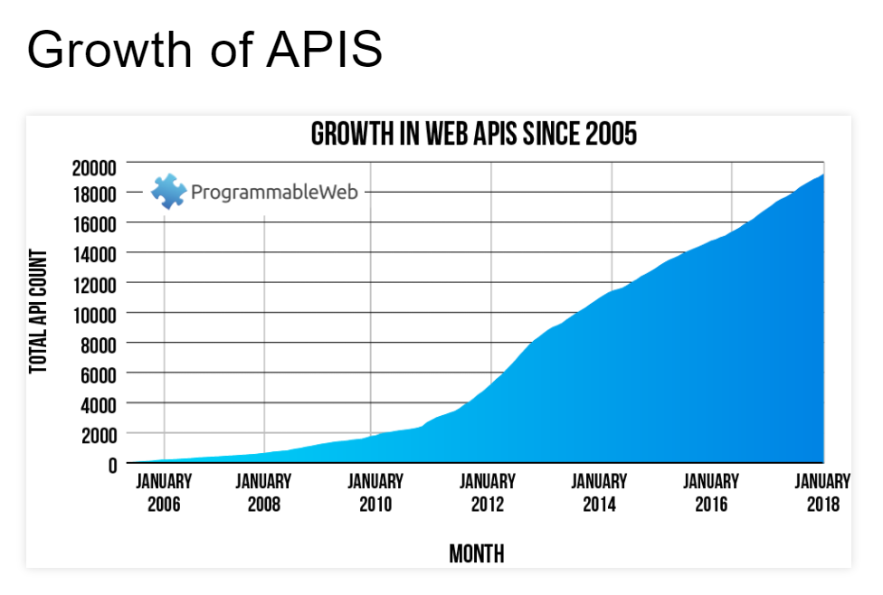

What is an API? Application Programming Interface
People wanted data sharing between organizations
Get data or send data
Interact with a site without a typical user interface
Social media, news media, data hubs
Allows the interfaces to share with each other
Share Instagram on FB or NYT article on Twitter
Some APIs even help with analysis

Slide 4
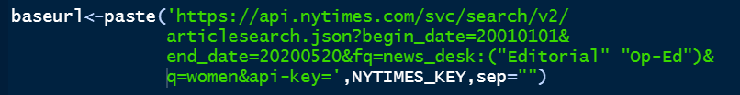
You need:
Credentialing
Key (almost always)
Secret and/or app name (sometimes)
API Calls that are specific to your API
To understand the data return format – JSON data

Slide 5
You need:
Credentialing
Key (almost always)
Secret and/or app name (sometimes)
Twitter example
Get a Developer Account if you want more than the last 7 days
https://developer.twitter.com/en/apply-for-access
Before you work with Twitter know that there was a big change to authorization protocol, so don’t use blogs with old dates
A better program to use is rtweet not TwitteR
Try these instructions for some updated basics
https://www.earthdatascience.org/courses/earth-analytics/get-data-using-apis/use-twitter-api-r/

Slide 6
New York Times example:
Creating a call
The first part is the api address
The part after the question mark is the query
What you can put in your query depends on your API and app

Slide 7
Editorials contain policy actors, solutions, and issues
We want to understand media because that gives us clues to:
what the major frames are
who is expected to solve the policy problems, and
what the major solutions proposed are
how much attention is given to women’s issues in various presidencies
We can measure the volume and relate it to attention as agenda’s shift
How policy actors are constructed in the media
proxy for social construction of target populations

Slide 8
Inductive Dictionary Development
Create n-grams
Coded n-grams to words/phrases to categories manually
Issue Frames
E.g.(RIGHTS, LGBTQ, ABORTION ,SEXASSUALT, VIOLENCE, MILITARY, HEALTH)
Actor Categories
E.g. (JUDICIAL, LEGISLATIVE, PRESIDENTIAL, VICTIMS, WOMEN, MEN, RELIGIOUS)
Solution Categories
E.g. (JUDICIAL, LEGISLATIVE, PRESIDENTIAL, VICTIMS, WOMEN, MEN, RELIGIOUS)
Read in dictionary
Code sentences containing those words
Measure sentiment of characters
Map issues, solutions, and characters over time
Run LDA model to compare findings of issues

Slide 9
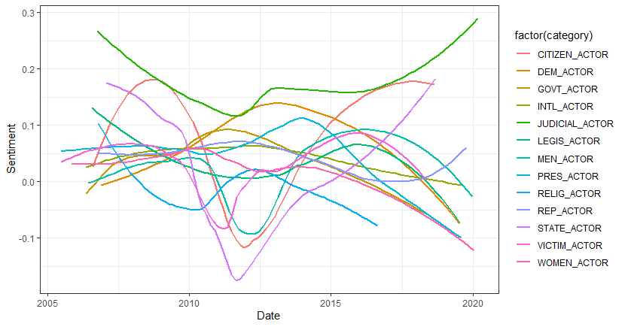
Findings-Actors

Slide 10
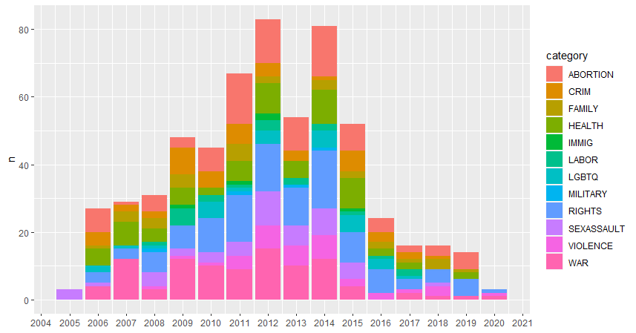
Findings -Issues

Slide 11
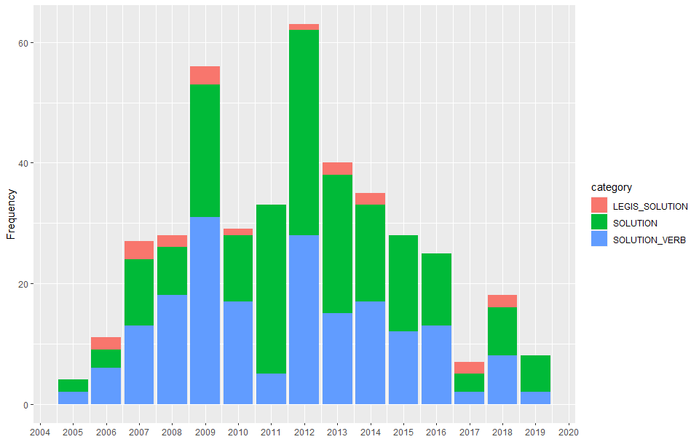
Findings -Solutions

Slide 12
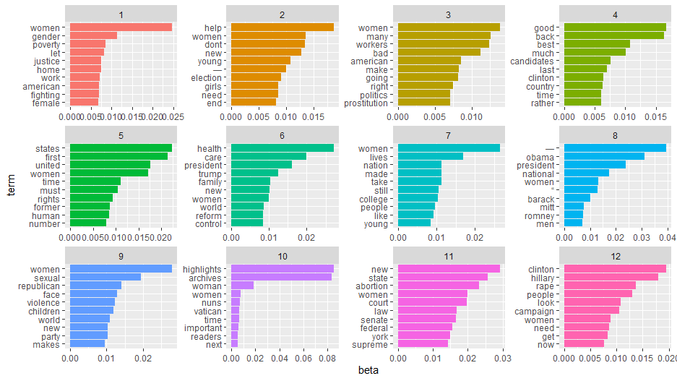
Findings –LDA model

Slide 13
Conclusions
RQ Conclusions
Presidents are strong agenda setters
you do see changes in:
activity about women’s issues,
variation in issues
construction of actors, and
volume of solutions posed regarding women’s issues during the terms
Methods Conclusions
LDA model did highlight a few issue frames we missed in the inductive, manual search
Prostitution
abortion discourse is centered around judicial actors
Takes more than a few days to train a model

