Slide 1
Deep Learning for EHR De-identification
Liping Wu

Slide 2
An innovative and promising way

Slide 3
Agenda
Deep Learning in EHR
De-identification
GAN
Results
Challenge

Slide 4
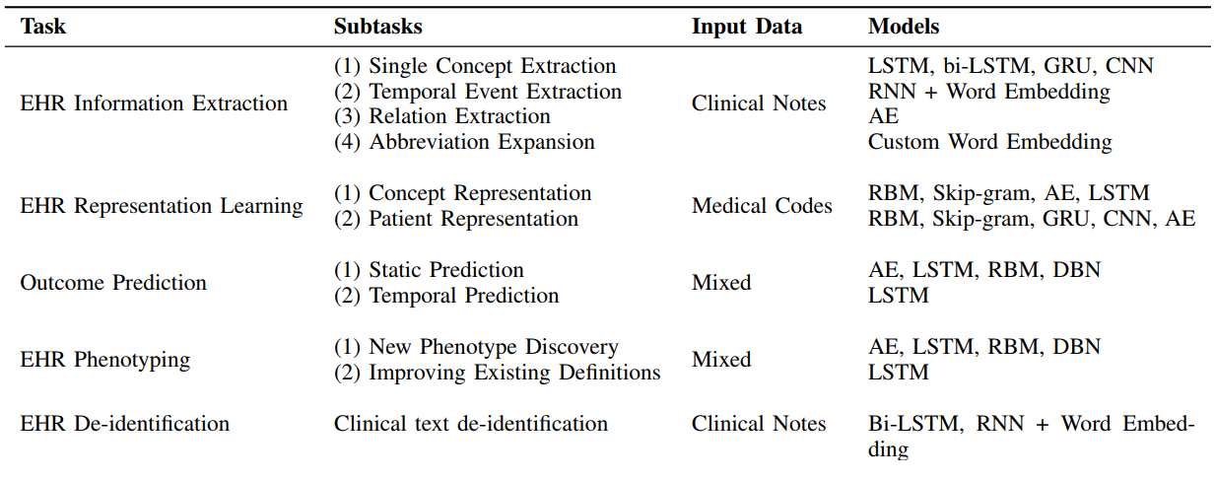
Deep Learning in EHR
Credit: Deep EHR: A Survey of Recent Advances on Deep Learning Techniques for Electronic Health Record (EHR) Analysis
https://arxiv.org/abs/1706.03446

Slide 5
De-identification
Transparency – public
Privacy - anonymous
The HIPAA Privacy Rule
EMA GDPR

Slide 6
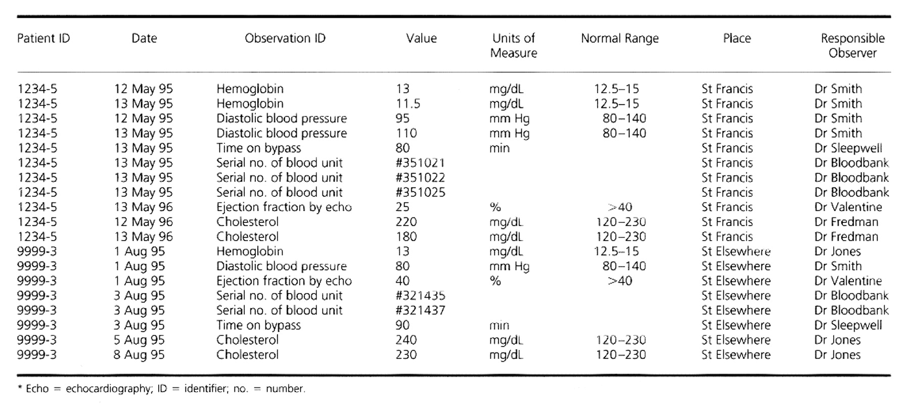
Sample Data

Slide 7
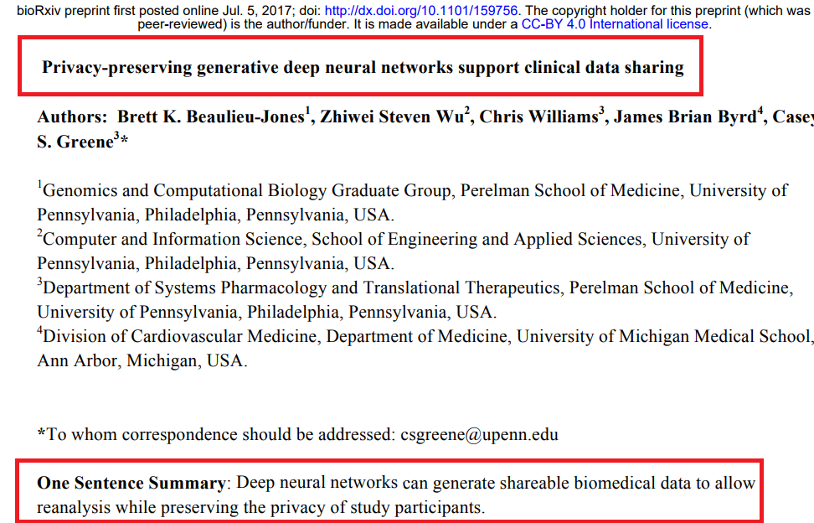
Notes:
https://github.com/greenelab/SPRINT_gan

Slide 8
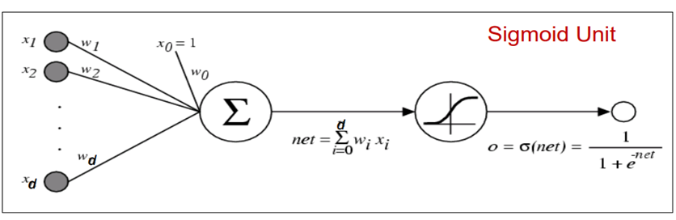
Logistic Regression – Simple Neural Network
Credit: http://www.cs.cmu.edu/~aarti/Class/10701/slides/Lecture22.pdf

Slide 9
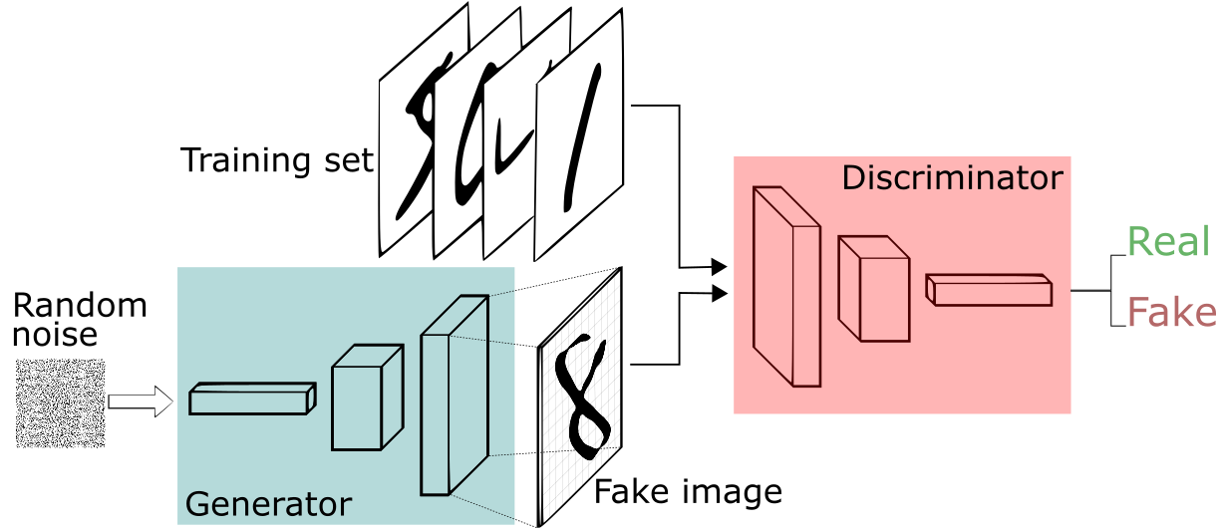
Generative Adversarial Networks (GAN)
Notes:
https://deeplearning4j.org/generative-adversarial-network
convolutional neural network

Slide 10
Research
Task: to generate realistic simulated blood pressure trajectories
Data: SPRINT trial dataset
Treatments: standard, intensive

Slide 11
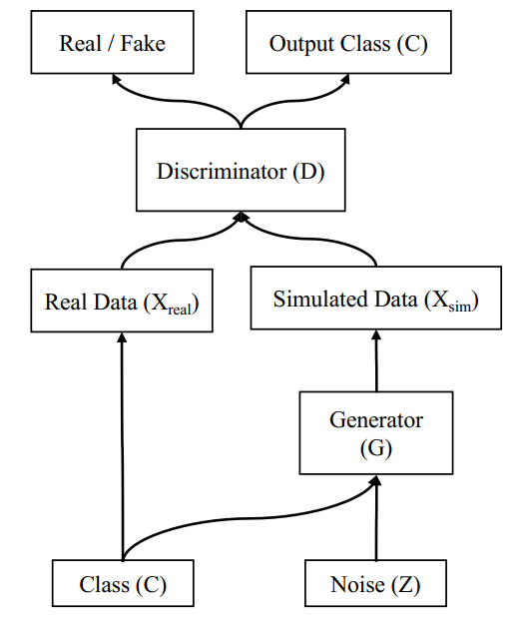
The Models
Two Gan models
With privacy constraints
Without privacy constraints
Open source
https://github.com/greenelab/SPRINT_gan

Slide 12
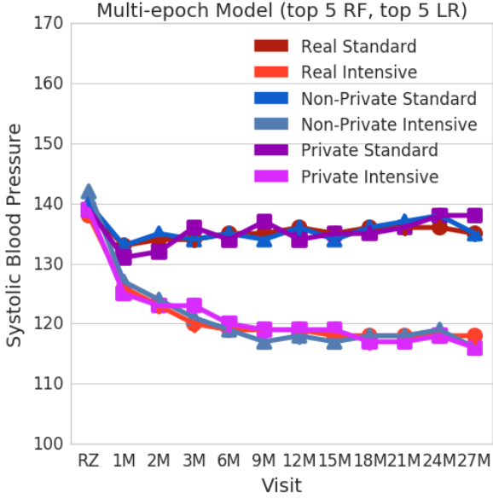
Result 1: Variable Distributions

Slide 13
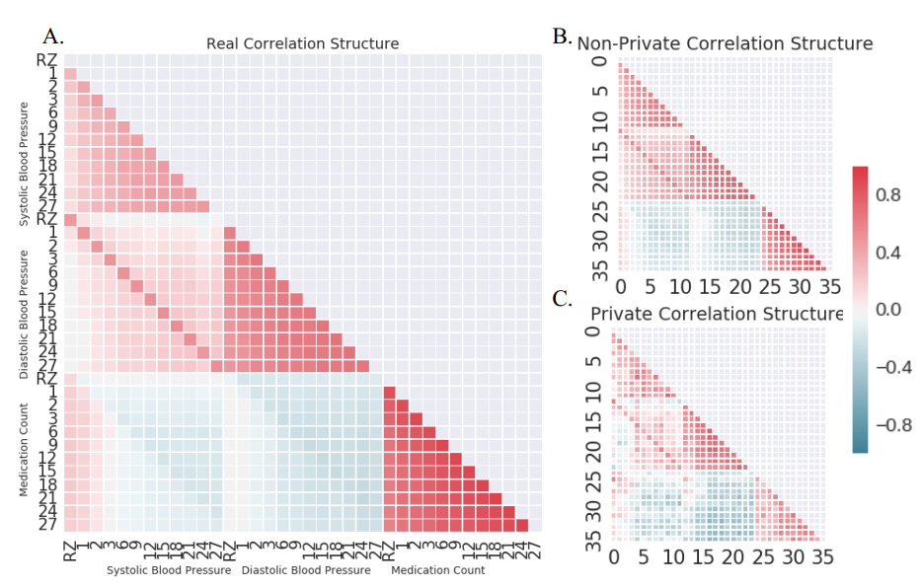
Result 2: Correlation Structure

Slide 14
Challenges
Data Heterogeneity
Small Data
Poor interpretability

Slide 15
Questions

Slide 16
Appendix

Slide 17
Deep Learning
Deep Learning is subset of Machine Learning.
Deep Learning can be used as supervised learning + unsupervised learning
Deep Learning is deep neural network.
Deep just means lots of layers; it doesn’t mean anything profound or superb.
We use neural network even we didn’t realize it
I mean Logistic Regression…

Slide 18
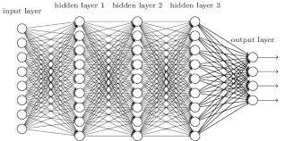
Deep Learning
We add more layers, we get Deep Neural Network!
Credit: https://www.quora.com/How-can-you-explain-Deep-neural-networks

Slide 19
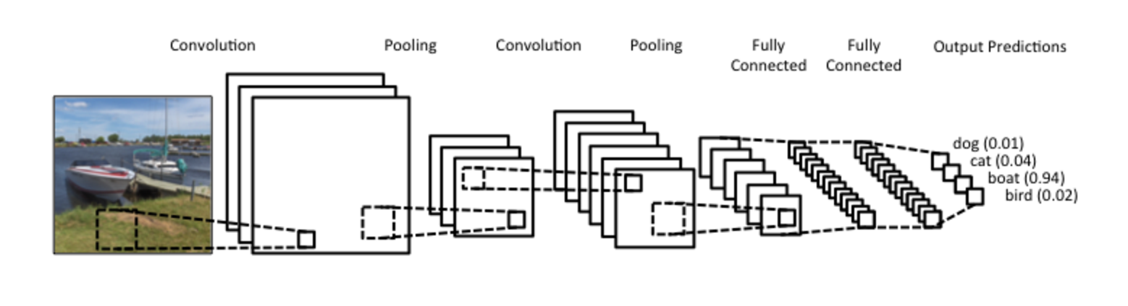
Deep Learning
We add special structures
CNN: convolutional neural network
Credit: http://www.wildml.com/2015/11/understanding-convolutional-neural-networks-for-nlp/

Slide 20
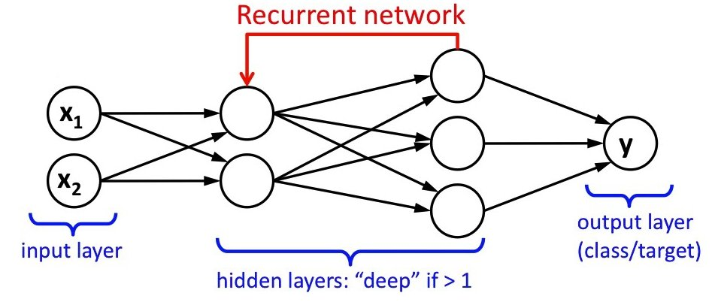
Recurrent Neural Network
We add special structures
RNN: recurrent neural network
Credit: https://leonardoaraujosantos.gitbooks.io/artificial-inteligence/content/recurrent_neural_networks.html

Slide 21
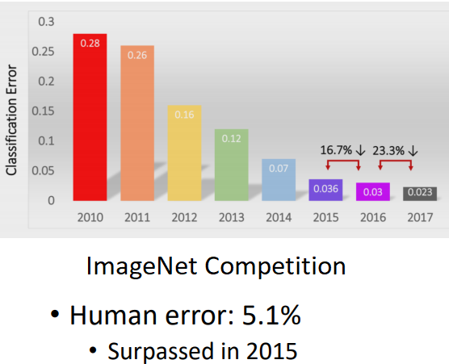
Where We Are Now
Credit: MIT 6.S094: Deep Learning for Self-Driving Cars

Slide 22
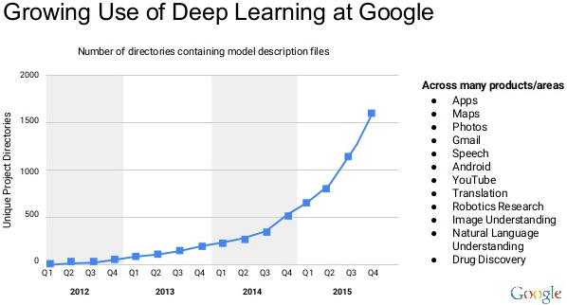
Credit: FastAI MOOC: Deep Learning Part 1: Practical Deep Learning for Coders

