Slide 1


C++ review
Dr. Qing Wang

Slide 2

Transitioning to C++
C++ Introduced
Basic C++ Programming
Memory Management
Mechanisms for Code Reuse and Abstraction

Slide 3
C++ Introduced
C++ Background
Compiling and Running a C++ Program

Slide 4
C++ Background
History
Key Features

Slide 5
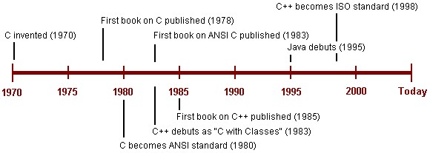
History
C++ is a modern object-oriented programming language that supports many of the same features as Java, including classes, inheritance, polymorphism, and exceptions.

Slide 6
Key Features
C++ is strongly typed. This simply means that every object must belong to a certain type and that operations such as assignment or comparison are only permitted between objects of the same type.
C++ has the concept of a class, a type of record that combines data members and the functions that operate on the data. Ignoring various minor differences, classes in C++ are very similar to classes in Java.

Slide 7
Key Features
C++ supports parameterized types, or templates. Templates make it possible to define, say, a single vector class that works for Booleans, characters, integers, reals, and so on.
C++ supports inheritance, a mechanism that makes it possible to build new classes (called derived classes) on top of an existing class (called the base class) without having to reiterate the base class design for each new class.

Slide 8
Key Features
C++ supports polymorphism. In C++, polymorphism is achieved through the use of virtual functions and pointer variables. Together with inheritance, this turns C++ into a full-fledged object-oriented language.
C++ comes with two libraries known as the Standard Library and the Standard Template Library (STL)—both of which extend the capabilities of the base language.

Slide 9
Key Features
C++ has a very large user base. From all over the world, public and private companies, government agencies, academics, and hobbyists use C++ in all types of interesting ways and applications. A major benefit of this large user base is the wide availability of different tools, libraries, and tutorials, all related to some aspect of the language.

Slide 10
Basic C++ Programming
Data Types
Specifying Classes
Input and Output
The Preprocessor
A Side-By-Side Example

Slide 11
Data Types
Fundamental Data Types
Strings
Arrays
Vectors
Creating New Data Type Names

Slide 12
Fundamental Data Types
The fundamental data types that C++ supports are similar to the primitive data types of Java. The following table lists each of the fundamental data types of C++ and the corresponding Java primitive data type.
C++ type | Java type
bool | boolean
char | char
int | int
short | short
long | long
float | float
double | double

Slide 13
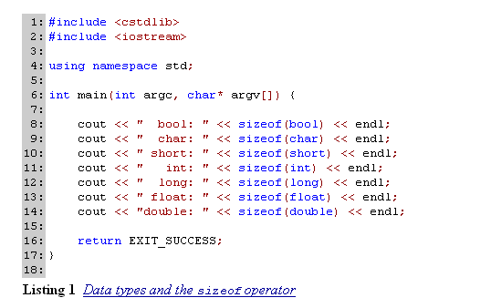
Example1

Slide 14
Read-only variable
Like Java, C++ contains a mechanism to create "read-only" variables. C++ uses the keyword const to allow programmers to create "read-only" variables.
This keyword signals that the variable being declared cannot be modified after it is initialized. The keyword const of C++ is analogous to the keyword final in Java.

Slide 15

Example2

Slide 16
Strings
In C++, the string data type provides the necessary abstraction to allow C++ programmers to work with character strings.
If a C++ program requires the string type, the programmer must refer to the library that defines this type. The following listing illustrates the C++ string data type in action.

Slide 17
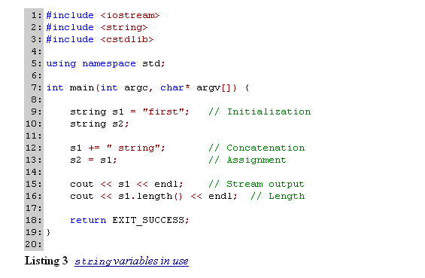
Example3

Slide 18

Arrays
C++ provides basic support for a sequence of homogeneous data objects through arrays. Both similarities and differences exist between Java arrays and arrays in C++.

Slide 19
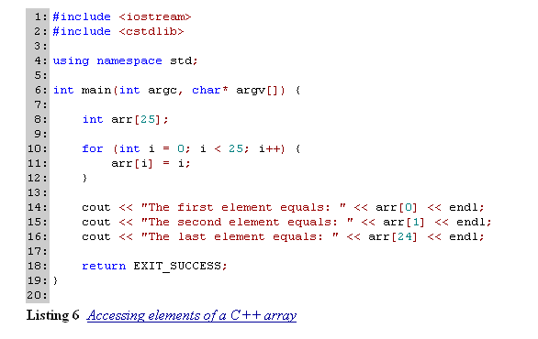
Example4

Slide 20
Vectors
The vector data type provides a much safer alternative to a basic C++ array. In C++, as in Java, vectors exist as feature-rich array.
For example, unlike an array in C++ a vector has a built in function that returns the size of the vector. Vectors also provide bounds checking support, and unlike arrays, they automatically increase in size when the need arises.

Slide 21
Creating New Data Type Names
It is possible in C++ for a programmer to create additional names for existing data types. Creating another name uses the keyword typedef. The syntax to create a new name is as follows.
typedef type-expression new-name;

Slide 22
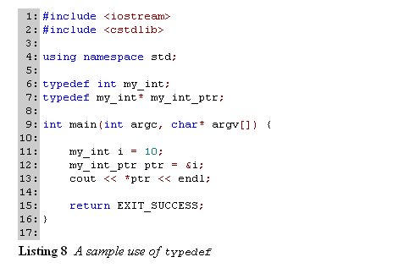
Example5

Slide 23
Specifying Classes
Basic Syntax
Constructors
The Destructor
Declaration vs. Definition

Slide 24
Basic Syntax
The class is the basic unit of abstraction in C++. As in Java, we can use classes to specify and then instantiate objects. The basic syntax involved in specifying a class and in instantiating an object differs between Java and C++. Let's look first at a simple class specified in Java, and then the corresponding version in C++.

Slide 25
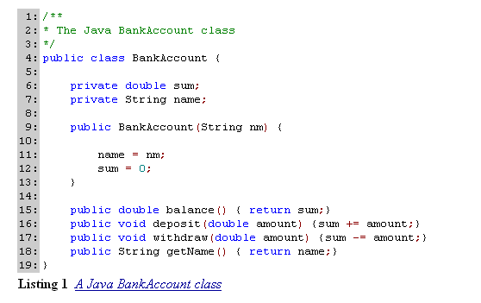
Example1 (Class in JAVA)

Slide 26
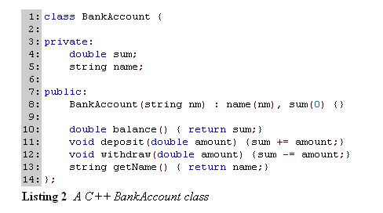
Example2 (Class in C++)

Slide 27
Constructors
Constructors are the methods of a class that define what actions to take when creating an object.
A C++ class can have multiple constructors. This allows variation in object instantiation since different numbers and types of parameters can exist in each constructor.

Slide 28
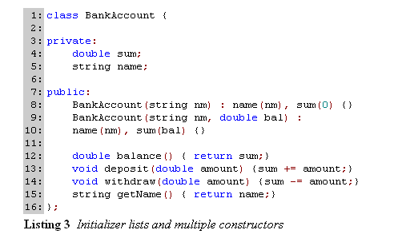
example3

Slide 29
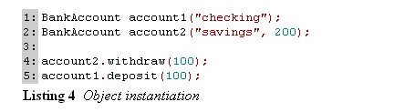
example4

Slide 30
The Destructor
A destructor is a special member function of a C++ class called when an object's lifetime ends.
Like a copy constructor, only one destructor can exist for a class. Since they execute when an object's lifetime ends, destructors typically define the actions necessary to release any resources that an object may be using.

Slide 31
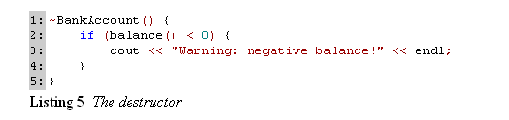
example5
Notes:
注意：必须使用构造函数来初始化对象；
构造函数和析构函数没有返回值；
析构函数没有参数；

Slide 32
Declaration vs. Definition
In this discussion on the specification of classes in C++, the term "definition" has been used regarding functions. When we "define" a function, we dictate the function's behavior through the code that exists within the curly braces.
The "declaration" of a function, on the other hand, only specifies the interface of the function. This interface includes the function name, the return type, and the list of parameters and their types.

Slide 33
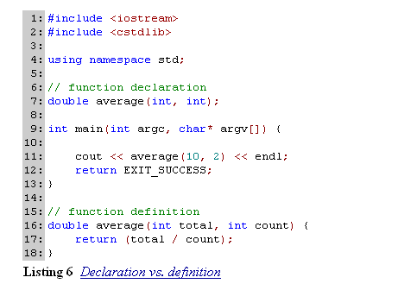
example6

Slide 34
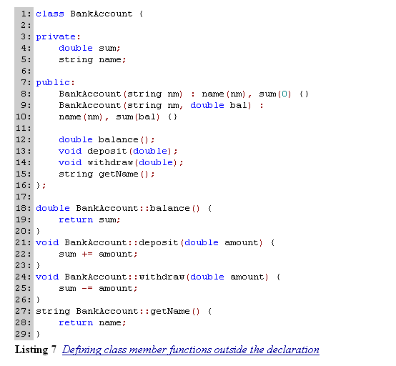
example7

Slide 35
内嵌函数
Class Cat
{
Public:
Cat ( int age);
~Cat();
int getAge() const {return itsAge;} //inline
oid SetAge (int age) {itsAge=age;}//inline
Private:
int itsAge;
};

Slide 36
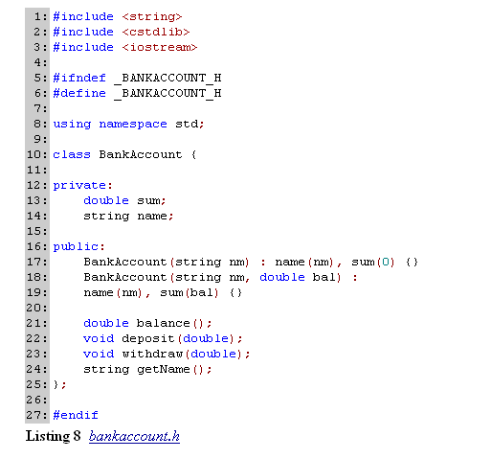
Example8-1
Notes:
注意: 类的声明告诉了编译器这个类是什么，有什么数据，有什么函数，所以类的声明称之为类的界面，通常保存在hpp文件中。
函数定义告诉编译器该函数的功能是什么，函数的定义称为类方法的实现，保存在cpp文件中。类的实现细节只是类的作者关心的事，类的客户不关心也不需要知道函数的实现。

Slide 37
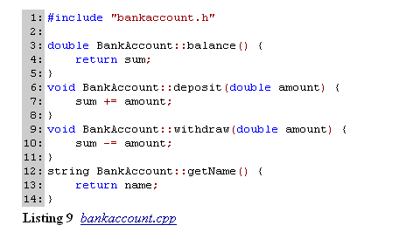
Example8-2

Slide 38
Input and Output
Streams
Using the Standard Streams
File Input and Output
Some Common Pitfalls

Slide 39
Streams
Input and output in C++ is based on the concept of a stream.
A stream is a sequence of bytes that flow from something to something else. The process of output involves moving bytes, one at a time, from a program to a device. This device could be a monitor, a printer, or even a file on a hard drive.
Input is the opposite. Input involves the flow bytes from a device (a keyboard, a file, a network connection) into the program.

Slide 40
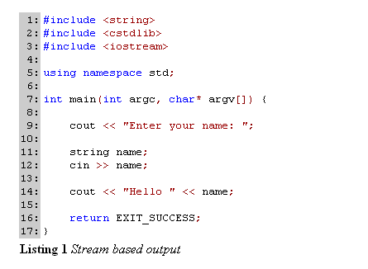
Exampl1

Slide 41
Using the Standard Streams
Three specific streams are always available throughout the lifetime of every C++ program.
  standard input, standard output, and standard error streams.
Each of these standard streams has a specific use. The standard input stream reads data from the console, the standard output stream writes data to the console, and the standard error stream displays error messages to the console.

Slide 42
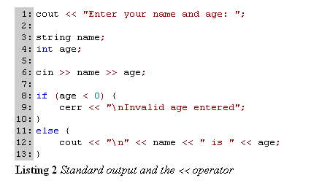
Example2

Slide 43
User-defined class
C++ programmers can define how the classes they create interact with streams using the << and >> operators. This is called operator overloading. Remember, stream classes define the insertion (<<) and extraction (>>) to operate in a special way, for many different data types.
Whether used with integers, floating point numbers, or strings, these operators output and format data accordingly. We can also define the behavior of these operators for classes that we create. This allows input and output code for user-defined classes to resemble input and output for built-in types.

Slide 44
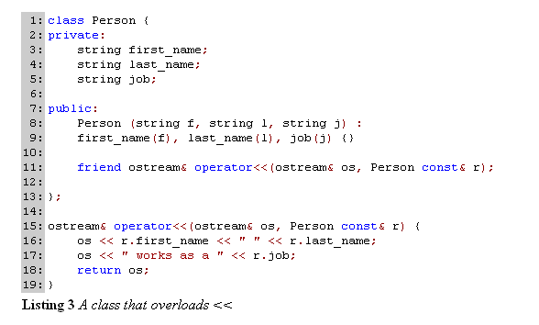
Example3-1

Slide 45


Eample3-2

Slide 46
File Input and Output
File based input and output is similar to the mechanisms for keyboard and screen I/O. The main difference is that programmers must explicitly open and close files.
In pseudocode, a generic program that reads input from a file might look like this.

Slide 47
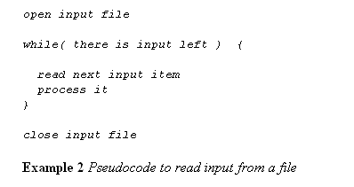
Example4-1

Slide 48
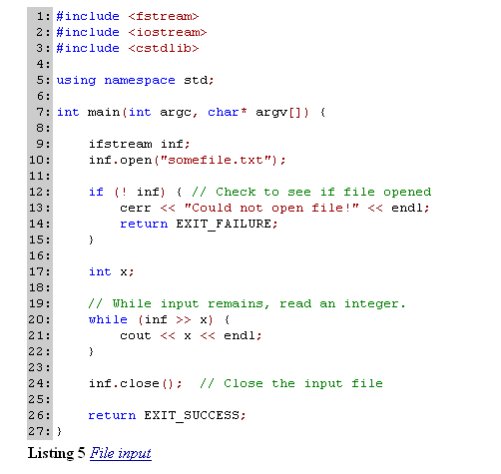
Example4-2

Slide 49
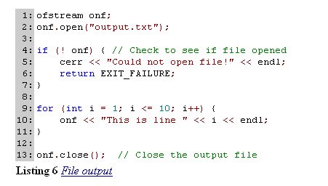
Example4-3

Slide 50
Some Common Pitfalls
Stream input expects white space to separate the values it reads. White space consists of spaces, horizontal and vertical tabs, new line, and carriage return characters. Many programmers new to C++ do not realize that stream input also ignores extra white space by default.
A common mistake for many new C++ programmers is to reverse the << and >> operators.

Slide 51
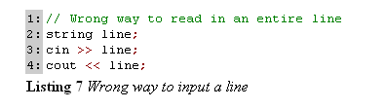
Pitfalls of I/O stream
Another common pitfall that most new C++ programmers encounter occurs when they try to read a line of text into a string variable.
Using the getline function found in the string library is the proper way to input an entire line of text.
char line[20];
cin.getline(line,20);

Slide 52
The Preprocessor
Text Substitution
File Inclusion
Macro Substitution
Conditional Compilation
An Example: Assumption Verification

Slide 53
Text Substitution
The preprocessor is a tool that C++ programmers use to manipulate the contents of source code files prior to compilation.

Slide 54
File Inclusion
File inclusion is a feature of the C++ preprocessor that allows a source code file to use shared code.
We consider shared code to be classes or functions declared in other files. In C++, we can only access a shared class or function by including its declaration into our program.

Slide 55
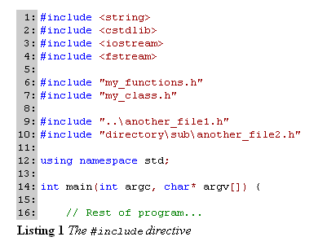
Example1

Slide 56
Macro Substitution
The C++ preprocessor can perform a programmer defined text substitution throughout an entire source code file. This is known as macro substitution.
Programmers define a macro using the #define preprocessor directive, which can take the following form.
#define identifier replacement-text
#define identifier(identifier, identifier, ...) replacement-text

Slide 57
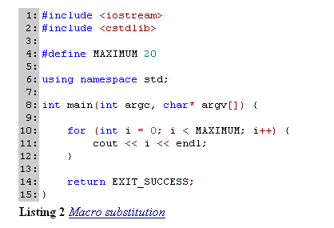
Example2-1

Slide 58
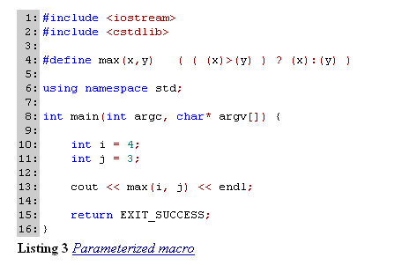
Example2-2
Notes:
#define ADD(a,b) a+b
test=c*add(a,b)*d;会被替换为test=c*a+b*d；

Slide 59
example
#include <iostream>
#include <cstdlib>
#define ADD(x,y) x+y
using namespace std;
int main() {
int x=3*ADD(1，2)*4
cout <<x<< endl;
return 0;
}
Notes:
希望结果36，实际11

Slide 60
Conditional Compilation
Beyond macro substitution, a more important reason to use #define is to support conditional compilation.
Using #define, and some other preprocessor directives, we can instruct the compiler to compile only certain sections of our source code. This is useful in many circumstances, one of which is for inserting debugging code that can be easily enabled and disabled.
Below we see an example that uses the #define, #if, and #endif directives.

Slide 61
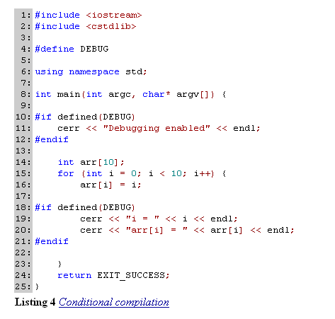
Example3

Slide 62
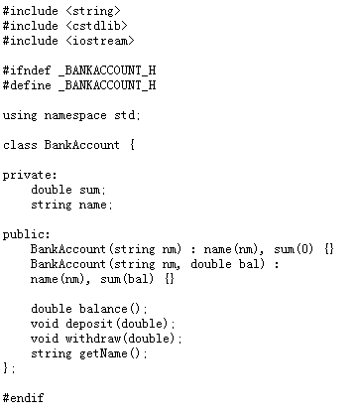
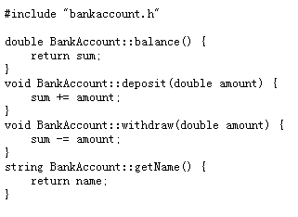
A side by side example
bankaccount.cpp
bankaccount.h

Slide 63
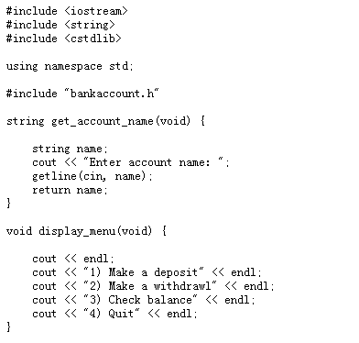
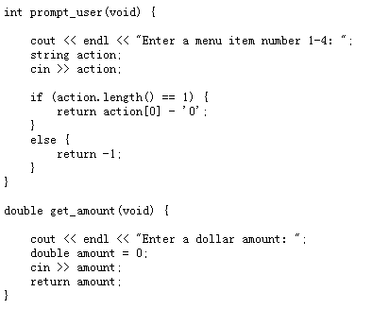
main.cpp-1

Slide 64
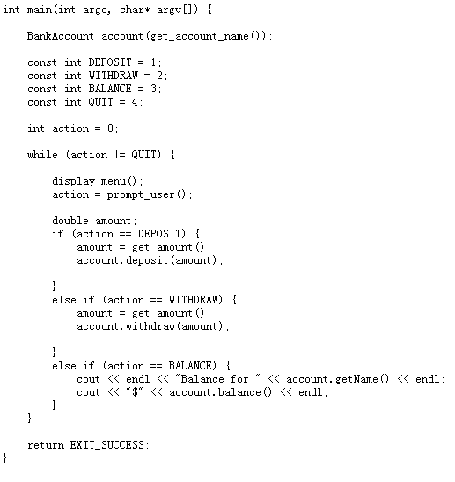
main.cpp-2

Slide 65
Memory Management
Pointers
Parameter Passing Mechanisms
Dynamic Memory Management

Slide 66
pointer
A pointer is a variable that stores the memory address of another variable.
A pointer variable is unique in that it stores the memory address of another variable.
A memory address is the specific location in main memory where a variable exists during program execution.

Slide 67
pointer
Programmers use pointers to indirectly access and manipulate other variables. This access and manipulation is considered "indirect" since it is accomplished using a pointer instead of the actual variable being modified.
Indirection allows the creation of complex data structures and powerful algorithms.
For instance, without pointers and indirection it would not be possible to create a linked list data structure.

Slide 68
Basic Operations of pointer
Declaration and Initialization
Dereference
Pointer Arithmetic

Slide 69

Declaration and Initialization
The declaration of a pointer variable requires the use of some unfamiliar syntax. A pointer declaration must prefix its variable name with an asterisk (*). This signifies to the compiler that the variable declared is a pointer.

Slide 70

Declaration and Initialization
Pointer initialization also requires some new syntax.
We cannot simply initialize a pointer to a non-pointer variable because pointers store memory addresses and not regular values.
Instead, we must obtain the memory address of the variable. The address-of (&) operator returns the memory address of where a variable is stored.

Slide 71
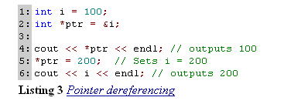
Dereference
Indirect access and manipulation of variables using pointers is accomplished using the dereference operator.
A programmer applies the dereference operator (*) to access or modify the value of the variable pointed to by a pointer.

Slide 72
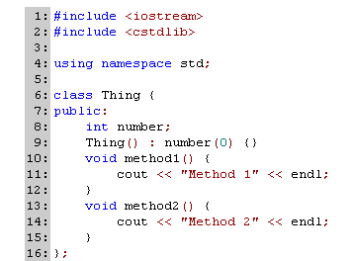
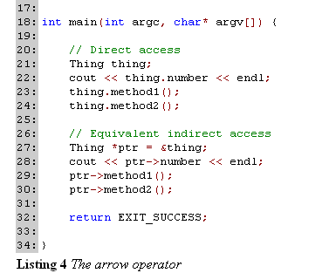
Example

Slide 73
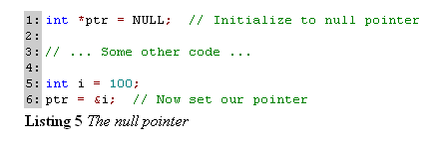
Dereference
We can only safely dereference pointers that point to valid memory addresses.
Dereferencing pointers that have not been initialized to valid memory addresses causes a run-time error. One technique used to avoid this problem is the initialization of pointer variables to the null pointer.

Slide 74
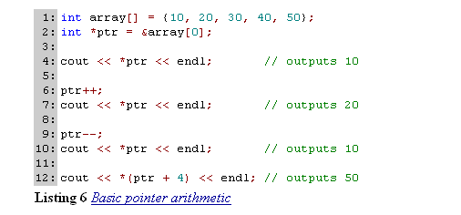
Pointer Arithmetic
Pointer arithmetic is the use of addition and subtraction to change the memory location that a pointer stores. These operations are all relative to the memory location currently stored in a pointer.

Slide 75
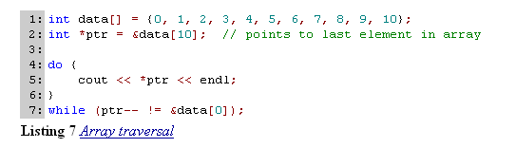
Example

Slide 76
Parameter Passing Mechanisms
Pass by Value
Pass by Reference
Pass by Pointer

Slide 77
Pass by Value
Pass by value is the default parameter passing mechanism in C++.
When a parameter is passed by value to a function, a copy of the parameter is created and given to the function. This is important, since if we make a change to a parameter that is passed by value, the original variable will remain unchanged.
Our change is made to a copy of the original variable.

Slide 78
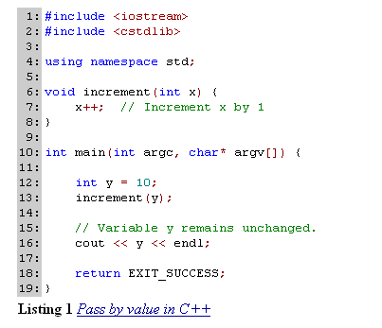
Example

Slide 79
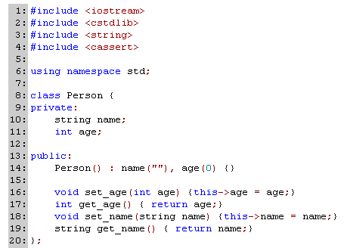
Pass by Value
C++ can also pass objects by value.

Slide 80
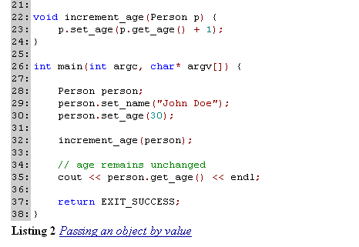
Example

Slide 81
Pass by Reference
Unlike pass by value, copies are not made of variables that are passed by reference.
Instead, a called function receives a reference, or alias, to the actual parameter supplied by the calling function.
For this reason, pass by reference is used to build functions that can modify the variables in the calling function.

Slide 82
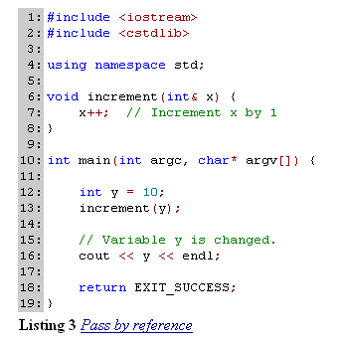
One common use of pass by reference is to create functions that can modify the variables passed to them by a calling function.

Slide 83
Pass by Reference
Passing a parameter by reference is also used as a mechanism to pass large objects to functions.
When objects are large, pass by value can result in time-consuming copy operations.
Pass by reference is more efficient because it does not involve copying.

Slide 84
#include <iostream>
using namespace std;
class Cat
{
public:
Cat();
Cat(Cat&);
~Cat();}
Cat::Cat()
{ cout<< "Cat Constructor..\n";}
Cat::Cat(Cat&)
{ cout<< "Cat copy Constructor..\n";}
Cat::~Cat()
{ cout<< "Cat Destructor..\n";}
Cat function1(Cat thecat);
Cat&function2(Cat& thecat);
int main()
{ cout<<"making cat..\n";
Cat frisky;
cout<<"calling function1..\n";
function1(frisky);
cout<<"calling function2..\n";
function2(frisky);
return 0;
}

Slide 85
making cat.. Cat Constructor.. calling function1.. Cat copy Constructor.. function1 return .. Cat copy Constructor.. Cat Destructor.. Cat Destructor.. calling function2.. function2 return .. Cat Destructor.. Press any key to continue

Slide 86
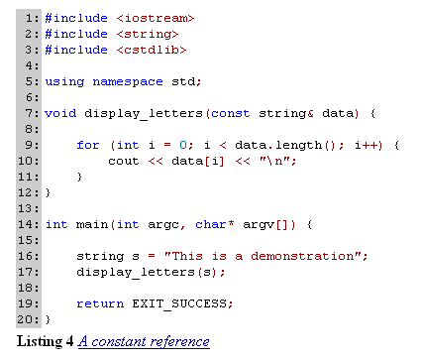
const reference

Slide 87
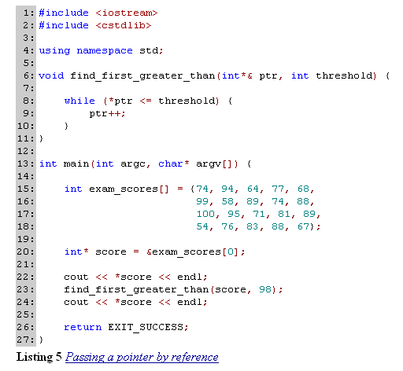
pass a pointer by reference

Slide 88
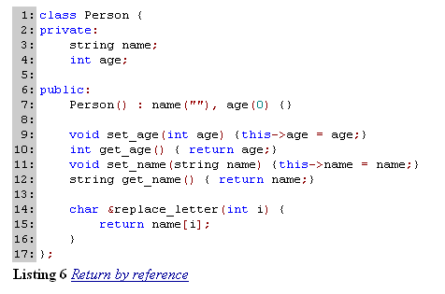
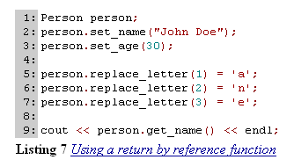
return by reference
Notes:
Jane Doe

Slide 89
#include<iostream>
using namespace std;
enum err_cod(sucess,error);
err_code factor(int,int&,int&);
int main()
{ int num,squ,cub;
err_cod result;
cout<<"enter a number(0-20):";
cin>>num;
result=factor(num,squ,cub);
if(result==sucess)
{cout<<"num: "<<num<<endl;
cout<<"squ: "<<squ<<endl;
cout<<"cub: "<<cub<<endl;}
else cout<<"error"<<endl;
return 0;
}
err_code factor(int n, int& rsqu,int& rcub)
{if(n>20) return error;
else{ rsqu=n*n;
rcub=n*n*n;
return sucess;
}
}
enter a number(0-20):3 num: 3 Squ: 9 Cub: 27

Slide 90
Cat &Function()
{
Cat Tom(5,9);
return Tom;
}//wrong
Notes:
在使用引用传递时不要返回不在作用域中的对象的引用

Slide 91
Dynamic Memory Management
The Free Store
Memory Allocation
Memory Deallocation
Copy Constructors
Some Common Pitfalls
  Memory Leaks
  Overwrites
  Using Deallocated Memory
  Deallocating Memory Twice

Slide 92
The free store
Variables created in the free store have dynamic extent. The extent of a variable describes how long a variable stays around in a program.
Another term commonly used in place of extent is lifetime.
Notes:
内存的5个区域 全局名字空间 自由存储区 寄存器 代码空间 栈

Slide 93

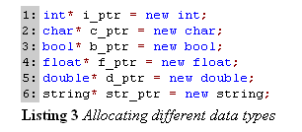
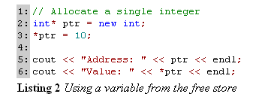
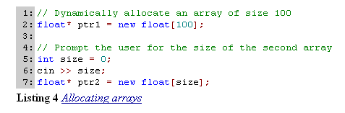
Memory Allocation
The process of obtaining memory from the free store is called memory allocation.
The operator new is used in C++ to allocate memory dynamically.

Slide 94
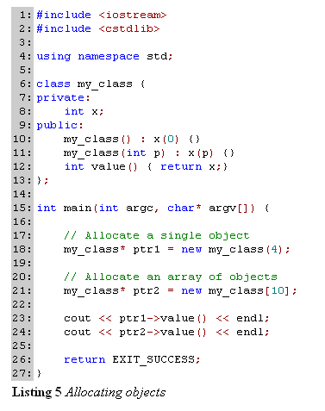
Memory
Allocation
Objects

Slide 95
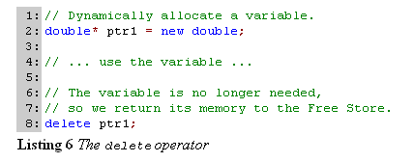
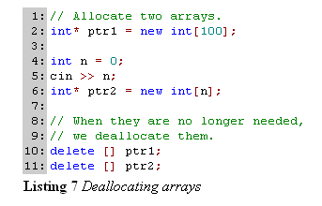
Memory Deallocation
The delete operator deallocates memory that is allocated using the new operator.

Slide 96
#include<iostream>
using namespace std;
int main()
{int var=5;
int* pLoc=&var;
int* pHeap=new int;
*pHeap=7;
cout<<var<<endl;
cout<<*pLoc<<endl;
cout<<*pHeap<<endl;
delete pHeap;
//pHeap=0;
pHeap=new int;
*pHeap=9;
cout<<*pHeap<<endl;
delete pHeap;
//pHeap=0;
return 0;}
5 5 7 9

Slide 97
#include<iostream>
using namespace std;
int main()
{int* pInt=new int;
*pInt=10;
cout<<*pInt<<endl;
delete pInt;
long* pLong=new long;
*pLong=0;
cout<<*pLong<<endl;
*pInt=20;//oh!
cout<<*pInt<<endl;
cout<<*pLong<<endl;
delete pLong;
return 0;
}
10 0 20 20

Slide 98
Copy Constructors
A copy constructor defines the actions that need to be taken to create a copy of an object.
Unlike regular constructors, a class can contain only one copy constructor.
If a C++ class does not define a copy constructor, the language provides to the class a default copy constructor.
This default copy constructor makes a byte-by-byte copy of the object.

Slide 99
Copy Constructors
Copy constructors are invoked whenever a copy of an object has to be made.
Three situations when copies of objects are made.
  During declaration that involves initialization
  When objects are passed by value
  When objects are returned by value

Slide 100


Example

Slide 101
Problem analysis
Old object
Free storage
New object
5
It’s member
variables
It’s member
variables
Default copy constructor
Old object
Free storage
New object
5
It’s member
variables
It’s member
variables
Missing pointer

Slide 102
Analysis: deep copy
Free storage
5
Old object
New object
5
It’s member
variables
It’s member
variables
Deep copy

Slide 103


Copy
Constructors
shallow copy
deep copy.

Slide 104


Some Common Pitfalls
Return
Memory Leaks
Overwrites
Using Deallocated Memory
Deallocating Memory Twice

Slide 105
Mechanisms for Code Reuse and Abstraction
Inheritance
Polymorphism
Templates
Exception Handling

Slide 106
Inheritance
Inheritance is a mechanism in C++ that facilitates abstraction and code reuse.
Inheritance establishes the "is-a" relationships between the classes contained in a program.
Using inheritance, new classes can be built based on old classes, allowing child classes to share data members and functions of the parent class. It is through these relationships that the advantages of data abstraction (generalization and specialization) emerge.

Slide 107

Example
C++ Inheritance

Slide 108
Inheritance
C++ and Java differ slightly in the data members that child classes inherit from their parents. In C++, a child class inherits all non-private data members including constructors. A child class in Java, however, inherits from its parent class all non-private data members except constructors. In both languages, child classes inherit all the non-private data members. In C++, this includes public and protected data members.

Slide 109

Example

Slide 110
inheritance
C++ contains three types, or levels, of inheritance:
  public,
    use public inheritance to model the "is-a" relationship of two classes.
  private,
  protected
    model a different type of relationship, namely the "uses-a" relationship.
    ®
Notes:
作为设计的一般规则，应该保持类的成员数据为私有，同时提供共有的访问函数来设置和获取私有成员变量

Slide 111
#include<iostream>
enum BREED{GOLDEN,CAIRN};
using namespace std;
class mammal{ public:
mammal();
~mammal();
int getage() const{return age;}
void setage(int i){age=i;}
protected:int age;};
class dog:public mammal{
public:
dog();
~dog();
BREED getbreed() const
{return breed;}
void setbreed(BREED b)
{breed=b;}
protected:
BREED breed;};
mammal constructor
dog constructor
fido age is 1
dog destructor
mammal destructor
mammal::mammal():age(1)
{cout<<"mammal constructor"<<endl;}
mammal::~mammal()
{cout<<"mammal destructor"<<endl;}
dog::dog():breed(GOLDEN)
{cout<<"dog constructor"<<endl;}
dog::~dog(){cout<<"dog destructor"<<endl;}
int main()
{ dog fido;
cout<<"fido age is "<<fido.getage()<<endl;
return 0;}

Slide 112
Multiple inheritance
Sub-class is derived from multiple base classes.
Syntax
class <sub_class>: public <base_class1>,<base_class2>
{
…
}
Example
Horse
Bird
Pegasus

Slide 113
Problems of multiple inheritance
Constructors?
  All of the constructor of all base classes
Ambiguous function calling?
  Using specific domain

Slide 114
#include<iostream>
enum COLOR{GOLDEN,RED};
using namespace std;
class horse{public:
horse(COLOR c,int w):color(c),weight(w)
{cout<<"horse construction "<<endl;}
~horse(){cout<<"horse destruction "<<endl;}
int getweight() const{return weight;}
COLOR getcolor() const{return color;}
void setweight(int i){weight=i;}
protected:COLOR color;
int weight;};
class bird{public:
bird(COLOR c,bool m):color(c),migrate(m)
{cout<<"bird construction "<<endl;}
~bird(){cout<<"bird destruction "<<endl;}
COLOR getcolor() const{return color;}
void setcolor(COLOR b){color=b;}
protected:
COLOR color;
bool migrate;};
class pegasus:public horse,public bird
{public:pegasus(COLOR c, int w, bool m, int h)
:horse(c,w),bird(c,m),height(h)
{cout<<"pegasus construction "<<endl;}
~pegasus(){cout<<"pegasus destruction "<<endl;}
int getheight() const {return height;}
protected:int height;};
int main()
{ pegasus p(RED,5,true,50);
cout<<p.getheight()<<endl;
//cout<<p.getcolor()<<endl;
return 0;}
horse construction
bird construction
pegasus construction
50
pegasus destruction
bird destruction
horse destruction
®
Notes:
注意在主程序中的getcolor函数在horse和bird中都有这样的函数，因此编译时会报错，正确的方法是指明要调用哪个基类的成员方法，可以写为p.horse::getcolor();

Slide 115
Problems
Animal
Animal
Horse
Bird
Pegasus
如果Animal中有个成员变量age和一个成员函数getage()，如果调用P.getage()，那么究竟是通过Horse还是通过Bird来调用从Animal中继承的getage()方法？

Slide 116
Problems
…
class pegasus: public Horse, public Bird
{ public:
pegasus(COLOR c, int w, bool m, int h, int a):horse(c, h, a), bird(c, m, a), height(h){cout<<“pegasua constructor”<<endl;}
~pegasus(){cout<<“pegasus destructor”<<endl;}
int getage() const {return Horse::getage();}
int getheight() const {return height;}
private: height;}
int main()
{pegasus p(RED,5,true,10,2);
cout<<“p age is ”<<p.getage()<<endl;
return 0;}
Animal constructor
horse constructor
Animal constructor
bird constructor
pegasus constructor
p age is 2
pegasus destructor
bird destructor
animal destructor
horse destructor
animal destructor
如果要在pegasus对象中调用getage()方法，就必须明确或完全限定这个方法。

Slide 117
Virtual inheritance
Diamond inheritance
可以通过虚继承的方法告知C++你不想使用共享基类的两个副本，而只想共享一个基类
Animal
Horse
Bird
Pegasus

Slide 118
Virtual inheritance
class animal{…};
class horse: virtual public animal{…};
class bird: virtual public animal{…};
class pegasus: public horse, public bird{…};
int main()
{pegasus p(RED,5,true,10,2);
cout<<“p age is”<<p.getage()<<endl;
return 0;}
Animal constructor
horse constructor
bird constructor
pegasus constructor
p age is 2
pegasus destructor
bird destructor
horse destructor
animal destructor
®

Slide 119
Polymorphism
A Mechanism for Abstraction
  polymorphism is the ability of an object to take on several different forms.
    Functions override
  polymorphism allows a programmer to refer to an object of one class as an object of another class.
    Class inheritance

Slide 120
Polymorphism
First, we can create collections of heterogeneous objects. We can operate on the individual objects in these collections as if they were all of the same type, without the objects losing their real identities.
Account[] accounts = { new CheckingAccount("Fred", 500, 100), new SavingsAccount("Wilma", 1000, 0.03), new CheckingAccount("Barney", 200, 100), new BondAccount("Betty", 2000, 0.07) }; for (int i = 0; i < 4; ++i) { System.out.println(accounts[i].showBalance()); }
Listing 1 Polymorphism in Java

Slide 121
Polymorphism
Second, we can code algorithms that make only minimal assumptions about the objects they manipulate. This can allow an algorithm to continue to function correctly even when a programmer introduces new child classes into the system.

Slide 122
Functions override
Example
  Traditional method
  int Double(int);
  long Double(long);
  float Double(float);
  double Double(double);
  Function overload
  int Double(int);
  long Double(long);
  float Double(float);
  double Double(double);
当派生类用与基类的成员函数相同的返回值和签名，但却用新的实现方法创建一个函数时，就称为覆盖了该方法。其中签名指的是函数名，参数表和可能的关键字const。

Slide 123
#include<iostream>
using namespace std;
class mammal{
public:
mammal():{cout<<"mammal constructor"<<endl;}
~mammal(){cout<<"mammal destructor"<<endl;}
void speak() const {cout<<"mammal sound"<<endl;}
protected:
int age;};
class dog:public mammal{
public:
dog(){cout<<"dog constructor"<<endl;}
~dog(){cout<<"dog destructor"<<endl;}
void speak() const{cout<<"dog sound"<<endl;}
protected:
int height;};
int main()
{ mammal pig;
dog fido;
pig.speak();
fido.speak();
return 0; }
mammal constructor
mammal constructor
dog constructor
mammal sound
dog sound
dog destructor
mammal destructor
mammal destructor

Slide 124
重载&覆盖
“overload(重载)”：
overload方法时参数类型、个数、顺序至少有一个不相同；
不能overload只有返回值不同的方法名；
overload存在于父类和子类、同类中。
“override（覆盖）”
override时，方法名、参数、返回值相同；
子类方法不能缩小父类方法的访问权限；
子类方法不能抛出比父类方法更多的异常（但子类方法可以不抛出异常）；
override存在于父类和子类之间。

Slide 125
隐藏基类方法
#include<iostream>
using namespace std;
class mammal{
public:
mammal():{cout<<"mammal constructor"<<endl;}
~mammal(){cout<<"mammal destructor"<<endl;}
void speak() const {cout<<"mammal sound"<<endl;}
void speak(int i) const {cout<<"mammal "<<i<<" sound"<<endl;}
protected:
int age;};
class dog:public mammal{
public:
dog(){cout<<"dog constructor"<<endl;}
~dog(){cout<<"dog destructor"<<endl;}
void speak() const{cout<<"dog sound"<<endl;}
protected:
int height;};
®
int main()
{ mammal pig;
dog fido;
pig.speak();
pig.speak(2);
fido.speak();
//fido.speak(2);
return 0; }
mammal constructor
mammal constructor
dog constructor
mammal sound
mammal 2 sound
dog sound
dog destructor
mammal destructor
mammal destructor
Notes:
规则：一旦覆盖了一个重载的方法，那么对这个方法的所有同名方法都被隐藏了，如果不想隐藏它们，则必须将它们全部覆盖。

Slide 126
调用基方法
#include<iostream>
using namespace std;
class mammal{
public:
mammal():{cout<<"mammal constructor"<<endl;}
~mammal(){cout<<"mammal destructor"<<endl;}
void speak() const {cout<<"mammal sound"<<endl;}
void speak(int i) const {cout<<"mammal "<<i<<" sound"<<endl;}
protected:
int age;};
class dog:public mammal{
public:
dog(){cout<<"dog constructor"<<endl;}
~dog(){cout<<"dog destructor"<<endl;}
void speak() const{cout<<"dog sound"<<endl;}
protected:
int height;};
int main()
{ mammal pig;
dog fido;
pig.speak();
pig.speak(2);
fido.speak();
fido.mammal::speak(2);
return 0; }
mammal constructor
mammal constructor
dog constructor
mammal sound
mammal 2 sound
dog sound
mammal 2 sound
dog destructor
mammal destructor
mammal destructor

Slide 127
Polymorphism in C++
The approach taken to achieve this goal in C++ is the same as in Java. Programmers invoke overridden methods of a child class via an ancestor class. In C++, we use virtual functions in conjunction with pointers to access objects polymorphically.
®
Notes:
在C++中,所谓多态,就是用指向基类的指针,通过虚函数特性,去执行子类的对应的函数.

Slide 128


How to use polymorphism?
®

Slide 129


Solution of polymorphism-1
using virtual functions

Slide 130

Solution of polymorphism-2
We could also have modified Shape by making area() not just virtual but also totally undefined. A function of this sort is called a pure virtual function.

Slide 131
Pure virtual function
A class that contains a pure virtual function is known as an abstract class.
Implementations in C++ only use abstract classes in conjunction with inheritance.
programmers never create instances of abstract classes.
merely to specify the common interface of child classes and to access these child classes polymorphically.

Slide 132


Slicing problem
®
注意：虚函数只对指针和引用有效，按值传递对象不允许调用虚函数，原因是按值传递时会发生数据切片。

Slide 133
class Mammal
{public:
Mammal():itsAge(1) { }
virtual ~Mammal() { }
virtual void Speak() const { std::cout << "Mammal speak!\n"; }
protected:
int itsAge;
};
class Dog : public Mammal
{public:
void Speak()const { std::cout << "Woof!\n"; }
};
class Cat : public Mammal
{public:
void Speak()const { std::cout << "Meow!\n"; }
};
void ValueFunction (Mammal m) {m.speak();}
void PtrFunction (Mammal* pm) {pm->speak();}
void RefFunction (Mammal& rm) {rm.speak();}
int main()
{
Mammal* ptr=0;
int choice;
while (1)
{
bool fQuit = false;
std::cout << "(1)dog (2)cat (0)Quit: ";
std::cin >> choice;
switch (choice)
{case 0: fQuit = true; break;
case 1: ptr = new Dog; break;
case 2: ptr = new Cat; break;
default: ptr = new Mammal; break;}
if (fQuit) break;
PtrFunction(ptr);
RefFunction(*ptr);
ValueFunction(*ptr);
}
return 0;
}

Slide 134
输出：
（1）dog (2)cat (0)quit: 1
Woof
Woof
Mammal speak!
（1）dog (2)cat (0)quit: 2
Meow
Meow
Mammal speak!

Slide 135

可以采用指针数组来解决Listing 3中的问题。

Slide 136
虚析构函数
一般规律：如果类中有虚函数，那么析构函数就应该是虚函数

Slide 137
#include <iostream>
using namespace std;
class ClxBase
{public:
ClxBase() { }
virtual ~ClxBase() {cout<<"ClxBase destructor"<<endl;}
virtual void DoSomething() { cout << "Do something in class ClxBase!" << endl; }};
class ClxDerived : public ClxBase
{public:
ClxDerived() { }
~ClxDerived() { cout << "ClxDerived destructor " << endl; }
void DoSomething() { cout << "Do something in class ClxDerived!" << endl; }};
int main()
{ClxBase *pTest = new ClxDerived;
pTest->DoSomething();
delete pTest;
pTest=0;
return 0;}
Do something in class ClxDerived ！
ClxDerived destructor
ClxBase destructor
Do something in class ClxDerived ！
ClxBase destructor
®
Notes:
只有基类的类的析构函数是虚函数时，用一个基类的指针删除一个派生类的对象时，派生类的析构函数才会被调用。

Slide 138
Suggestions
In order to obtain polymorphic behavior, we need to
  deal with pointers rather than direct objects because of slicing
  declare member functions to be virtual

Slide 139


Templates
Template Functions
  Allow a programmer to apply the logic of a function to more than one data type.
®

Slide 140

Using Template Functions
®

Slide 141

Incorrectly Using Template Functions

Slide 142

Using Template Functions

Slide 143


Template Classes
A template class in C++ is a class whose definition is independent of a specific data type.

Slide 144

Example

Slide 145
Template Classes
就像函数模版一样，一个类模版也可以有几个模版参数，此外，它们中的一部分还可以是普通类型的参数。例如：
Template<class T, int n,class U>class X{…}
注意：模版在编译时实例化，传递给非参数化类型参数的值必须是常量。

Slide 146
example
Template<class T, int n>
Class X{…};
int main()
{ X<float ,22> x1;//ok
const int n=44;
X<char,n> x2;//ok
int m=66;
X<short,m> x3;//wrong
}

Slide 147


Templates typedef

Slide 148
Exception Handling
C++ Exception Handling Fundamentals
The C++ Standard Exception Hierarchy
Using Intermediate Handlers
Summary of Best Practices

Slide 149

C++ Exception Handling Fundamentals (try & catch)
C++ exception handling centers around the use of the try keyword and the catch keyword.
Example

Slide 150

throw
C++ programmers trigger exceptions using the throw statement.
In a throw statement, a programmer specifies the exception to trigger following the keyword throw.
Example
®

Slide 151

Exception Handling
A function can transfer execution to a catch statement that exists in another function.
Example

Slide 152

Exception Handling
C++ provides a mechanism to catch exceptions of all possible types.
A catch block whose argument contains ellipsis catches all exceptions. This is useful in situations where a programmer wants to ensure that all possible exceptions are caught.
Example

Slide 153

The C++ Standard Exception Hierarchy
Figure 1 The standard exception hierarchy

Slide 154
Two typical exceptions
The bad_alloc and out_of_range exceptions are two standard exceptions that we pay careful attention to in this course.
  Exception bad_alloc is thrown by the new operator whenever memory cannot be allocated as requested.
  Exception out_of_range is thrown by the member function at of type vector when an element whose index is out of range s requested.

Slide 155
Catching standard exception objects by reference allows a programmer to handle exceptions polymorphically.
This is useful since it allows a catch block to handle an entire group of exceptions from the standard exception hierarchy.
For instance, catching class runtime_error by reference catches exceptions of type runtime_error and all descendents of type runtime_error. A catch block that catches class exception by reference will catch all exceptions in the standard exception hierarchy.

Slide 156

Tips
This interfaces function returns a string describing the type of the invoking exception object.

Slide 157

Tips
Extend the standard exception hierarchy by defining their own exception classes that inherit from one of the standard exception classes.

Slide 158
From a software engineering perspective, creating custom exception classes that extend the standard exception hierarchy is a good practice.
This allows a programmer to work with their user-defined exceptions and the standard exceptions in the same manner since they both share the same interface.
User-defined exception classes are also useful since they can be programmed to store information about the state of a program when the exception occurred.

Slide 159

Exception Specification
An exception specification guarantees the types of exceptions that a function can throw.
®
Notes:
C++程序员应该谨慎的使用异常指定，它可能会给你带来麻烦，例如一个子类希望重载父类的一个成员方法，但是父类的该方法进行了异常指定，这可能会对子类的方法重载造成困难，例如，子类希望能够抛出out_of_range异常，而在父类的成员方法中却指定了只抛出length_error异常。

Slide 160

Standard Exception Hierarchy
The main routine of a program that handles exceptions using the standard exception hierarchy typically should follow a standard format.

Slide 161

Problem
Analyze the undesired exception handling

Slide 162

Using Intermediate Handlers
Intermediate exception handlers are exception handlers that catch an exception, deallocate some resource, and immediately rethrow the exception.
Example

Slide 163
Summary of Exception Handling
Best Practices
Include all code that might throw exceptions in try blocks
Handle exceptions where it is known how to recover from the exception
Catch exceptions by reference
Use exception specifications only for non-virtual functions that throw specific exceptions
Create user-defined exception classes that extend the standard exception hierarchy
In main, wrap all code in a try block, catch class exception and catch all exceptions
Use intermediate exception handlers to avoid leaking memory

Slide 164
Summary
C++ fundamentals
Class & object
Memory management
Inheritance
Polymorphism
Template
Exception handling
Standard template library (STL)

Slide 165
Introduction to the Standard Template Library
STL Overview
Containers
Iterators
Algorithms

Slide 166
STL Overview
The library is organized into three main abstractions
  Containers
  Iterators
  Algorithms
®

Slide 167
Detail of containers
The containers include strings, vectors, lists, sets, stacks, and the like.
The containers are organized as a collection of independent C++ classes.
All the STL containers classes are template classes.
®

Slide 168



Containers

Slide 169
Iterators
Iterators provide a uniform interface between containers and algorithms in the STL.
Iterators are modeled after plain C++ pointers.
In particular, operators operator*, operator++ and so forth are properly overloaded, so that the use of iterators is very similar to the use of pointers.

Slide 170


Iterators
®

Slide 171
Algorithms
The core of the STL is its extensive collection of algorithms.
  Insertion
  Removal
  Modification
  Traversal
  Replacement
  Sorting
  ……

Slide 172

Example of Algorithms

