Slide 1
Topics in Computer and Communication Networks: Cloud Computing
COMP660L Fall 2009 HKUST
Lin Gu (lingu@cse.ust.hk)
Sept 3, 2009
Notes:
Short sentences

Slide 2
Logistics
About guest lecture by Dr. Mao
  May be scheduled to the morning of Sept. 18
About projects

Slide 3
Internet-Scale Computing
We know how to solve “some” problems on a global scale
  Example: DNS, MAC and IP assignment, web search, web email, …
Each web search query essentially involves an Internet of data
  Main players: AltaVista, Inktomi, Google
  Conservatively assume 20 billion web documents, 4KB/doc → 80TB data
  “grep” would take more than one day on extremely fast hard drives. Traditional RDB? Probably slower.
What if we had only half a second?

Slide 4
How to Search for a “Planet”?
  Luiz Andre Barroso, Jeffrey Dean, Urs Holzle. Web Search for a Planet: The Google Cluster Architecture. IEEE Micro, vol. 23, no. 2, pp. 22-28, Mar./Apr. 2003
  Michael Armbrust, Armando Fox, Rean Griffith, Anthony D. Joseph, Randy Katz, Andy Konwinski, Gunho Lee, David Patterson, Ariel Rabkin, Ion Stoica, and Matei Zaharia. Above the Clouds: A Berkeley View of Cloud Computing. UC Berkeley Technical Report UCB/EECS-2009-28, Feb., 2009.
  Birman, K., Chockler, G., and van Renesse, R. Toward a cloud computing research agenda. SIGACT News 40, 2 (Jun. 2009), 68-80.

Slide 5
How to Search for a “Planet”?
The system builds up from commodity components
Hundreds of engineers, years of hard work, and innovation
The system must scale
  The search-oriented architecture evolves to support new online services such as social network
Many parts of the system are different from traditional distributed system solutions
  “Compatibility” is a non-goal and non-concern

Slide 6
A Closer Look at the Problem
Indices
  Index the data to transform 80TB raw data to multiple TBs of inverted index
  Each query “only” reads hundreds of MBs of data
  Results returned for each indexed term are merged and ranked
Still a significant computation task
  Billions of CPU cycles
Must handle thousands of queries per second at peak
  Conservatively assume: 1B Internet users, each issuing one search per day → 11574 queries per second
How many machines do we need? Can we synchronize them?
In addition, enormous computation for constructing the index

Slide 7
Google’s Cluster Architecture
Goals
A high-performance distributed system for search
  Thousands of machines collaborate to handle the workload
Price-performance ratio
Scalability
Energy efficiency and cooling
High availability
  Luiz Andre Barroso, Jeffrey Dean, Urs Holzle. Web Search for a Planet: The Google Cluster Architecture. IEEE Micro, vol. 23, no. 2, pp. 22-28, Mar./Apr. 2003

Slide 8
Google’s Cluster Architecture
Parallelism
Crucial to performance (both throughput and latency)
Data centric parallelization
  MapReduce
  Data dependence
Goals
A high-performance distributed system for search
Price-performance ratio
Scalability
Energy efficiency and cooling
High availability

Slide 9
Google’s Cluster Architecture
Reliability from software
Hardware is unreliable commodity PCs
  Good for price-performance ratio
Reliability from redundancy
  Replicate data and function
Automatically handles failure
Goals
A high-performance distributed system for search
Price-performance ratio
Scalability
Energy efficiency and cooling
High availability

Slide 10

Query Processing
San Jose
How to serve a query
  The browser issues a query
  DNS lookup
  HTTP request
  GWS
  Backend
  HTTP response
Google.com
London
Hong Kong
HTTP
HTTP
GWS
GWS
GWS
GWS
GWS
Backend

Slide 11
Query Processing
Query backend and query execution
  Index server → Hit lists
  Intersection
  Calculate relevance scores and rank
  Document servers: form title, URL, summary (snippet)
  Ancillary tasks (e.g., spelling check)
  And ads inserted ☺
Goals
A high-performance distributed system for search
Price-performance ratio
Scalability
Energy efficiency and cooling
High availability
Question: how many servers would allocate for the index server conclomorate? How many for document servers, spell checking, etc?

Slide 12
Query Processing
Scalable architecture (relate to parallelism)
  Data partitioning and replication
    Shards and replica
  Data (documents, indices) increase → add shards
  User base expands → add machines for each shard
Goals
A high-performance distributed system for search
Price-performance ratio
Scalability
Energy efficiency and cooling
High availability
Question: How about latency? Would latency increase with the multiple-tier query processing? How long is the latency like?

Slide 13
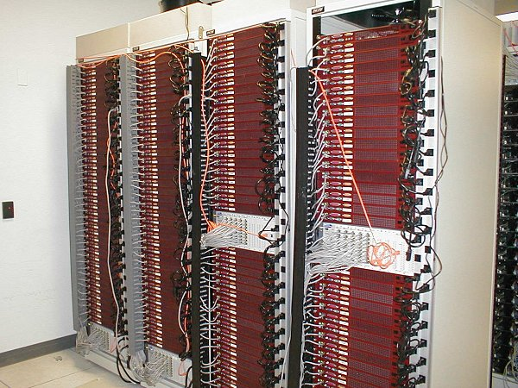
Hardware
Based on commodity x86 products
Racks of servers
  40—80 servers/rack
  Each rack has two sides, about 40u/side
  Not targeting the top performance servers. “large” (80GB) hard drives
Expect servers to work for two or three years

Slide 14
Hardware
Switches
  Each side of a rack has a 100Mbps Ethernet switch that connects to a core gigabit switch via one or two gigabit uplinks
  The core gigabit switch connects all racks together
Routing
Fiber links
Numbers are for reference only.

Slide 15
Energy Efficiency
Goals
A high-performance distributed system for search
Price-performance ratio
Scalability
Energy efficiency and cooling
High availability
Calculation
  PC: 90W DC, 120W AC
  Rack: 10KW
  Power density: 400W/square ft
    700W/square ft or more for high-end servers
  Typical datacenter’s power density: 150W/squre ft.
Solution: cooling and/or additional space
Reducing power consumption also lowers operational cost

Slide 16
Availability
Fault tolerance
  Multiple levels of load balancing, sharding, and replication
Disaster recovery
  Highly distributed geographically
Goals
A high-performance distributed system for search
Price-performance ratio
Scalability
Energy efficiency and cooling
High availability

Slide 17
Summary
Review the goals
A high-performance distributed system for search
  Hardware, networking, parallelization, software
Price-performance ratio
  Commodity PC servers, software reliability
Scalability
  Sharding, replication
Energy efficiency and cooling
High availability
  Redundancy, automatic fail over, globally distributed system
Goals accomplished?

Slide 18
Summary
Design for price-performance ratio
Data centric parallelization
  Abundant thread-level parallelism
  Achieves very high throughput and low latency
Partition and replicate data and logic
  For reliability and performance
Multi-level load balancing
“Simple” is beautiful
Orchestrate global computing resources for global users

Slide 19
Questions and Limitations
How close are we to a good cloud computing infrastructure?
Like any systems, the Google system as described in the paper, has limitations
Can we improve?

Slide 20
Questions and Limitations
Update friendliness
  The consistency of the system relies on the fact that frequent data accesses (e.g., querying the index servers) are reads
Timeliness
  Multiple levels of load balancing, sharding, and replication
Hardware
  Is the current hardware hierarchy the ultimate design for Internet-based computing?

Slide 21
Questions and Limitations
Architecture
  Multiple-issue out-of-order execution is “beyond the point of diminishing return”. What architectural designs can help further enhance the performance?
  The paper provides a few speculations
Data dependence
  The limitation of sharding
General review of the design context
  Has the design context changed?
Ultimate solution?

Slide 22
Summary
The Google search system is a good example of solutions to Internet-scale problems
Today, many applications are more complex than search
There are many new challenges and opportunities when we gradually implement the idea of cloud computing

