Slide 1
Topics in Computer and Communication Networks: Cloud Computing
COMP660L Fall 2009 HKUST
Lin Gu (lingu@cse.ust.hk)
Sept 8. and Sept.10, 2009
Notes:
Short sentences

Slide 2
Above the Clouds
  Luiz Andre Barroso, Jeffrey Dean, Urs Holzle. Web Search for a Planet: The Google Cluster Architecture. IEEE Micro, vol. 23, no. 2, pp. 22-28, Mar./Apr. 2003
  Michael Armbrust, Armando Fox, Rean Griffith, Anthony D. Joseph, Randy Katz, Andy Konwinski, Gunho Lee, David Patterson, Ariel Rabkin, Ion Stoica, and Matei Zaharia. Above the Clouds: A Berkeley View of Cloud Computing. UC Berkeley Technical Report UCB/EECS-2009-28, Feb., 2009.
  Birman, K., Chockler, G., and van Renesse, R. Toward a cloud computing research agenda. SIGACT News 40, 2 (Jun. 2009), 68-80.

Slide 3
Above the Clouds
Overview of cloud computing
Definitions
Reviews of several technical topics
Research problems
Open questions
It is worth reviewing many statements and speculations in this paper. We may have different views on some of them.

Slide 4
What is Cloud Computing?
A few statements
  Cloud Computing, the long-held dream of computing as a utility, has the potential to transform a large part of the IT industry, making software even more attractive as a service and shaping the way IT hardware is designed and purchased.
  Cloud Computing refers to both the applications delivered as services over the Internet and the hardware and systems software in the datacenters that provide those services.
  An old idea whose time has come

Slide 5
More Definitions
The services provided to users: Software as a Service (SaaS).
The datacenter hardware and software: Cloud.
Pay-as-you-go Cloud available to the general public: Public Cloud
The service being sold: Utility Computing.
Internal datacenters of a business or other organization: Private Cloud
Cloud Computing: the sum of SaaS and Utility Computing, but does not include Private Clouds.
SaaS Providers: Cloud Users
The organization that provides compute and communication infrastructure for a cloud system: Cloud Providers

Slide 6
More Definitions
The hardware point of view
The illusion of infinite computing resources available on demand
The elimination of an up-front commitment by Cloud users
  Allowing companies to start small and increase hardware resources only when there is an increase in their needs.
The ability to pay for use of computing resources on a short-term basis as needed (e.g., processors by the hour and storage by the day) and release them as needed

Slide 7
More Statements
“Any application needs a model of computation, a model of storage, and a model of communication.”
“… the construction and operation of extremely large-scale, commodity-computer datacenters at lowcost locations was the key necessary enabler of Cloud Computing, for they uncovered the factors of 5 to 7 decrease in cost of electricity, network bandwidth, operations, software, and hardware available at these very large economies.”

Slide 8
More Statements
“The statistical multiplexing necessary to achieve elasticity and the illusion of infinite capacity requires each of these resources to be virtualized to hide the implementation of how they are multiplexed and shared.”
“We predict Cloud Computing will grow, so developers should take it into account.”
“… a necessary but not sufficient condition for a company to become a Cloud Computing provider is that it must have existing investments not only in very large datacenters, but also in large-scale software infrastructure and operational expertise…”

Slide 9
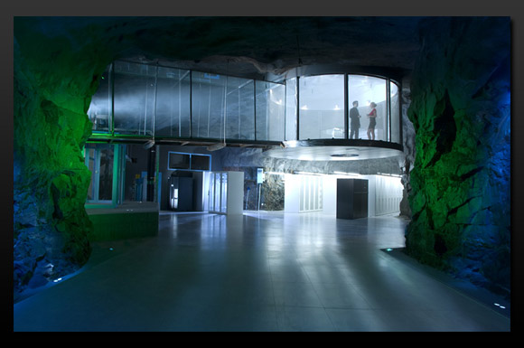
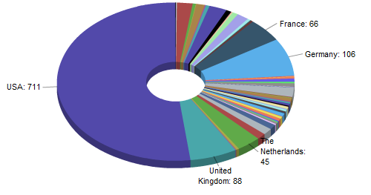
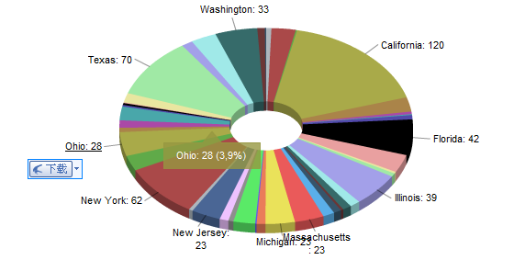
Datacenters
Datacenters and their locations
  BBC report on an MS datacenter: http://news.bbc.co.uk/2/hi/technology/7694471.stm
Why location matters?
  Cost, tax… Network connections to the datacenters are also important. (e.g., Quincy, WA)
A datacenter in an original neclear bunker in Stockholm – believed to be an extra-safe datacenter – From pingdom.com
From datacentermap.com

Slide 10
More Statements
“Building, provisioning, and launching such a facility is a hundred-million-dollar undertaking”
Software infrastructure is also important
Good news: they have been built
Physically, it is easier to ship photons than electrons
Cloud computing = Datacenter computing = Quincy computing?
How about application framework ?

Slide 11
About Levels of Abstractions
Amazon EC2
Google Apps Engine
Microsoft Azure

Slide 12
Potential Research Directions
“All levels should aim at horizontal scalability of virtual machines over the efficiency on a single VM.”
“Application Software needs to both scale down rapidly as well as scale up, which is a new requirement. Such software also needs a pay-for-use licensing model to match needs of Cloud Computing.”
“Infrastructure Software needs to be aware that it is no longer running on bare metal but on VMs. Moreover, it needs to have billing built in from the beginning.”

Slide 13
Potential Research Directions
“Hardware Systems should be designed at the scale of a container (at least a dozen racks), which will be the minimum purchase size. Cost of operation will match performance and cost of purchase in importance, rewarding energy proportionality such as by putting idle portions of the memory, disk, and network into low power mode.”
“Processors should work well with VMs, flash memory should be added to the memory hierarchy.”
“LAN switches and WAN routers must improve in bandwidth and cost.”

Slide 14
Obstacles and Opportunities
Data Lock-In – standardize APIs
Data Confidentiality and Auditability
Data Transfer Bottlenecks
Scalable Storage
Bugs in Large Distributed Systems
Availability of Service, Performance Unpredictability, Scaling Quickly, Reputation Fate Sharing, Software Licensing

Slide 15
Overview Papers
  Luiz Andre Barroso, Jeffrey Dean, Urs Holzle. Web Search for a Planet: The Google Cluster Architecture. IEEE Micro, vol. 23, no. 2, pp. 22-28, Mar./Apr. 2003
  Michael Armbrust, Armando Fox, Rean Griffith, Anthony D. Joseph, Randy Katz, Andy Konwinski, Gunho Lee, David Patterson, Ariel Rabkin, Ion Stoica, and Matei Zaharia. Above the Clouds: A Berkeley View of Cloud Computing. UC Berkeley Technical Report UCB/EECS-2009-28, Feb., 2009.
  Birman, K., Chockler, G., and van Renesse, R. Toward a cloud computing research agenda. SIGACT News 40, 2 (Jun. 2009), 68-80.

Slide 16
Above the Clouds
Definitions, discussions, research questions
The discussion and the research questions provide many insights into this research area
“We were forced to revise our ‘definition’ of cloud computing”
“The keynote speakers seemingly discouraged work on some currently hot research topics”
“they left us thinking about a number of questions that seem new to us”

Slide 17
Views Research Directions
The academia and industry may have different views on the key research problems in an area
  Research Parkinsonism: brain (academia) and hands (industry) are not synchronized
LADIS workshop invited active practitioners from the industry to share their insights
  Jerry Cuomo, James Hamilton, Franco Travostino, and Randy Shoup
Many interesting insights

Slide 18
Consensus and Locking
Locking
  A key mechanism in system design
  Read locks, exclusive locks, related to synchronization mechanisms
  Task synchronization in OS, file systems, database transactions
Distributed locking
Consensus

Slide 19
Consensus and Locking
Is consensus a goal? Is it affordable?
Consensus is a prolific research area
  How to deal with faults, imperfect communication, and Byzantine errors yet provide sound and useful semantics to application is a challenging problem
  Paxos, Chubby, …
Consensus “ wasn’t the goal” in Google, eBay, etc.
  Distributed locking to be avoided

Slide 20
Consensus and Locking
Completely avoid distributed locking?
  Build a distributed system without locking?
  Locking is very useful, if not indispensible, in many computing systems (e.g., Bigtable)
Avoid, not eliminate, distributed locking
  It may often depend on the functions of an application or the semantics of a service

Slide 21
Consensus and Locking
Precisely, what is the problem of locking?
  Performance?
  Convoy problem, leading to feedback oscillations (e.g., multicast storms, chaotic load fluctuations)
  Coupling, uncertainty, risks
Designs need to be evaluated in the application setting
“spooking correlations” “self-synchronization”

Slide 22
Recovery-Oriented Computing
Some large datacenters favor a Recovery-Oriented Computing (ROC) approach
  Reboot On “Complaints”?
  Not informing the clients (not seeking a graceful shutdown)
Client applications are designed around this semantics
Task migration useful?

Slide 23
Recovery-Oriented Computing
Transparent task migration not useful in an ROC system
  Analogous to the end-to-end argument
Time to review our system design techniques
  What techniques are useful? What are not?
  Many brilliant techniques in traditional systems may not work well in the new context.
  What new techniques do we need?
“if a low level mechanism won’t simplify the higher level things that use it, how can we justify the complexity and cost of the low level tool?”

Slide 24
Design Principles
Semantics and their cost
  Transactional database? High cost
  eBay’s experience: started with a “massive parallel database”, but “diverged from the traditional database model over time
What semantics shall we provide and use?
  ACID is not bad, it’s just costly
  What is the affordable and useful semantics?

Slide 25
Design Principles
How to construct lock-free services and applications?
  Designing “loosely coupled” systems
The design philosophy for the new context
“scalability and robustness in cloud settings arises not from tight synchronization and fault-tolerance of the ACID type, but rather from loose synchronization and self-healing convergence mechanisms.”

Slide 26
Important Research Problems
Power management
  Energy-oriented optimization
  Work (not task) migration for a more balanced system
  “Lazy” task decomposition
New model
  Consistency, model of loosely couple system
  Byzantine consensus in the new setting
Relates to the Google search system design

Slide 27
Important Research Problems
Stability of large-scale systems
  Understanding thrashes
  Understanding the workload (e.g., subscription patterns)
Research tools
  How to evaluate a solution?
“it seems nearly impossible to validate scalable protocols without working at some company that operates a massive but proprietary infrastructure”

Slide 28
Important Research Problems
Virtualization
  Examine and evaluate solutions in a virtualized environment
  New OS or virtualization architecture?
Organization of scalable computing systems
  An army of cheap PCs appear to be better (true?)
  Faults, failures and recovery

