Slide 1
Topics in Computer and Communication Networks: Cloud Computing
COMP660L Fall 2009 HKUST
Lin Gu (lingu@cse.ust.hk)
Sept 1, 2009
Notes:
Short sentences

Slide 2
Course Organization
Course homepage
  http://ec2-75-101-219-168.compute-1.amazonaws.com/
Lectures
  Introduction
  Guest lecturer on Sept. 8
    Dr. Weihang Jiang: senior research engineer at Pattern Insight, Dr. Xinsheng Mao (IBM, China)
Paper discussion
  Presentation, discussion, and reviewing notes
Projects or surveys

Slide 3
Course Organization
Grades will be largely based on paper discussion and class projects/surveys
  No tests, mid-terms, or final exams
  Present two papers in class and lead discussions
  You can choose to do a course project or a survey on a relevant topic, but the former is strongly encouraged.
Grading
  20% class participation
  30% presentation
  50% project/survey

Slide 4
Course Organization
Paper discussion
  See the ‘Reading list’ in the course web page. More information about these papers is at http://baijia.info Most of the entries contain a link to the PDF file from a reliable source.
  Participate in Q&A style discussions. Everyone can ask and answer questions.
  Each student presents two papers. Post a reply to the papers you select at baijia.info to make “reservation”. (email me your username at baijia.info so that I know who is to present which paper. If you like, you can create and use more than one usernames.) Case studies are equivalent to papers. Select the papers before Sept. 10.
  Papers will be presented in the order given in the reading list. Take this into consideration when selecting papers. You may present two papers on two separate days.
  Each student writes reviewing notes for 6 or more papers presented in this course. Post the reviewing notes as replies to the papers at baijia.info

Slide 5
Course Organization
Paper discussion – to who presents
  Each presentation including discussions is limited to 40 minutes (It’s a hard time limit). The presentation part should not exceed 30 minutes.
  You don’t have to limit yourself to the paper under discussion. Feel free to include other sources of relevant information (e.g., a related paper)
  Do not simply repeat what the paper says. Add your own analysis, assessment, and interpretation. Give examples to illustrate the concepts and mechanisms described in the paper. Highlight key contributions. Comment on the strengths and weakness of the work. Relate the work to other papers you read inside or outside this course. Speculate future work.
  Be ready to lead the discussion.

Slide 6
Course Organization
Paper discussion – about the reviewing notes
  No specific format, but the notes are expected exhibit critical and independent thinking
  Suggestions
    Like the presentation – do not simply repeat what the paper says. Add your own analysis, assessment, and interpretation. Comment on the strengths and weakness of the work. Relate the work to other papers you read inside or outside this course. Speculate future work.
  They don’t have to be lengthy
  Post the reviewing notes within one week after the presentation day of the paper

Slide 7
Course Organization
Paper discussion – case study
  Do not just read the advertisement. Show your critical and independent thinking!
  Try it!
    Whenever it is possible, try the service or software, write some programs, and tell us your experience.
  Relate the case with papers.

Slide 8
Course Organization
Projects
  Individual projects, no team effort
  The course site has several project ideas. You are encouraged to propose project ideas by sending me email. If I reply with approval, you can proceed with the project.
    Criteria for approval: relevant to the course, achievable within the scope of available resources, non-trivial
    You are welcomed to work on a problem related to your own research
  Project grading
    Novelty, technical merits, usefulness
    Implementation quality and completeness
    Project presentation

Slide 9
Course Organization
Projects
  All projects should be decided (approved) before Oct. 20, 2009
  Project deliverables
    Report, code
  Project presentations around the end of this semester

Slide 10
Course Organization
Surveys
  You can choose to work on a survey instead of a project. (Note: projects are encouraged)
  Detailed background research on a relevant topic (e.g., energy efficiency in datacenters)
  (Optional) Position-paper style sections promoting a research approach, justifying the feasibility, and estimating expected results
  Deliverable: a survey report

Slide 11
Definition
What is “cloud computing”
Why is it useful?
What are the research problems?

Slide 12
What is Computing?
What are the basic elements of “computing”?
The DUL (data, users, logic) simplification
  Three basic elements: data, users, logic
  They exist in all non-trivial computing applications
  They are ‘basic’
    Other components in computing can be related to these elements (e.g., program comprises data and logic)
Computing is to apply logic to transform data in such a way that users find useful

Slide 13
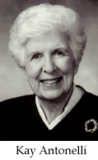
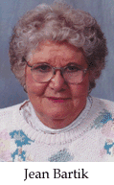


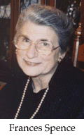
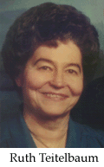
A Little Bit History
The 1940’s
  ENIAC, …
  Logic: rather simple
  Users: scientists, trained engineers and staff
  Application: calculation
  Computing paradigm: machine code, dedicated computer
The Women in Technology International Hall of Fame: Early Programmers (witi.com)

Slide 14
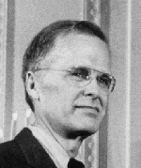
A Little Bit History
The 1950’s
  IBM 701, …
  Logic: faster
  Data: larger but too slow to be fed to the logic execution component
  Users: broader user base, more sensitive to cost
  Paradigm: Batch programming, Fortran (1956)
John Backus

Slide 15
A Little Bit History
The 1960’s
  IBM System 360, …
  Logic: complex, much faster
  Users: high-order language programmers showed up, commercial applications, more interactive
    This also means a diversity of applications
  Data: larger
  Paradigm: Multiprogramming
“(Multics) must run continuously and reliably 7 days a week, 24 hours a day in a way similar to telephone or power systems, and must be capable of meeting wide service demands: from multiple man-machine interaction to the sequential processing of absentee-user jobs;…”
-- F. J. Corbató,
“Introduction and Overview of the Multics System”

Slide 16
A Little Bit History
The 1970’s
  Mainframes
  Logic: complex, fast, parallel
  Users: much broader user base, commercial application users are important customers
  Data: larger, valuable, taking a central stage
  Paradigm: database
“System/370 Models 155 and 165 can provide computer users with dramatically higher performance and information storage capacity for their data processing dollars than ever before available from IBM in medium- and large-scale systems.”
-- System/370 announcement from IBM“

Slide 17

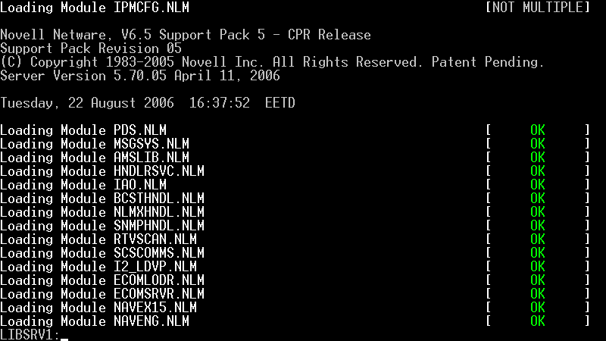
A Little Bit History
The 1980’s
  PCs
  Logic: affordably available
  Users: everybody in the office knows computers and some own one
  Data: large centralized data storage and disk drives on PCs
  Paradigm: client server model
Novell Netware

Slide 18

A Little Bit History
The 1990’s
  Powerful and affordable microprocessor based systems (PCs become a commodity – standardized, affordable, and reasonably high-quality)
  Logic: enormous computing power, often connected
  Users: further growth in user base
  Data: abundant affordable storage (RAM, hard drives), often connected
  Paradigm: Internet and browsers
Netscape logo

Slide 19
A Little Bit History
The 2000’s
  Internet connections become a commodity
  Logic: distributed and connected
  Users: hundreds of millions of users with a diversity of networked devices
  Data: a vast amount of distributed data
  How should we compute?

Slide 20
What is Cloud Computing?
Cloud computing : to integrate data, users, and logic on a vast, potentially global, scale
Ideally, one computer for all
Practically, a few hundred computers, each serving hundreds of millions of users

Slide 21
What Are the Benefits?
The economy of scale
  Better resource utilization, lower cost, …
  Example: online storage
Better systems, better quality
  A global system can afford to hire the best team in the world to develop and support it
  A system used by a vast number of users every day improves every day
More important, …

Slide 22
What Are the Benefits?
More importantly, better methodology
  Example: web email service – How can web mail systems eliminate spam mails?
  Agile development – Why is Agile development techniques welcomed by many Internet application providers?
  Example: software testing – How could fewer testers make higher-quality software?
As Internet connections become reasonably reliable, easily affordable, and broadly available, it is now possible to realize these benefits!

Slide 23
Examples of Internet-Scale Systems
Web search
  Every web search through Google, Yahoo!, Bing involves a whole Internet’s data
Web mails
  Pioneered by Hotmail, led by Yahoo!
Online Office software
  Microsoft Office Live, Google Docs, Zoho, sometimes called “Office 2.0”
More applications to appear …
Question: Can commercial IT systems migrate to the cloud computing paradigm?

Slide 24
What Is a Cloud-Based System Like?
Very few data, but we can look at some Internet-scale systems
Yahoo! network
  A global network of datacenters and network exchanges
  A smaller regional network exchange may process 100K-700K packets/sec, corresponding to a data rate of 160-800MB/sec
  Larger datacenters and network exchanges have much higher throughput
  More than 120 datacenters and network exchanges globally
  Hundreds of thousands of computers collaborate to conduct computing
Representatives locations around the world
City | Country/Area
Santa Clara | U.S.A.
Mumbai | India
Taipei | Taiwan
Sao Paulo | Brazil
Beijing | China
London | UK
Tokyo | Japan
Mascot | Australia
Singapore | Singapore
Brussels | Belgium
Paris | France
Hong Kong | Hong Kong
Courtesy data from Yahoo! Research.

Slide 25
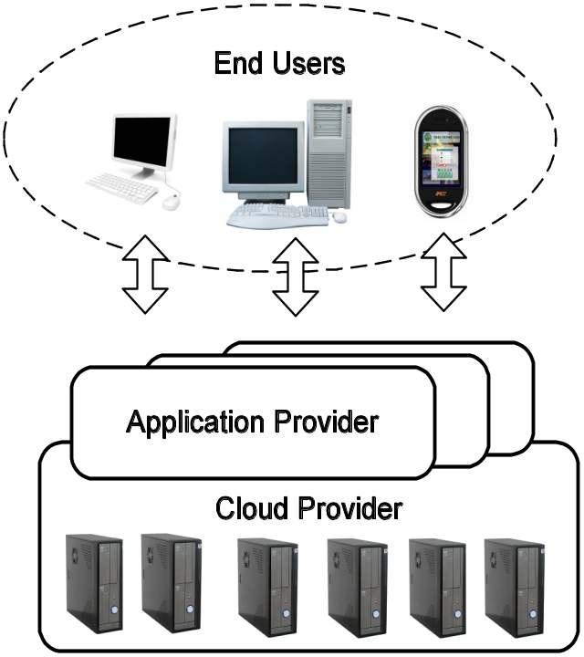
What Is a Cloud-Based System Like?
Cloud computing organization
  Cloud providers
  Application providers
  End users
Properties of data, users and logic, and design considerations?
  Very large data size, distributed (for various reasons)
  Data belongs to users! (not applications, not cloud providers)
  A diversity of users, large user population, distributed in a large geographic region, users can be mobile
  Enormous computation power for parallel logic
  Very high service quality is required (availability, reliability, throughput, latency, ease-of-use, and so on)
    Example: Murphy’s law was never so true!

Slide 26
Challenges and Research Problems
A new computing paradigm with many challenges
What computer can support 6 billion users?
It may take 60ms for light travels from one component to another
Can we shutdown/restart the global computer?
How do we install/upgrade software on this computer?
Can we store the schematics of the next-generation iPhone and Blackberry on the same hard drive?

Slide 27
Challenges and Research Problems
Opportunities for innovation
Hardware
  High-performance, reliable, cost-effective computing infrastructure
  Cooling and energy efficiency
System software
  Operating systems
  Compilers
  Database
  Execution engines and containers

Slide 28
Challenges and Research Problems
Networks
  Interconnect and global network structuring
  Traffic engineering
Design and programming
  Data consistency mechanisms (e.g., replications)
  Fault tolerance
  Interfaces and semantics
Software engineering
User interface
Application architecture

Slide 29
Next …
Read papers for the introductory lectures
  Luiz Andre Barroso, Jeffrey Dean, Urs Holzle. Web Search for a Planet: The Google Cluster Architecture. IEEE Micro, vol. 23, no. 2, pp. 22-28, Mar./Apr. 2003
  Birman, K., Chockler, G., and van Renesse, R. Toward a cloud computing research agenda. SIGACT News 40, 2 (Jun. 2009), 68-80.
  Michael Armbrust, Armando Fox, Rean Griffith, Anthony D. Joseph, Randy Katz, Andy Konwinski, Gunho Lee, David Patterson, Ariel Rabkin, Ion Stoica, and Matei Zaharia. Above the Clouds: A Berkeley View of Cloud Computing. UC Berkeley Technical Report UCB/EECS-2009-28, Feb., 2009.
Paper bidding for your presentations
  Select the papers/case studies you want to present. First come first serve

