Slide 1
CS4487 Mortality
Group 1
LIU Pengze (54381922)
QIU Rui (54380741)

Slide 2
Outline
Data Pre-processing
Classifier training
Handling data imbalance
Feature selection
Model ensemble
Multiple time-series classification

Slide 3
1. Data Preprocessing
1.1. Remove "ignore" variables
In mortality_baseline_vars_new.csv, if the "Ignore" column is 1, then it means that variable is probably not useful or was an intermediate variable of some other analysis.
The first step is to remove all "ignore" labels.
1.2. Process Time-robust and Time-sensitive variables
We split the dataset into two sub-sets:
Time-robust variables: the variables without "Mi" where i is the month index
"Time-sensitive variables: the continuous data, a batch of variables in the month order
Attribute without "M\d" in the name where \d is an integer.
We use regular expression to split the variables by name.

Slide 4
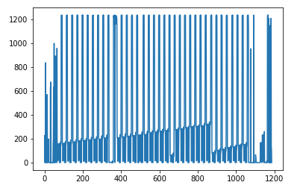
1. Data Preprocessing
1.3. Filter attributes with too many NaN values
Cast the dataset into a numpy array of floating points
Plot the number of NaNs in each attribute
Filter attributes with more than 400 NaNs

Slide 5
1. Data Preprocessing
1.4. Imputer: relace NaN cells
1.4.1. Simple Imputer
We can use "Mean", "Median", "Most_frequent (Mode)" imputer here.
Most-frequent imputer is favorable because it is applicable to nominal data without generating meaningless data.
1.4.2. Latent Factor Model (LFM)¶
Instead of using a simple imputer, we use a parameterized imputer to "learn" the missing values in the dataset.

Slide 6
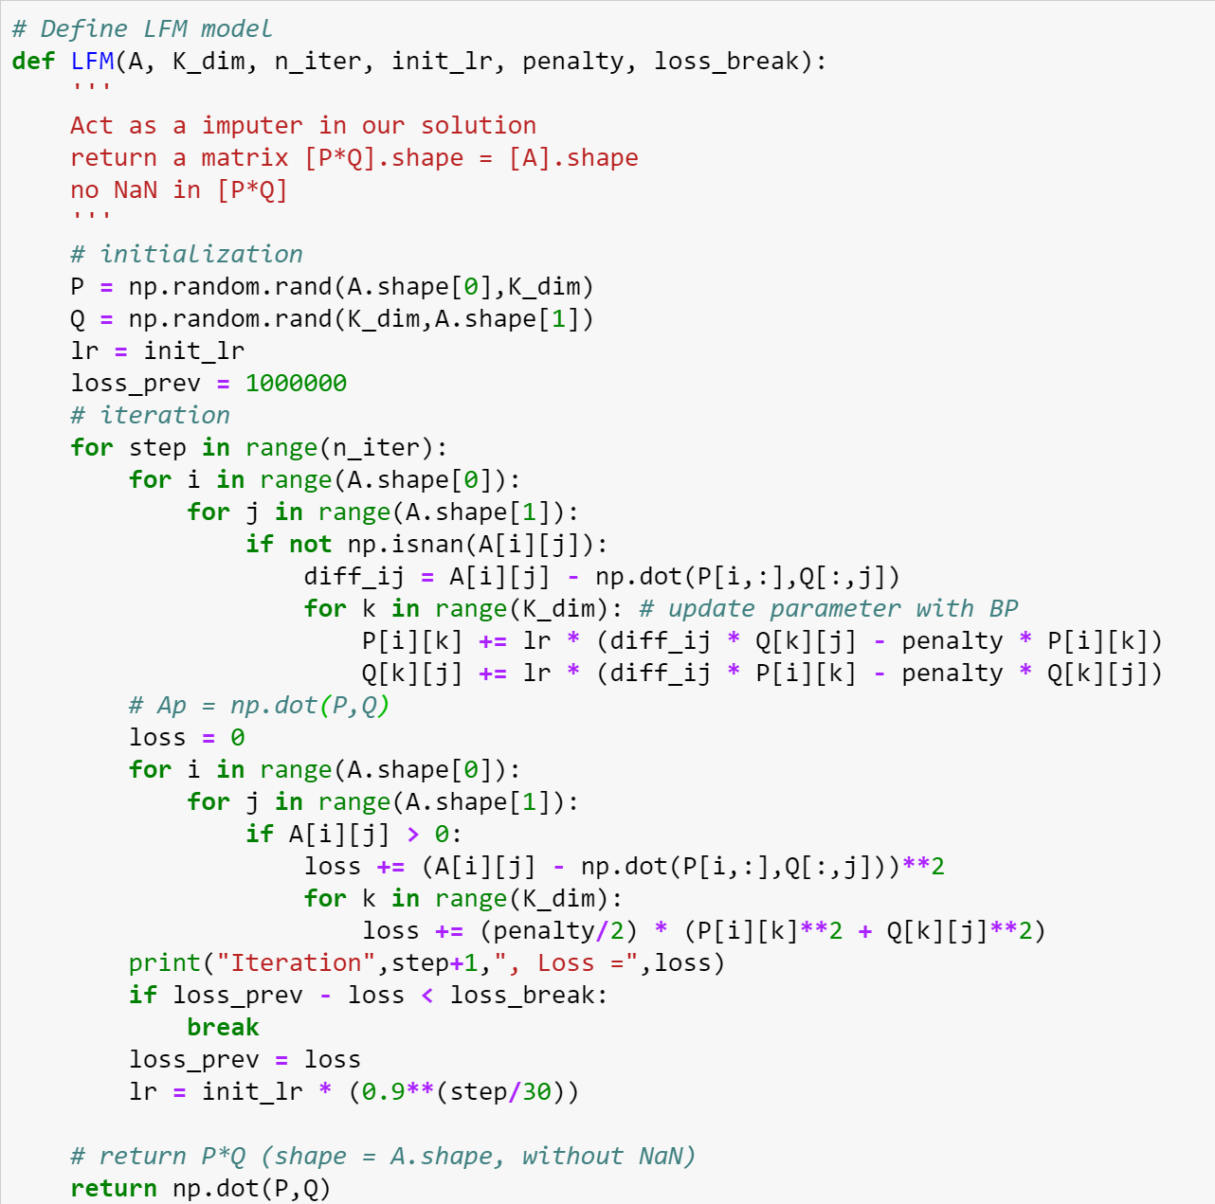
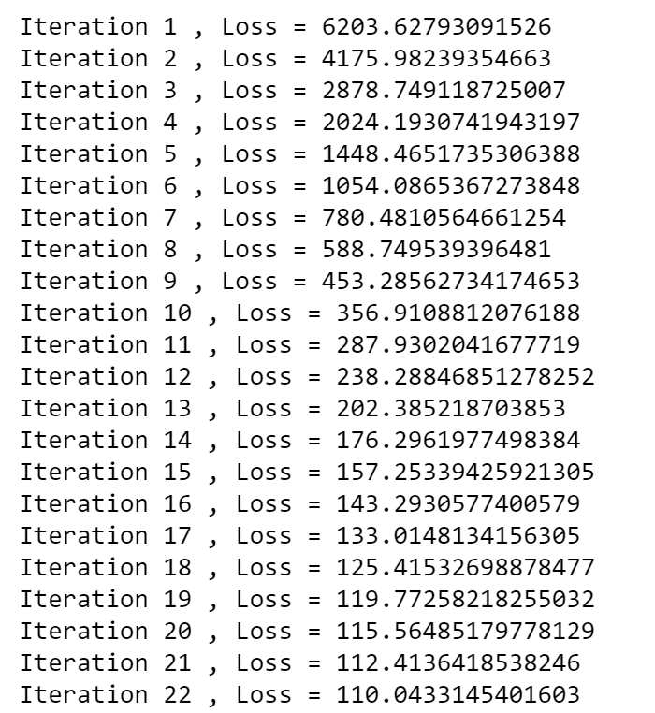
1.4. LFM implementation

Slide 7
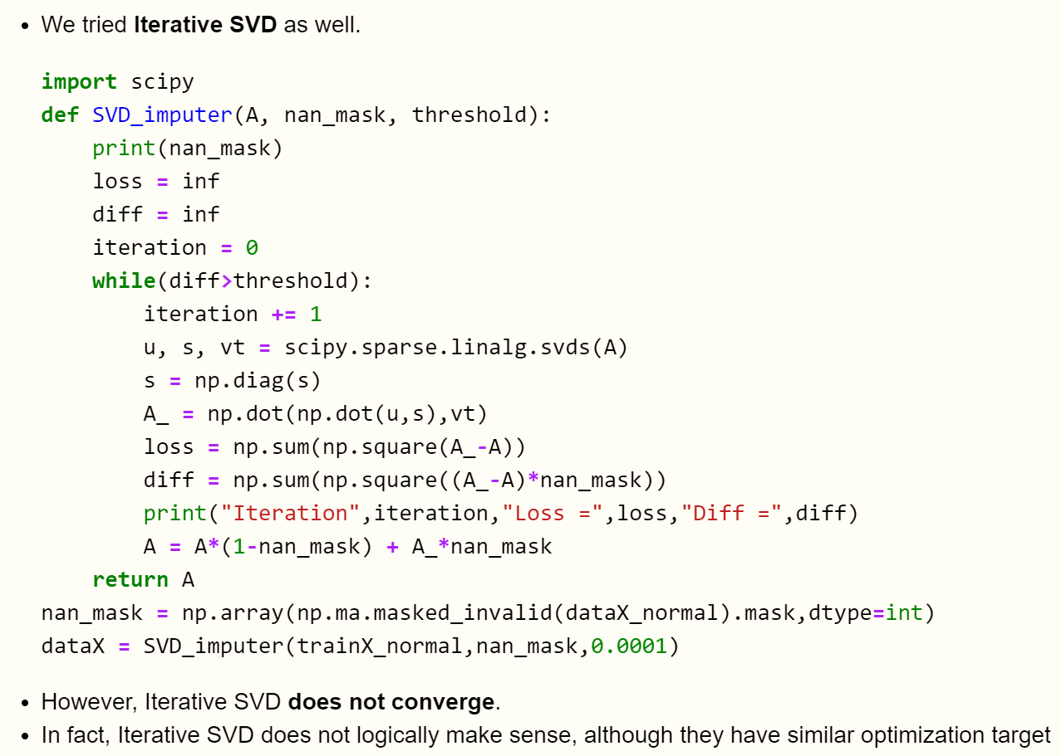
1. Data Preprocessing

Slide 8
1. Data Preprocessing
1.5 Data normalization without NaN
Here we may try "l2", "l1", "minmax".
We use L2 norm here. L1 is also acceptable.

Slide 9
2. Classifier Training
We tried multiple classifiers:
Logistic Regression (baseline)
SVM
AdaBoost
Neural Network
Random Forest
Experiment suggests that Random Forest (RF) is the best model for the given task.

Slide 10
2. Classifier Training
2.4. Neural Network
In this section, we use a fully connected network to fit our dataset.
We believe CNN is not applicable to this problem because, compared with image data, the "local information" in each sample is meaningless. The order of the attributes does not matter. All the (normal) variables are independent.
For better performance, we tried different combinations of FC layers and normalization techniques.
The hyperparameters are well tuned.

Slide 11
2. Classifier Training
Section 2 Conclusion
Random Forest with a large number of estimators is the best classifier for the given task.
This might reflect that the data is not properly linear separated, and hence, as it would be discussed in the next section, the imbalance nature of the data might also account for the outstanding performance of random forest.
We will use RF as the default classifier for the experiment below.

Slide 12
3. Solving data inblance learning¶
Directly deploy classifiers on the data is not desirable. This might be caused by the limitation of the nature of the data set. It is obvious that there are only 73 positive samples while over 1000 negative samples. Therefore, with these limited positive samples would make the model less specific or too general. For example, for every sample predict negative, over 93% accuracy would be detected but the roc-auc score is low. Therefore, we have to make the model more specifc to the positive samples.

Slide 13
3.1. Under Sampling
One trick to solve the imbalance problem is to undersampling the surfeit samples, in this case that is to randomly delete the negative samples so that the population of those two classes would be comparable. However since there are only 58 which might not be enough to perform further classifier so it is first abandoned. A simple test is performed below, and it turns out that the under sampling could not be used.

Slide 14
3.2. Over Sampling
Another solution focuses itself on the opposite way, that is to over sample the positive data, so that the model would eliminate the underfitting problems and make the model more specific to the positive samples.
3.2.1. Inspired by data augmentation
Similar to the image data clinical data is also with noises so it is acceptable to use some similar trick to generate more positive data. In this project, we add normal distributed noise to the original samples.
this augmentation-like technique helps a lot which means that, the imbalance nature is one of bottle necks for classification, and the model should be tuned to be more specific to the positive data.

Slide 15
3.2. Over Sampling
3.2.2. SMOTE
There is some other available algorithms for oversampling. The most well-known one is called SMOTE, it considers the closeness between all pairs of the positive samples, and for each pair of positive samples the augmented samples are on the line of them. In addition, this algorithm is available in the library called imblearn

Slide 16
3.2. Over Sampling
3.2.3. MSMOTE
In addition, there is a modified SMOTE algorithm, called MSMOTE implemented in imblearn.combine.SMOTEENN, it consider different number of neighbors so that the added samples is not subjected to the line between them.
3.2.4. Adasyn
This method deploy AdaBoost for the goal of data oversampling, and it is available in imblearn.over_sampling.ADASYN

Slide 17
3.3. Adapted algorithms
Gradient Boosting Classifier
Random Forest
It is so lucky for us that initially, we choose Random Forest as the one to be tried since it is more robust in imbalanced data learning.

Slide 18
3.4. Anomaly Detection
For this unusual scenario, an unconventional prospection could help. Since the positive samples are so rare that it could be regarded as outlier as well. Therefore, some anomaly detection algorithms could be tried. For example, DBSCAN and Isolation Forest
DBSCAN
Isolation Forest
Bad performances could also accounted by the nature that the data is not perfectly linearly separatable and the density is not really ineven enoudh for both rbf kernal and the dbscan

Slide 19
4. Feature Selection
4.1. Manual feature selection
According to our experiment, data-sensitive variables has a low correlation with the prediction, so we directly remove the data-sensitive columns.
Nominal data is not performing well, and nominal data cannot be directly normalized. For simplicity and better performance, we remove all Nominal columns as well.
Above logic is applied to Section 1, 2. We achieved a reasonably good result with time-robust continuous variables.

Slide 20
4. Feature Selection
4.1. Manual feature selection
According to our experiment, data-sensitive variables has a low correlation with the prediction, so we directly remove the data-sensitive columns.
Nominal data is not performing well, and nominal data cannot be directly normalized. For simplicity and better performance, we remove all Nominal columns as well.
Above logic is applied to Section 1, 2. We achieved a reasonably good result with time-robust continuous variables.

Slide 21
4. Feature Selection
4.2. Correlation Based Feature Selection
4.2.1. Pearson Correlation
4.2.2. Spearman Correlation
4.2.3. Kendall Tau's Correlation

Slide 22
4. Feature Selection
4.3. Feature Selection Models
Select attributes by classifier weights
Select from model
L1-based feature selection
Tree-based feature selection
Universal Feature Selection
Chi-square Test: Chi-squared stats of non-negative features for classification tasks.
F-value Test: ANOVA F-value between label/feature for classification tasks. (Achieves the best performance in our dataset)
MI: Mutual information for a discrete target.

Slide 23
5. Other tricks
5.1. Model Ensemble
We tried to ensemble several random forests with different tree numbers/random states.
The cell below shows an example of our model ensemble.
We also tried joint-model ensemble with RF, LR and SVM. But the performances are not desirable.

Slide 24
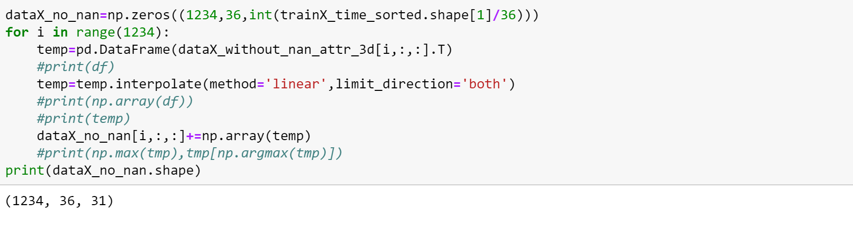
5. Other tricks
5.2. Time series
to use the time series, there are some different methods. However, this type of data is relatively complicated, so NNs are tried.
Preprocessing:

Slide 25
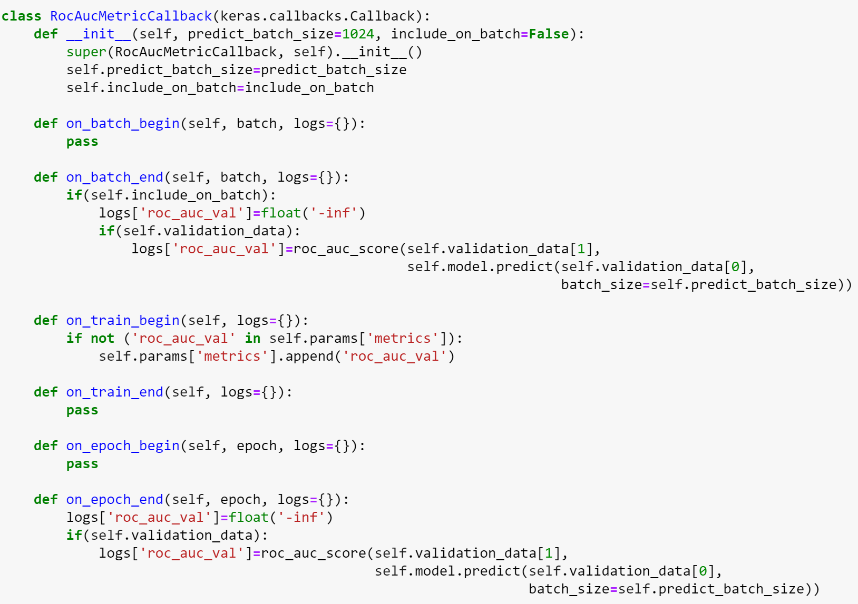
5.2 Time-series classification
Neural Networks

Slide 26
5.2 Time-series classification
Neural Networks
CNN with 1-D convolution
Simple RNN
LSTM
CNN + LSTM

Slide 27
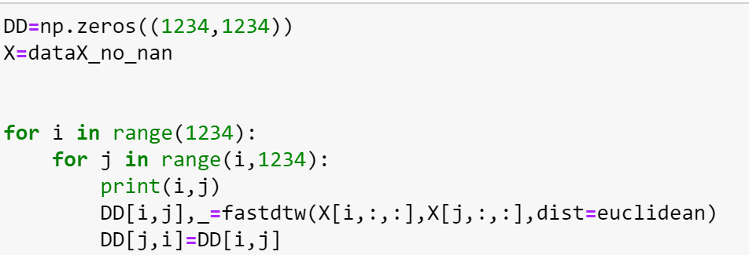
5.2 Time-series classification
DTW
For time series DTW is another conventional. On the obtained distance matrix KNN is performed.

Slide 28
5.2 Time-series classification
Conclusion:
the time series are not of significance since the overall performance is not very high. In addition, the classic machine learning algorithms is better in this context, this might be accounted for by the limitation of the data and the imbalanced natural of the whole dataset.

Slide 29
Conclusion
After all trials above, we combine the best models in each step to generate our final result.
The settings of our last trial is:
Feature selection: remove "ignore variable" and the variables with >400 NaN cells. And use ANOVA F-value between label/feature to select the top-280 features.
Data preprocessing: use l2-norm, and LFM-based imputer to fill in the NaN values. Use gaussian noise for oversampling.
Model selection: we ensemble two Random Forest models with different tree numbers.

