Slide 1
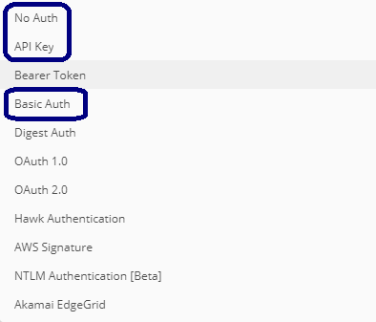
API Authentications
Non-Authen + Postman tool
Basic Authen
Token Authen
API Key

Slide 2
Project Demo
Python
Sqlite database
SQLAlchemy
Flask framework

Slide 3
Non-Authen + Postman tool
Action | HTTP method
Create | Post
Read | Get
Update | Put
Delete | Delete

Slide 4
Why & When?
Be available only to registered users.
Use for sensitive data.
Track the requests (who is calling, the usage).
Control the request (block, limit).
Apply different permission levels.

Slide 5
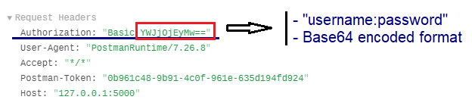
Basic Authen
Send username, password to verify in every request.
=> Unsafe
Request Header:

Slide 6
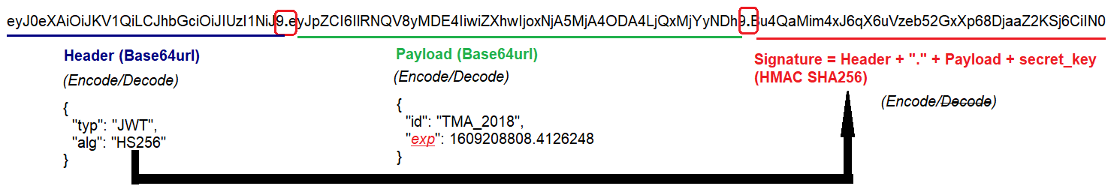
Token Authen
JWT (JSON Web Token)

Slide 7
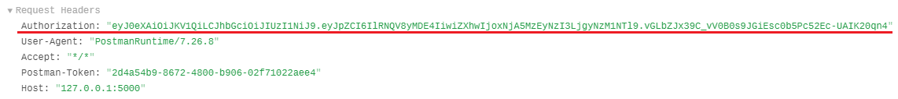
Token Authen
Use username, password to get the token.
Send the token to verify in every request.
Safe (the token has expiration and cannot decode)
Request Header:

Slide 8
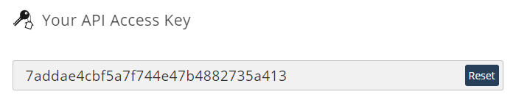
API Key
API key is a simple encrypted string.
Register the provider to get API key (sent email).
Advantage:
User identification.
Project identification.
Billing.
Disadvantage:
If the key is stolen, it has no expiration
=> Reset or Disable API key.

