Slide 1
Introduction to .NET for Apache Spark
Luis Quintanilla
@ljquintanilla

Slide 2





Welcome
ML.NET Content Developer, Microsoft
lqdev@outlook.com
http://luisquintanilla.me
@ljquintanilla
https://github.com/lqdev

Slide 3
Code & Slides
http://bit.ly/NYCCodeCamp2019

Slide 4
Agenda
01
What is Big Data?
02
Apache Spark
03
.NET for Apache Spark
04
Working with Data
05
Build Apps with .NET for Apache Spark

Slide 5
What is Big Data?

Slide 6
3 V’s of Big Data
Volume
Terabytes
Petabytes
Variety
Structured
Unstructured
Velocity
Batch
Streaming

Slide 7






Big Data Software

Slide 8
What is Apache Spark?

Slide 9

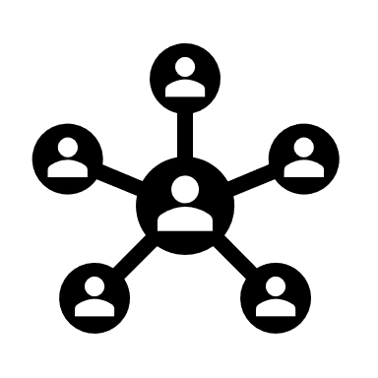

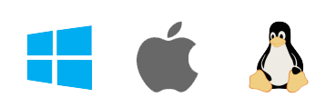
Apache Spark
Open Source
Cross Platform
Distributed*
Extensible

Slide 10
Apache Spark Architecture
SQL
Streaming
Machine Learning
(MLLib)
Graph
(GraphX)
SQL
Streaming
Machine Learning
(MLLib)
Apache Spark

Slide 11


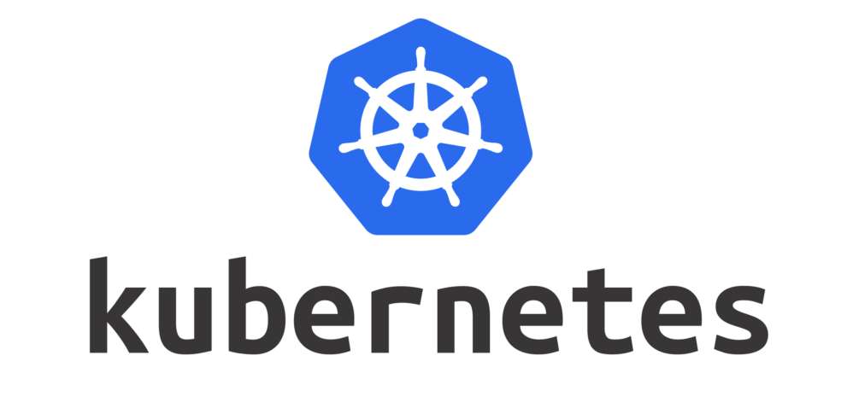
Apache Spark Execution
Driver (s)
Worker(s)
Cluster Manager
Notes:
https://spark.apache.org/docs/latest/cluster-overview.html
Each application gets its own executor processes, which stay up for the duration of the whole application and run tasks in multiple threads. This has the benefit of isolating applications from each other, on both the scheduling side (each driver schedules its own tasks) and executor side (tasks from different applications run in different JVMs). However, it also means that data cannot be shared across different Spark applications (instances of SparkContext) without writing it to an external storage system.
Spark is agnostic to the underlying cluster manager. As long as it can acquire executor processes, and these communicate with each other, it is relatively easy to run it even on a cluster manager that also supports other applications (e.g. Mesos/YARN).
The driver program must listen for and accept incoming connections from its executors throughout its lifetime (e.g., see spark.driver.port in the network config section). As such, the driver program must be network addressable from the worker nodes.
Because the driver schedules tasks on the cluster, it should be run close to the worker nodes, preferably on the same local area network. If you’d like to send requests to the cluster remotely, it’s better to open an RPC to the driver and have it submit operations from nearby than to run a driver far away from the worker nodes.

Slide 12
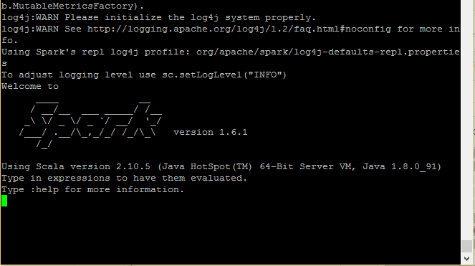
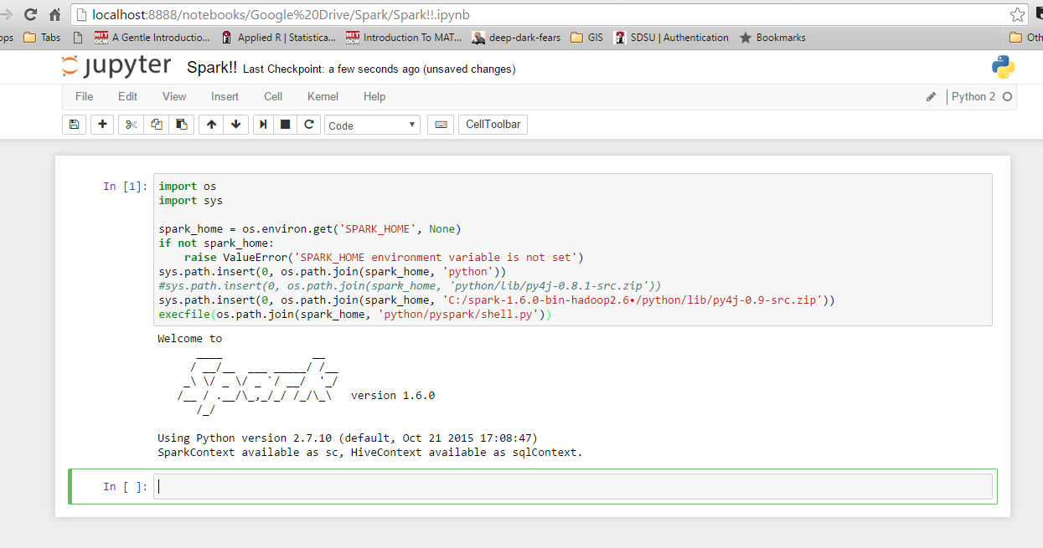
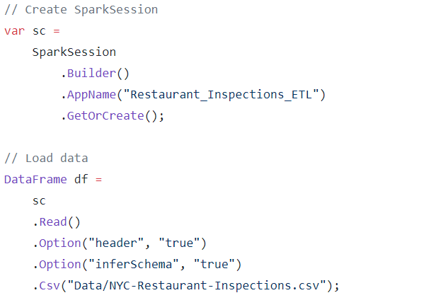
Interacting with Apache Spark
Traditional
Apps
Shell
Notebooks

Slide 13
Extending Apache Spark
PySpark
SparkR
.NET for Apache Spark
Many more…
Spark Interop Layer
JVM (Java/Scala) API
Apache Spark Core

Slide 14
.NET for Apache Spark

Slide 15

.NET for Apache Spark
Open Source
Cross Platform
.NET
Standard
Extensible

Slide 16
.NET for Apache Spark Architecture
SQL
Streaming
Machine Learning
(ML.NET)
Graph
(?)
.NET for Apache Spark

Slide 17
ML.NET Framework
Transforms
Missing Values
Feature Selection
Trainers
SVM
K-Means
Misc
Data Loaders
Evaluators
Extensions
Normalization
Boosted Trees
TensorFlow
ONNX
Logistic Regression
Notes:
Build and train ML.NET Models
Run ANY Model

Slide 18
Data in Apache Spark
Resilient Distributed Datasets (RDD)
DataFrames
Datasets

Slide 19
Demo .NET for Apache Spark DataFrames

Slide 20
Demo .NET for Apache Spark Streaming

Slide 21
Building Applications with .NET for Apache Spark

Slide 22


Restaurant Inspections

Slide 23

Restaurant Inspections Architecture
1
ETL
(.NET Core Console)
2
Training
(.NET Core Console)
3
ML
(.NET Core
Class Library)
4
Enrichment
(.NET Core Console)

Slide 24
Demo Restaurant Inspections ETL

Slide 25
What is Machine Learning?
Artificial Intelligence
Machine Learning

Slide 26
Machine Learning Tasks
Supervised Learning
Unsupervised Learning
Regression
Classification
Clustering
What is the price of a home in NYC?
Is this a dog or cat?
Customer segments in a database
Notes:
Supervised Learning
Regression – What is the price of a home in NYC?
Classification – Is this a dog or a cat?
Unsupervised Learning
Clustering – What kinds of topics are present in this database

Slide 27
Classification Example
Training Data
New Data
Species | Is Independent | Class
Canine | False | Dog
Feline | True | Cat
Feline | True | Cat
Canine | False | Dog
Canine | True | Dog
Species | Is Independent
Canine | False
Prediction
Class
Dog
Features
(input)
Label
(output)

Slide 28
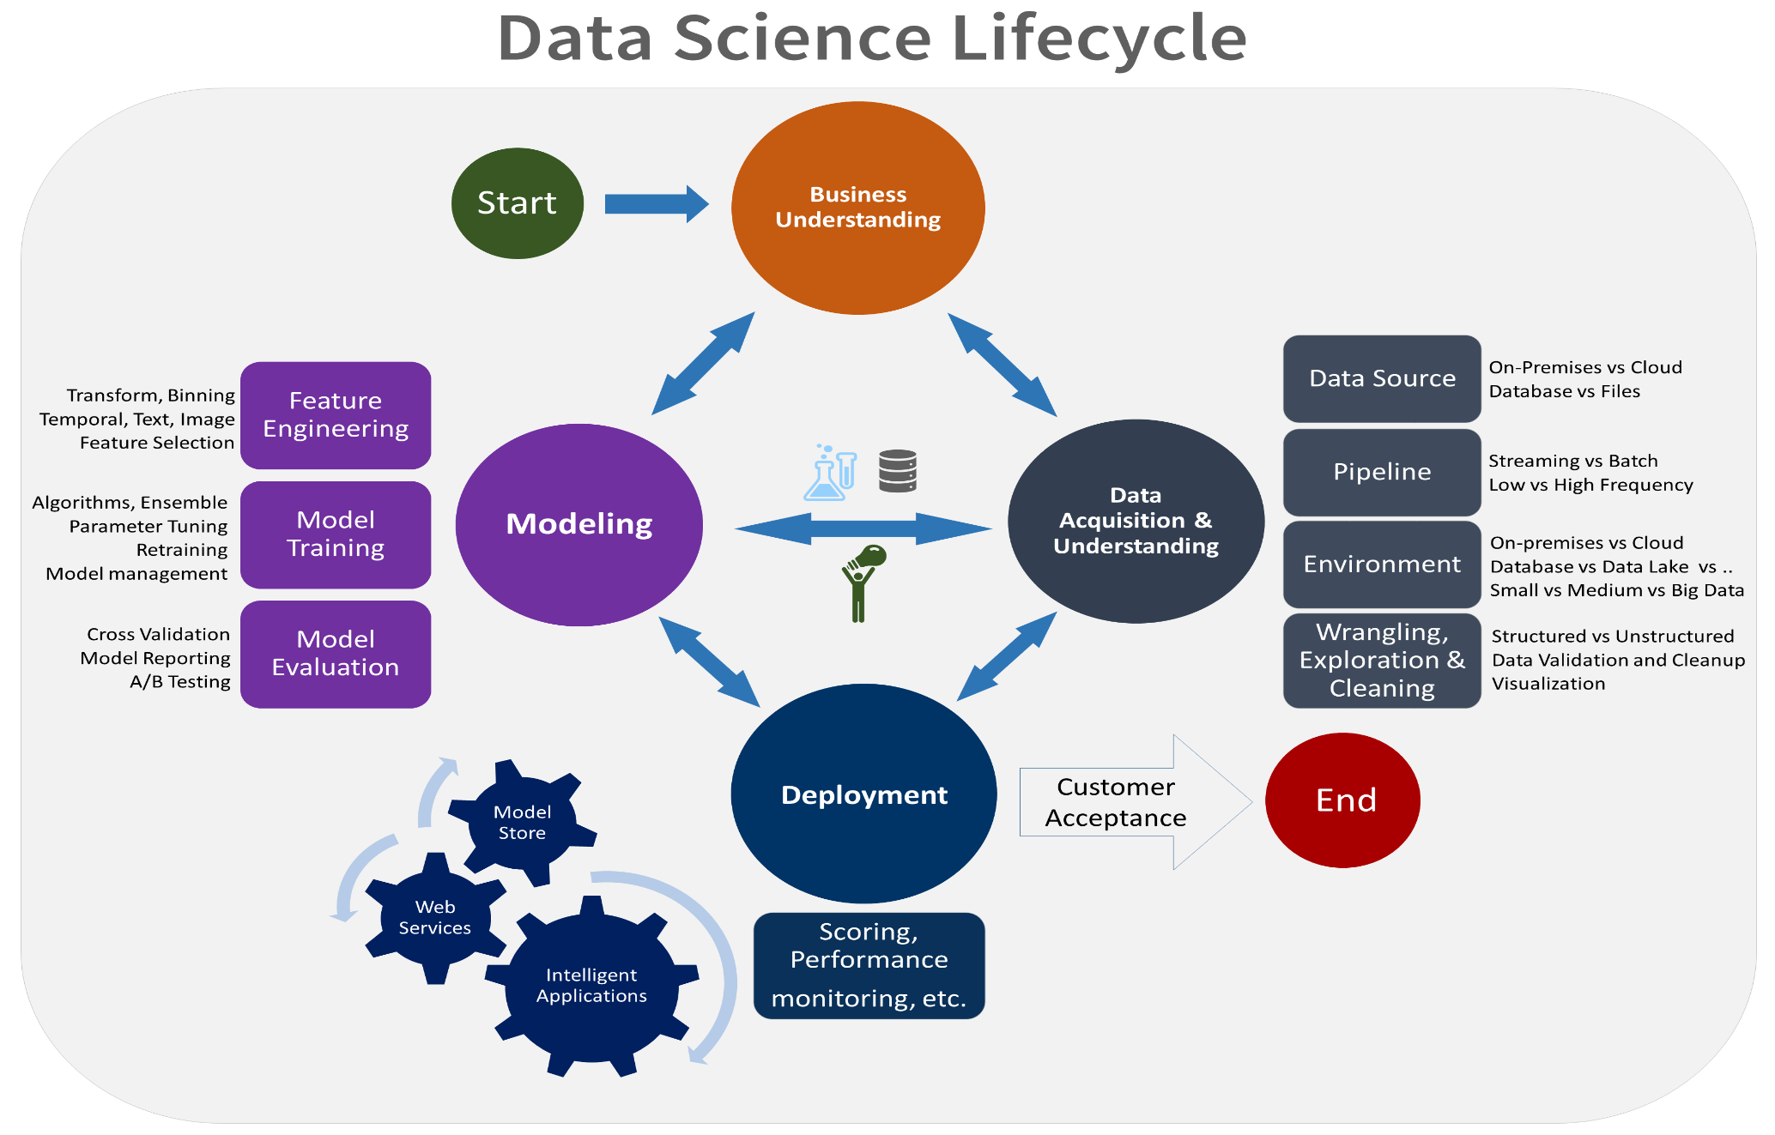
The Continuous Machine Learning Process

Slide 29

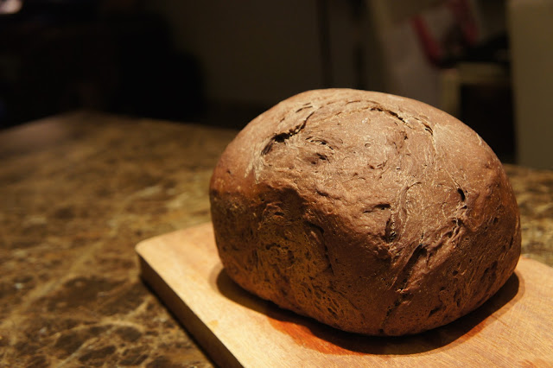
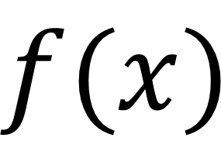
What is a model?
True
$$f(x)$$
False
Input
Model
Output

Slide 30
Demo Restaurant Inspections Training (ML.NET Automated (Auto) ML)

Slide 31
Demo Restaurant Inspections Enrichment (.NET for Apache Spark + SQL)

Slide 32
Demo Restaurant Inspections Enrichment (Azure HDInsight)

Slide 33
Takeaways
Apache Spark is a fast and extensible computing platform for processing Big Data workloads.
.NET for Apache Spark brings the power of Apache Spark to the .NET ecosystem.
.NET for Apache Spark provides easy integration with other .NET libraries / frameworks such as ML.NET.

Slide 34
Resources
http://luisquintanilla.me/2019/09/15/restaurant-inspections-etl-data-enrichment-spark-auto-ml-net/
https://docs.microsoft.com/en-us/dotnet/spark/
https://github.com/dotnet/spark
https://docs.microsoft.com/en-us/dotnet/machine-learning/
https://github.com/dotnet/machinelearning
https://spark.apache.org/

Slide 35
Questions ?

