Slide 1
Getting Started with F# and Jupyter Notebooks
Luis Quintanilla
@ljquintanilla
Notes:
Thank organizers
Firsts
First F# conference
First time giving this talk
Picked up F# about a year ago -> Maybe less
Isaac Abraham -> Get Programming with F#

Slide 2
Hello
Luis Quintanilla
Content Developer @ Microsoft
GitHub:
lqdev
Blog: http://luisquintanilla.me
Twitter:
@ljquintanilla
E-Mail: lqdev@outlook.com
This Photo by Unknown Author is licensed under CC BY-SA
Notes:
How to start

Slide 3

Code & Slides
http://bit.ly/SouthernFriedFSharp2019

Slide 4
Agenda
Development Experience
Development Environments
REPL
Fsharp.Formatting
FsLab Journal
Jupyter
Notebooks
Ecosystem
F# and Jupyter Notebooks
Local
Hosted
Notes:
The Code Writing Process

Slide 5
What Do You Want Out of Your Development Experience?
Interactive
Reproducible
Documented
Collaborative
Extensible
Notes:
Iterative - You want instant feedback and fix mistakes as you see them
Reproducible – Avoid it works on my machine
Documented – Goes along with reproducible.
Collaborative – People should be able to pick it up. People should be able to use the tools as well
Extensible – You can add on to your code or the tools

Slide 6
Read-Evaluate-Print Loop (REPL)
Interactive
Reproducible?
Documented?
Collaborative?
Notes:
Shortcomings
Not graphical
Not Ad-Hoc

Slide 7
Demo Fsharp.Formatting
Notes:
Show Demo1
Show Demo2

Slide 8
Fsharp .Formatting
Interactive?
Reproducible
Documented
Collaborative?
Extensible
Notes:
You have to keep building it.

Slide 9
Demo FsLab Journal
Notes:
Show Demo1
Show Demo2

Slide 10
FsLab Journal
Interactive
Reproducible
Documented
Extensible
Collaborative?
Notes:
Cons
Constantly Reloads
Not Running Continuously
Not Collaborative
In Demo:
Create one from scratch
dotnet new fslab-journal -lang F# -n Experiment1
cd Experiment1
Run
build run

Slide 11
Jupyter
Open Source Interactive Computing Environment
Over 40 languages
Notebooks
Hub

Slide 12
Getting Started Jupyter Notebooks
Anaconda
Data Science Platform
Package Management
Tooling
IDE
Notes:
Show anaconda

Slide 13
Demo Jupyter Notebooks
Notes:
Show Demo1
Go over cell and cell types
Show ad-hoc changes
Show export types
Show Demo2

Slide 14
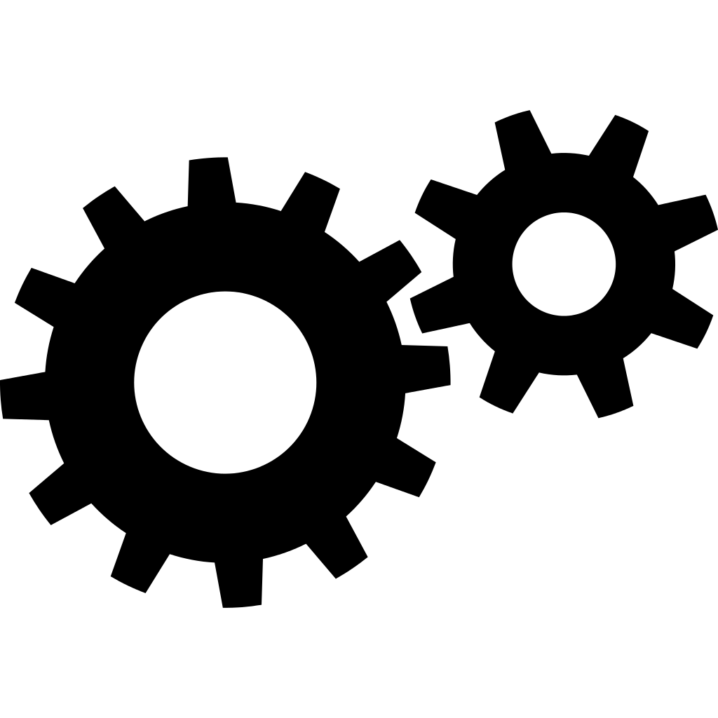
Jupyter Notebooks Internals
Interactive Computing Protocol
Notebook
Document
Format
Kernel
Notes:
Show what a ipynb looks in raw format

Slide 15
Jupyter Ecosystem
Extensions
NBGrader
Nteract
Many more…

Slide 16
NBGrader
Source: https://github.com/jupyter/nbgrader
Notes:
Create something for the students
Then, have some tests that will run against the code to be written by the student
Totals the scores

Slide 17
Papermill
Source: https://github.com/nteract/papermill
Notes:
Define parameters that get executed by your program.
Run the CLI
Long-Running Jobs

Slide 18
Jupyter
Interactive
Reproducible
Documented
Collaborative
Extensible
Notes:
Iterative - You want instant feedback and fix mistakes as you see them
Reproducible – Avoid it works on my machine
Documented – Goes along with reproducible.
Collaborative – People should be able to pick it up. People should be able to use the tools as well
Extensible – You can add on to your code or the tools

Slide 19
Jupyter Notebooks F#
F# 4.1
Jupyter 5.7.7
Cross-Platform
Local – IFSharp
Hosted – Azure Notebooks

Slide 20
Demo IFSharp
Notes:
Show the GitHub
Show Demo3
Show Demo4

Slide 21
Demo Azure Notebooks
Notes:
Add IFSharp to Jupyter Notebooks
Add logo
Show that you can control what gets installed with REPL
You can specify where you want your container to run

Slide 22
Takeaways
F# provides several environments
Choose your own adventure
Jupyter Notebooks make prototyping, documentation and learning easy
Jupyter Notebooks open standards make it easy to extend the tool

Slide 23

Questions
Notes:
Add IFSharp to Jupyter Notebooks
Add logo
Show that you can control what gets installed with REPL
You can specify where you want your container to run

Slide 24
Resources
http://fsprojects.github.io/FSharp.Formatting/literate.html
https://fslab.org/download/
https://jupyter.org/
https://github.com/fsprojects/IfSharp
https://github.com/jupyter/nbgrader
https://github.com/nteract/papermill
https://notebooks.azure.com/lqdev/projects/southernfriedfsharp2019
https://dotnet.microsoft.com/apps/machinelearning-ai/ml-dotnet

