Slide 1
Interactive Programming F#
Luis Quintanilla
@ljquintanilla

Slide 2
Hello
Luis Quintanilla
Content Developer @ Microsoft
GitHub:
lqdev
Blog: http://luisquintanilla.me
Twitter:
@ljquintanilla
E-Mail: lqdev@outlook.com
This Photo by Unknown Author is licensed under CC BY-SA
Notes:
Picked up F# about a year ago -> Maybe less
Started programming with JavaScript and Python. Mainly because Python in particular is heavily used in the Machine Learning space.
Slowly started making my way
I started about a year ago with Issac Abraham's Get Programming with F#.

Slide 3

Code & Slides
http://bit.ly/NYCNETDevs072019

Slide 4
Agenda
Development Experience
Development Environments
REPL / F# Scripts
Fsharp.Formatting
FsLab Journal
Jupyter
Notebooks
Ecosystem
F# and Jupyter Notebooks
Local
Hosted
Notes:
The Code Writing Process

Slide 5
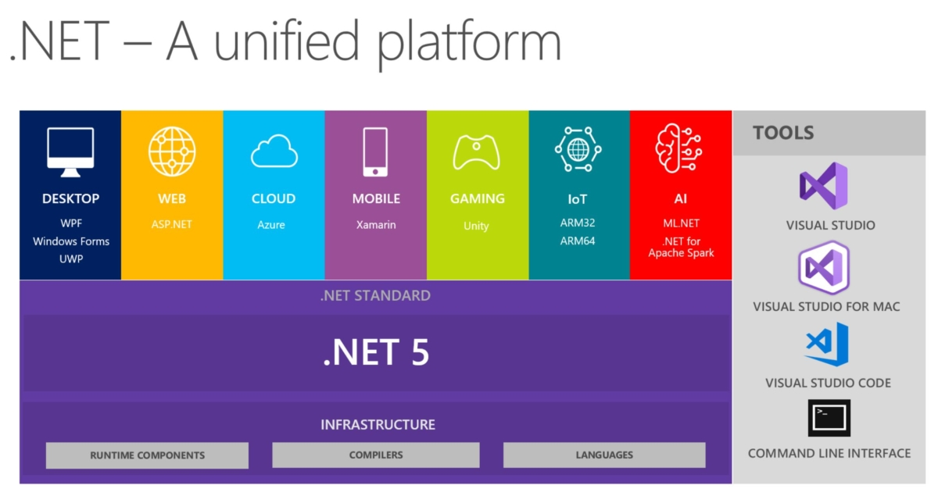
Notes:
Why is this important?
At a bare minimum, it's another set of tools in your toolbox.
.NET ecosystem has changed in many ways over the past few years.
Traditionally, .NET was mainly Windows and focused mainly around Desktop and Web Applications.
Today, .NET can be used cross-platform.
More importantly, the use cases for .NET have expanded as well (IoT, Machine Learning and Big Data).
As the use cases continue to evolve, so are development practices.

Slide 6
What Do You Want Out of Your Development Experience/ Environment?
Interactive
Reproducible
Documented
Collaborative
Extensible
Notes:
Interactive
You want to immediately make sure that your code works and that the output is what you expect.
Reproducible
You want to be able to get the same result every time but more importantly you want others to be able to get the same results as you.
Documented
Code commends can litter your code base and finding that balance between being expressive while limiting the number of code comments
This is a big one for me. Not just because I work on docs, but because I know everyone here is guilty at some point of going on vacation or being away from a project in a while and you come back to it you have no idea what you did.
Collaborative
Rarely do you work by yourself. You want to be able to collaborate with your co-workers and having something that's well documented goes a long way.
Extensible
You want to be able to adapt your environment to your needs. If there's a feature that's not there, no need to wait for first-party support. DIY.

Slide 7
Read-Evaluate-Print Loop (REPL)
Interactive
Reproducible?
Documented?
Collaborative?
Extensible?
Notes:
Shortcomings
Not graphical
Not Ad-Hoc
REPL
Talk about Ionide. Krzysztof Cieślak From <https://twitter.com/k_cieslak>
Interactive
Yes.
Using FSI, you can get started quickly
Reproducible
Maybe.
F# Script to preserve
Documented
Maybe
F# Script to add comments
Collaborative
Maybe
F# Scripts you can share with others
Extensible
Maybe
F# is open source, so you could make changes to the source code.

Slide 8
Demo Fsharp.Formatting

Slide 9
Fsharp .Formatting
Interactive?
Reproducible
Documented
Collaborative?
Extensible
Notes:
Interactive?
Maybe
You have to keep rebuilding to see your changes
Reproducible
Yes. It's just an annotated F# Script
Documented
Yes
You move beyond code comments to using Markdown so you're able to be more expressive in your code.
Collaborative
Maybe.
You could share the scripts but you have to build.
Extensible
Yes.
Make modifications to F# Formatting

Slide 10
Demo FsLab Journal

Slide 11
FsLab Journal
Interactive
Reproducible
Documented
Extensible
Collaborative?
Notes:
Cons
Constantly Reloads
Not Running Continuously
Not Collaborative
In Demo:
Create one from scratch
dotnet new fslab-journal -lang F# -n Experiment1
cd Experiment1
Run
build run
Interactive
Maybe
You have to wait for it to reload
Reproducible
Yes. Very similar to Fsharp.Formatting
Documented
Yes. Very similar to Fsharp.Formatting
Collaborative
Maybe. You could share the scripts but you have to build
Extensible
Yes.
Make modifications to the project

Slide 12
Jupyter
Open Source Interactive Computing Environment
Over 40 languages
Notebooks
Hub

Slide 13
Getting Started Jupyter Notebooks
Anaconda
Data Science Platform
Package Management
Tooling
IDE
Notes:
Show anaconda

Slide 14
Demo Jupyter Notebooks
Notes:
Show Demo1
Go over cell and cell types
Show ad-hoc changes
Show export types
Show Demo2

Slide 15

Jupyter Notebooks Internals
Interactive Computing Protocol
Notebook
Document
Format
Kernel
Notes:
Show what a ipynb looks in raw format
Notebook Document Format (JSON)
Interactive Computing Model (network protocol JSON over ZMQ(Zero MQ) and WebSockets)
Kernel (Processes that run interactive code in a particular programming language and return output to the user).

Slide 16
Jupyter Ecosystem
Extensions
NBGrader
Papermill
Many more…
Notes:
There are different ways you can extend Notebooks (front-end / server-side) extensions.
NBGrader (Grade notebooks)
Papermill (Parameterize and execute notebooks)

Slide 17
NBGrader
Source: https://github.com/jupyter/nbgrader
Notes:
Create something for the students
Then, have some tests that will run against the code to be written by the student
Totals the scores

Slide 18
Papermill
Source: https://github.com/nteract/papermill
Notes:
Define parameters that get executed by your program.
Run the CLI
Long-Running Jobs

Slide 19
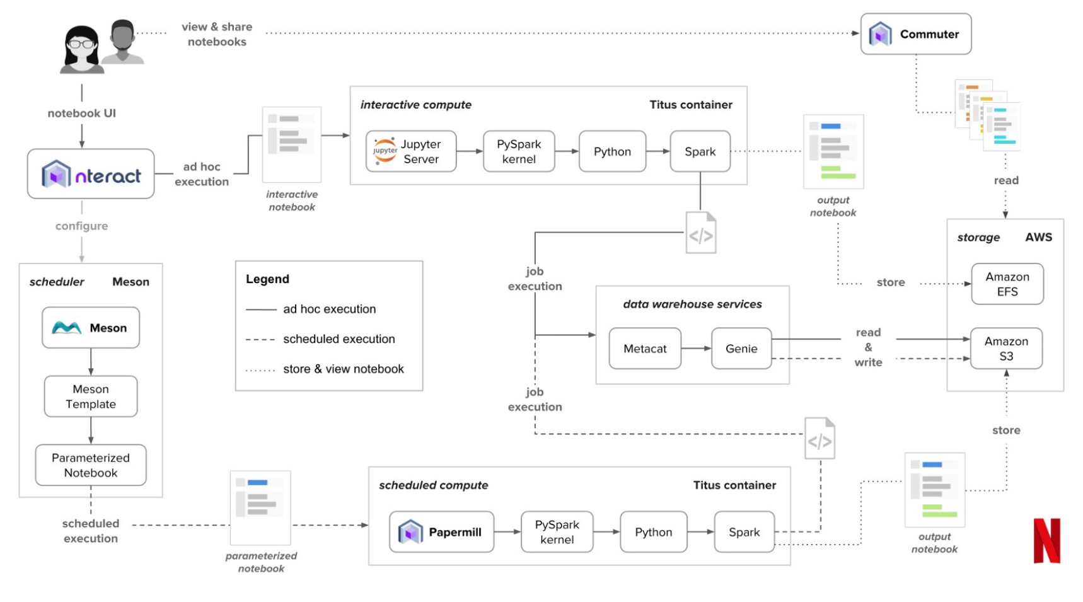
Notebooks in Production
Source: https://medium.com/netflix-techblog/notebook-innovation-591ee3221233

Slide 20
Jupyter
Interactive
Reproducible
Documented
Collaborative
Extensible
Notes:
Interactive
Yes
You can see your results immediately without rebuilding
Reproducible
Yes
Just re-run the notebook
Documented
Yes
Mix markdown with your code
Collaborative
Yes. You can share the NB directly, HTML, PDF, etc
Extensible
Yes
Create front-end or server-side extensions

Slide 21
Jupyter Notebooks F#
F# 4.1
Jupyter 5.7.7
Cross-Platform
Local – IFSharp
Hosted – Azure Notebooks

Slide 22
Demo IFSharp
Notes:
Show the GitHub
Show Demo3
Show Demo4

Slide 23
Demo Azure Notebooks
Notes:
Add IFSharp to Jupyter Notebooks
Add logo
Show that you can control what gets installed with REPL
You can specify where you want your container to run

Slide 24
Takeaways
F# provides several environments
Choose your own adventure
Jupyter Notebooks make prototyping, documentation and learning easy
Jupyter Notebooks open standards make it easy to extend the tool

Slide 25

Questions
Notes:
Add IFSharp to Jupyter Notebooks
Add logo
Show that you can control what gets installed with REPL
You can specify where you want your container to run

Slide 26
Resources
http://fsprojects.github.io/FSharp.Formatting/literate.html
https://fslab.org/download/
https://jupyter.org/
https://github.com/fsprojects/IfSharp
https://github.com/jupyter/nbgrader
https://github.com/nteract/papermill
https://notebooks.azure.com/lqdev/projects/nycnetdevs201907

