Slide 1
The battle of neighborhoods
Cousera’s capstone

Slide 2
OUTLINE
Business Problem
Data
Methodology
Analysis
Conclusion

Slide 3
Business problem

Slide 4
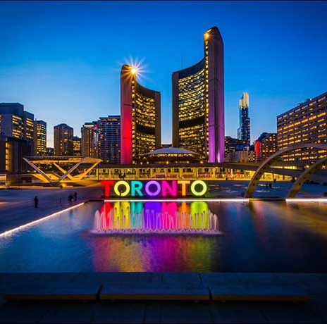
This project aims to find the most suitable and secure location for opening some kinds of business places like Grocery Store, Gas Station,... in Toronto, Canada. We will use data science tools to analyse data and focus on the safest borough and explore its neighborhoods and the 10 most common venues in each neighborhood so that the best neighborhood where grocery stores are not amongst the most common venues can be selected.

Slide 5
Based on definition of our problem, we must:
Find the safest borough based on crime statistics
Following data will be needed to extract the required information:
Part 1: Using a real world data set from Kaggle containing the Toronto Police Data from 2014 to 2019: A dataset consisting of the crime statistics of Toronto along with coordinates of neighborhoods, type of crime, and record time.
Part 2: Use the data from Wikipedia about neighborhoods and borough in Toronto.: Borough information will be used to map the existing data where each neighbourhood can be assigned with the right borough.
Part 3: Find the safest borough: Analyse the data and find the safest places.
DATA

Slide 6
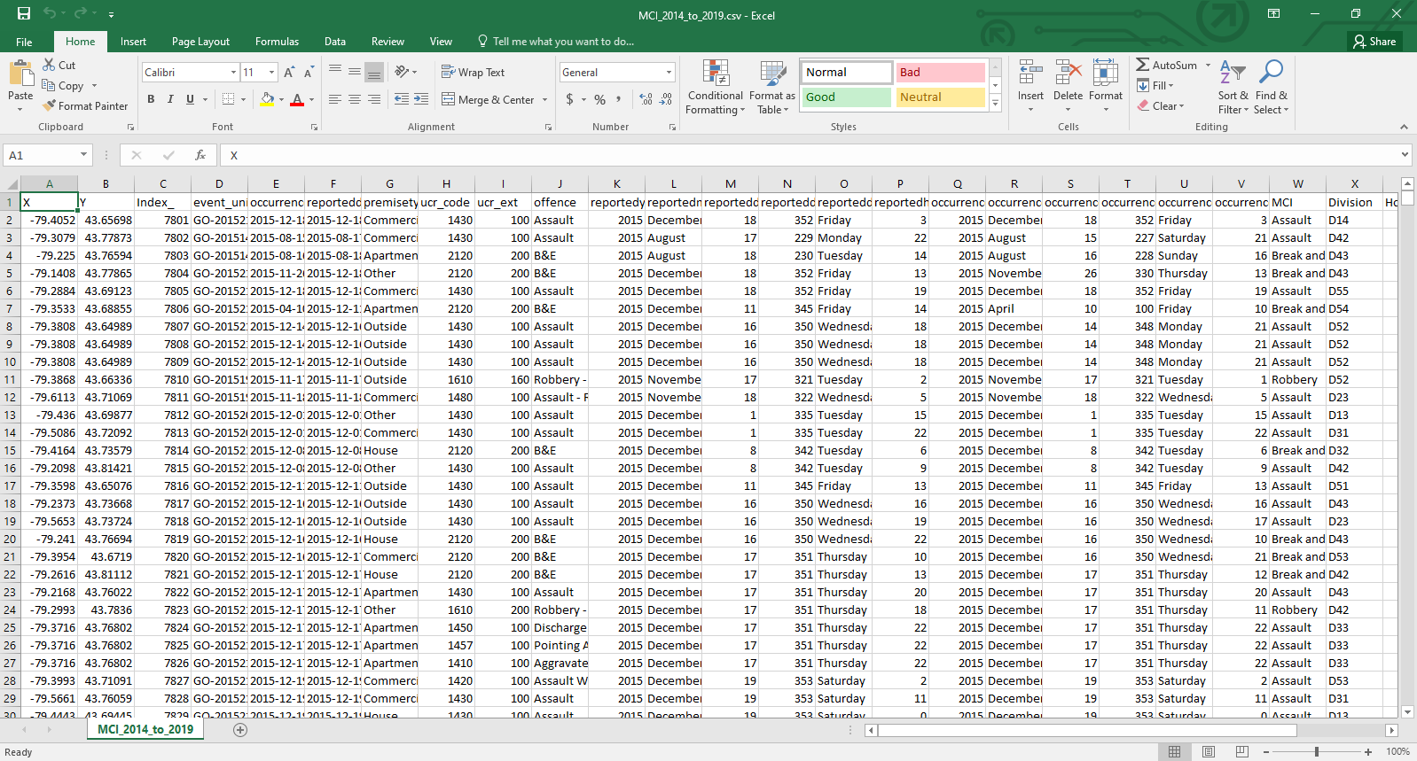
Part 1: Using a real world data set from Kaggle containing the Toronto from 2014 to 2019

Slide 7
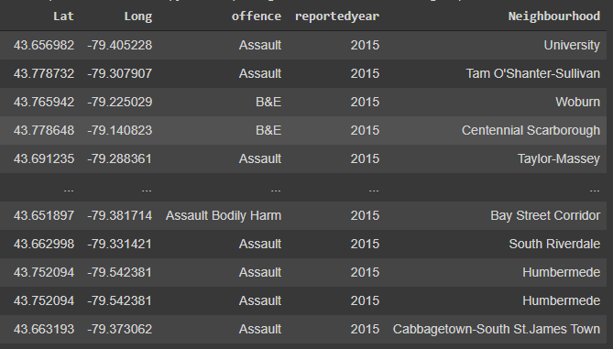
Data after clean

Slide 8
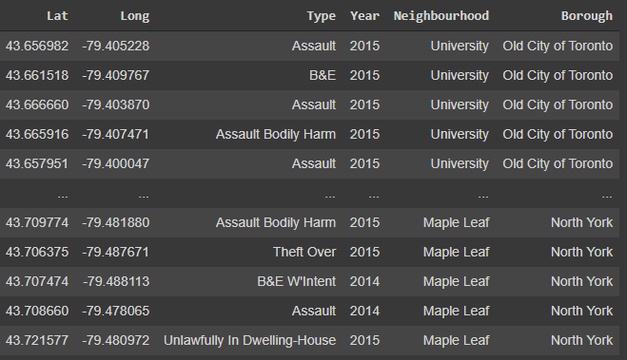
Merge with borough data

Slide 9
Methodology
Categorized the methodologysection into two parts:
Exploratory Data Analysis: Visualise the crime reports in different boroughs to idenity the safest borough and normalise the neighborhoods of that borough.
Modelling: To help stakeholders choose the right neighborhood within a borough we will be clustering similar neighborhoods using K - means clustering to address this problem so as to group data based on existing venues which will help in the decision making process.

Slide 10
Analysis

Slide 11
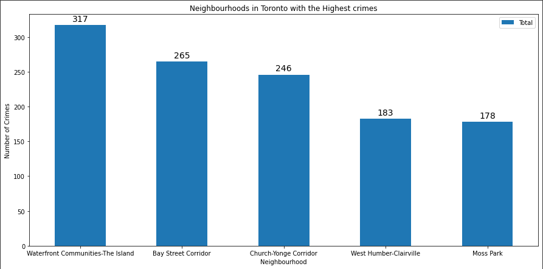
5 Neighborhoods with highest crime

Slide 12
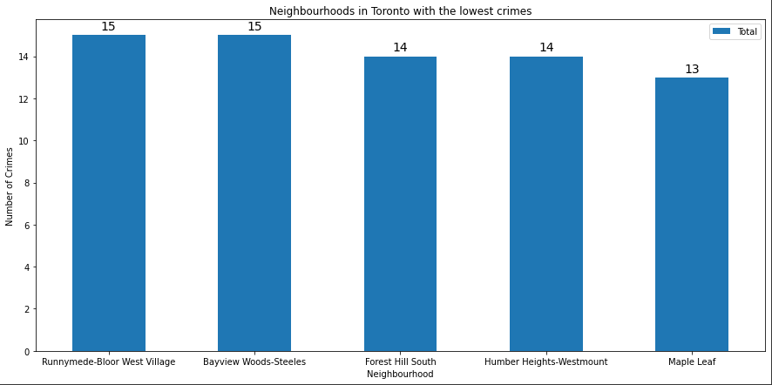
5 Neighborhoods with lowest crime

Slide 13
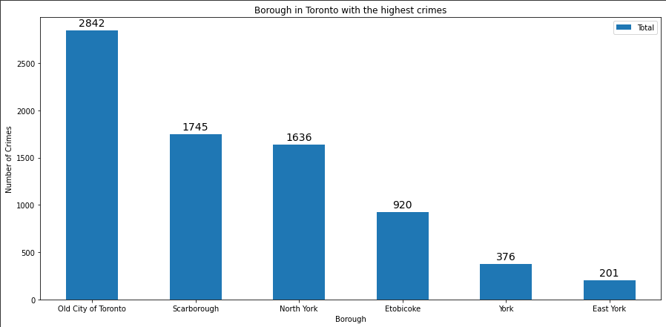
Borough with highest crime

Slide 14
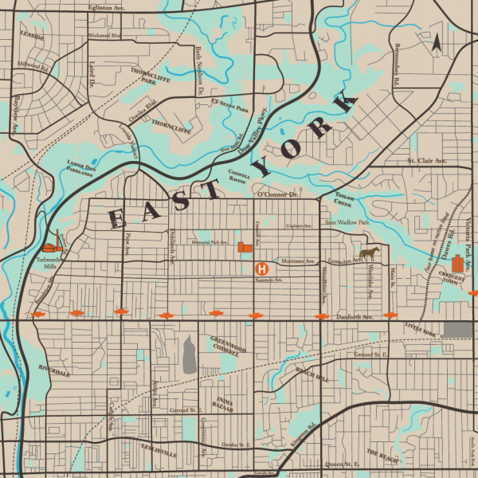
Based on exploratory data analysis it is clear that East York has the lowest crimes

Slide 15
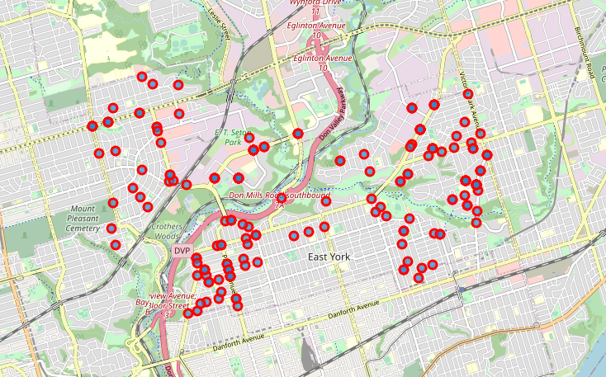
Toronto's East York Borough and it's Neighborhoods

Slide 16
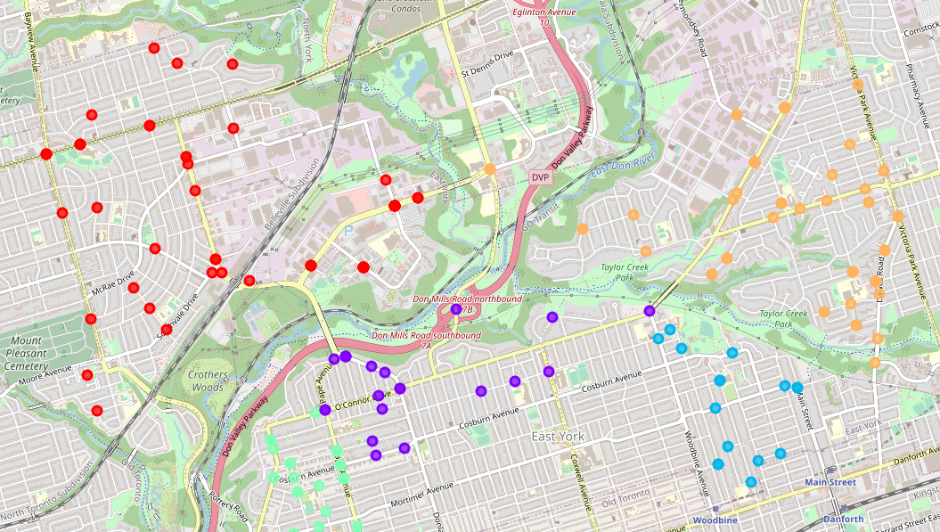
Clustering east york’s neighbourhoods

Slide 17
conclusion
We have explored the crime data to understand different types of crimes in all neighborhoods of Toronto and later categorized them into different boroughs, this helped us group the neighborhoods into boroughs and choose the safest borough.

