Slide 1
PowerWalk: Scalable Personalized PageRank via Random Walks with Vertex-Centric Decomposition
Qin Liu, John C.S. Lui
Chinese University of Hong Kong
Zhenguo Li, Jiefeng Cheng
Huawei Noah’s Ark Lab
Speaker: Zhipeng Huang, University of Hong Kong

Slide 2

Background
What is Personalized PageRank (PPR)?
PageRank: a measure of importance of vertices
Personalized PageRank: consider user preferences by assigning more importance to certain vertices
Applications of PPR:
personalization of web searches
general searches in social networks
graph partitioning[FOCS’06]
Twitter “who to follow” service[WWW’13]
Notes:
What is PPR?
We know that the popular PageRank algorithm is used to measure the importance of vertices in a graph. For example, measure the importance of a web page in the web graph of the Internet. To consider user preferences in a modern search engine, researchers proposed personalized PageRank which assigns more importance to certain vertices.
PPR has a lot of applications, including
- personalized web search engine
- search in social networks
- graph partitioning
the Twitter “who to follow” service
The figure on the right is an example of the “who to follow” service of Twitter.

Slide 3
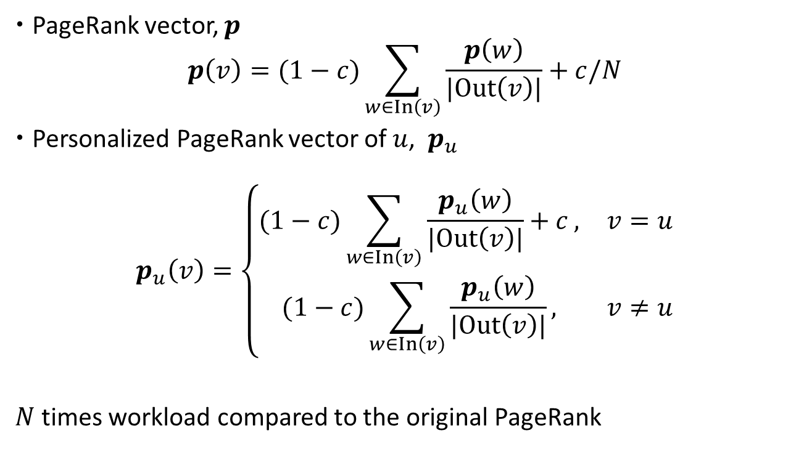
Definition of PPR
PageRank vector, $p$ $p\left(v\right)=(1−c)\sum_{w∈In\left(v\right)}{\frac{p\left(w\right)}{|Out\left(v\right)|}}+c/N$
Personalized PageRank vector of $u$, $p_{u}$
$$p_{u}\left(v\right)=\left\{\begin{matrix}(1−c)\sum_{w∈In\left(v\right)}{\frac{p_{u}\left(w\right)}{|Out\left(v\right)|}}+c , & v=u \\ (1−c)\sum_{w∈In\left(v\right)}{\frac{p_{u}\left(w\right)}{|Out\left(v\right)|}}, & v≠u\end{matrix}\right.$$
$N$ times workload compared to the original PageRank
Notes:
Now let me introduce the definition of PPR. Let In(v) denote the set of in-neighbors of v, and Out(v) the set of out-neighbors of v, and N the number of vertices.
The PageRank vector p is defined as
...
The intuition behind this definition is that a vertex is important if vertices that point to it (or its in-neighbors) are important.
For each vertex u, we can define p_u as
...
In the original PageRank, we consider all vertices equally. But in the PPR vector with respect to u, we assign more importance to vertex u.
Since each vertex has a different PPR vector, PPR requires N times workload compared to the original PageRank.

Slide 4
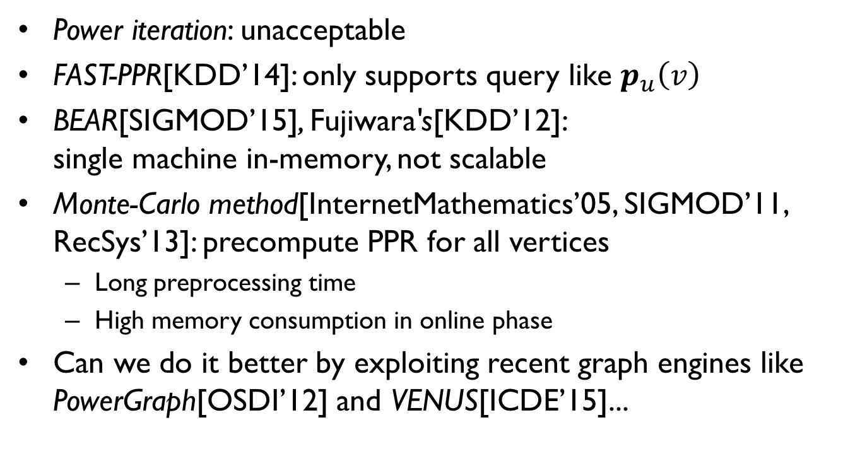
Related Work
Power iteration: unacceptable
FAST-PPR[KDD’14]: only supports query like $p_{u}\left(v\right)$
BEAR[SIGMOD’15], Fujiwara's[KDD’12]: single machine in-memory, not scalable
Monte-Carlo method[InternetMathematics’05, SIGMOD’11, RecSys’13]: precompute PPR for all vertices
Long preprocessing time
High memory consumption in online phase
Can we do it better by exploiting recent graph engines like PowerGraph[OSDI’12] and VENUS[ICDE’15]...
Notes:
The power iteration method computes the PPR vectors by definition which is obviously unacceptable. There has been many studies on PPR computation. Among them, some have limited functionality. For example, FAST-PPR only supports single-pair query like p_u(v). Some methods are in-memory algorithms and not scalable.
One practical solution is the Monte-Carlo method which approximates PPR vectors using random walk simulation. Previous studies show that the Monte-Carlo method can scale to large graphs. However, since the Monte-Carlo method needs to precompute and store all PPR vectors firstly, it suffers from long preprocessing time and high memory consumption.
In this paper, we propose a new framework for PPR computation by exploiting recent graph engines like PowerGraph and VENUS.

Slide 5
Our Contributions
A scalable framework, PowerWalk, for answering queries to any PPR vectors
Trade off offline preprocessing and online query according to memory budget
Experiments on billion-scale real-world graphs
Response to a batch of PPR queries in seconds
3.64s for 10,000 queries on twitter graph (1.5B edges)
Notes:
Our main contribution is a new framework called PowerWork that can answer queries to any PPR vectors efficiently. PowerWalk first computes a light-weight index in offline, then it can answer PPR queries online. More importantly, our system can trade off offline preprocessing and online query according to the available memory, which allows it to handle billion-scale graphs.
Our evaluation on large graphs shows that our system responses to a batch of PPR queries in seconds. For example, on a Twitter-follow graph with 1.5 billion edges, our system response to 10,000 queries in 3.64 seconds.

Slide 6
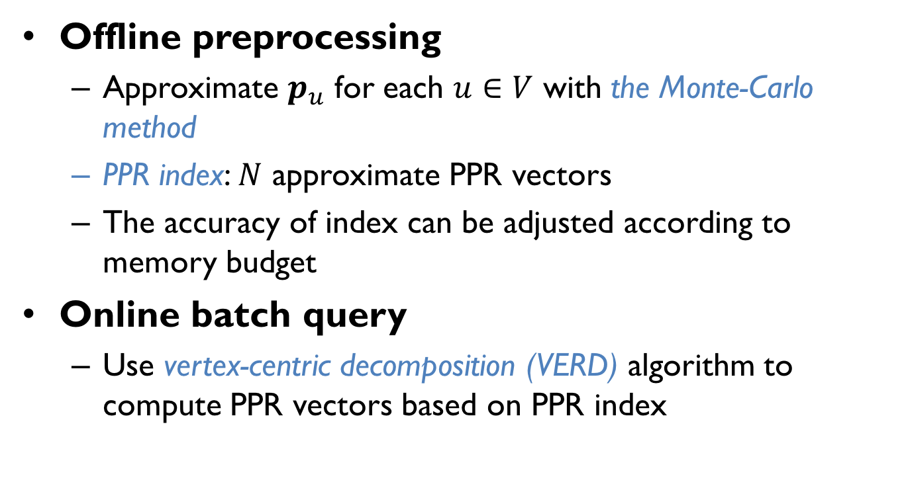
Overview of PowerWalk
Offline preprocessing
Approximate $p_{u}$ for each $u∈V$ with the Monte-Carlo method
PPR index: $N$ approximate PPR vectors
The accuracy of index can be adjusted according to memory budget
Online batch query
Use vertex-centric decomposition (VERD) algorithm to compute PPR vectors based on PPR index
Notes:
This is the overview of PowerWalk. First in the offline preprocessing, we use the Monte-Carlo method to compute an approximate PPR vector for each vertex in the graph. We call the N approximate PPR vectors the PPR index. Note that the accuracy of the PPR index can be adjusted according to the available main memory.
For the online batch query, we use our vertex-centric decomposition algorithm to compute PPR vectors based on the PPR index.

Slide 7
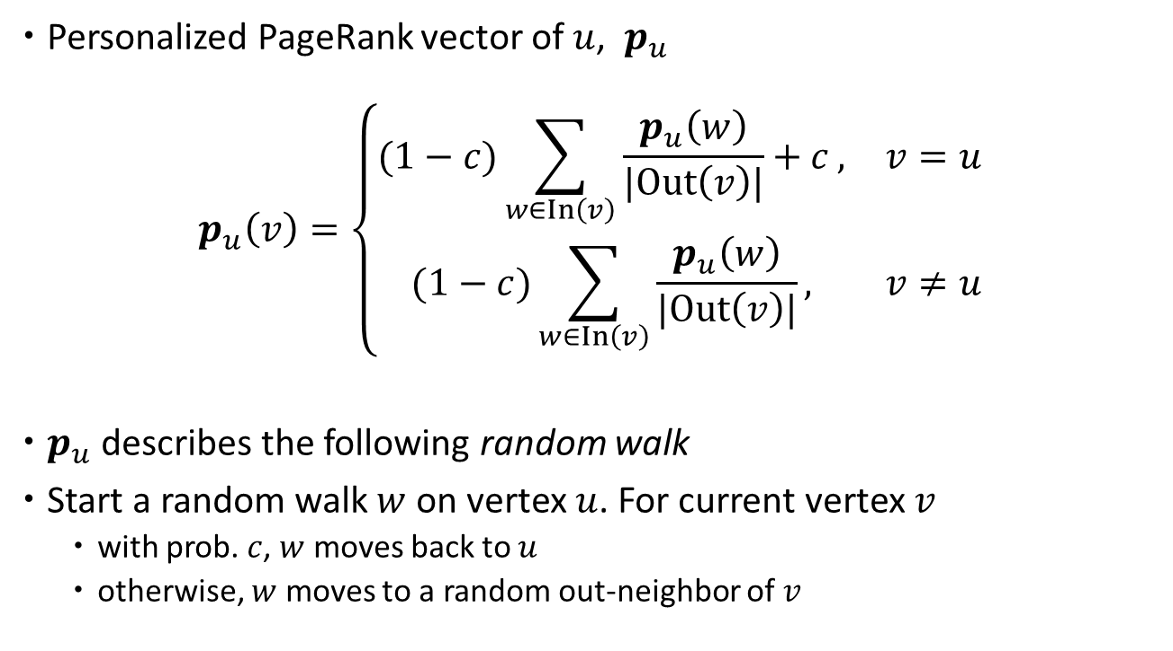
Monte-Carlo Simulation
Personalized PageRank vector of $u$, $p_{u}$
$$p_{u}\left(v\right)=\left\{\begin{matrix}(1−c)\sum_{w∈In\left(v\right)}{\frac{p_{u}\left(w\right)}{|Out\left(v\right)|}}+c , & v=u \\ (1−c)\sum_{w∈In\left(v\right)}{\frac{p_{u}\left(w\right)}{|Out\left(v\right)|}}, & v≠u\end{matrix}\right.$$
$p_{u}$ describes the following random walk
Start a random walk $w$ on vertex $u$. For current vertex $v$
with prob. $c$, $w$ moves back to $u$
otherwise, $w$ moves to a random out-neighbor of $v$
Notes:
Let’s revisit the definition of PPR and consider the following random walk.
…
It can be shown that p_u(v) actually describes the probability of this random walk visiting v at its equilibrium.
This suggests that we can approximate p_u by simulating random walks.

Slide 8

Monte-Carlo Simulation
Simulate a very long random walk
$p_{u}$ can be approximated by the distribution of all vertices on the walk
Notes:
More specifically, to approximate p_u, we can simulate a very long random walk starting from u. Every step, the walk steps to a random neighbor of current vertex with probability (1-c), otherwise it teleports to vertex u.
And p_u can be approximated by the distribution of all vertices on the walk.

Slide 9
Monte-Carlo Simulation
Break a long walk into many parallel short walks
Notes:
However, simulating a long random walk is very costly if the graph is distributed to a cluster of machine or stored on the disk. It is easy to see that it is equivalent to simulate many short random walks if we break the long random walk when it teleports.

Slide 10
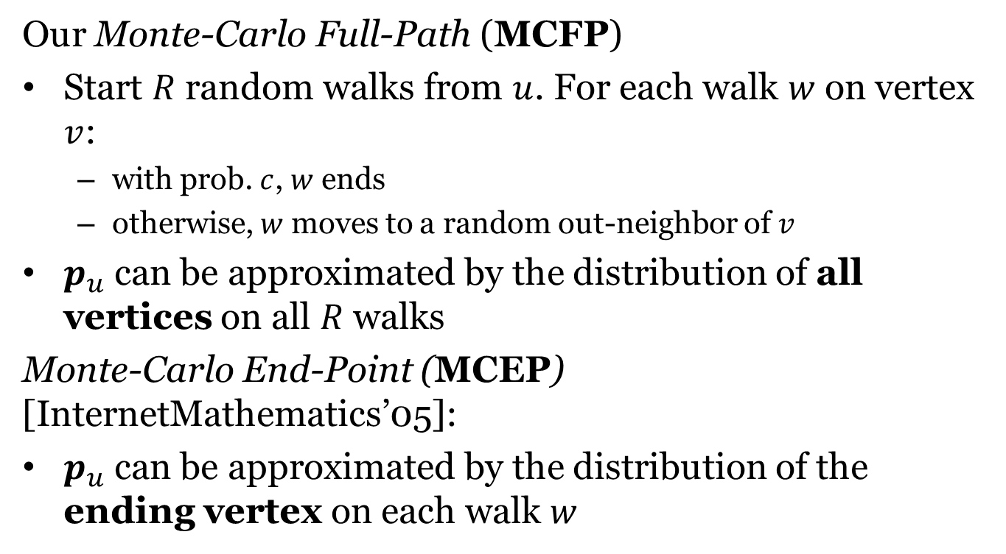
Monte-Carlo Simulation
Our Monte-Carlo Full-Path (MCFP)
Start $R$ random walks from $u$. For each walk $w$ on vertex $v$:
with prob. $c$, $w$ ends
otherwise, $w$ moves to a random out-neighbor of $v$
$p_{u}$ can be approximated by the distribution of all vertices on all $R$ walks
Monte-Carlo End-Point (MCEP) [InternetMathematics’05]:
$p_{u}$ can be approximated by the distribution of the ending vertex on each walk $w$
Notes:
Now we can give our Monte-Carlo Full-Path (MCFP) algorithm:
…
On contrast, the previous Monte-Carlo End-Point (MCEP) algorithm proposed in 2005 approximates p_u using only the ending vertex.

Slide 11

Comparison of Monte-Carlo Methods
With $R$ random walks from each vertex
Previous MCEP has $R$ independent samples
Our MCFP has $R/c$ dependent samples
Theorem: MCFP converges exponentially fast
MCFP is more efficient
Notes:
With 𝑅 random walks from each vertex, the previous MCEP uses 𝑅 independent samples, while our MCFP algorithm can ultilize all 𝑅/𝑐 dependent samples.
Since c is smaller than 1, our MCFP algorithm can use more samples, though they are dependent.
In our paper, we prove that our MCFP algorithm converges exponentially fast which has the convergence rate of the MCEP algorithm.
In evaluation, we find that our MCFP converges much faster than MCEP. To achieve the same accuracy, when c is 0.15, our algorithm only need to simulate 15% of random walks that are used by MCEP.

Slide 12
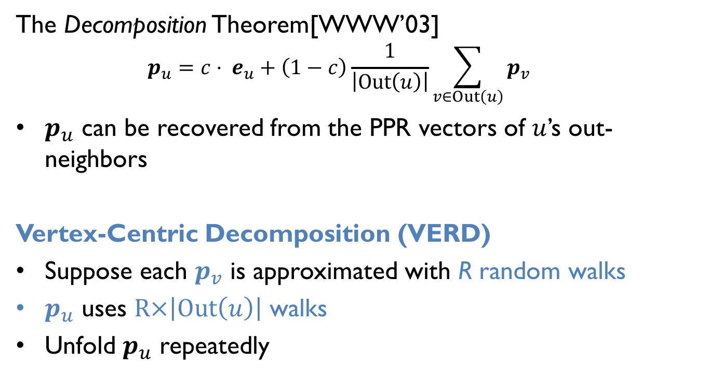
Online Query
The Decomposition Theorem[WWW’03]
$$p_{u}=c⋅ e_{u}+\left(1−c\right)\frac{1}{\left|Out\left(u\right)\right|}\sum_{v∈Out\left(u\right)}{p_{v}}$$
$p_{u}$ can be recovered from the PPR vectors of $u$’s out-neighbors
Vertex-Centric Decomposition (VERD)
Suppose each $p_{v}$ is approximated with R random walks
$p_{u}$ uses $R×\left|Out\left(u\right)\right|$ walks
Unfold $p_{u}$ repeatedly
More accurate
Notes:
For the online query, we use the decomposition theorem proved by Jeh and Widom in 2003. The decomposition theorem shows that the PPR vector p_u can be recovered from the PPR vectors of u’s out-neighbors.
So if each p_v in the PPR index is approximated with R random walks. We can recover p_u with R*|Out(u)| random walks. This gives us a more accurate p_u compared to the one in the PPR index.
By unfolding p_u repeatedly, we can achieve arbitrary accuracy in online phase.

Slide 13
Implementation
Offline preprocessing
Simulate billions of random walks
Independent, can be easily parallelzed
VENUS[ICDE’15] is a single machine graph disk-based engine
Each instance of VENUS runs independently on a cluster
Online batch query
Implement VERD for multiple vertices on PowerGraph[OSDI’12]
Fast response for thousands of queries
Notes:
Next, we introduce the implementation of PowerWalk on two graph engines VENUS and PowerGraph.
The offline preprocessing needs to simulate R random walks for each of all N vertices. So we need to simulate billions of random walks. Note that these random walks are independent and can be easily distributed on multiple machines. We implement our random walk simulation on VENUS which is a single machine disk-based graph processing system, and run each VENUS instance independently on a cluster of machines.
For online query, we implement VERD on PowerGraph which is a distributed in-memory graph engine. Its fast in-memory engine allows our algorithm to response thousands of queries in seconds.

Slide 14
Random Walks on VENUS
Vertex Update Function
void update(v) {
for each walk w on v {
r <- uniform[0, 1]
if r < c then // teleport
move w to w’s source
else
move w to a random neighbor
}
}
Graph is maintained by VENUS.
How to store the states of random walks?
Notes:
In recent graph processing systems, users need to implement an update function which will be run for each vertex v iteratively. To implement random walk simulation on VENUS, the update function takes a vertex v, then for each walk w on vertex v, we move walk w to the starting vertex of walk w with prob. c, otherwise we move w to a random neighbor.
In VENUS, the graph structure are maintained by the system on the disk. The VENUS system will minimize the random I/O operations to the graph to accelerate the computation. This remains a question that is how to store the states of random walks efficiently.

Slide 15
Efficient Storage for Walk States
Store walks in buckets (DrunkardMob[RecSys’13])
In memory
One array for each vertex costs too much
0
1
2
…
1000
0-100
101-200
201-300
…
901-1000
Merge random walks of adjacent vertices in to buckets
A very large array of pointers.
Notes:
Since we need random access to the states of random walks, we need an efficient data structure to store the random walks. An easy solution is to create an array with length N and store all random walks separately. Each element in the array is a pointer that points to the list of random walks. However it takes too much memory when N is large. Here we implement a bucket data structure proposed in 2013. We divides vertices from 1 to N to multiple sub-intervals, and store the random walks on the same interval in a bucket.

Slide 16
Online Batch Query
Implement Vertex-Centric Decomposition (VERD) on PowerGraph
Why PowerGraph?
Disk-based systems cannot response in real-time
PowerGraph: a mature in-memory graph engine
Batch PPR queries
Batch queries are common in search engines[WSDM’11]
Access to graph and PPR index can be multiplexed and aggregated into larger packets
Notes:
We implement our online query phase on PowerGraph, because we need fast response to PPR queries which is not possible for a disk-based system. We choose PowerGraph because it’s a mature in-memory graph engine.
Moreover, as pointed out by a paper in WSDM’11, there are a number of important scenarios where large batches of queries are submitted to search engines and web services. In evaluation, we show we can execute a batch of PPR queries efficiently, because the access to graph and PPR index can be multiplexed and aggregated into larger packets.

Slide 17
Evaluation
Cluster
8 nodes (each with 16 cores, 377GB RAM, 20TB disk)
Dataset
Dataset | N | M
twitter-2010 | 41,652,230 | 1,468,365,182
uk-union | 133,633,040 | 5,507,679,822
Notes:
Our evaluation is conducted on a cluster of eight machines, and each has 16 cores and 377GB RAM.
We use two billion-scale datasets, the twitter-follow graph and the web graph generated by crawling the .uk domain.

Slide 18

Preprocessing Costs
PowerWalk can adjust the costs of preprocessing by varying the number of random walks on each vertex, $R$
The previous Monte-Carlo method takes very long preprocessing time and need to store a very large index
Dataset | Type | PowerWalk |  | Monte-Carlo
 |  | R=10 | R=100
twitter-2010 | Preprocessing time | 933.8 s | 1728.2 s | 4.5 h
 | Index size | 12.4 GB | 95.5GB | 1.48 TB
uk-union | Preprocessing time | 2087.4 s | 3187.2 s | 11.6 h
 | Index size | 29.7 GB | 148.0 GB | 1.1 TB
Notes:
First, we show the preprocessing costs of our PowerWalk framework. Here R is the number of random walks on each vertex. When R is 10, we take 933 s to preprocess the twitter graph, and when R is 100, the preprocessing time increases to 1728 s. When R increases, the size of index also increases. So by adjusting R, we can adjust the time and space consumption of preprocessing. We’ll show the effective of R on online query later.
The previous Monte-Carlo method needs to precompute all PPR vectors and store them. It’s very time and space consuming. For example, it takes more than 10 hours to preprocess the uk-union graph.

Slide 19
Query Performance
Power iteration (PI): the naïve way
Monte-Carlo: retrieve PPR vectors from disk directly
Datasest | Number of queries | Power iteration | Monte-Carlo | PowerWalk
 |  |  |  | R=10 | R=100
twitter-2010 | 1 | 95.2 s | 25 ms | 2.28 s | 1.65 s
 | 100 | - | 2.50 s | 2.45 s | 1.65 s
 | 10,000 | - | 117.50 s | 8.74 s | 3.64 s
 | 100,000 | - | 978.25 s | 52.20 s | 17.96 s
uk-union | 1 | 320 s | 18 ms | 4.81 s | 3.70 s
 | 100 | - | 1.75 s | 4.91 s | 3.80 s
 | 10,000 | - | 125.25 s | 5.78 s | 3.96 s
 | 100,000 | - | 1037.25 s | 44.19 s | 7.68 s
Notes:
For the online query, we also implement the power iteration method on PowerGraph. For the Monte-Carlo method, we use a key-value storage to store all PPR vectors on disk.
As shown in the table, with larger R, our PowerWalk system can answer PPR queries faster because it needs lesser iterations in the online phase.
The Monte-Carlo method can answer one query very fast because it loads the PPR vector from disk directly. However, as the number of queries increases, the Monte-Carlo method becomes too slow because its index is too large to be cached in the main memory. On contrast, our PowerWalk framework can answer tens of thousands queries in seconds.

Slide 20
Conclusion
Propose PowerWalk, a framework for online PPR computation on distributed graph engines
Use MCFP to compute a light-weight PPR index
Use VERD to compute a batch of PPR vectors based on PPR index
Evaluation shows it is scalable in balancing offline preprocessing and online query costs

Slide 21
Thank You!

