Slide 1
CensableLiving Blog in php with MVC framework
By Aaron Palmer, James Jhurani and Longyi Qi

Slide 2
AGILE

Slide 3
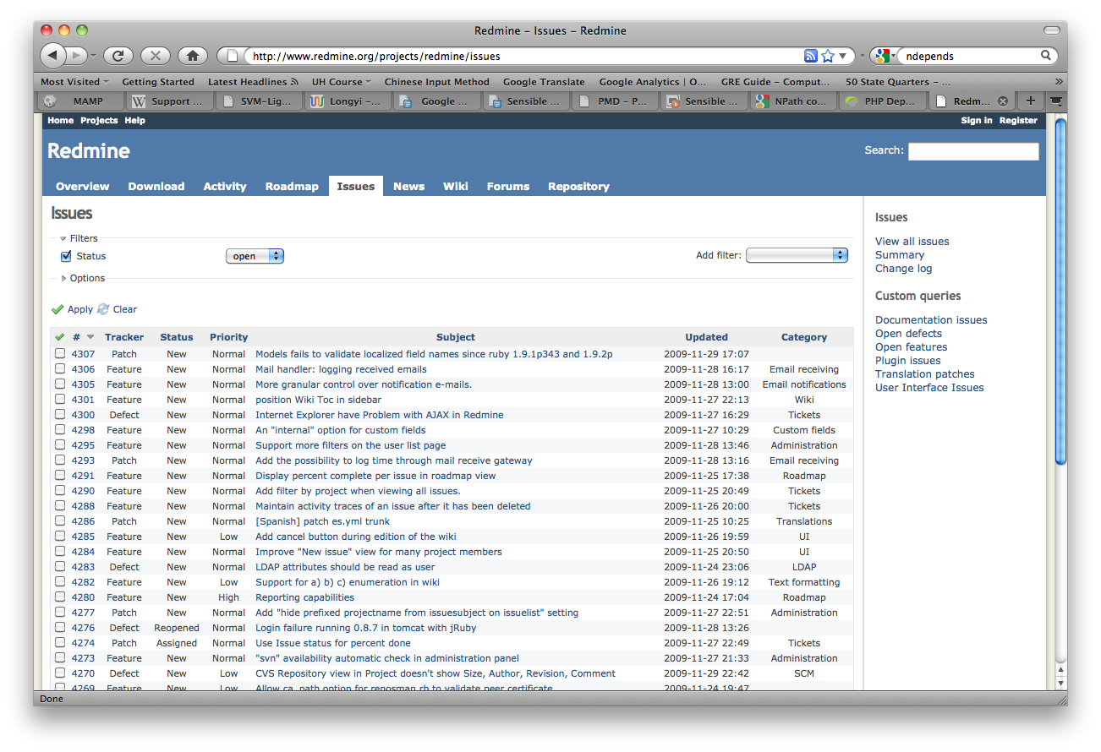
Redmine – Overview
Flexible role based access control
Flexible issue tracking system
Gantt chart and calendar
News, documents & files management
Feeds & email notifications
Per project wiki
Per project forums
Time tracking

Slide 4
Database Schema

Slide 5
MVC Framework

Slide 6
Some design patterns…

Slide 7
Useful code metrics

