Slide 1
SensibleLiving in php with MVC framework
By Aaron Palmer, James Jhurani and Longyi Qi

Slide 2
Why we used AGILE
Agile has less limitations than traditional plan-driven methodologies
We favor:
Individuals and interactions over processes and tools
Working software over comprehensive documentation
Customer collaboration over contract negotiation
Responding to change over following a plan
We collaborated thru our google group, google wave, redmine
Self-documenting code
Made SRS at start of semester, responded to clients' requests
Instead of using a ghant chart, we based what to do off of key importance

Slide 3
Technology and Tools we used:
Programming language: PHP 5
Libraries: PhpUnit(for tests), Xdebug(for code coverage), Pdepend(for program metrics)
Database: MySQL
Editor: TextMate, vim and notepad
Web technology: HTML 4
Server: Apache httpd
Agile development practice: Redmine, Google Group mailing list, Google docs and Google Wave

Slide 4
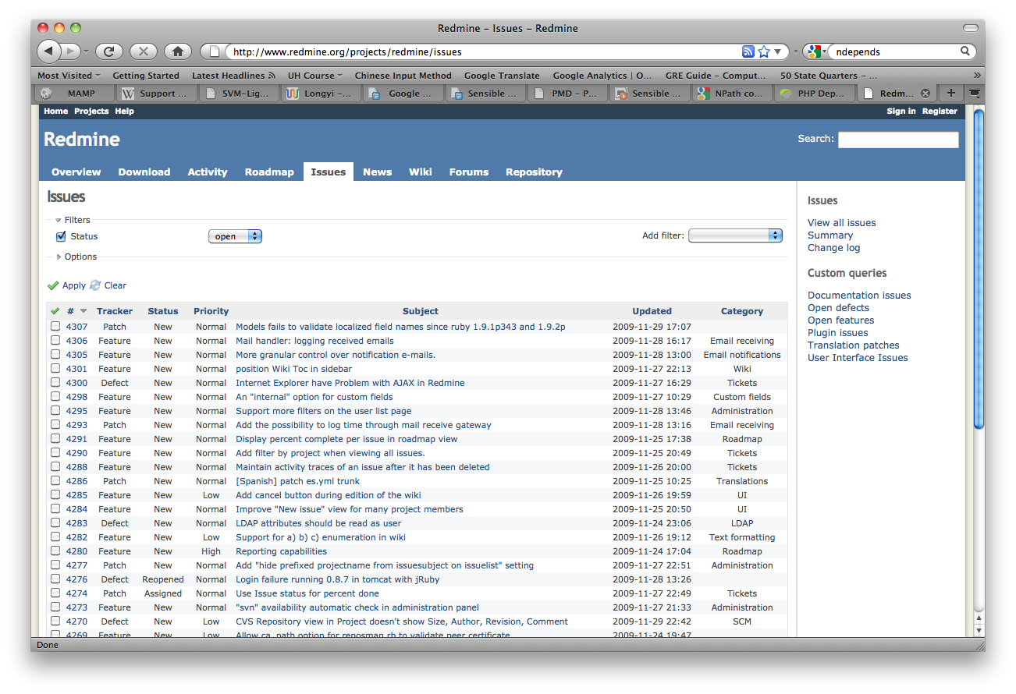
Redmine – Overview
Flexible role based access control
Flexible issue tracking system
Gantt chart and calendar
News, documents & files management
Feeds & email notifications
Per project wiki
Per project forums
Time tracking

Slide 5
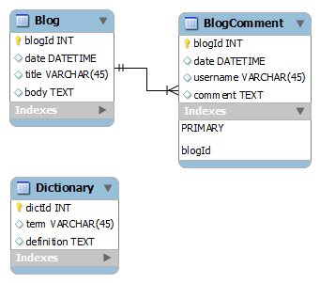
Database Schema

Slide 6
Introduction to Sensible PHP and Sensible Living
Sensible PHP is a php mvc framework.
Sensible Living is the first application of Sensible PHP.

Slide 7
Features (done)
By using our management script, it's pretty easy to initialize the project, create applications and sync with database.
We focus on adhering to the DRY principle, so it's easy to modify the models, and write controllers, additional database logics and views.
Flexible in coding, reuse and deployment.
Easy to handle static media files, like Javascript, cascade style sheet, images, audios and videos.
Easy for modification and extension as we adhere OCP principle.
No worry on URL address, simply use the application name and the action name, user can get the result.
Trash the old applications when running the clean or init project command.

Slide 8
Features (in mind)
Form Generation and validations
Automatic admin interface
Template system
Cache system
Error notification email to the admin

Slide 9
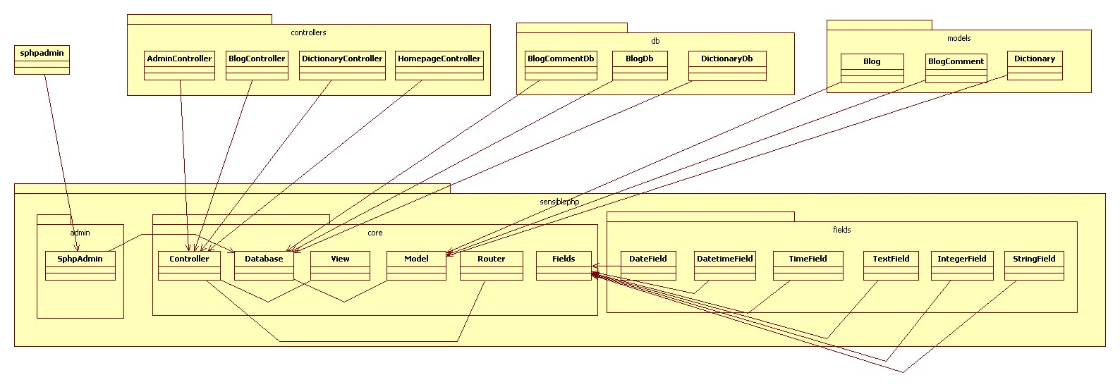
Class Diagram

Slide 10
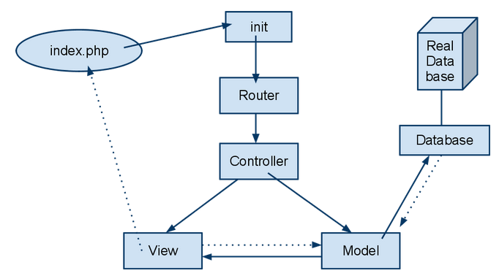
Action Flow Diagram

Slide 11
Design Principles

Slide 12
Don't Repeat Yourself Principle
Our framework is DRY
Our applications are DRY
Our application deployment also is DRY

Slide 13
Open-Closed Principle
Applications
Field type in framework

Slide 14
Single Responsibility Principle
Method
Class
Package
Component

Slide 15
Acyclic Dependence Principle
the dependency structure is a directed acyclic graphic without cycles

Slide 16
Stable Dependency Principle and Stable Abstraction Principle
all components with high I metrics depend on the ones with low I metrics, and what's more, the result of our A, I and D' is great!

Slide 17
Design Patterns
MVC design pattern
Observers pattern
Object Adapter

Slide 18
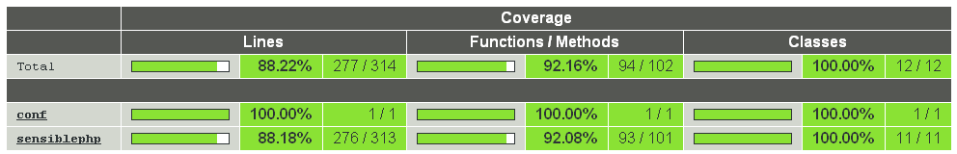
Test Cases for Sensible PHP Framework

Slide 19
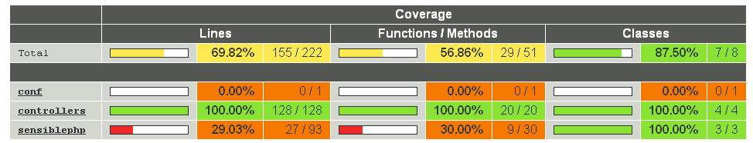
Test cases for Sensible Living Applications

Slide 20
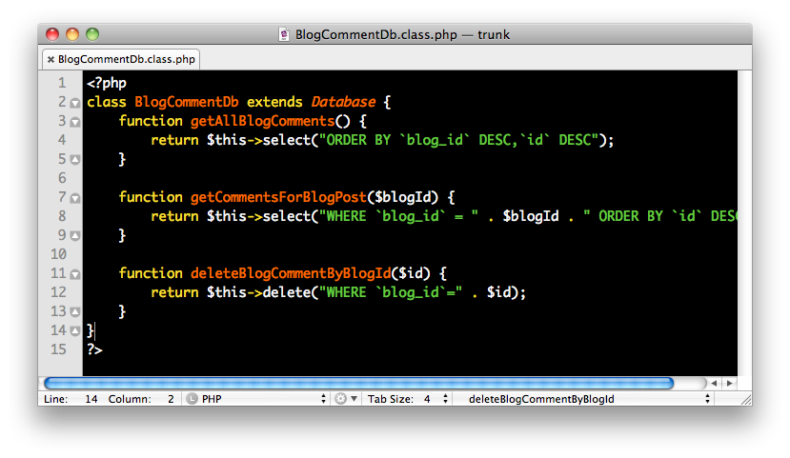
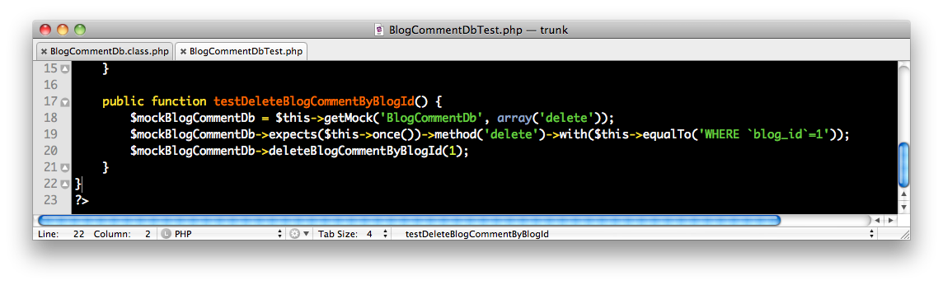
Test cases for Sensible Living Applications

Slide 21
Proud
MVC Framework itself
DRY
OCP
Test code coverage and other metrics

Slide 22
Not proud
Some amazing features of sensible php left
Some applications of sensible living left

Slide 23
Useful code metrics

Slide 24
Questions?

Slide 25
Thank you!

