Slide 1
CAR ACCIDENTS SEVERITY PREDICTION
LIUQI QIAN

Slide 2
introduction
As the most commonly used transports, automobiles play an important role in daily life. People drive cars to work, study, travel, and even move to a new house. With the widespread use of automobiles, the possibility of traffic accidents increases inevitably. Besides, the environmental factors including weather, location light, and more will also affect the probability of accidents.
Help the people who are involved in the accidents, this project will utilize certain know conditions to predict the severity of the accidents and reduce the risks of accidents happen by taking actions.

Slide 3
DATA SOURCE
Seattle weekly collision (starts 2004)
Original csv file : CSV FILE
Metadata: ArcGIS Metadata Form

Slide 4
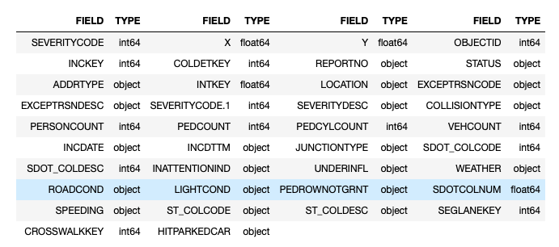
DATA DESCRIPTION
Total 194,673 rows, 38 columns

Slide 5
Target variable
Severity Code
136,485 code 1 → prop damage
58,188 code 2 → injury

Slide 6
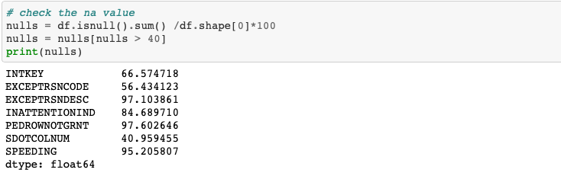
NA VALUES
Drop columns which have more than 40% NA values

Slide 7
Drop unrelated columns
WEATHER
X, Y, LOCATION
INCDTTM
PEDCOUNT, PEDCYLCOUNT
ST_COLCODE, ST_COLDESC, STOD_COLCODE, STOD_COLDESC
HITPARKEDCAR
JUNCTIONTYPE
STATUS

Slide 8
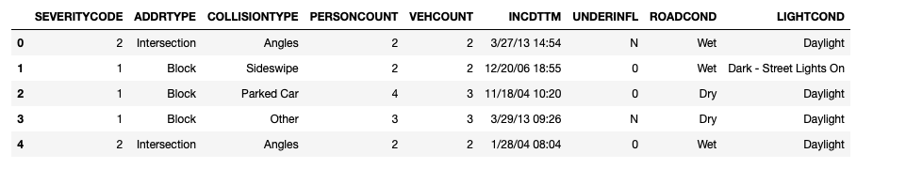

Slide 9
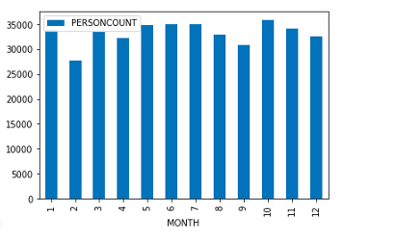
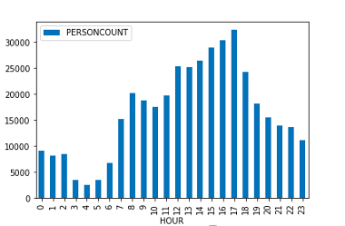
CONVERT TYPE, EXTRACT NEW COLUMNS

Slide 10
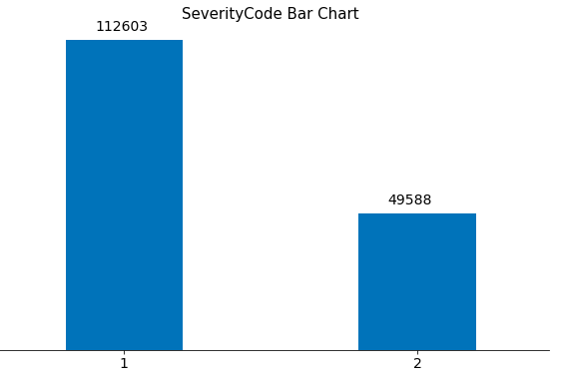
SEVERITY CODE BAR CHART

Slide 11
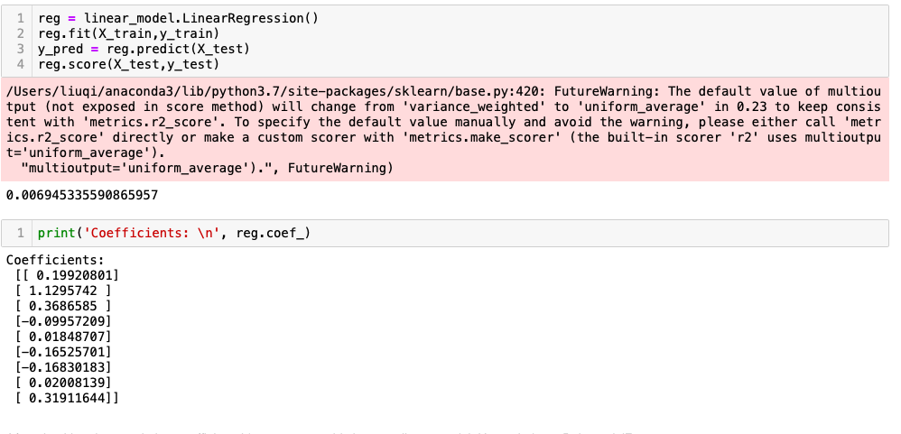
MODEL – LINEAR REGRESSION

Slide 12
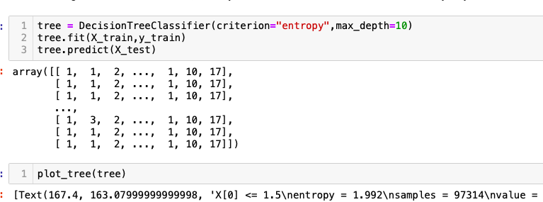
MODELS - DECISION TREE

Slide 13
CONCLUSION
It is useful to use the machine learning to predict the severity of car accidents. Most of the algorithms are biased towards to most frequent class. Proper preprocessing of the data will give optimal results.

