Slide 1

High School Graduation Rate Analysis and Prediction
Lexi Liu

Slide 2
Introduction
In 2004, there are only 71.7% students were graduated from high school successfully.
In 2013, it increased to 81.4% with 1.8 million more people graduated successfully.
The government set up a goal that 90% of students will graduate from high school successfully in 2020.
To achieve this goal, it is necessary to find out root causes lead to high school graduation rate and build models to predict future graduation rate.

Slide 3
Dataset
AT&T data for diplomas:
http://datafordiplomas.devpost.com/details/resources
2010 census data merged 2013 graduation data
2317 records with missing value and error
565 variables including census/graduation factors
Average yearly temperature data on state level
Average winter temperature data on state level
School system quality/safety data on state level

Slide 4
Pre-processing Dataset
1. Choose variables most related to topic, used calculated percentage variables only
2. Clean data, eliminate most of the missing values
3. Analyze feature importance to choose features
4.Fill in average value for missing value columns in Python

Slide 5
Problem Statement and Hypothesis
There are lots of factors can affect graduation rate, finding the root causes can help government set up new rules to help schools increase graduation rate by 2020.
Some of the hypotheses are:
Weather and location of states can affect graduation rate.
Families with high movement rate and poverty level have lower graduation rate
Students with employed are having less time study, lead to lower graduation rate

Slide 6
Analysis

Slide 7
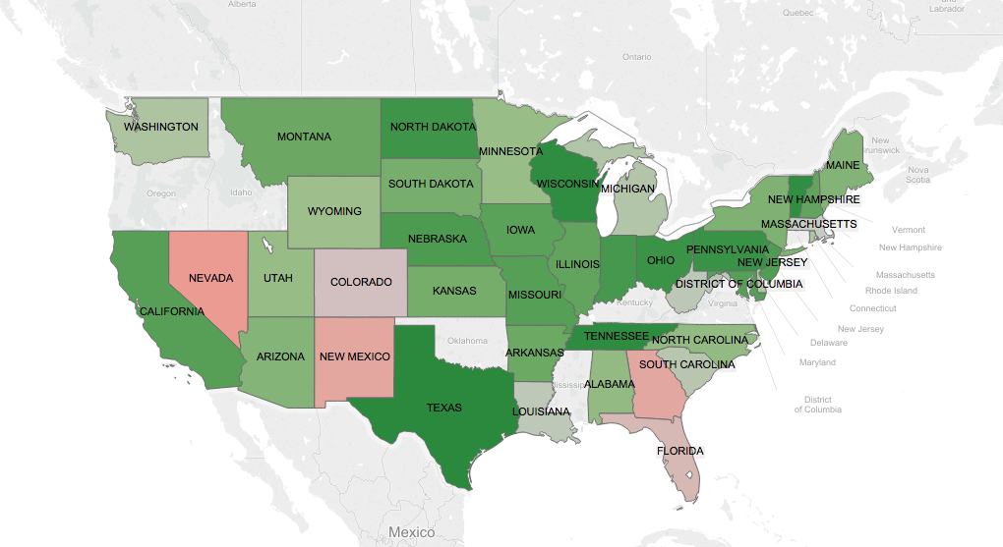
Graduation Rate Overview on State Level

Slide 8
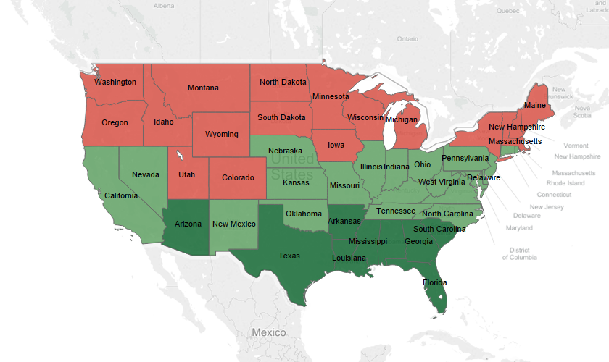
Average Yearly temperature vs. Graduation rate
Red:low Green:high

Slide 9
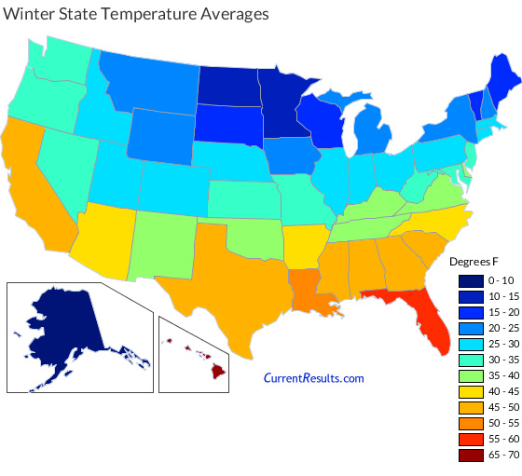
Average winter temperature vs. Graduation rate

Slide 10
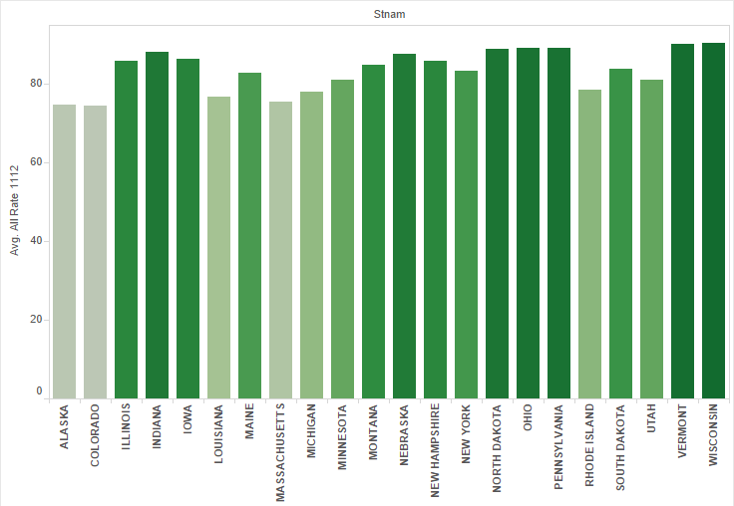
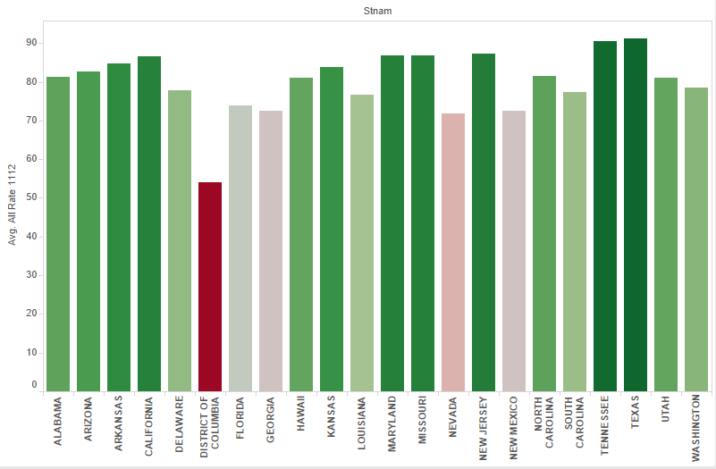
North
South

Slide 11
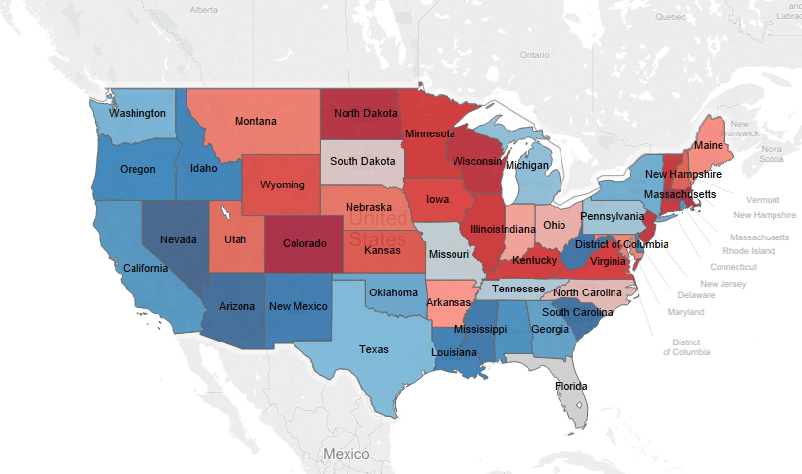
School-System Quality ranking on State Level
Red:good Blue:bad

Slide 12
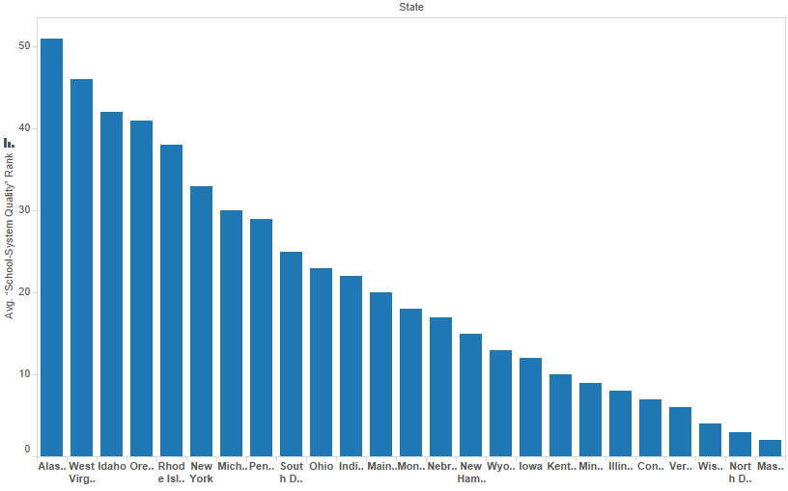
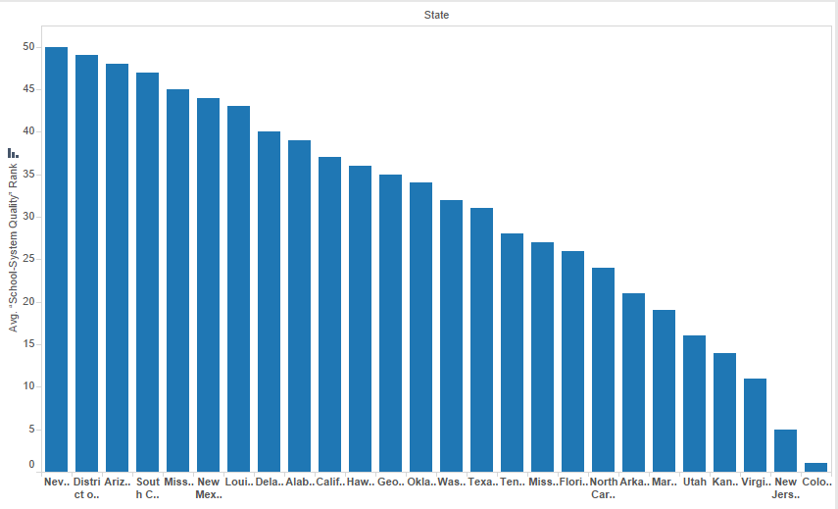
North
South

Slide 13
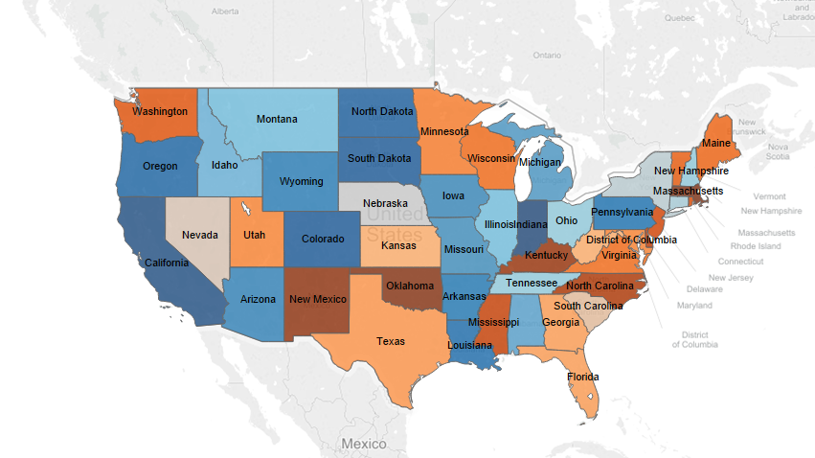
School Safety ranking vs. graduation rate
Orange:good Blue:bad

Slide 14
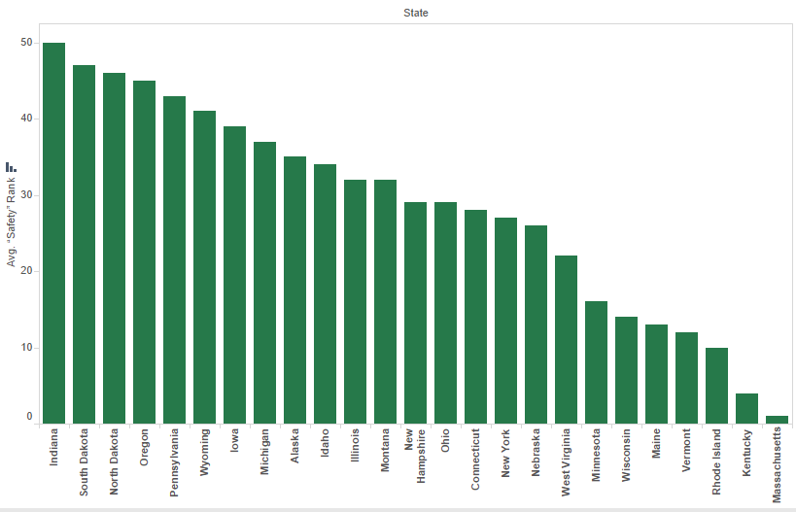
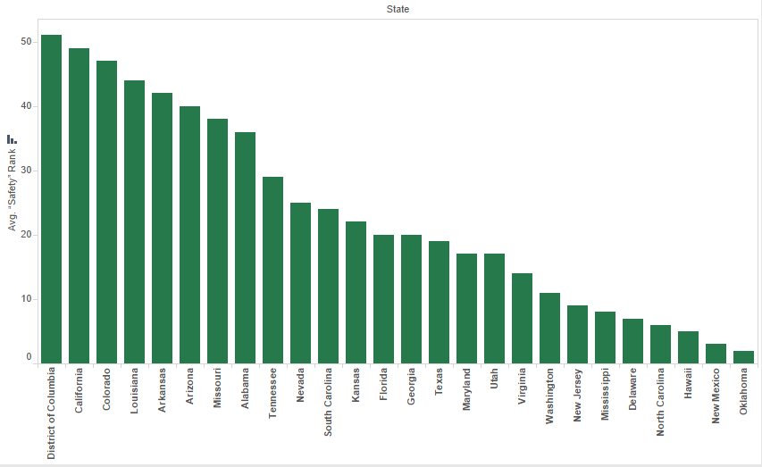
North
South

Slide 15
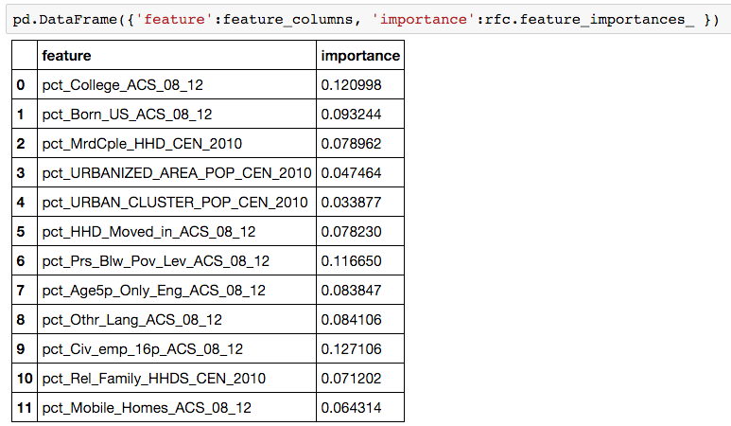
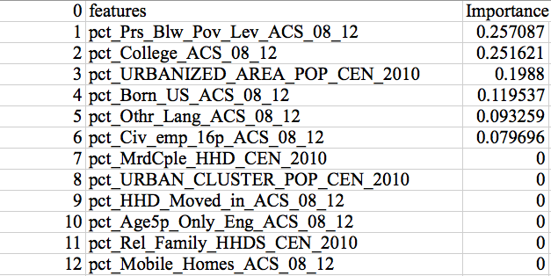
Feature Importance
Random Forest
Decision Tree

Slide 16
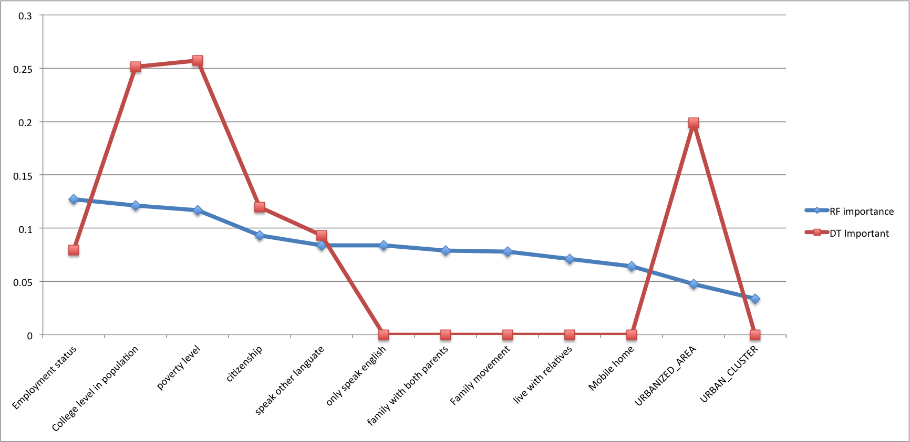
Feature Importance

Slide 17
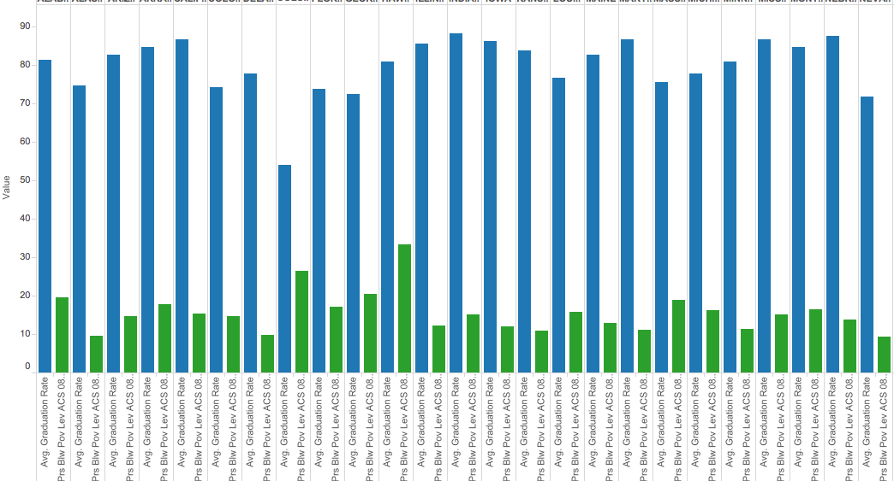
Poverty vs. Graduation rate

Slide 18
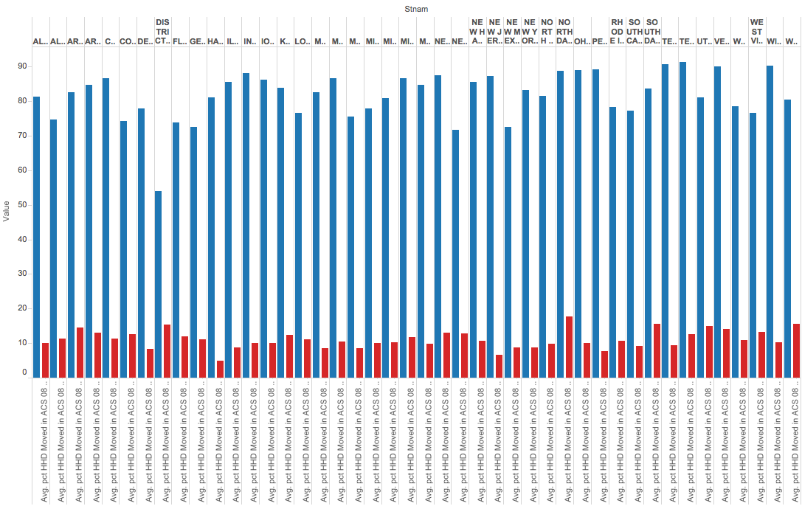
Household Movement vs. Graduation Rate

Slide 19
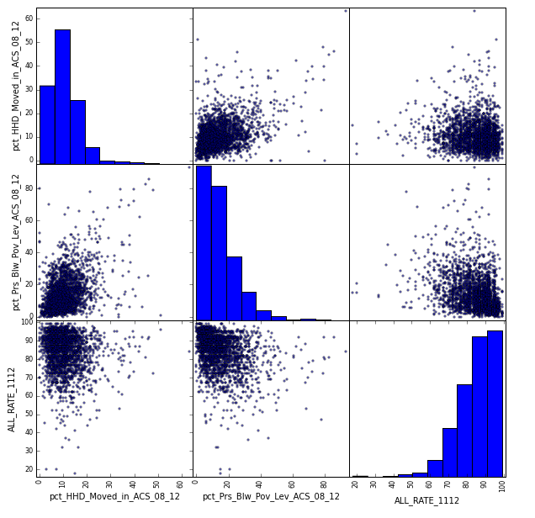
Poverty, Movement & GR

Slide 20
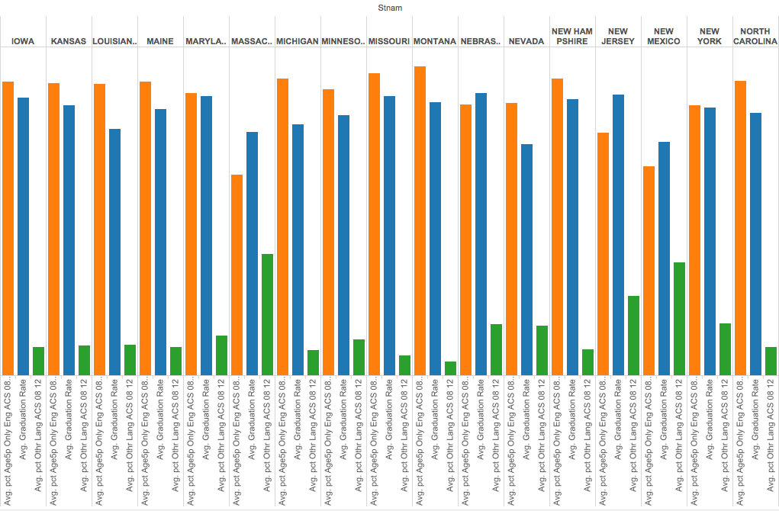
English Level vs. GR

Slide 21
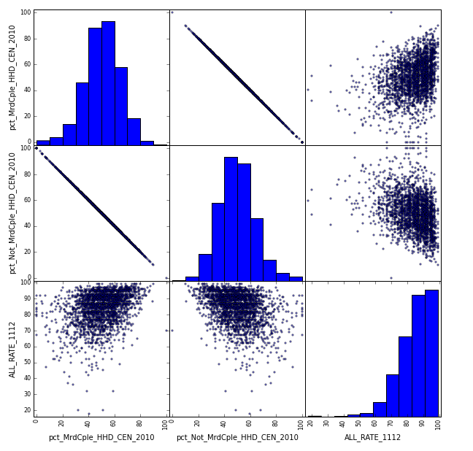
Linear regression of GR vs. family marriage status

Slide 22
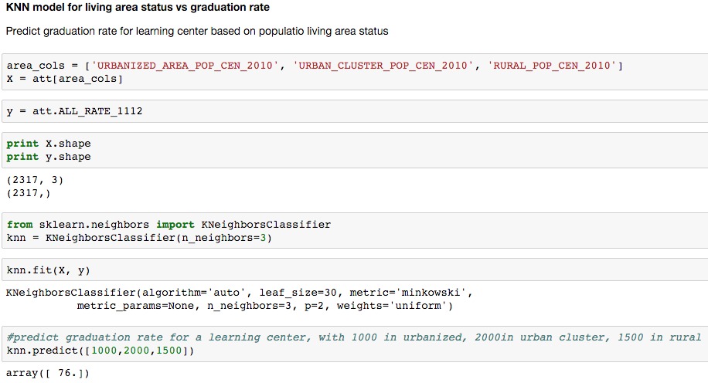
KNN Model Prediction

Slide 23
Conclusion
1. Northern states have higher average graduation rate than southern states, due to better school-system quality in northern states. Government should improve school system in southern states
2. Poverty level has negative correlation with graduation rate. Government can provide more benefits for poverty families with students going to high school.
3. The more frequency a household moves, the lower the graduation rate. The government should make movement and transfer process simpler.

Slide 24
Conclusion
4. Higher percentage of English-speaking student leads to higher graduation rate. Schools should provide more tutoring for non-native students.
5. Students with both parents have higher graduation rate than single family. Schools can build connection with single families and give concern about these students to see if they have problem in living and learning. Government can provide more subsidies for single families as well.

Slide 25
Questions??

