Slide 1
OBJECT ORIENTED PROGRAMMING
6.0001 LECTURE 8

Slide 2
OBJECTS
Python supports many different kinds of data
1234 3.14159 "Hello" [1, 5, 7, 11, 13]
{"CA": "California", "MA": "Massachusetts"}
each is an object, and every object has:
  a type
  an internal data representation (primitive or composite)
  a set of procedures for interaction with the object
an object is an instance of a type
  1234 is an instance of an int
  "hello" is an instance of a string
6.0001 LECTURE 8

Slide 3
OBJECT ORIENTED PROGRAMMING (OOP)
EVERYTHING IN PYTHON IS AN OBJECT (and has a type)
can create new objects of some type
can manipulate objects
can destroy objects
  explicitly using del or just “forget” about them
  python system will reclaim destroyed or inaccessible objects – called “garbage collection”
6.0001 LECTURE 8

Slide 4
WHAT ARE OBJECTS?
objects are a data abstraction
that captures…
an internal representation
  through data attributes
an interface for interacting with object
  through methods
(aka procedures/functions)
  defines behaviors but hides implementation
6.0001 LECTURE 8

Slide 5
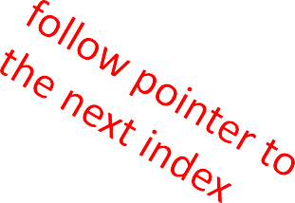
EXAMPLE:
[1,2,3,4] has type list
how are lists represented internally? linked list of cells
L =
1 -> 2 -> 3 -> 4 ->
how to manipulate lists?
  L[i], L[i:j], +
  len(), min(), max(), del(L[i])
  L.append(),L.extend(),L.count(),L.index(),
L.insert(),L.pop(),L.remove(),L.reverse(), L.sort()
internal representation should be private
correct behavior may be compromised if you manipulate internal representation directly
6.0001 LECTURE 8

Slide 6
ADVANTAGES OF OOP
bundle data into packages together with procedures that work on them through well-defined interfaces
divide-and-conquer development
  implement and test behavior of each class separately
  increased modularity reduces complexity
classes make it easy to reuse code
  many Python modules define new classes
  each class has a separate environment (no collision on function names)
  inheritance allows subclasses to redefine or extend a selected subset of a superclass’ behavior
6.0001 LECTURE 8

Slide 7
CREATING AND USING YOUR OWN TYPES WITH CLASSES
Implementing the class Using the class
make a distinction between creating a class and
using an instance of the class
creating the class involves
  defining the class name
  defining class attributes
  for example, someone wrote code to implement a list class
using the class involves
  creating new instances of objects
  doing operations on the instances
  for example, L=[1,2] and len(L)
6.0001 LECTURE 8

Slide 8


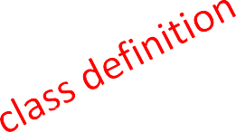
DEFINE YOUR OWN TYPES
Implementing the class
Using the class
use the class keyword to define a new type
class
Coordinate(object):
#define attributes here
similar to def, indent code to indicate which statements are part of the class definition
the word object means that Coordinate is a Python object and inherits all its attributes (inheritance next lecture)
  Coordinate is a subclass of object
  object is a superclass of Coordinate
6.0001 LECTURE 8

Slide 9
WHAT ARE ATTRIBUTES?
data and procedures that “belong” to the class
data attributes
  think of data as other objects that make up the class
  for example, a coordinate is made up of two numbers
methods (procedural attributes)
  think of methods as functions that only work with this class
  how to interact with the object
  for example you can define a distance between two coordinate objects but there is no meaning to a distance between two list objects
6.0001 LECTURE 8

Slide 10
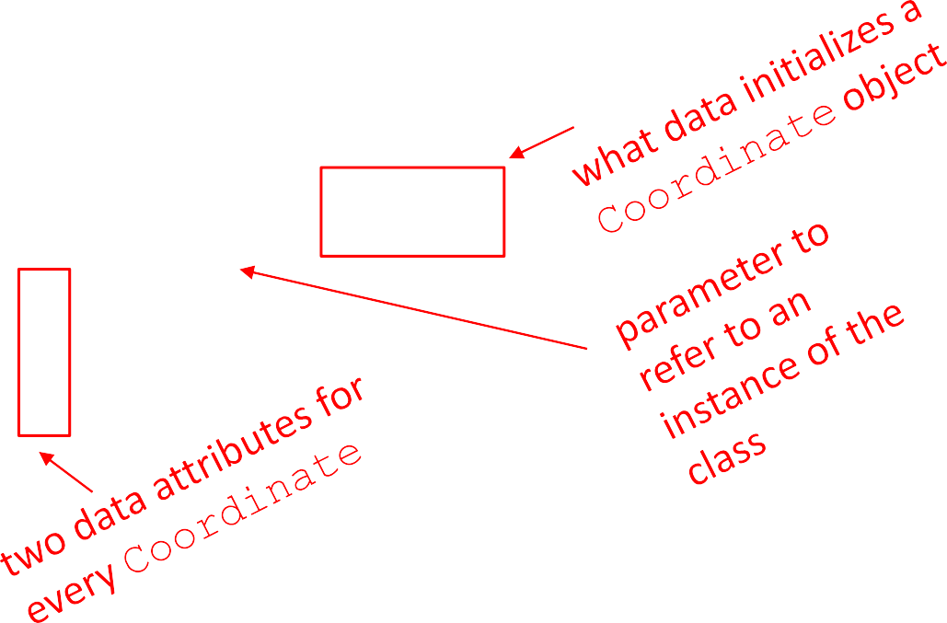
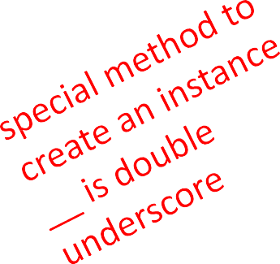


DEFINING HOW TO CREATE AN INSTANCE OF A CLASS
Implementing the class Using the class
first have to define how to create an instance of object
use a special method called
initialize some data attributes
class Coordinate(object):
init to
def init (self, x, y):
self.x | = | x
self.y | = | y
6.0001 LECTURE 8

Slide 11
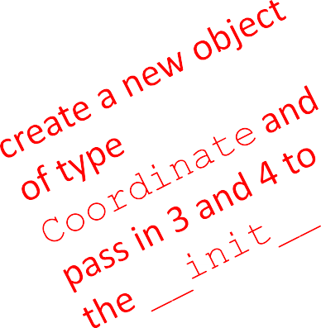
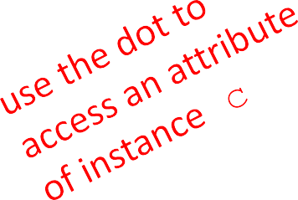
ACTUALLY CREATING AN INSTANCE OF A CLASS
Implementing the class Using the class
c =
Coordinate(3,4)
origin = Coordinate(0,0) print(c.x)
print(origin.x)
data attributes of an instance are called instance variables
don’t provide argument for self, Python does this automatically
6.0001 LECTURE 8

Slide 12
WHAT IS A METHOD?
procedural attribute, like a function that works only with this class
Python always passes the object as the first argument
  convention is to use self as the name of the first argument of all methods
the “.” operator is used to access any attribute
  a data attribute of an object
  a method of an object
6.0001 LECTURE 8

Slide 13
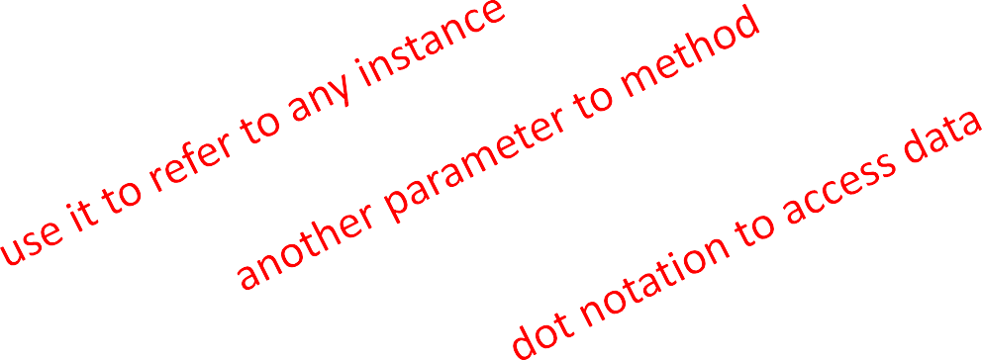
DEFINE A METHOD FOR THE
Coordinate CLASS
Implementing the class Using the class
class Coordinate(object): def init (self, x, y):
self.x = x self.y = y
def distance(self, other): x_diff_sq = (self.x-other.x)**2 y_diff_sq = (self.y-other.y)**2
return (x_diff_sq + y_diff_sq)**0.5
other than self and dot notation, methods behave just like functions (take params, do operations, return)
6.0001 LECTURE 8

Slide 14

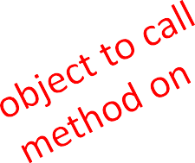
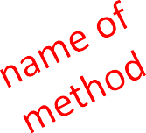
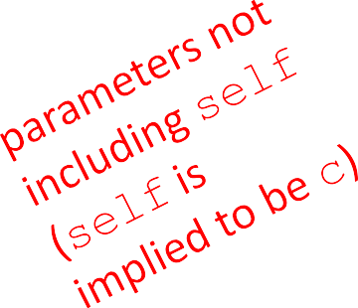

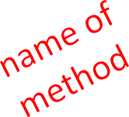
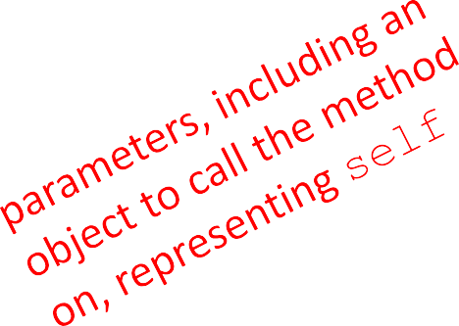
HOW TO USE A METHOD
Implementing the class
Using the class
def distance(self, other):
# code here
Using the class:
conventional way
c = Coordinate(3,4) zero = Coordinate(0,0)
equivalent to
c = Coordinate(3,4) zero = Coordinate(0,0)
print(c.distance(zero))
print(Coordinate.distance(c, zero))
6.0001 LECTURE 8

Slide 15
PRINT REPRESENTATION OF AN OBJECT
>>> c = Coordinate(3,4)
>>> print(c)
< main .Coordinate object at 0x7fa918510488>
uninformative print representation by default
define a str method for a class
Python calls the str method when used with
print on your class object
you choose what it does! Say that when we print a
Coordinate object, want to show
>>> print(c)
<3,4>
6.0001 LECTURE 8

Slide 16
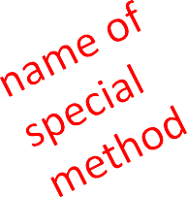
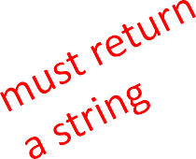
DEFINING YOUR OWN PRINT METHOD
Implementing the class Using the class
class Coordinate(object):
def init (self, x, y): self.x = x
self.y = y
def distance(self, other): x_diff_sq = (self.x-other.x)**2 y_diff_sq = (self.y-other.y)**2
return (x_diff_sq + y_diff_sq)**0.5 def str (self):
return
"<"+str(self.x)+","+str(self.y)+">"
6.0001 LECTURE 8

Slide 17
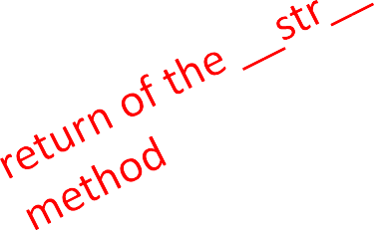
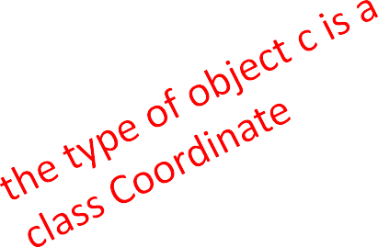
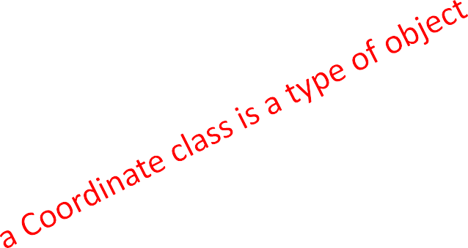
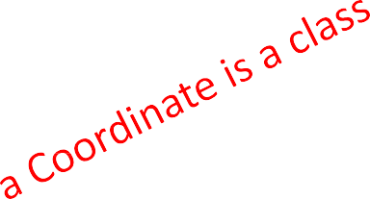
WRAPPING YOUR HEAD AROUND TYPES AND CLASSES
Implementing the class Using the class
can ask for the type of an object instance
>>> c = Coordinate(3,4)
>>> print(c)
<3,4>
>>> print(type(c))
<class main .Coordinate>
this makes sense since
>>> print(Coordinate)
<class main .Coordinate>
>>> print(type(Coordinate))
<type 'type'>
use isinstance() to check if an object is a Coordinate
>>> print(isinstance(c, Coordinate)) True
6.0001 LECTURE 8

Slide 18
SPECIAL OPERATORS
▪ +, -, ==, <, >, len(), print, and many others
https://docs.python.org/3/reference/datamodel.html#basic-customization
like print, can override these to work with your class
define them with double underscores before/after
add (self, other) | → | self | + | other
sub (self, other) | → | self | - | other
eq (self, other) | → | self | == other
lt (self, other) | → | self | < other
len (self) | → | len(self)
str (self) ... and others | → | print self
6.0001 LECTURE 8

Slide 19
EXAMPLE: FRACTIONS
create a new type to represent a number as a fraction
internal representation is two integers
  numerator
  denominator
interface a.k.a. methods a.k.a how to interact with
Fraction objects
  add, subtract
  print representation, convert to a float
  invert the fraction
the code for this is in the handout, check it out!
6.0001 LECTURE 8

Slide 20
THE POWER OF OOP
bundle together objects that share
  common attributes and
  procedures that operate on those attributes
use abstraction to make a distinction between how to implement an object vs how to use the object
build layers of object abstractions that inherit behaviors from other classes of objects
create our own classes of objects on top of Python’s basic classes
6.0001 LECTURE 8

Slide 21
Break for 10 mins

Slide 22
CLASS DEFINITION INSTANCE OF AN OBJECT TYPE vs OF A CLASS
class name is the type
class Coordinate(object)
class is defined generically
  use self to refer to some instance while defining the class
(self.x – self.y)**2
  self is a parameter to methods in class definition
class defines data and methods common across all instances
instance is one specific object
coord = Coordinate(1,2)
data attribute values vary between instances
c1 = Coordinate(1,2)
c2 = Coordinate(3,4)
  c1 and c2 have different data attribute values c1.x and c2.x because they are different objects
instance has the structure of the class
6.0001 LECTURE 9

Slide 23


GETTER AND SETTER METHODS
class Animal(object):
def init (self, age): self.age = age self.name = None
def get_age(self): return self.age
def get_name(self): return self.name
def set_age(self, newage): self.age = newage
def set_name(self, newname=""):
self.name = newname
def str (self):
return "animal:"+str(self.name)+":"+str(self.age)
getters and setters should be used outside of class to access data attributes
6.0001 LECTURE 9

Slide 24


INFORMATION HIDING
author of class definition may change data attribute
variable names
class Animal(object):
def init (self, age):
self.years
= age
def get_age(self): return self.years
if you are accessing data attributes outside the class and class definition changes, may get errors
outside of class, use getters and setters instead use a.get_age() NOT a.age
  good style
  easy to maintain code
  prevents bugs
6.0001 LECTURE 9

Slide 25
PYTHON NOT GREAT AT INFORMATION HIDING
allows you to access data from outside class definition
print(a.age)
allows you to write to data from outside class definition
a.age = 'infinite'
allows you to create data attributes for an instance from outside class definition
a.size = "tiny"
it’s not good style to do any of these!
6.0001 LECTURE 9

Slide 26

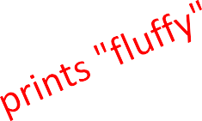
DEFAULT ARGUMENTS
default arguments for formal parameters are used if no actual argument is given
def set_name(self, newname=""): self.name = newname
default argument used here
a = Animal(3) a.set_name() print(a.get_name())
argument passed in is used here
a = Animal(3) a.set_name("fluffy")
print(a.get_name())
6.0001 LECTURE 9

Slide 27
Inheritance

Slide 28




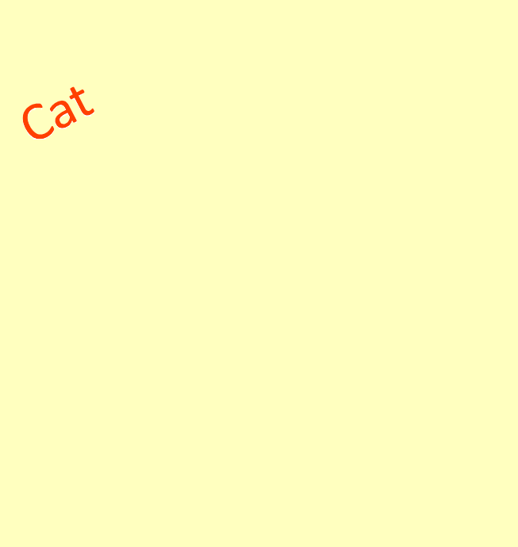
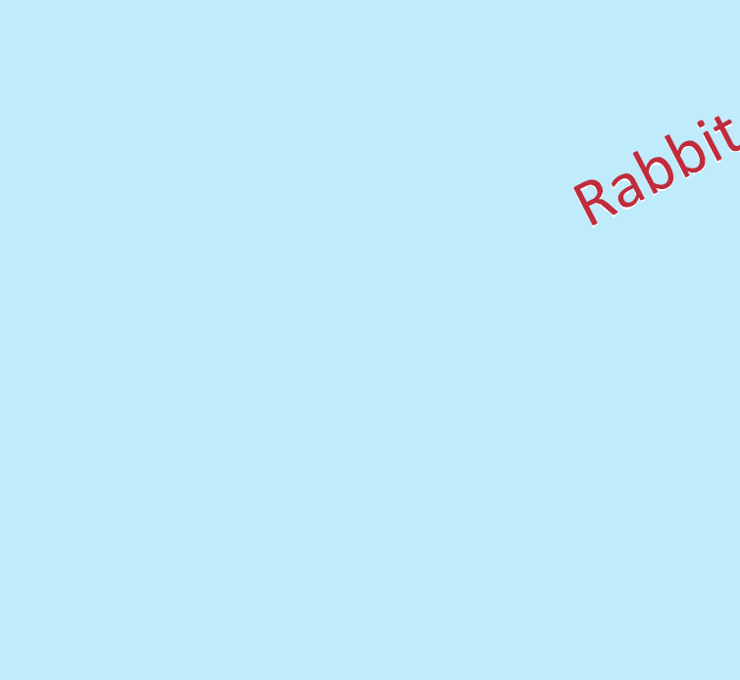






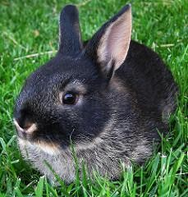
HIERARCHIES
Image Credits, clockwise from top: Image Courtesy Deeeep, CC-BY-NC. Image Image Courtesy MTSOfan, CC-BY-NC-SA. Image Courtesy Carlos Solana, license CC-BY-NC-SA. Image Courtesy Rosemarie Banghart-Kovic, license CC-BY-NC-SA. Image Courtesy Paul Reynolds, license CC-BY. Image Courtesy Kenny Louie, License CC-BY. Courtesy Harald Wehner, in the public Domain.
6.0001 LECTURE 9

Slide 29
HIERARCHIES
parent class
(superclass)
child class
Animal
(subclass)
inherits all data and behaviors of parent class
add more info
add more behavior
override behavior
Person
Cat
Rabbit
Student
6.0001 LECTURE 9

Slide 30
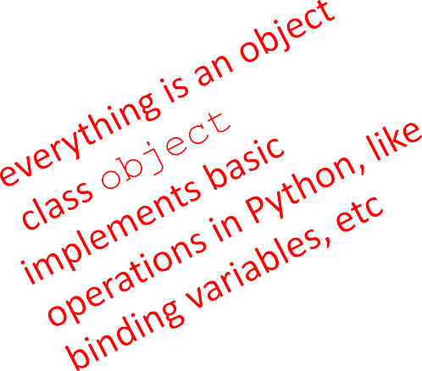
INHERITANCE: PARENT CLASS
class Animal(object):
def init (self, age): self.age = age self.name = None
def get_age(self): return self.age
def get_name(self): return self.name
def set_age(self, newage): self.age = newage
def set_name(self, newname=""): self.name = newname
def str (self):
return "animal:"+str(self.name)+":"+str(self.age)
6.0001 LECTURE 9

Slide 31

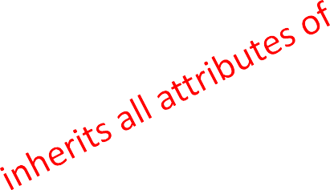
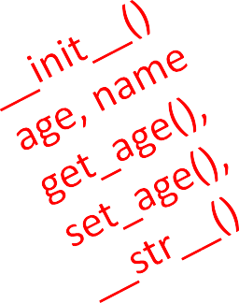
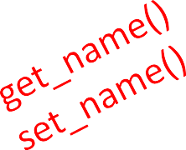
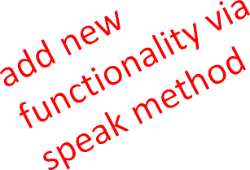
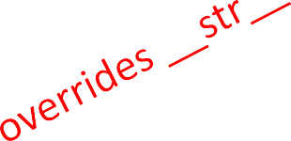
INHERITANCE: SUBCLASS
class Cat(Animal):
def speak(self):
print("meow")
def str (self):
return "cat:"+str(self.name)+":"+str(self.age)
add new functionality with speak()
  instance of type Cat can be called with new methods
  instance of type Animal throws error if called with Cat’s new method
init is not missing, uses the Animal version
6.0001 LECTURE 9

Slide 32
WHICH METHOD TO USE?
subclass can have methods with same name as superclass
for an instance of a class, look for a method name in
current class definition
if not found, look for method name up the hierarchy
(in parent, then grandparent, and so on)
use first method up the hierarchy that you found with that method name
6.0001 LECTURE 9

Slide 33
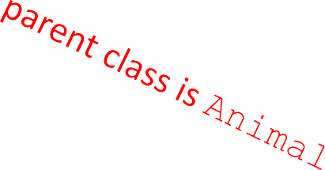


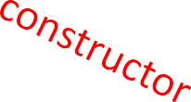

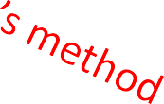

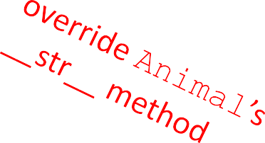
class Person(Animal):
def init (self, name, age):
 | Animal. init (self, age)
 | self.set_name(name)
 | self.friends = []
def get_friends(self):
return self.friends
def add_friend(self, fname):
if fname not in self.friends: self.friends.append(fname)
def speak(self):
print("hello")
def age_diff(self, other):
diff = self.age - other.age print(abs(diff), "year difference")
def str (self):
return "person:"+str(self.name)+":"+str(self.age)
6.0001 LECTURE 9

Slide 34
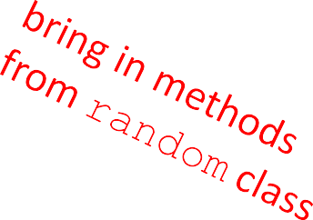
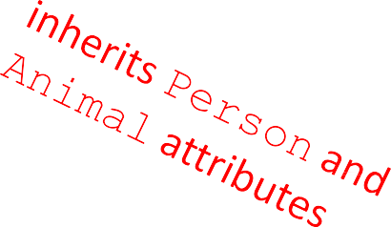

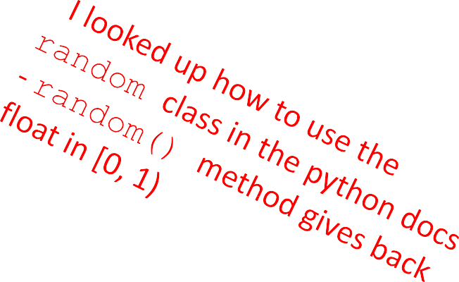
import random
class Student(Person):
def init (self, name, age, major=None): Person. init (self, name, age) self.major = major
def change_major(self, major):
self.major = major def speak(self):
r =
random.random()
if r < 0.25:
print("i have homework")
elif 0.25 <= r < 0.5:
print("i need sleep") elif 0.5 <= r < 0.75:
print("i should eat") else:
print("i am watching tv") def str (self):
return "student:"+str(self.name)+":"+str(self.age)+":"+str(self.major)
6.0001 LECTURE 9

Slide 35
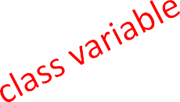
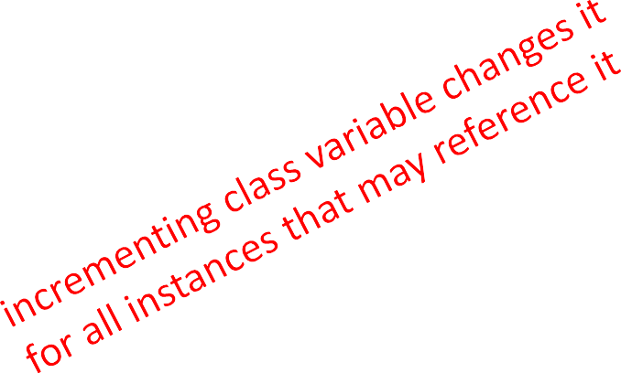
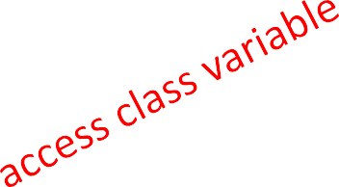
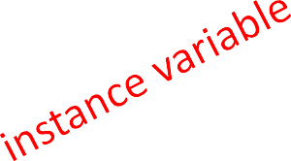
CLASS VARIABLES AND THE
Rabbit SUBCLASS
class variables and their values are shared between all instances of a class
class Rabbit(Animal): tag = 1
def init (self, age, parent1=None, parent2=None): Animal. init (self, age)
self.parent1 = parent1 self.parent2 = parent2
self.rid | = | Rabbit.tag
Rabbit.tag += 1
tag used to give unique id to each new rabbit instance
6.0001 LECTURE 9

Slide 36
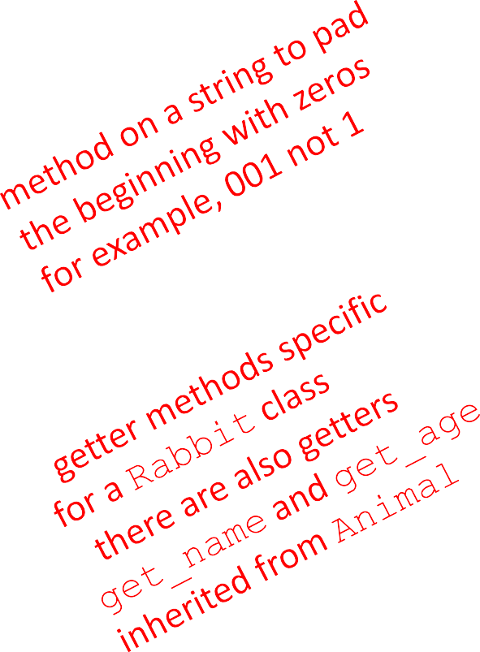
Rabbit GETTER METHODS
class Rabbit(Animal):
tag = 1
def init (self, age, parent1=None, parent2=None): Animal. init (self, age)
self.parent1 = parent1 self.parent2 = parent2 self.rid = Rabbit.tag Rabbit.tag += 1
def get_rid(self):
return str(self.rid).zfill(3) def get_parent1(self):
return self.parent1 def get_parent2(self):
return self.parent2
6.0001 LECTURE 9

Slide 37
WORKING WITH YOUR OWN TYPES
def add (self, other):
# returning object of same type as this class return Rabbit(0, self, other)
recall Rabbit’s init (self, age, parent1=None, parent2=None)
define + operator between two Rabbit instances
  define what something like this does: r4 = r1 + r2
where r1 and r2 are Rabbit instances
  r4 is a new Rabbit instance with age 0
  r4 has self as one parent and other as the other parent
  in init , parent1 and parent2 are of type Rabbit
6.0001 LECTURE 9

Slide 38

SPECIAL METHOD TO
COMPARE TWO Rabbits
decide that two rabbits are equal if they have the same two parents
def eq (self, other):
parents_same = self.parent1.rid == other.parent1.rid \ and self.parent2.rid == other.parent2.rid
parents_opposite = self.parent2.rid == other.parent1.rid \
and self.parent1.rid == other.parent2.rid return parents_same or parents_opposite
compare ids of parents since ids are unique (due to class var)
note you can’t compare objects directly
  for ex. with self.parent1 == other.parent1
  this calls the eq method over and over until call it on None and gives an AttributeError when it tries to do None.parent1
6.0001 LECTURE 9

Slide 39

Advanced:
Multiple inheritance, encapsulation, polymorphism

Slide 40

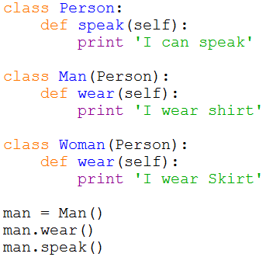

Inheritance
Inheritance in Python is simple,
Just like JAVA, subclass can invoke
Attributes and methods in superclass.
From the example, Class Man inherits Class Person, and invoke speak() method In Class Person
Inherit Syntax:
class subclass(superclass):
…
…
In Python, it supports multiple inheritance,
In the next slide, it will be introduced.

Slide 41

Multiple Inheritance
Python supports a limited form of multiple inheritance.
A class definition with multiple base classes looks as follows:
class DerivedClass(Base1, Base2, Base3 …)
<statement-1>
<statement-2>
…
The only rule necessary to explain the semantics is the resolution rule used for class attribute references. This is depth-first, left-to-right. Thus, if an attribute is not found in DerivedClass, it is searched in Base1, then recursively in the classes of Base1, and only if it is not found there, it is searched in Base2, and so on.

Slide 42

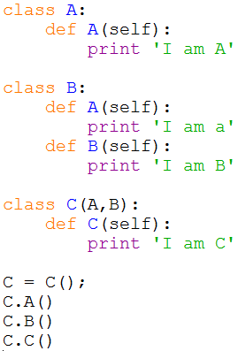
An Example of Multiple Inheritance
C multiple-inherit A and B, but since A is in the left of B, so C inherit A and invoke A.A() according to the left-to-right sequence.
To implement C.B(), class A does not have B() method, so C inherit B for the second priority. So C.B() actually invokes B() in class B.

Slide 43
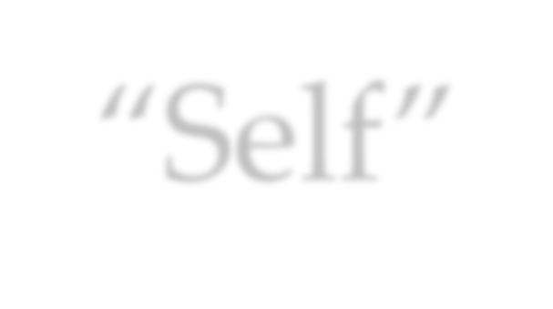
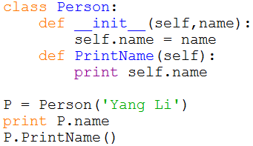
“Self”
“Self” in Python is like the pointer “this” in C++. In
Python, functions in class access data via “self”.
“Self” in Python works as a variable of function but it
won’t invoke data.

Slide 44



Encapsulation – Accessibility (1)
In Python, there is no keywords like ‘public’, ‘protected’ and ‘private’ to define the accessibility. In other words, In Python, it acquiesce that all attributes are public.
But there is a method in Python to define Private:
Add “ ” in front of the variable and function name can hide them when accessing them from out of class.

Slide 45

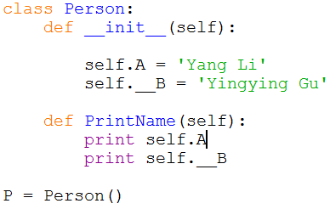
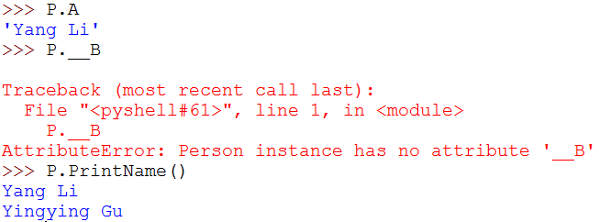
An Example of Private
Public variable
Private variable
Invoke private variable in class
Access public variable out of class, succeed Access private variable our of class, fail
Access public function but this function access Private variable B successfully since they are in the same class.

Slide 46



Encapsulation – Accessibility (2)
Actually, the private accessibility method is just a rule,
not the limitation of compiler.
Its fact is to change name of private name like variable
or function() to
_ClassName function().
because of wrong names.
_ClassName variable or So we can’t access them
We even can use the special syntax to access the private data or methods. The syntax is actually its changed name. Refer to the following example in the next slide.

Slide 47

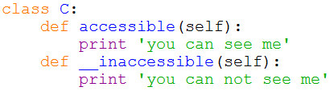
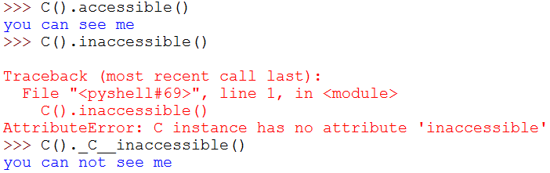
An example of Accessing Private
Define public function
Define private function
Access public function
Can’t access private function
Access private function via changed name

Slide 48
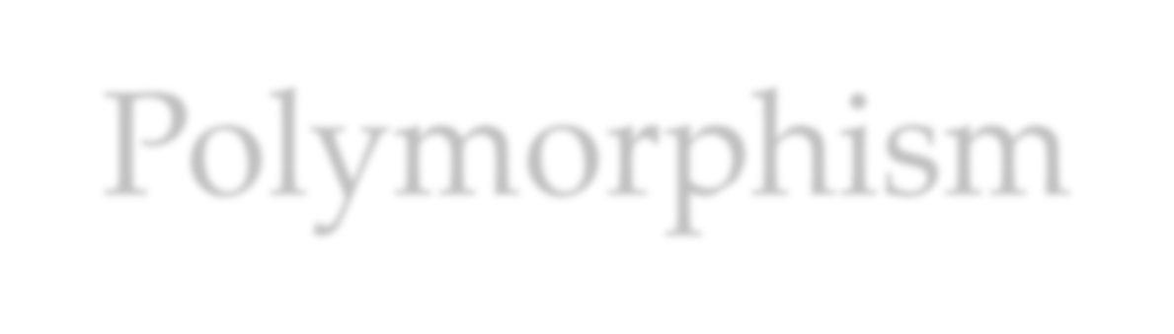

Polymorphism
Polymorphism is an important definition in OOP. Absolutely, we can realize polymorphism in Python just like in JAVA. I call it “traditional polymorphism”
In the next slide, there is an example of polymorphism in Python.
But in Python,
Only traditional polymorphism exist?

Slide 49

Compare Accessibility of Python and Java
Java is a static and strong type definition language. Java
has strict definition of accessibility type with keywords.
While Python is a dynamic and weak type definition language. Python acquiesces all the accessibility types are public except for supporting a method to realize private accessibility virtually.
Someone think Python violates the requirement of encapsulation. But its aim is to make language simple.

Slide 50
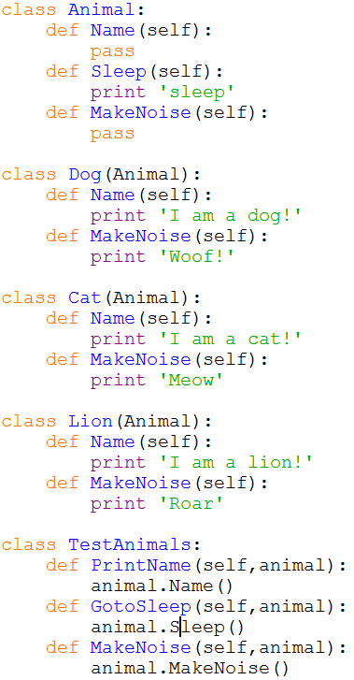


Traditional Polymorphism Example

Slide 51


Everywhere is polymorphism in Python (1)
Since Python is a dynamic programming language, it means Python is strongly typed as the interpreter keeps track of all variables types. It reflects the polymorphism character in Python.
Dynamic language
Polymorphism
Track variables types

Slide 52



Everywhere is polymorphism in Python (2)
So, in Python, many operators have the property of polymorphism. Like the following example:
Looks stupid, but the key is that variables can support any objects which support ‘add’ operation. Not only integer but also string, list, tuple and dictionary can realize their relative ‘add’ operation.

Slide 53



Everywhere is polymorphism in Python (3)
Some methods in Python also have polymorphism character like ‘repr’ function.
For ‘repr’ method, it can transfer any kinds of data to string type. In the above example, it converts integer 123 to string ‘123’ and it can even added to string c ‘string’ to get ‘123string’.

Slide 54

Avoid Destroying Polymorphism!
Many operators and functions in Python are polymorphic. So as long as you use the polymorphic operators and functions, polymorphism will exist even if you don’t have this purpose.
The only way to destroy polymorphism is check types by using functions like ‘type’, ‘isinstance’ and ‘issubclass’ etc.
So in the programming, we should avoid using these methods which might destroy polymorphism except for compiler design.
The most important thing is to let objects to work according to
your requirements rather than mind if they have right types

Slide 55

How to Affect Polymorphism
Traditional polymorphism design
Polymorphic operators and methods
Polymorphism
Functions of ‘type’, ‘isinstance’, ‘issubclass’ etc

Slide 56

Conclusion
As a OOP language, Python has its special advantages but also has its disadvantages.
Python can support operator overloading and multiple inheritance etc. advanced definition that some OOP languages don’t have.
The advantages for Python to use design pattern is that it supports dynamic type binding. In other words, an object is rarely only one instance of a class, it can be dynamically changed at runtime.
But Python might ignore a basic regulation of OOP: data and methods hiding. It doesn’t have the keywords of ‘private’, ‘public’ and ‘protected’ to better support encapsulation. But I think it aims to guarantee syntax simple. As the inventor of Python, Guido Van Rossum said: “abundant syntax bring
more burden than help”.

