Slide 1





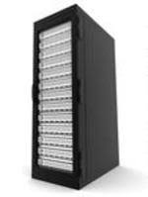
adminNode
LustreMGS-MDS
enp0s3
enp0s3
internet
enp0s4
enp0s8
enp0s8
MGS-MDS-OS.vdi
MGT.vdi
MDT.vdi
AN-OS.vdi
adminNET
LustreOSS0
ComputeNode0
storageNET
enp0s3
enp0s8
enp0s3
OST0.vdi
OST1.vdi
enp0s8
OSS0-OS.vdi
CN0-OS.vdi
ComputeNode1
LustreOSS1
enp0s3
enp0s8
enp0s3
OST2.vdi
OSS1-OS.vdi
OST3.vdi
CN1-OS.vdi
enp0s8

