Slide 1
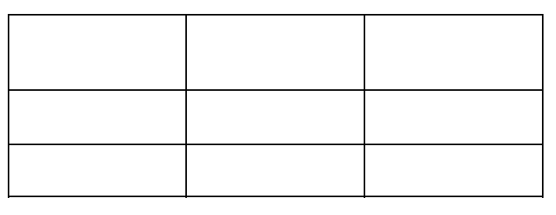
Track 1 (Control)
Track 2 (Medium)
Track 3 (High)
D
H
L
200
200
200
200
C
G
K
100
100
100
100
B
F
J
50
50
50
50
200
100
(0,0)
300
A
E
I
20
20
20
06/03/22, 07/14/22, 07/18/22 All Disturbances
Notes:
POLE KEY
Letter- Top-Bottom
A- 687-688 (Air Logger 689)
B-689-690
C-692-765
D-766-767
E-768-771
F-772-807
G-808-809
H-810-811
I-812-813
J-814-815
K-816-817
L-818-885

Slide 2
Track 1 (Control)
Track 2 (Medium)
Track 3 (High)
200
100
D
A
50
L
C
G
K
B
F
J
300
H
200
E
100
I
(0,0)
Distance from Disturbance
H,E,I: 20ft B,F, J: 20ft
C,G,K: 35ft D,A,L: 50ft
08/27/22 Disturbance 1 and 2

Slide 3
08/27/22 Disturbance 3
Track 2 (Medium)
Track 3 (High)
200
100
G
K
D
A
L
50
C
B
F
J
300
200
100
(0,0)
H
E
I
Distance from Disturbance: H,E,I: -20ft B,F, J: 20ft C: 35ft G,K: 75ft D,A,L: 50ft

Slide 4
9/10/22 Disturbance 1
Track 1 (Control)
Track 2 (Medium)
Track 3 (High)
200
100
50
B
D
G
C
F
300
200
100
(0,0)
Distance from Disturbance: B:5ft D:10ft G:20ft C:35ft F:50ft

Slide 5
9/10/22 Disturbance 2
Track 1 (Control)
Track 2 (Medium)
Track 3 (High)
200
100
50
J
K
L
I
E
B
D
G
C
F
300
200
100
(0,0)
Distance from Disturbance: E:5ft I:10ft L:20ft K:35ft J:50ft

Slide 6
9/17/22
Track 1 (Control)
Track 2 (Medium)
Track 3 (High)
200
100
I
H
G
D
50
L
F
C
K
E
B
J
300
200
100
(0,0)
A
Distance from Disturbance: A:-45ft B:20ft C:35ft D:50ft H:75ft

Slide 7
9/25/22
Track 1 (Control)
Track 2 (Medium)
Track 3 (High)
200
100
50ft
50
C
20ft
B
-20ft
A
300
200
100
(0,0)

Slide 8
10/01/22 Disturbance 1 and 2
Track 1 (Control)
Track 2 (Medium)
Track 3 (High)
200
315
(W)
(N)
225
45
(S)
Compass
Headings
135
(E)
100
90
Relative
Angles
180
0
50
270
H
F
E
D
C
B
A
G
L
K
J
I
300
200
100
(0,0)
Distance from Disturbance: A:-25ft B:20ft C:35ft D:50ft E:75ft F:100ft
H:150ft I:35ft J:50ft K:75ft L:100ft G:150ft 240 degrees

Slide 9
10/01/22 Disturbance 3
Track 1 (Control)
Track 2 (Medium)
Track 3 (High)
200
I
50
100
C
50
50
A
300
200
100
(0,0)

Slide 10
10/5/22 Disturbance 1 and 2
Track 1 (Control)
Track 2 (Medium)
Track 3 (High)
200
50
D
250
C
150
B
A
100
-25
250
150
50
G
F
E
50
300
200
100
(0,0)

Slide 11
Track 1 (Control)
Track 2 (Medium)
Track 3 (High)
200
H
150
D
150
150
L
C
G
K
100
100
100
100
B
F
J
50
50
50
50
E
25
I
25
300
200
100
(0,0)
A
10/15/22

Slide 12
11/2/22 Disturbance
Track 1 (Control)
Track 2 (Medium)
Track 2 (Medium)
Track 3 (High)
Track 3 (High)
L
K
J
I
G
F
A
-25
250
D
150
C
B
50
H
E
200
100
(0,0)

Slide 13
11/9/22 Disturbance 1
Track 1 (Control)
Track 2 (Medium)
Track 3 (High)
200
150
I
K
50
L
H
50
100
E
150
50
50
F
G
J
50
A
150
B
50
C
50
D
300
200
100
(0,0)

Slide 14
11/9/22 Disturbance 2
Track 1 (Control)
Track 2 (Medium)
Track 3 (High)
200
50
150
I
50
K
L
100
H
100
E
50
100
150
50
F
G
J
50
50
50
100
150
D
A
B
C
(0,0)
100
200
300

