Slide 1
INTRODUCE HTML5, CSS3 & JS / FRONT-END ROADMAP
NGUYỄN THÀNH LUÂN

Slide 2
What is a website ?
Website is a collection of related network web resources, such as web page, multiple-media content, which are typically identified with a common domain name, and published on at least on web server.
Webserver includes hardware and software.
Domain is alias replace for IP of webserver.

Slide 3
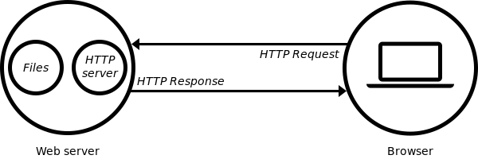
How is a webserver working ?

Slide 4
What is HTTP ?
HTTP stand for Hypertext transfer protocol
It is a protocol using to transfer data from webserver to client and as well as from client to webserver
HTTP build on top of TCP/IP protocol

Slide 5

Different between backend developer and frontend developer
Backend Developer: Working with what working on the server(Server Language + Database)
Frontend Developer: Working with what working on the client (HTML+JS+CSS)
If you do well both it, they call you is a full stack developer or a “coder god” (just kidding ☺)))

Slide 6
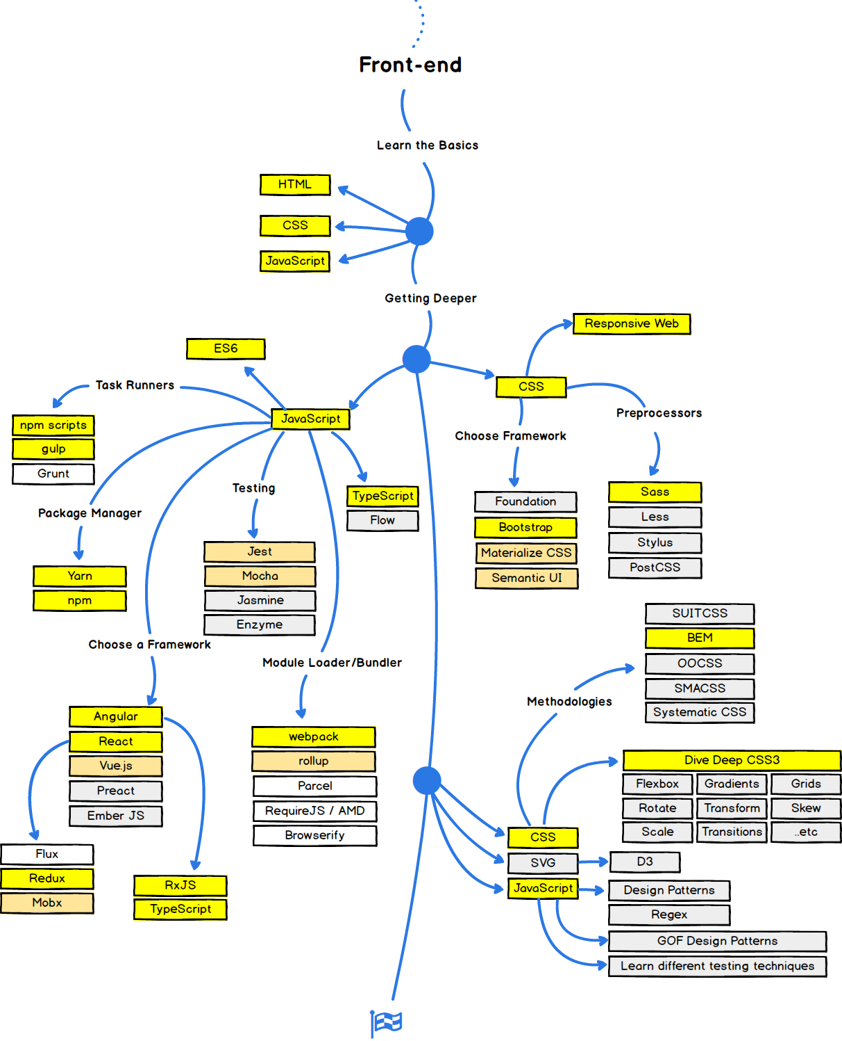

So how to become a frontend developer ?
OMG, khó v … !!!

Slide 7
WHAT IS HTML ?
HTML stand for hyper text markup language
HTML is a documentation come with rich content
Using to make static webpage
Use tag to mark element on the document

Slide 8
HTML documentation structure
<!DOCTYPE html>
<html lang="en">
<head>
</head>
<body>
</body>
</html>

Slide 9
SYNTAX OF HTML TAG (ELEMENT)
<tagname attribute=“attribute value”>
<chilelement>Content is here</chilelement>
</tagname>
The attribute description for tag element.
Have 2 kind of attribute is user defined attribute and built in attribute.
Every tags have three attribute is class, id and style.
You can place custom attribute into tag, but it will not affect by browser, it just use for JavaScript DOM accessing.

Slide 10
Main elements tag in HTML
<span>
<div>
<img><img src=“” alt=“”/>
<a><a href=“” title=“”/>
<h1> … <h6>
<ul>
<ol>
<strong>
<pre>
<small>
<strike>
<mark>
<i>
form

Slide 11
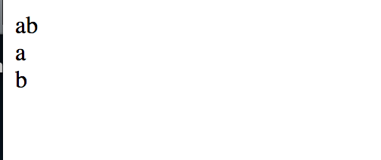
Difference between <span> and <div>
For example
<span>a</span><span>b</span>
<div>a</div><div>b</div>

Slide 12
Important Element in HTML
<form></form>
<input>
<select>
<label>

Slide 13
Form
Form allow client submit or send data to webserver via http method.
Form attribute: action, method, enctype
Action: “processing data link”
Method: GET|POST
Enctype: application/x-www-form-urlencoded | multipart/form-data | text/plain
In Form, have children element defined for input view. For example
<input type=“” name=“” value=“”/>
type attribute = text|number|phone|mail|button|checkbox|image|date|color|month|password|url|week|file|radio|check
<select name=“”>
<option value=“”>label name</option>
</select>
<label></label>

Slide 14
Demo FORM
Teacher demo about form

Slide 15

CSS
If HTML is the backbone of a webpage, CSS is exactly is an skins of it
CSS is stand for Cascading style sheets
Is a collection of styles used to change the appearance of
HTML elements on Webpages
Defined a set of standard rules that provide better control over
The page layout and appearance.

Slide 16
HOW TO PUT CSS INTO HTML DOCUMENTATION
We have three way to put css into HTML
External way
<link rel="stylesheet" type="text/css" href="styles.css”>
Internal way
<style type="text/css">
/*Noi dung CSS*/
</style>
Embed style way

Slide 17
CSS
Each CSS rule consists of the following parts:
Selector and Declaration block
For example
h1 {
color:blue;
font-size:12px
}

Slide 18
CSS Selector
CSS selectors are used to “find” HTML elements base on their name, id, class, attribute, and more.
CSS provide three main selector :
+, element selector
+, id selector
+, class selector
+, Combinator Selector
+, Pseudo Selector

Slide 19
COMBINATOR SELECTOR
Descendant Selector
div p { color: yellow; }
<div>
<p>a</p>
<p>b</p>
</div>

Slide 20
COMBINATOR SELECTOR
Child Selector
Div > p { color: yellow; }
<div>
<p>a</p>
<p>b</p>
<span><p></p></span>
</div>

Slide 21
COMBINATOR SELECTOR
Adjacent Sibling
div + p {
color: yellow;
}
<div>
<p>a</p>
</div>
<p>b</p>

Slide 22
General Sibling Selector
Select all elements that are siblings of a specified element
div ~ p{
color: yellow;
}
<div>a</div>
<p>b</p>
<p>c</p>

Slide 23
PSEUDO SELECTOR
:checked
:visited
:link
:before
:after
:hover
:first-line
:nth-child(i)
:nth-last-child(i)
:nth-of-type(i)
:nth-last-of-type(i)
:first-child()
:last-child()

Slide 24
CSS SPECIFICITY
Many rules apply to an element then rule have have specificity greater will be choose
Rules have same specificity then choose last rule
How to calculation the specificity
Element selector : 1 point
Pseudo, attribute, class: 10 point
Id : 100 point
Universal: 0 point

Slide 25
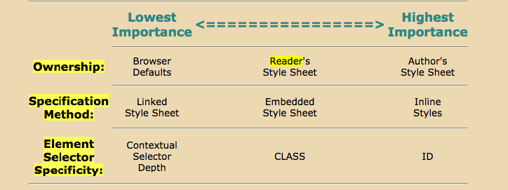
What IS MEANING OF CASCADING

Slide 26
HOW TO LAYOUT PAGE USE CSS
Before we are through this slide, let check few css properties we must know.

Slide 27
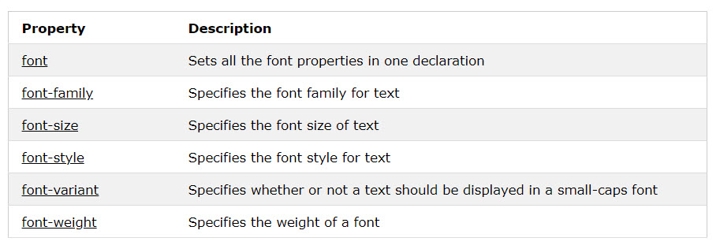
CSS FONT

Slide 28
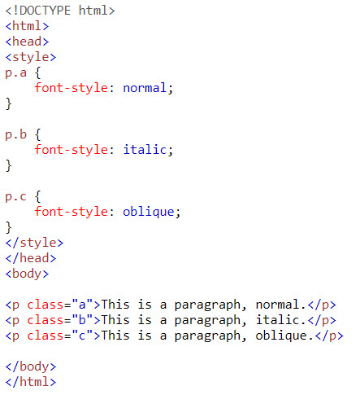
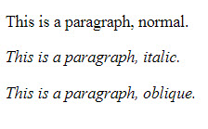
CSS FONT

Slide 29
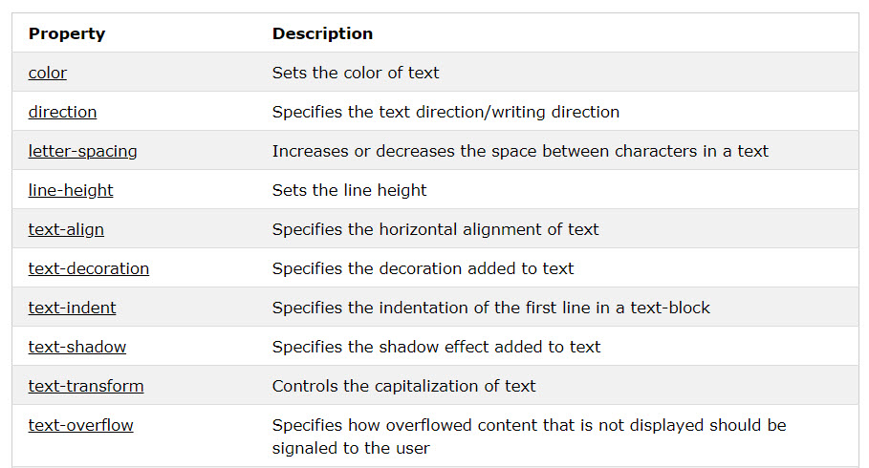
CSS TEXT

Slide 30
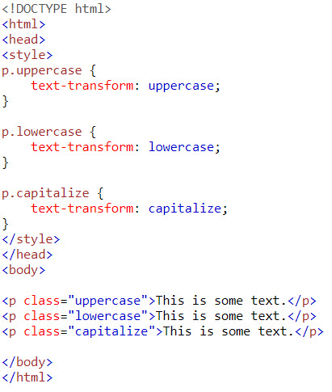
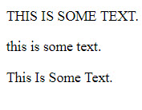
CSS TEXT

Slide 31
CSS BACKGROUND
Property | Description
background | Sets all the background properties in one declaration
background-color | Sets the background color of an element
background-image | Sets the background image for an element
background-origin | Specifies where the background image(s) is/are positioned
background-position | Sets the starting position of a background image
background-repeat | Sets how a background image will be repeated
background-size | Specifies the size of the background image(s)

Slide 32
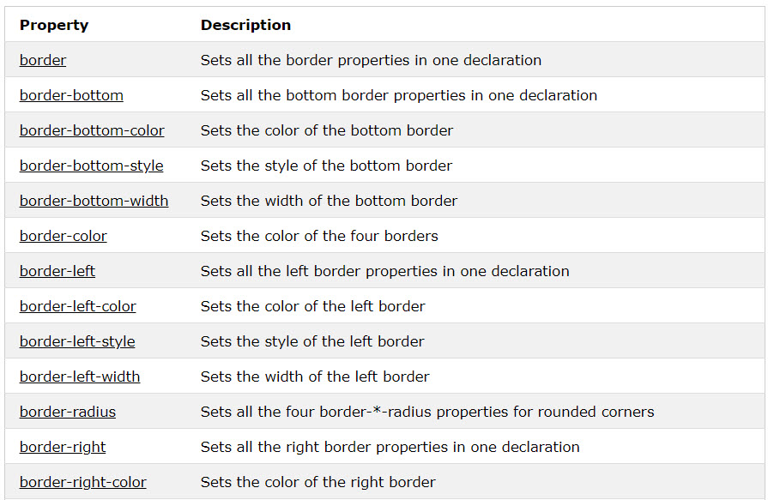
CSS BORDER

Slide 33
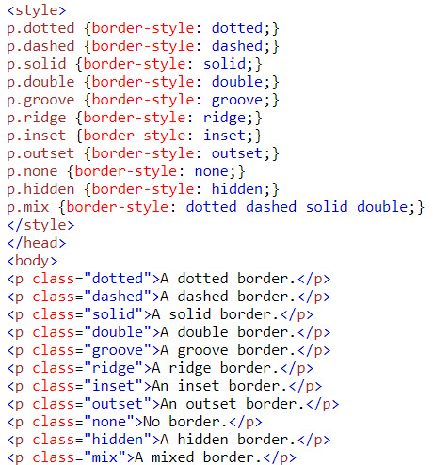
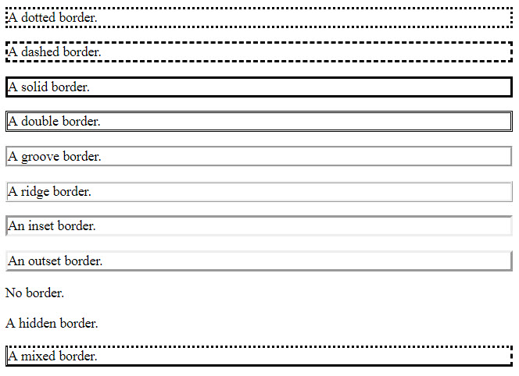
CSS BORDER

Slide 34
BOX MODEL
All HTML elements can be considered as boxes. In CSS, the term "box model" is used when talking about design and layout.
The CSS box model is essentially a box that wraps around every HTML element. It consists of: margins, borders, padding, and the actual content

Slide 35
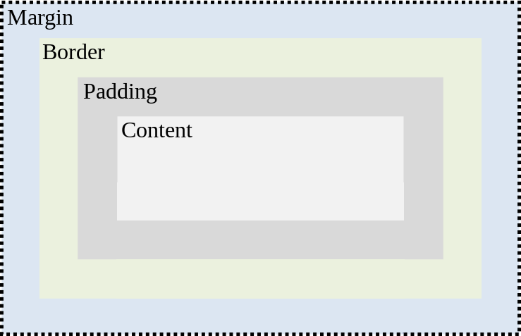
BOX MODEL

Slide 36
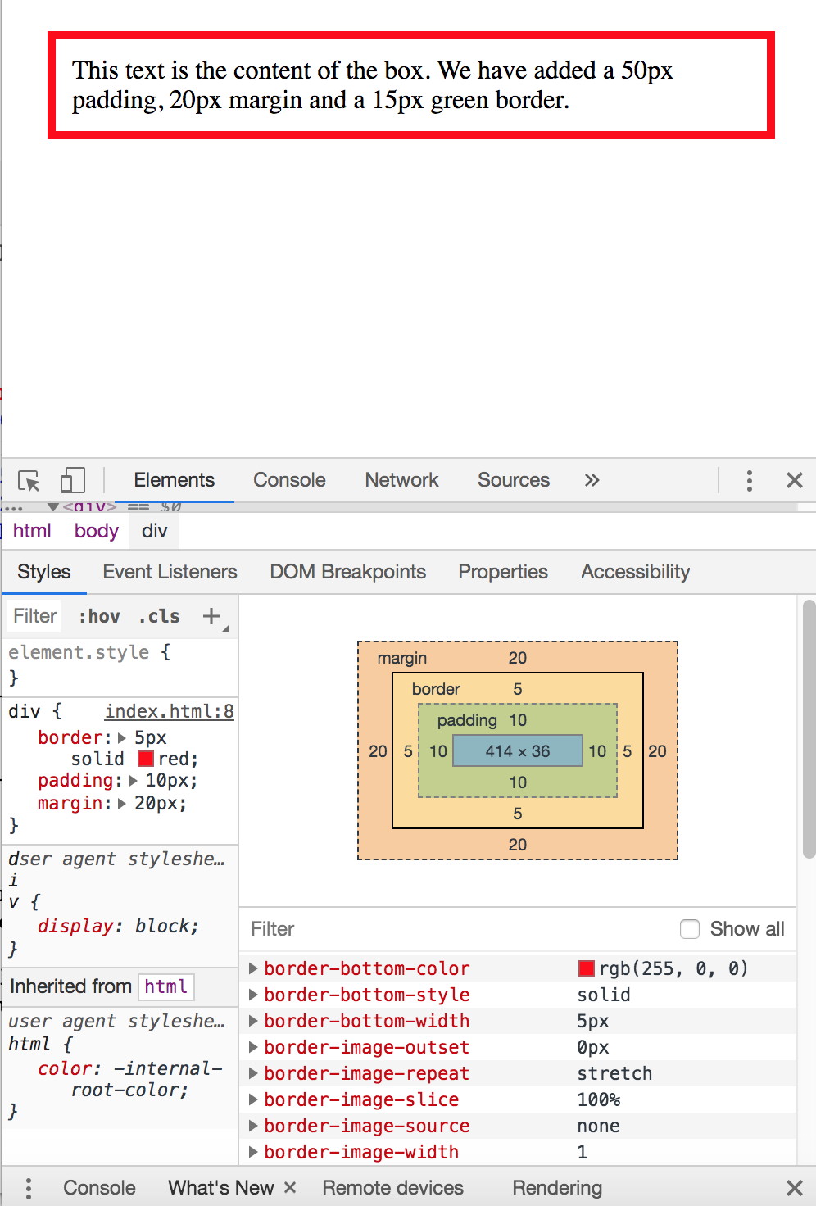
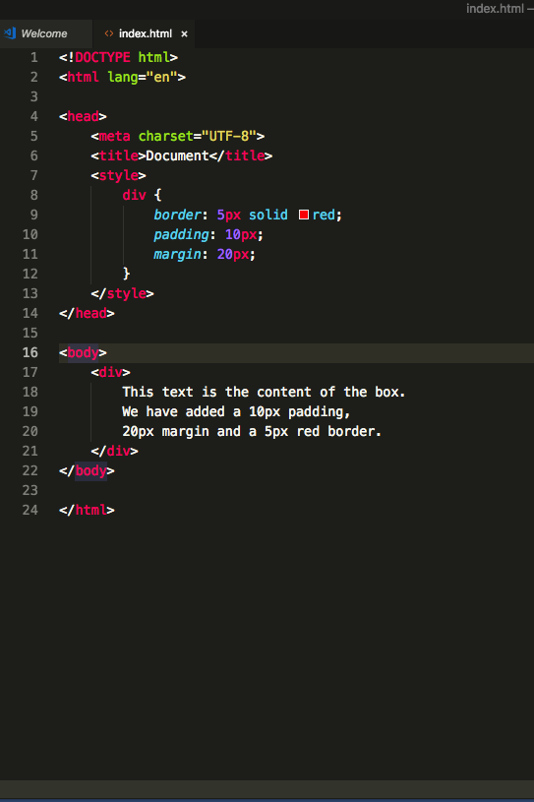
BOX MODEL

Slide 37
How to layout webpage
To layout an webpage, you must remember two things:
How to positioning HTML elements (position,float,clear properties)
The display type of elements ( display properties)

Slide 38
POSITIONING HTML ELEMENTS
CSS positioning properties:
Are used to control the placement of elements on a Web page.
The position property is used to position an element on a Web page using the following positioning methods:
Static
Fixed
Relative
Absolute
Position property come with another bunch properties is margin, left, top, right, bottom properties

Slide 39
STATIC POSITION
HTML elements are positioned static by default
An element with position: static; is not positioned in any special way; it is always positioned according to the normal flow of the page
Static Position do not support left, right, bottom, top properties

Slide 40
RELATIVE POSITION
An element with position: relative; is positioned relative to its normal position.
Setting the top, right, bottom, and left properties of a relatively-positioned element will cause it to be adjusted away from its normal position. Other content will not be adjusted to fit into any gap left by the element.

Slide 41
FIXED POSITION
An element with position: fixed; is positioned relative to the viewport, which means it always stays in the same place even if the page is scrolled. The top, right, bottom, and left properties are used to position the element.

Slide 42
ABSOLUTE POSITION
An element with position: absolute; is positioned relative to the nearest positioned ancestor (instead of positioned relative to the viewport, like fixed).

Slide 43


STATIC POSITION
#two {
background: green;
margin-left:20px
}

Slide 44

RELATIVE POSITION
#two {
position:relative;
background:green;
left:20px
}

Slide 45
NOTE
In Absolute position, if the parent element don’t have relative properties, the child element which has absolute properties will get the viewport as parent

Slide 46
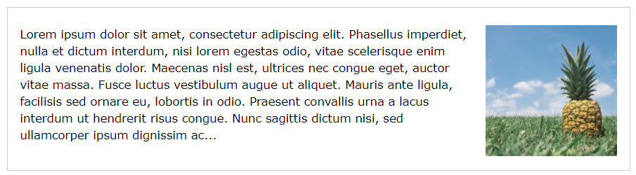

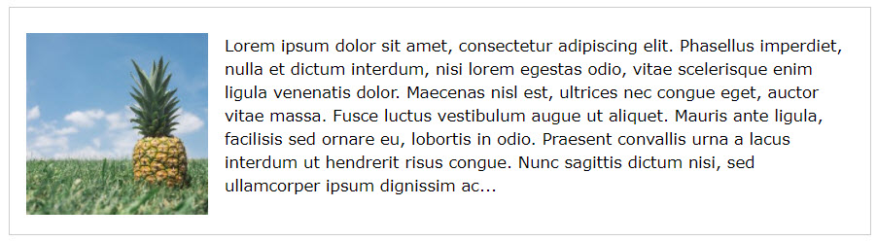

POSITIONING HTML ELEMENT

Slide 47
DISPLAY PROPERTIES
This properties control what the way of elements display
The popular properties is: inline, block, inline-block, ….

Slide 48
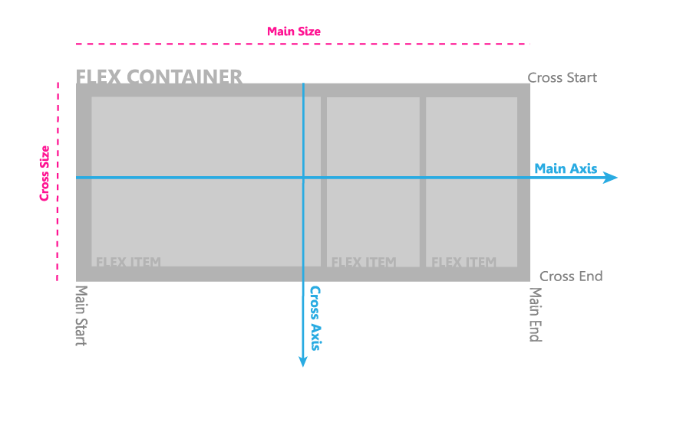
FLEXBOX

Slide 49
FLEXBOX
display: flex
flex-direction: row | row-reverse | column | column-reverse;

Slide 50
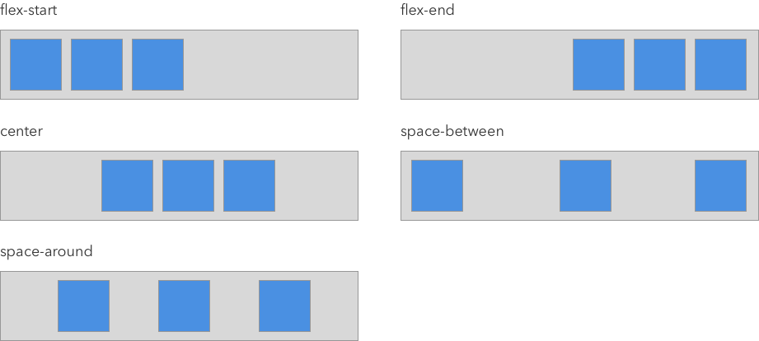
JUSTIFY-CONTENT
Justify-content
This defines the alignment along the main axis

Slide 51
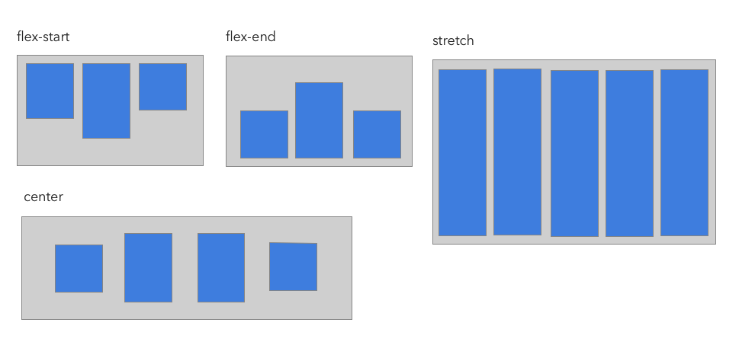
FLEXBOX
Align-items
This defines the alignment along the cross axis

Slide 52
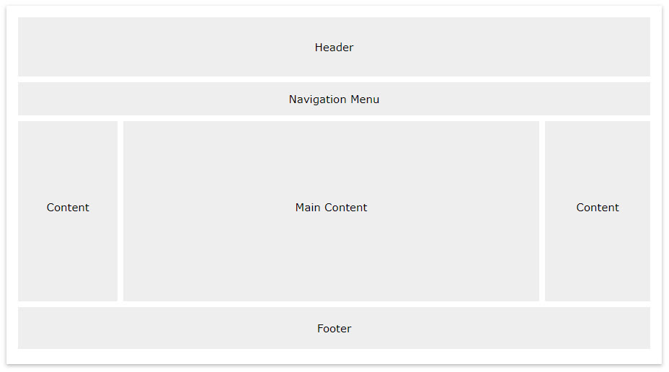
LAYOUT WEBAPGE EXERCICE

Slide 53

CONCLUSION SESSION 1
Advanced properties of CSS
Properties of CSS3
Designing layout of website

Slide 54



JAVASCRIPT (CONT SESSION 2)
What is JavaSript ?

Slide 55
OVERVIEW
Interpreted language
Born on 1995, Mocha
Rename to LiveScript
1997, rename to Javascript
Syntax like C/the father of all high programing languages

Slide 56
HISTORY OF JAVASCRIPT
Phiên bản | Tên chính thức | Mô tả
1 | ECMAScript 1 (1997) | Phiên bản đầu tiên.
2 | ECMAScript 2 (1998) | Chỉ thay đổi, biên tập lại.
3 | ECMAScript 3 (1999) | Thêm Regular Expressions. Thêm try/catch.
4 | ECMAScript 4 | Never released.
5 | ECMAScript 5 (2009) | Thêm “strict mode”. Thêm JSON support. Thêm String.trim(). Thêm Array.isArray(). Thêm Array Iteration Methods.
5.1 | ECMAScript 5.1 (2011) | Chỉ thay đổi, biên tập lại.
6 | ECMAScript 2015 | Thêm let and const. Thêm default parameter values. Thêm Array.find(). Thêm Array.findIndex().
7 | ECMAScript 2016 | Thêm exponential operator (**). Thêm Array.prototype.includes.
8 | ECMAScript 2017 | Thêm string padding. Thêm new Object properties. Thêm Async functions. Thêm Shared Memory.
9 | ECMAScript 2018 | Thêm rest / spread properties. Thêm Asynchronous iteration. Thêm Promise.finally(). Additions to RegExp.

Slide 57

IS JAVASCRIPT A OOP LANGUAGE ?

Slide 58
PURPOSE OF JAVASCRIPT
Client-Side(Frontend Developer)
Backend-Side(NodeJS)
Desktop App(Electron framework)
Mobile App(Ionic, react-native)

Slide 59
FALL IN LOVE WITH JAVASCRIPT
Defining Variables
Using Operators
Using Conditional Constructs
Break and Continue
Function

Slide 60
Defining Variables
var, let, const
For example
var name = “Luan”;
var age = “27”;

Slide 61
Using Operators
Is a set of one or more characters that is used for computations or comparisons.
Can be used to modify the values stored in the variables.
Can belong to any one of the following categories:
Arithmetic
Assignment
Arithmetic Assignment
Comparison
Logical

Slide 62
Using Operators
An arthimetic operator includes : + - * / %
An assignment operator use to assign value to variable
An arthimetic assignment use to assign and arthmetic

Slide 63
Using Operators (CONT+)
An arthimetic assignment use to assign and arthmetic
+=
-=
*=
/=
%=

Slide 64
Using Operators (CONT+)
Comparison Operator includes:
<
>
<=
>=
==
!=
===

Slide 65
Using Operators (CONT+)
Logical operators includes
&&
!
||

Slide 66
Using CONDITIONAL CONSTRUCTS
If … else
switch … case
The if … else construct
if (exp) {
// Statements;
} else {
// Statements;
}

Slide 67
Using CONDITIONAL CONSTRUCTS
Switch…case construct
switch(cond){
case <case1>:
break;
case <case2>:
break;
……..
}

Slide 68
Using LOOP
For …. loop
for (initialize variable; test condition; step value) { // code block }
do … while
do { Statements; } while(condition)
while … do
while (expression) { statements; }

Slide 69
BREAK & CONTINUE
The break statement:
Is used to exit the loop. Prevents the execution of the remaining statements of the loop.Is usually placed within an if construct inside the loop.
The continue statement:
Is used to skip all the subsequent instructions and take the control back to the beginning of the loop.

Slide 70
FUNCTION
Built-in function. For example
parseInt()
parseFloat()
alert()
prompt()
confirm()
User-defined functions

Slide 71
FUNCTION (CONT+)
Defining Syntax (Normally)
function method(param,param){
}
Anounymous function
var x = function (a, b) {return a * b}; var z = x(4, 3);
using new
var myFunction = new Function(“a”, “b”, “return a + b”);
var x = myFunction(4, 3);

Slide 72
FUNCTION (CONT+)
Self Invoke method
(function() { console.log("Hello!!");}).call()
Callback function
function call (func)
{
func();
}
call (function(){
alert(“Call”);
});

Slide 73
HOW TO USING JS IN HTML DOC
Embed into HTML document via script tag
Example: <script src="jquery.js"></script>

Slide 74
WHAT IS JS CAN DO IN HTML DOC ?
Accessing, changing the structure of DOM
Changing the style of HTML elements via DOM
Detect event from user to web page
Processing HTTP request and response

Slide 75
WAIT !!! WHAT IS DOM ?
DOM is stand for Document Object Model, it is an API for HTML. It defines
HTML element as objects
The properties of all HTML elements
The methods to access all HTML elements
The events for all HTML elements

Slide 76
DOM TREE
The HTML DOM model is constructed as a tree of Objects.
In the DOM, all HTML elements are defined as objects.
A property is a value you can get or set
A method is an action you can do
For example:
getElementByid() method -> get node
innerHTML property -> change content of node or get content of node

Slide 77
LIST OF POPULAR DOM METHODS
appendChild()
cloneNode()
getElementsByClassName()
getElementsByTagName()
removeAttribute()
removeChild()
insertBefore()

Slide 78
List of popular Properties
style
innerHTML
innerText
Id
firstChild
firstElementChild
children
childNodes

Slide 79
USE JAVASCRIPT TO WORKING WITH DOM
Simple examples using DOM to update content in JavaScript
Write an script validate form using JavaScript and DOM

Slide 80
What next ?
IMPROVE CSS,HTML,JS skills
SASS
GULP
WEBPACK
JS LIB, JS FRAMEWORK

Slide 81
CONCLUSION
JS Basic
Working with DOM
Frontend RoadMap

