Slide 1
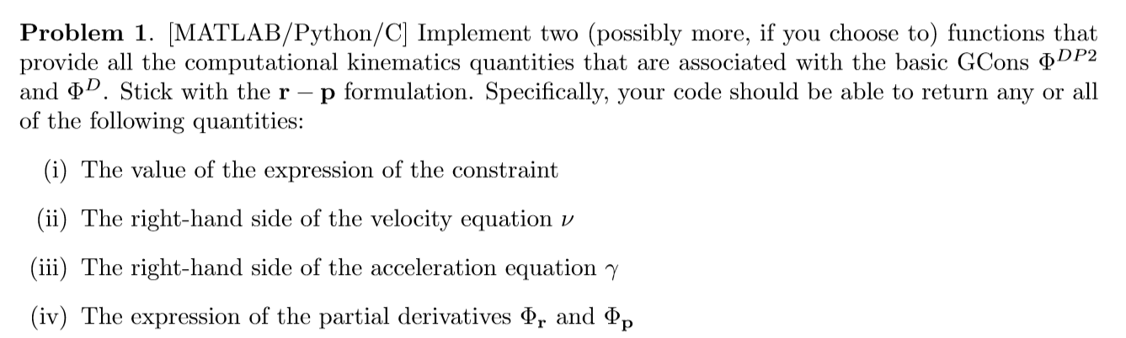

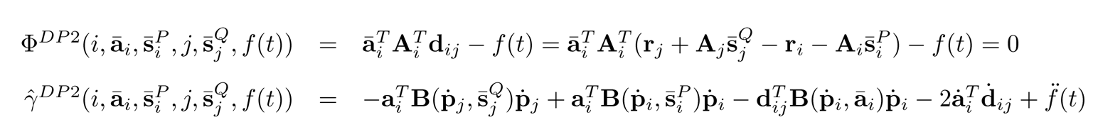
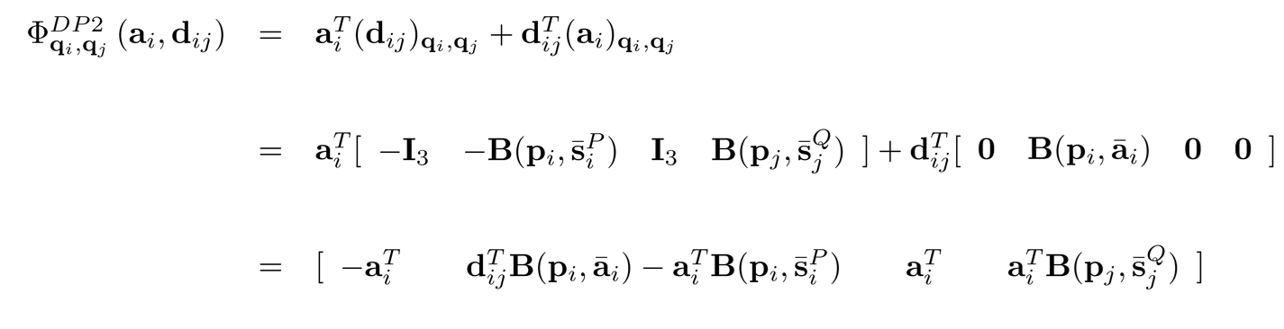
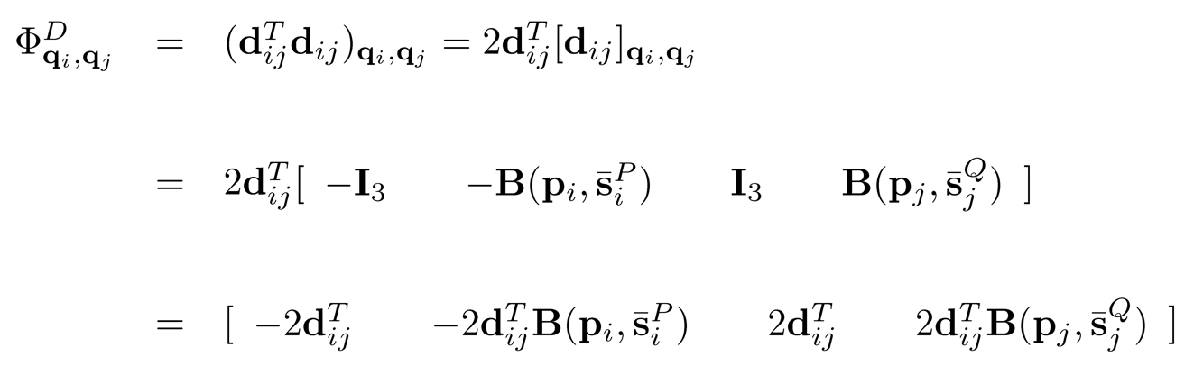
HW6 P1
The following equations are implemented in HW6_Q1.py :

Slide 2
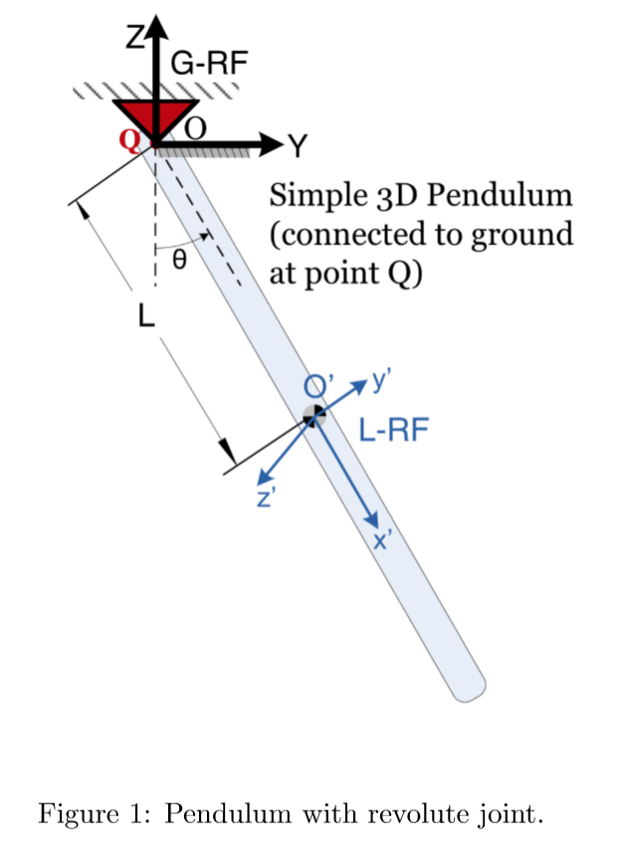
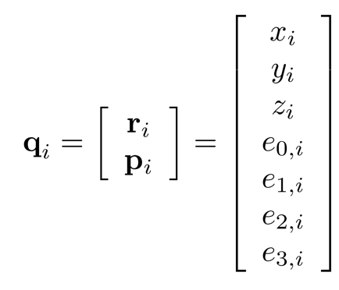





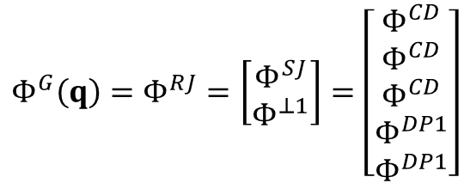


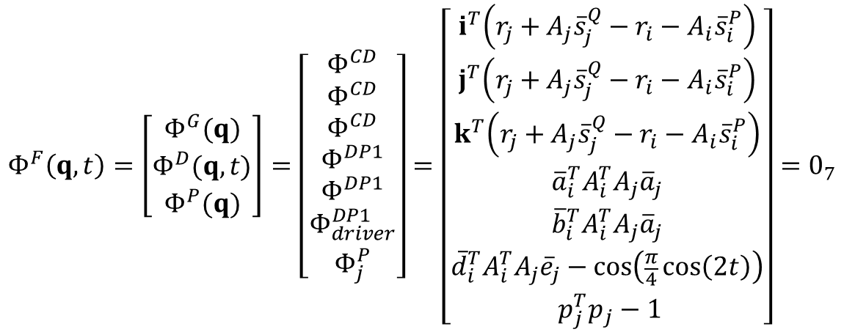


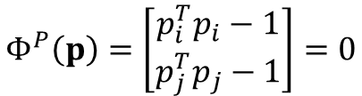


$$Φ^{G}\left(q\right)=Φ^{RJ}=\left[\begin{matrix}Φ^{SJ} \\ Φ^{⊥1}\end{matrix}\right]=\left[\begin{matrix}Φ^{CD} \\ Φ^{CD} \\ \begin{matrix}Φ^{CD} \\ \begin{matrix}Φ^{DP1} \\ Φ^{DP1}\end{matrix}\end{matrix}\end{matrix}\right]$$
$$Φ^{D}\left(q,t\right)=Φ^{DP1}=0$$
$$Φ^{P}\left(p\right)=\left[\begin{matrix}p_{i}^{T}p_{i}−1 \\ p_{j}^{T}p_{j}−1\end{matrix}\right]=0$$
nb = 1 (i=ground, j=bar)
nc = 7 * nb = 7 ( qj)
$$Φ^{F}\left(q,t\right)=\left[\begin{matrix}Φ^{G}(q) \\ \begin{matrix}Φ^{D}(q,t) \\ Φ^{P}(q)\end{matrix}\end{matrix}\right]=\left[\begin{matrix}Φ^{CD} \\ Φ^{CD} \\ \begin{matrix}Φ^{CD} \\ \begin{matrix}Φ^{DP1} \\ \begin{matrix}Φ^{DP1} \\ \begin{matrix}\begin{matrix}Φ_{driver}^{DP1} \\ \begin{matrix}Φ_{j}^{P}\end{matrix}\end{matrix}\end{matrix}\end{matrix}\end{matrix}\end{matrix}\end{matrix}\right]=\left[\begin{matrix}i^{T}\left(r_{j}+A_{j}{\overline{s}}_{j}^{Q}−r_{i}−A_{i}{\overline{s}}_{i}^{P}\right) \\ j^{T}\left(r_{j}+A_{j}{\overline{s}}_{j}^{Q}−r_{i}−A_{i}{\overline{s}}_{i}^{P}\right) \\ \begin{matrix}k^{T}\left(r_{j}+A_{j}{\overline{s}}_{j}^{Q}−r_{i}−A_{i}{\overline{s}}_{i}^{P}\right) \\ \begin{matrix}{\overline{a}}_{i}^{T}A_{i}^{T}A_{j}{\overline{a}}_{j} \\ \begin{matrix}{\overline{b}}_{i}^{T}A_{i}^{T}A_{j}{\overline{a}}_{j} \\ \begin{matrix}\begin{matrix}{\overline{d}}_{i}^{T}A_{i}^{T}A_{j}{\overline{e}}_{j}−\cos\left(\frac{π}{4}\cos\left(2t\right)\right) \\ \begin{matrix}{ p}_{j}^{T}p_{j}−1\end{matrix}\end{matrix}\end{matrix}\end{matrix}\end{matrix}\end{matrix}\end{matrix}\right]=0_{7}$$
Inputs for CD constraints:
Inputs for DP1 constraints:
Inputs for DP1 driver constraint:
$${\overline{s}}_{i}^{P}=\left[\begin{matrix}0 & 0 & 0\end{matrix}\right]$$
$${\overline{a}}_{j}=\left[\begin{matrix}0 & 0 & 1\end{matrix}\right]$$
$${\overline{d}}_{i}=\left[\begin{matrix}0 & 0 & −1\end{matrix}\right]$$
$${\overline{s}}_{j}^{Q}=\left[\begin{matrix}−2 & 0 & 0\end{matrix}\right]$$
$${\overline{a}}_{i}=\left[\begin{matrix}0 & 1 & 0\end{matrix}\right]$$
$${\overline{e}}_{j}=\left[\begin{matrix}1 & 0 & 0\end{matrix}\right]$$
$$i=\left[\begin{matrix}1 & 0 & 0\end{matrix}\right]$$
$${\overline{b}}_{i}=\left[\begin{matrix}0 & 0 & 1\end{matrix}\right]$$
$$j=\left[\begin{matrix}0 & 1 & 0\end{matrix}\right]$$
k$=\left[\begin{matrix}0 & 0 & 1\end{matrix}\right]$

Slide 3







Jacobian
$${ partial wrt p}_{i}$$
$${ partial wrt p}_{j}$$
$${ partial wrt r}_{i}$$
$${ partial wrt r}_{j}$$
$$Φ_{q_{i},q_{j}}^{CD}= \left[−\begin{matrix}c^{T} & \begin{matrix}−c^{T}B\left(p_{i},{\overline{s}}_{i}^{P}\right) & \begin{matrix}c^{T} & c^{T}B\left(p_{j},{\overline{s}}_{j}^{Q}\right)\end{matrix}\end{matrix}\end{matrix}\right]$$
$$Φ_{q_{i},q_{j}}^{DP1}= \left[\begin{matrix}0_{1x3} & \begin{matrix}a_{j}^{T}B\left(p_{i},{\overline{a}}_{i} \right) & \begin{matrix}0_{1x3} & a_{i}^{T}B\left(p_{j},{\overline{a}}_{j}\right)\end{matrix}\end{matrix}\end{matrix}\right]$$
1x14
Dropping i values because i is ground
$${ partial wrt r}_{j}$$
$${\left.\frac{∂Φ^{F}}{∂q}\right|}_{q=q^{(0)}}=\left[\begin{matrix}\begin{matrix}\begin{matrix}\begin{matrix}1 & \begin{matrix}0 & 0 & \begin{matrix}0 & 0 & \begin{matrix}0 & 0\end{matrix}\end{matrix}\end{matrix}\end{matrix}\end{matrix}\end{matrix}\end{matrix}\right]$$
First Row of Jacobian
$${ partial wrt p}_{j}$$

Slide 4
HW6 P3

