Slide 1

TripWithMe
Lior Raz
Post PC : Human-Centric Mobile Computing, HUJI, 2013

Slide 2
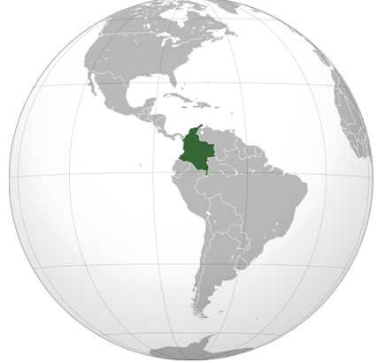
Say you…
Found yourself in Colombia
All alone
In the middle of the night

Slide 3
You want to get something out of it
See some great views
Join a group
Find someone to talk to
Share
…
Wonder what <?> would have done…

Slide 4
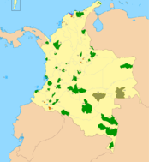


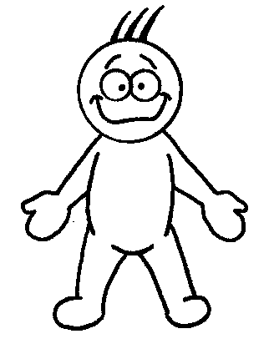



What you would have want
Join our group to #@!#$#@
Oh, Its so magnificent!
Hey, Loco!
You gotta go the mountains. Its Rock!

Slide 5
TripWithMe is…
Map Oriented
Traveling
Totally Random
Social
App

Slide 6

And what if…
You’re actually on your SOFA AT HOME
Interested in Norway…

Slide 7
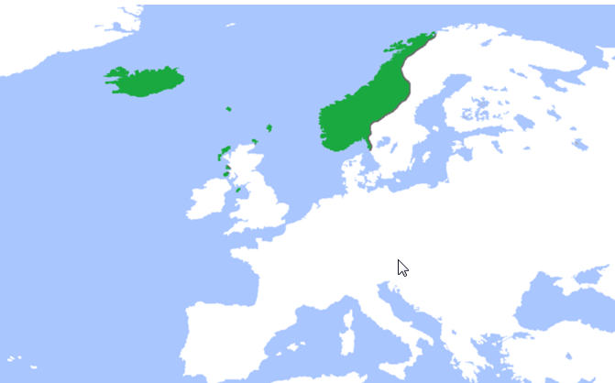
Say Goodbye to Eduardo..

Slide 8

Architecture
Parse:
User Accounts (social nets included)
DB for users data (details, photos…)
Messages for IM
Google Map / MapView
Friends List View
All Countries screen (collected by anonymous person)
Buddy Bubble
Online / Offline Toggle
Location managing
Offline storage of old locations
Integrate other Social nets - Facebook
IM (“Offline” messages)

Slide 9
Feedback…

