Slide 1
NEWS FEED
Notes:
Davide
Goodmorning.

Slide 2

Hello!
Team members for group project:
Notes:
Davide
My team group is composed of antonio ionta, leonardo razovic, nurken, pietro lamanna and me.

Slide 3
Objectives
Develop a distributed software application exploiting containerization paradigm.
Follow a development workflow coherent with agile principles and Scrum methodology.
Notes:
Davide
Our work’s objectives were to develop a distributed software application, that exploits the containerization paradigm.
In the development of our project we followed carefully agile principles and scrum methodology, in order to manage our workflow at best, minimizing the time between ideation and launch.
(A container is a software unit, which packages one or more software applications, along with their configurations and dependencies, such that these applications can run quickly and reliably in a suitable container execution environment)

Slide 4
1.
THE SYSTEM
Initial Idea | User Stories
Notes:
Davide
The app developed by us is called NEWS FEED.

Slide 5
Abstract
Interactive dashboard showing news articles collected from RSS sources.
Dedicated user area for a custom experience.
External service for retrieving full articles text.
Natural Language Processing for summarizing articles content.
Notes:
Davide
As can be seen from the name, the base idea was to realize a dashboard that collects news articles from different sources.
In this interactive dashboard the articles are shown either in full text, due to an external service, and in a summarized text, through a natural language processing.
Furthermore, there is a dedicated user area, where the users may customize their feed page as they wish.

Slide 6
Is it possible to enhance the process of news consulting from the Web?
Notes:
Davide
The NEWS FEED app can “make the life simpler” to someone that wants to receive news from several different sources, grouping them in one single layout. In this way the user could save time, seeing all the wanted news articles without surfing the web, from page to page.

Slide 7

User Stories
Exploration
Investigating news sources and having an overview of available articles.
Deepening
Focusing on a specific article and obtain more details about it.
Processing
Elaborate in some way the content of a selected article to extrapolate an information not directly accessible.
Customization
Need of a personal area where tailoring the experience with the system.
Flexibility
Desire of different authentication methods.
Data Transparency
Be owner of your personal information, with the possibility to delete everything associated to your own account.
Notes:
Davide
The user stories are various:
- they can log into the system using the authentication method that they prefer;
- the users can explore and investigates among news and can have an overview of several available articles and, for example, compare them;
- they can customize their experience in “customize page”;
- they can focus on a specific article, obtaining more details, and extrapolating information that are not directly accessible;
- they are free to modify or delete their personal data from the system;

Slide 8
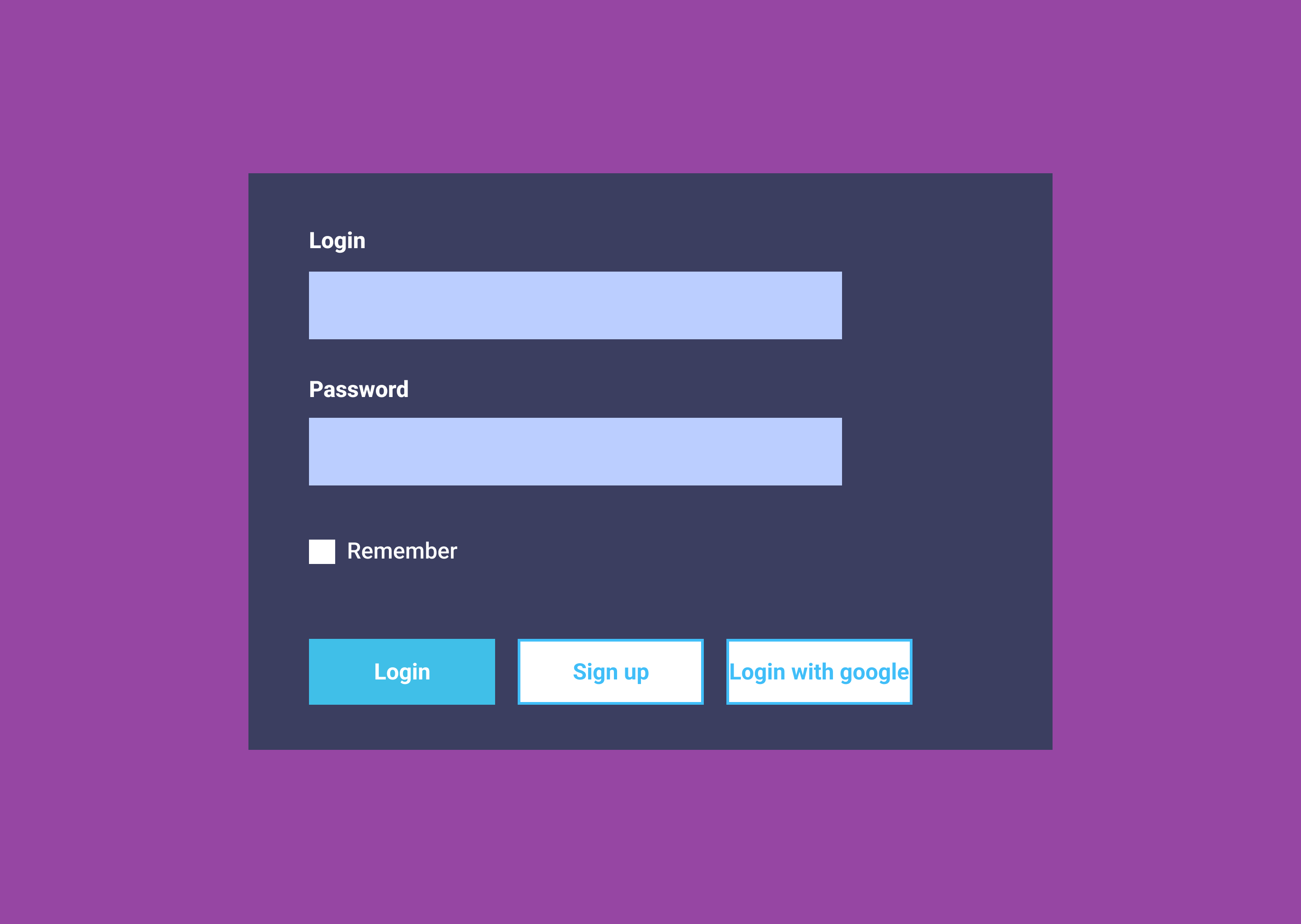
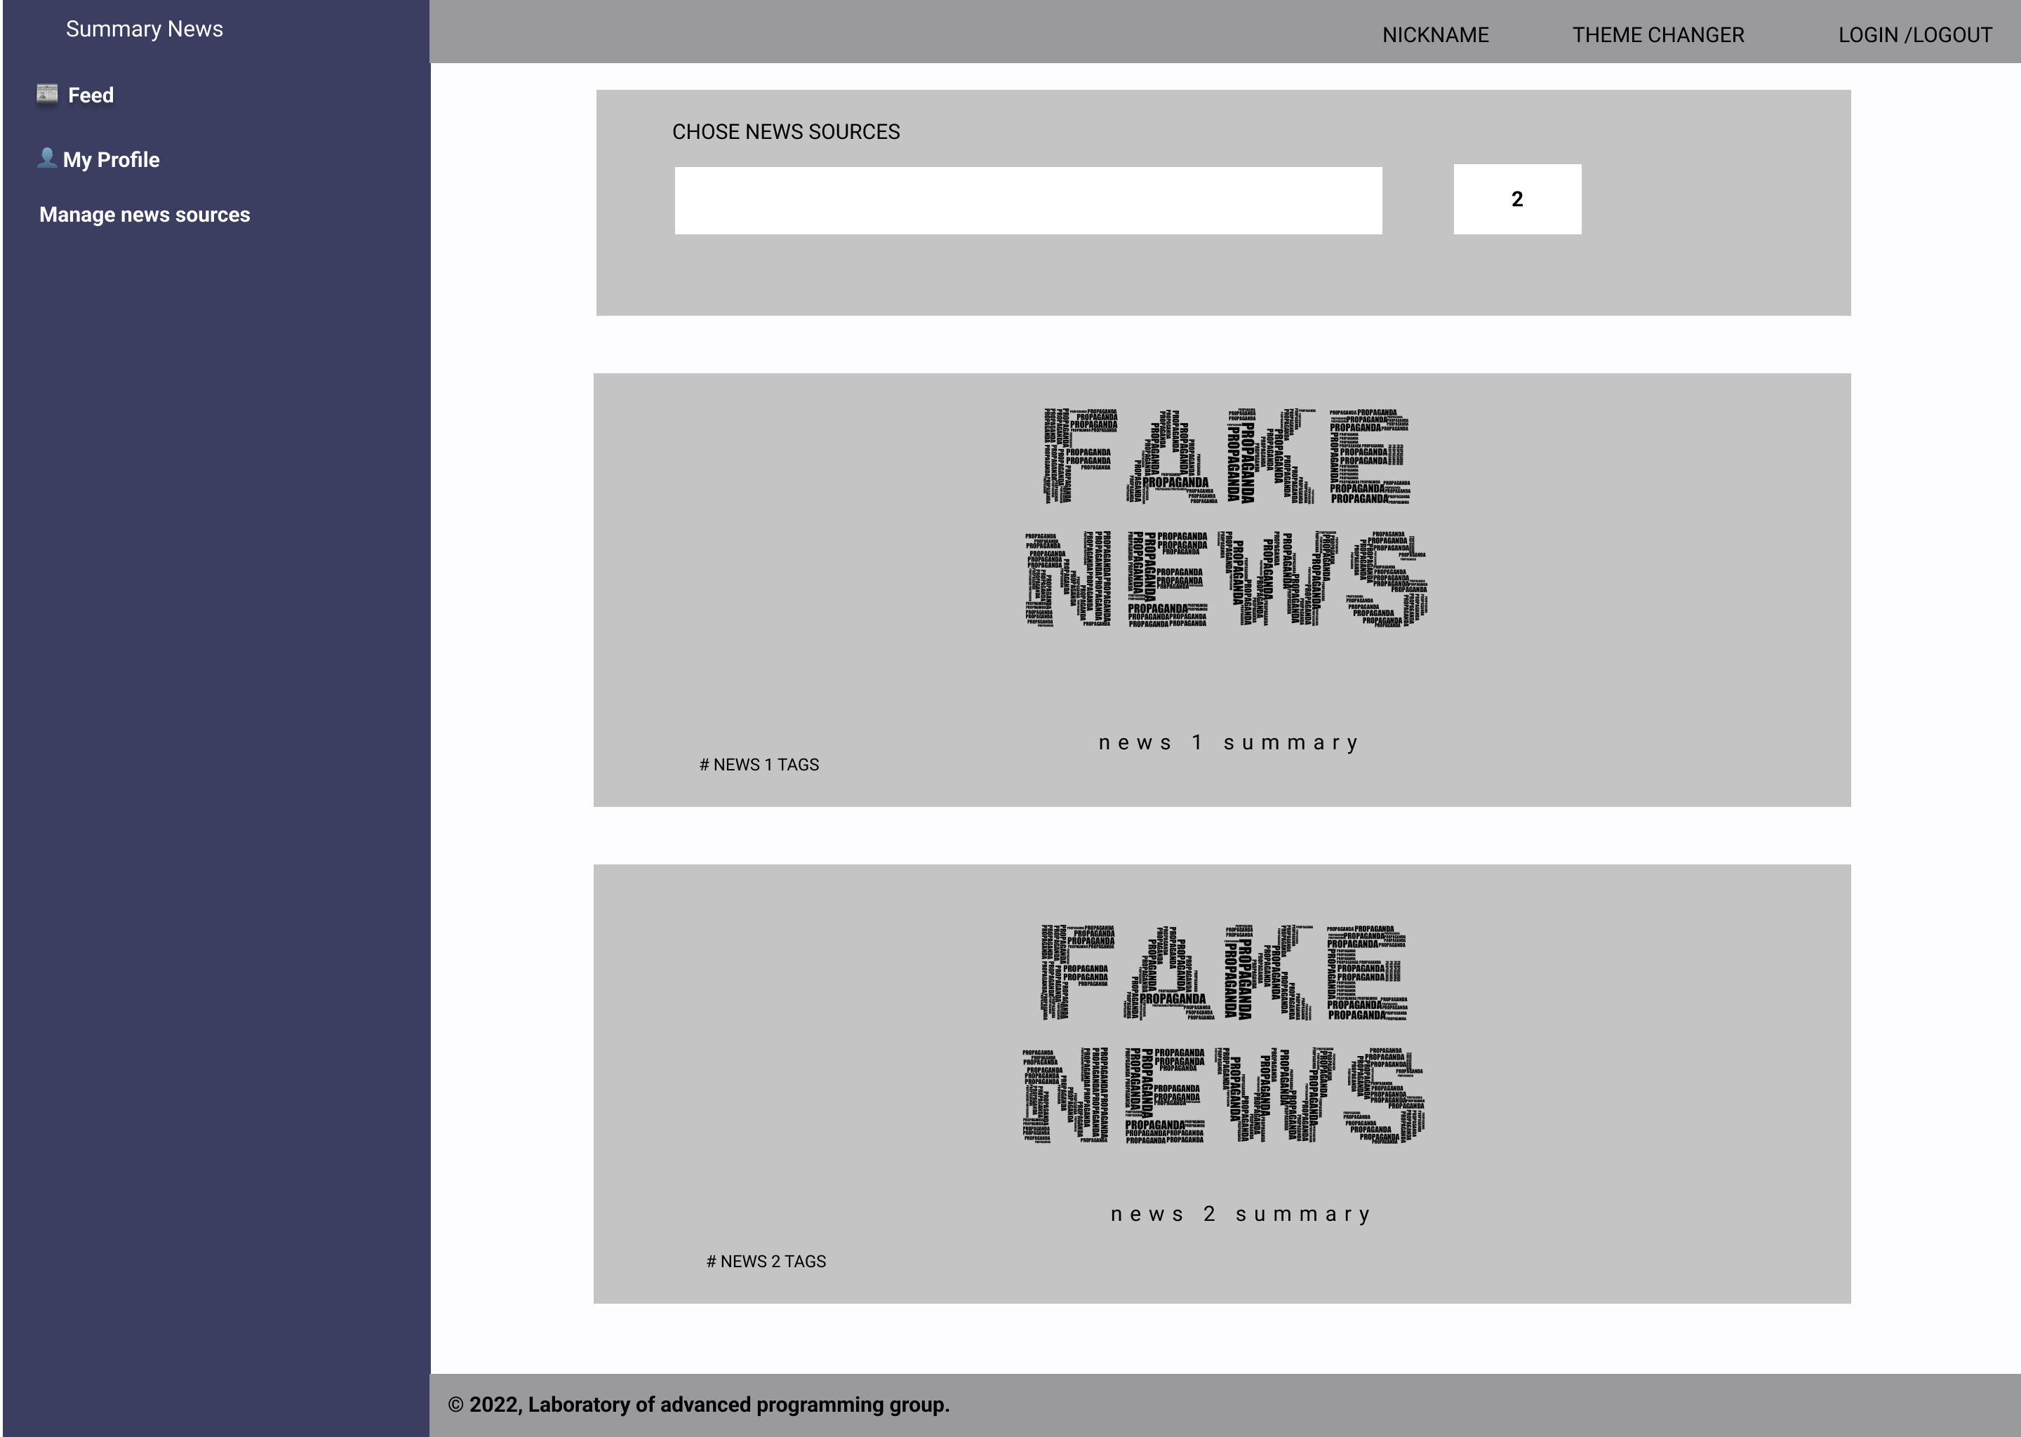
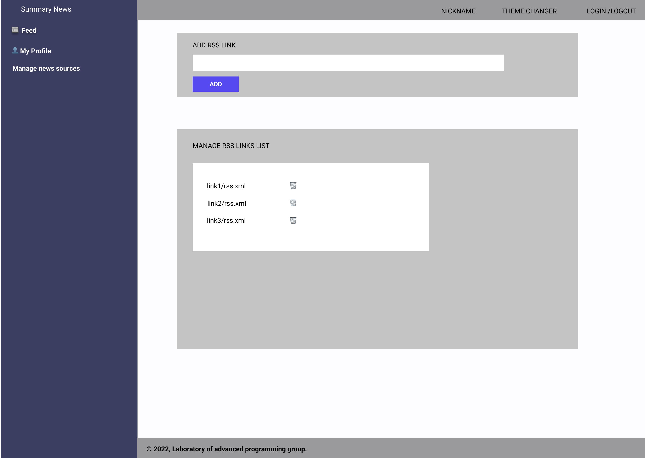
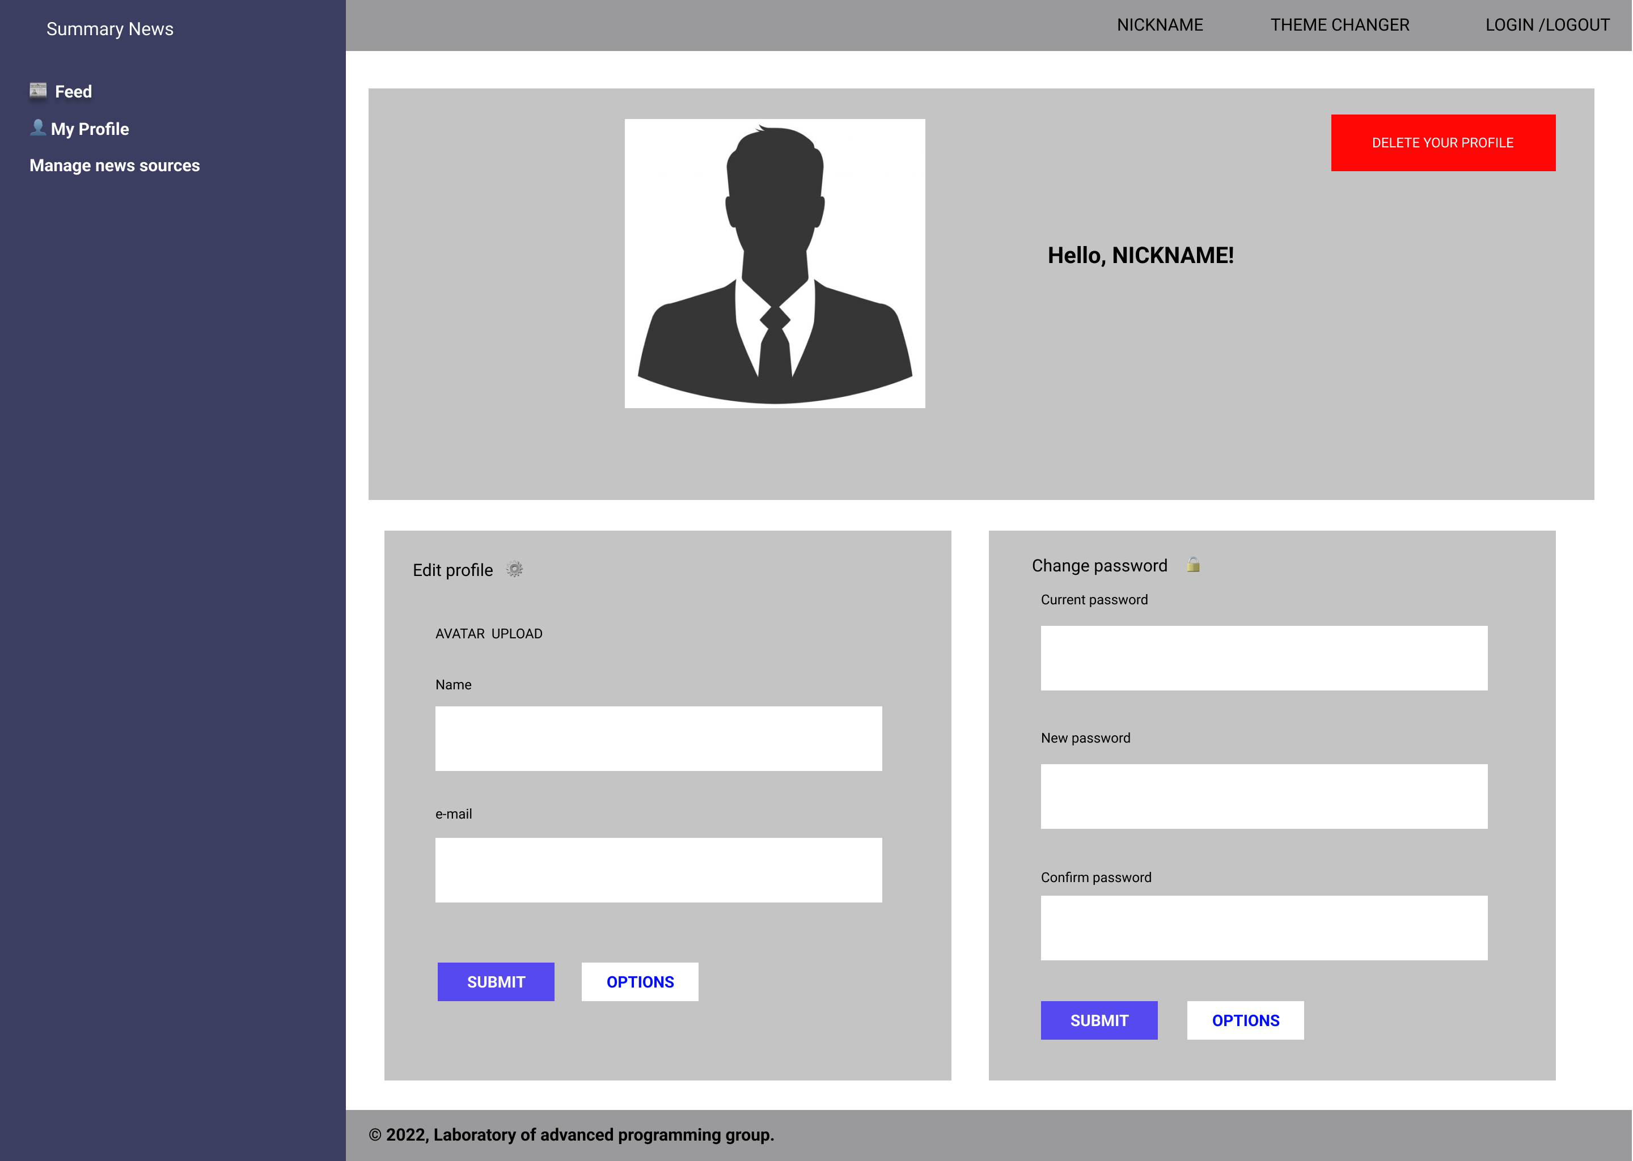
Prototyping
Front-end
Notes:
Davide

Slide 9
2.
PLANNING
Effort Estimation
Notes:
Pietro

Slide 10
1 MVP
6 Sprints
233 Hrs
Ready for customers feedback
Each sprint composed by 2 weeks
Total Estimated Hours
Notes:
Pietro

Slide 11
68 FP
5440 SLOC
7.4 person/month
Biased Function Points
Notes:
Pietro

Slide 12
3.
TECHNICAL ARCHITECTURE
Distributed Software Application with Containerization
Notes:
Leonardo

Slide 13

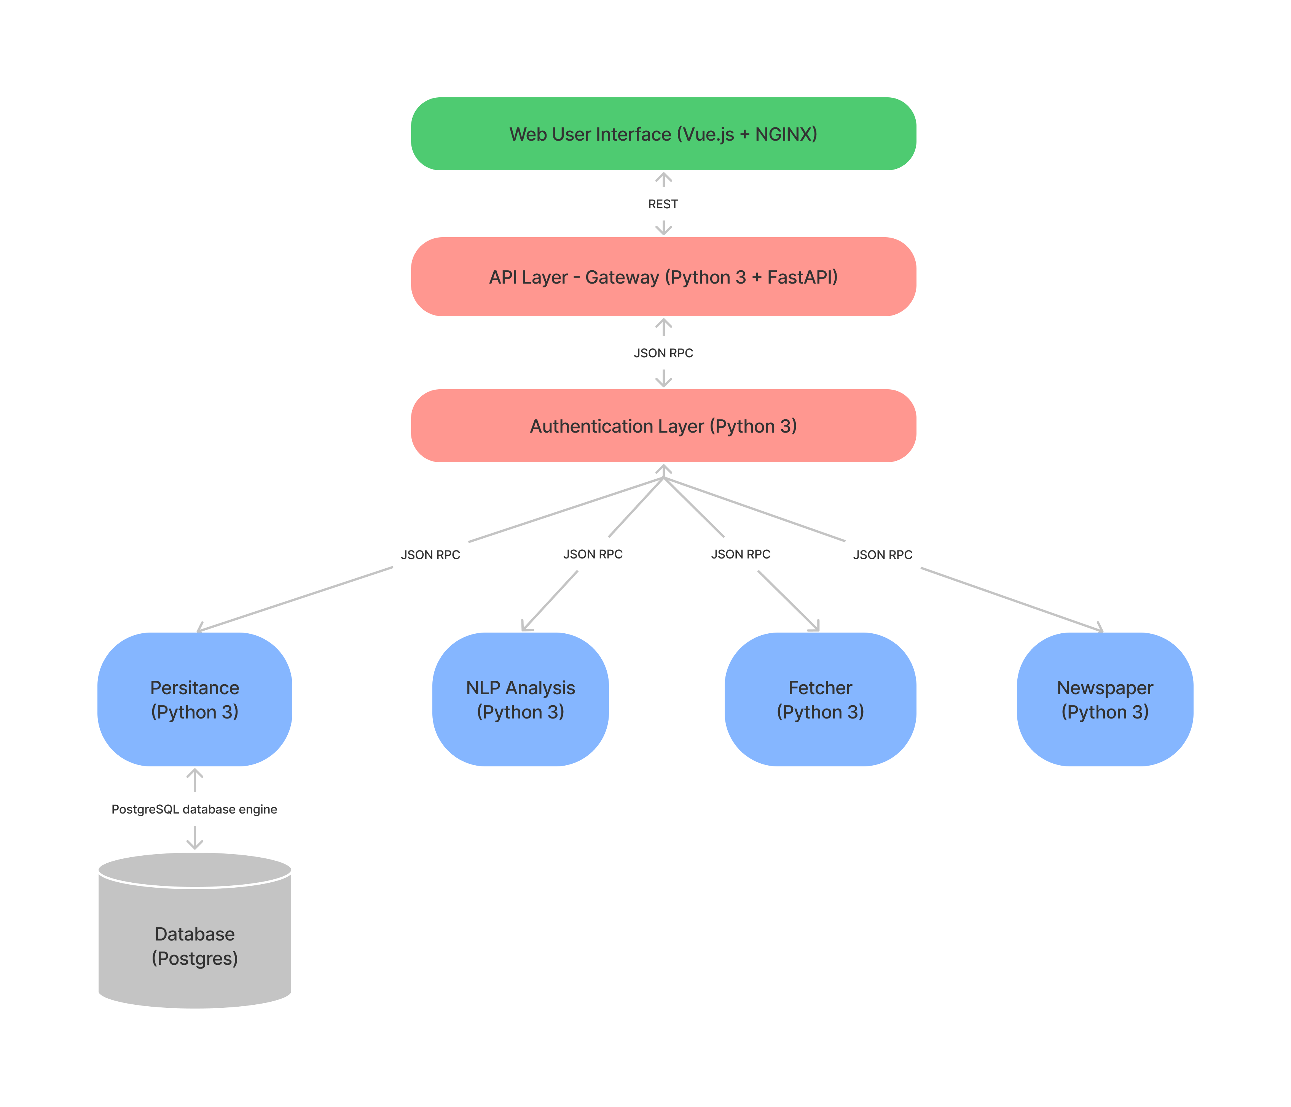







Notes:
Leonardo

Slide 14
JSON RPC
Stateless, light-weight remote procedure call (RPC) protocol.
Transport agnostic.
Designed to be simple!
Better solution than REST because:
Straightforward scope.
Well-defined encoding for request-response flow.
Notes:
Leonardo

Slide 15
Containerization Docker File Code Snippets
FROM python:3.9-slim as requirements-stage
WORKDIR /tmp
RUN pip install poetry
COPY ./pyproject.toml ./poetry.lock* /tmp/
RUN poetry export -f requirements.txt --output requirements.txt --without-hashes
FROM python:3.9-slim
RUN apt-get update && apt-get install -y --no-install-recommends git && apt-get purge -y --auto-remove
WORKDIR /code
COPY --from=requirements-stage /tmp/requirements.txt /code/requirements.txt
RUN pip install --no-cache-dir --upgrade -r /code/requirements.txt
COPY ./app /code/app
CMD ["python", "app/main.py"]
Notes:
Leonardo

Slide 16
Orchestration Docker Compose Code Snippets
version: "3"
services:
[...]
postgres:
image: postgres:alpine
restart: unless-stopped
volumes:
- db-data:/var/lib/postgresql/data
networks:
backend:
aliases:
- database.dev
[...]
ports:
- "5432:5432“
[...]
[...]
webserver:
depends_on:
- postgres
- persistence
build:
context: webserver/
restart: unless-stopped
ports:
- "5000:5000"
networks:
- backend
- frontend
[...]
[...]
networks:
frontend:
driver: bridge
backend:
driver: bridge
volumes:
db-data:
driver: local
nltkdata:
driver: local
[...]
Notes:
Leonardo

Slide 17
GitOps
[...]
jobs:
build:
runs-on: ubuntu-latest
steps:
- name: Checkout
uses: actions/checkout@v2
- name: Set up Docker Buildx
uses: docker/setup-buildx-action@v1
- name: Login to DockerHub
uses: docker/login-action@v1
with:
username: ${{ secrets.DOCKER_HUB_USERNAME }}
password: ${{ secrets.DOCKER_HUB_ACCESS_TOKEN }}
- name: Build and push
uses: docker/build-push-action@v2
with:
context: ./webserver
file: ./webserver/Dockerfile
builder: ${{ steps.buildx.outputs.name }}
push: true
tags: ${{ secrets.DOCKER_HUB_USERNAME }}/ap-webserver:latest
cache-from: type=registry,ref=${{ secrets.DOCKER_HUB_USERNAME }}/ap-webserver:buildcache
cache-to: type=registry,ref=${{ secrets.DOCKER_HUB_USERNAME }}/ap-webserver:buildcache,mode=max
Notes:
Leonardo

Slide 18
4.
BACK-END
API | Auth | Logic | Persistence
Notes:
Pietro

Slide 19

Auth
Google Sign-in and traditional credentials.
Hashed passwords.
Custom JWT.
Notes:
Pietro

Slide 20


API Gateway
Single entry-point towards backend.
Only secured APIs.
Implemented with FastAPI.
Notes:
Antonio
1. Architectural choice of exploiting a gateway <-> security pattern.
2. Why FastAPI? <-> OpenAPI Specification.
3. Overview of the entire APIs through Swagger/OpenAPI Editor: <https://editor.swagger.io>.
4. Connection with next slide: communication with logic microservices through JSON RPC.

Slide 21
Logic Modules
Persistence: SQLAlchemy ORM for managing interactions with db.
Fetcher: feedparser for news retrieval.
Newspaper: newspaper for extracting full article text.
NLP Analysis: nltk for summarizing article content.
Notes:
Antonio
1. Brief discussion of the utilization of an ORM approach.
2. feedparser for extracting basic pieces of information from news RSS feeds.
3. neewspaper for elaborating an article starting from its URL: retrieving the full text, if freely available.
4. nltk for ML task: natural language processing for extracting a full-sense textual summary starting from a textual content of a specific article.

Slide 22
Persistence – Model
User
int | id | PK
str | email
str | name
str | password
RssFeed
int | id | PK
str | url
int | rank
(0, n)
(1, 1)
Notes:
Antonio
1. Very simple model for implementing basic user-customization functionalities about RSS Feed.
2. Use of integer id exploiting Postgre sequences.
3. One-to-may relation with eager fetching and cascade and orphan delete.

Slide 23
5.
FRONT-END
Actual User Experience/Interface
Notes:
Nurken

Slide 24
User Experience
Login/Sign-up
News Management
Personal Area Customization
The user can either:
Login with Google Sign-in.
Sign-up with traditional username + password.
The user can:
Explore news fetched from a selected RSS source.
Obtain full text and short summary of specific article content.
The user can:
Modify the RSS sources.
Change colors theme.
Change password.
Delete account.
Notes:
Nurken

Slide 25
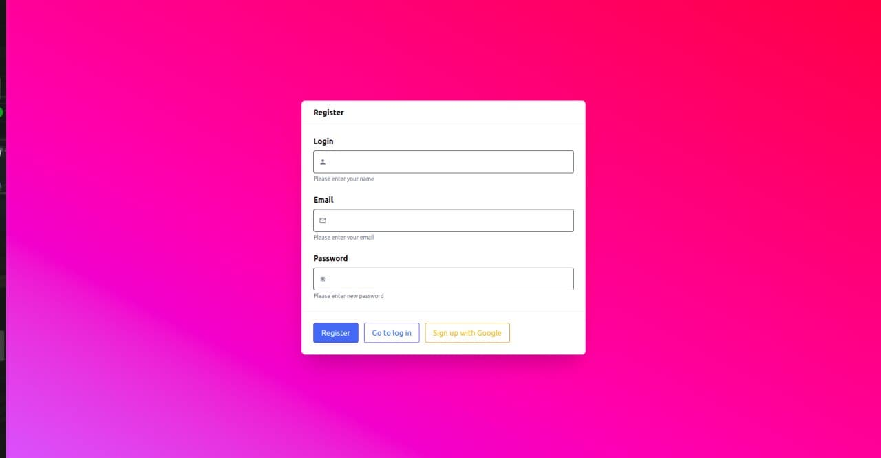
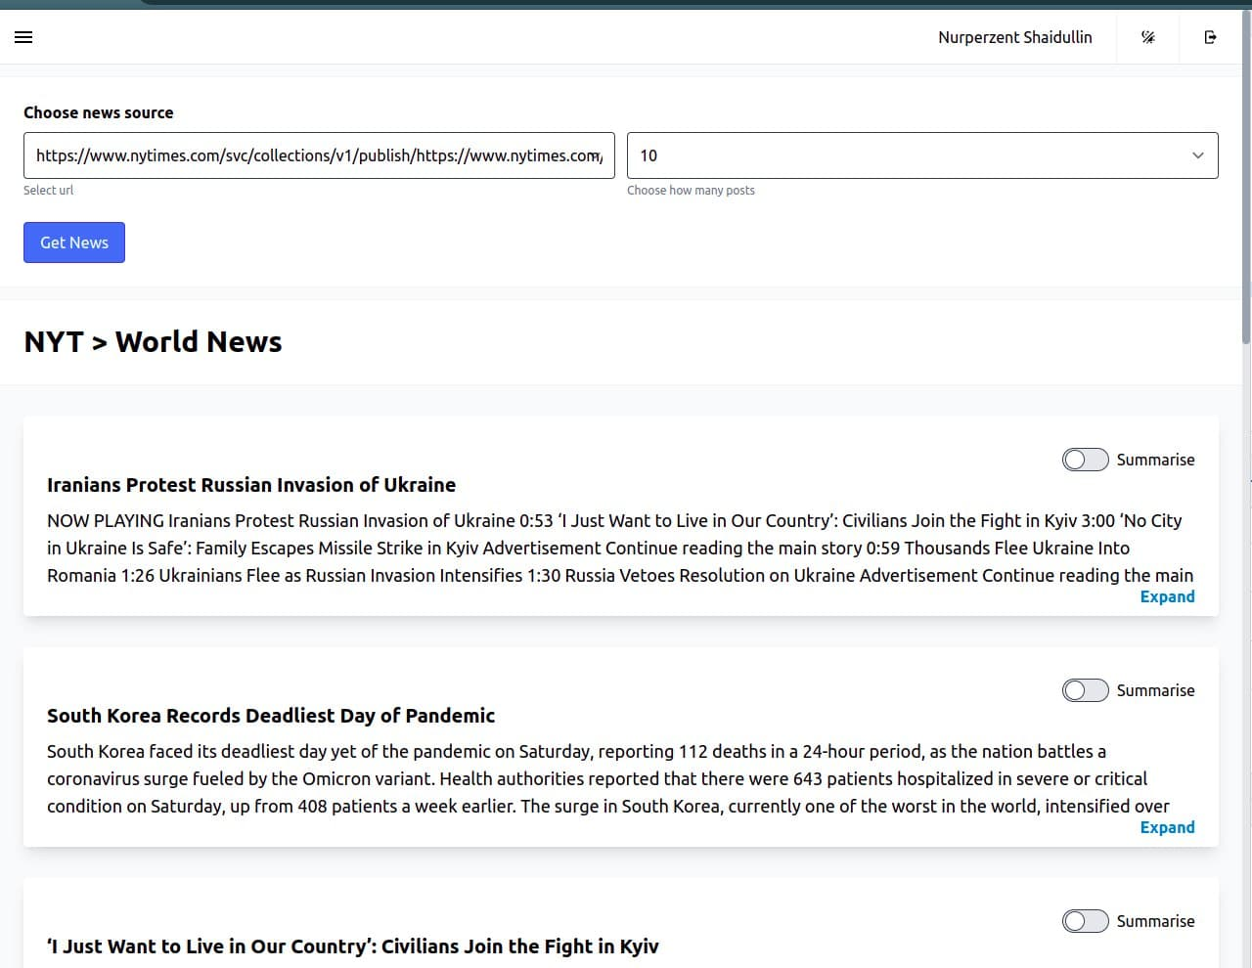
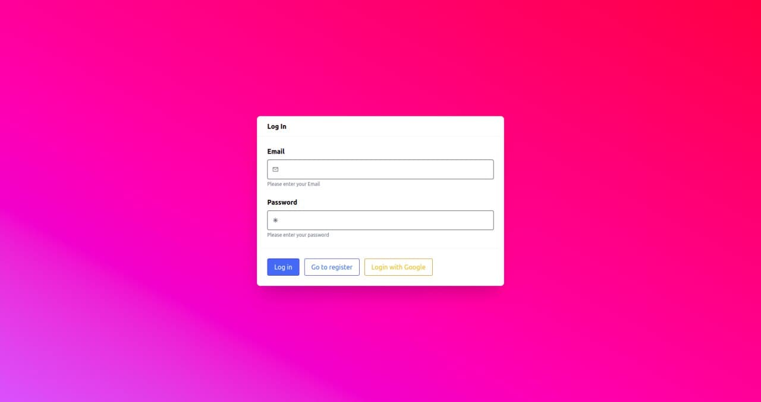
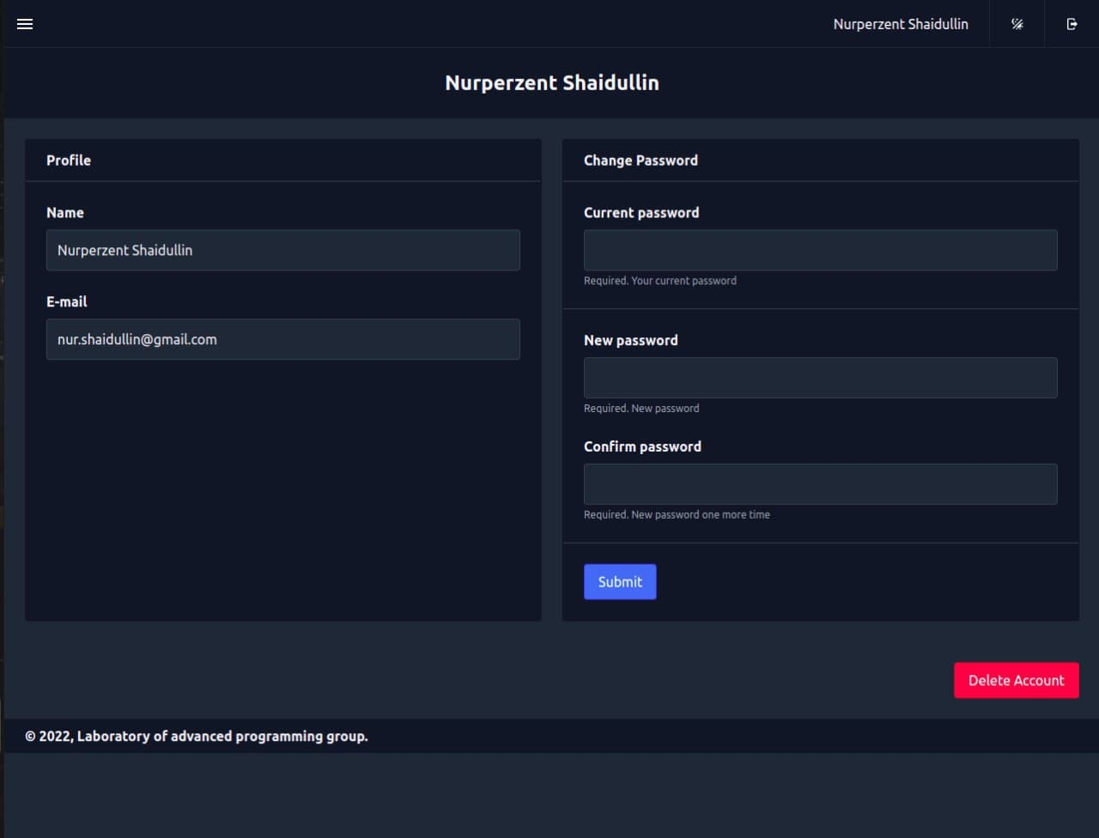
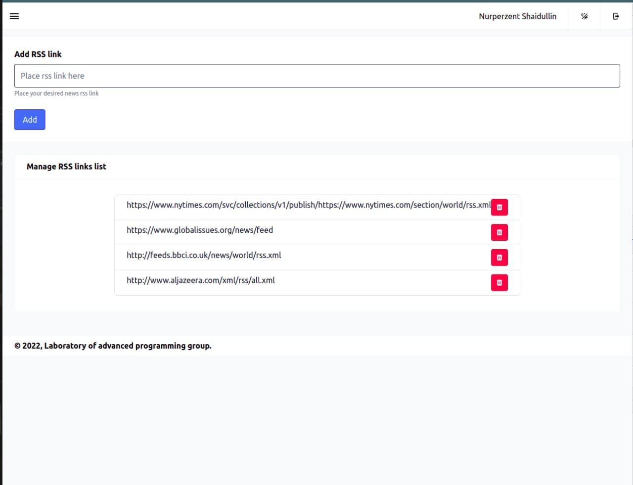
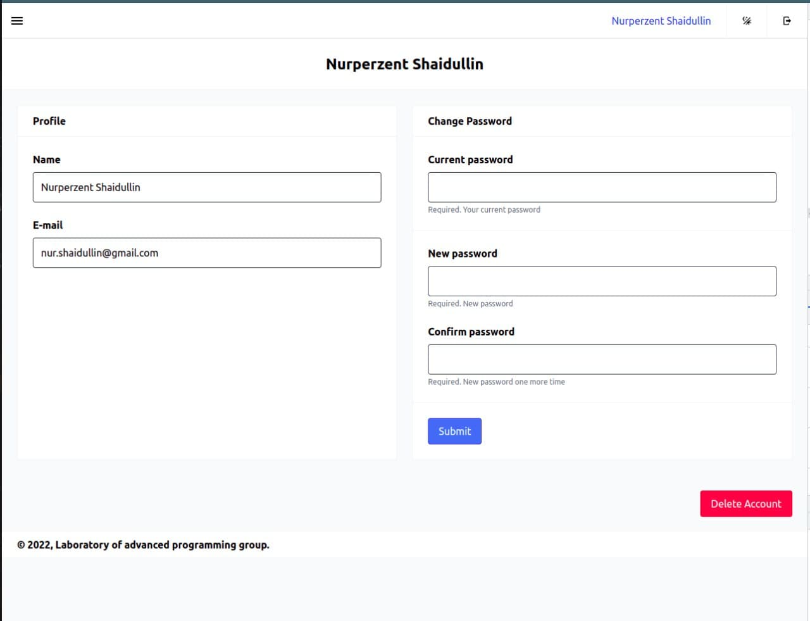
Front-end
User Interface
Notes:
Nurken

Slide 26
6.
CONCLUSIONS
Sprints Analytics
Notes:
Davide

Slide 27
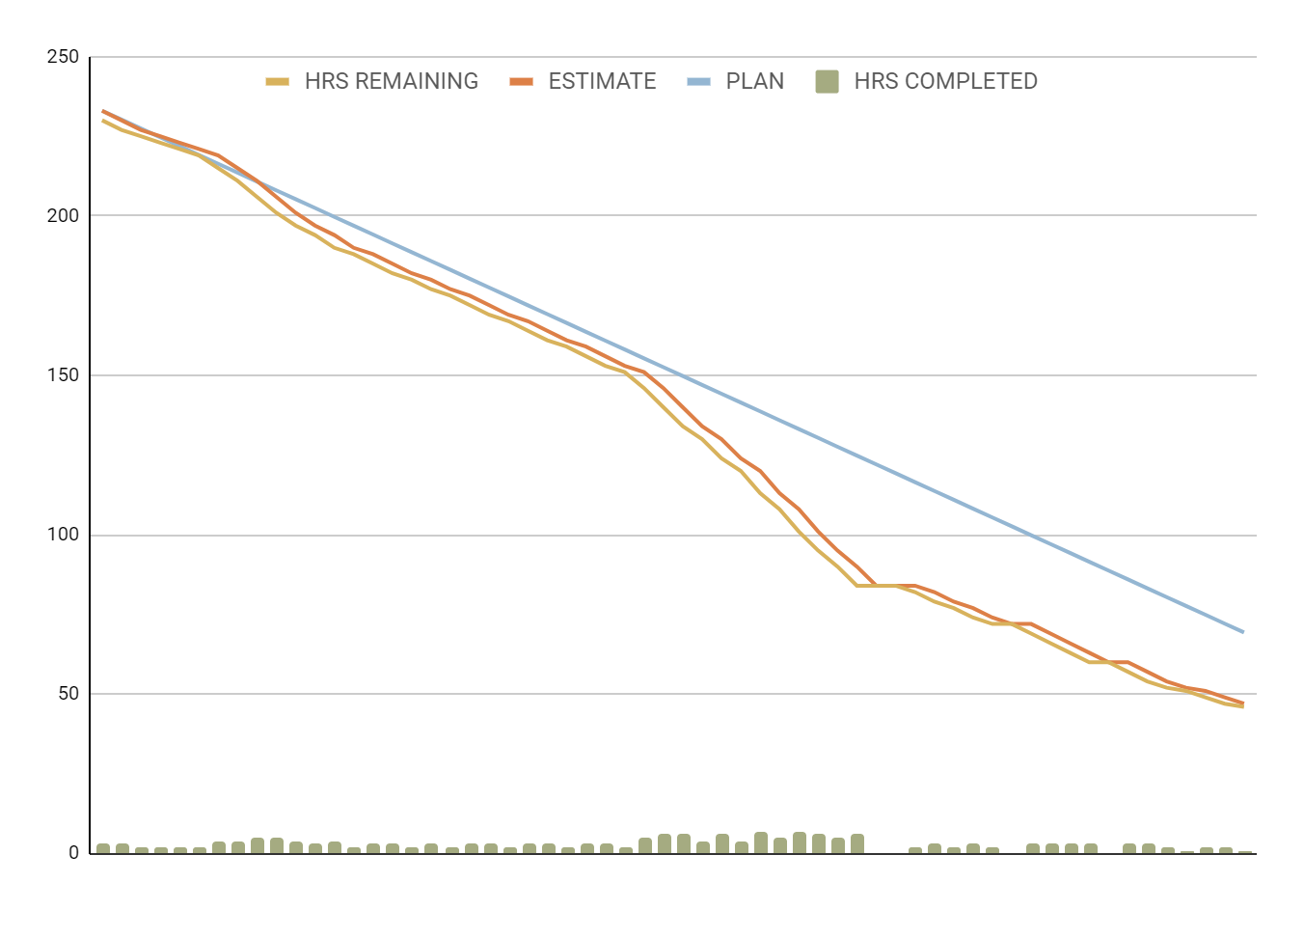
Burndown
Notes:
Davide
This is the burndown chart, in which the blue line is the plan, the orange one represents the estimated hours, and the yellow one represents the hours of our actual work.
As can be seen, we were not able to respect the hours estimated, going over 36 hours.

Slide 28

Thanks!
Share ideas and get involved!
Visit the GitHub page of the project
Notes:
Davide

