Slide 1

Humor detection in short English phrases using NLP
Humor detection
Leyla Rocío Becerra Barajas
Joan Gabriel Bofill Barrera
Camilo Alfonso mosquera Benavides

Slide 2

Introduction

Slide 3
Literature review
What are the main characteristics in texts that let support the humor detection?
Which NLP techniques have been used to detect humor in texts?
Which case study of humor detection would use as reference in this project?
Research questions
SLR
( TITLE-ABS-KEY ( natural AND language AND processing AND ( humor OR feelings ) AND ( detection OR computation ) ) AND LANGUAGE ( English ) ) AND PUBYEAR ¿ 2015
Search process
+ The publication must have a complete literature review or detailed explanation about techniques of humor detection or a comparative study with tables/figures
+The most complete publication will be included in case of similar or redundant studies
-Informal papers will be excluded
Inclusion and exclusion criteria
Systematic Literature Review
Quality assessment
The literature review is consistent and is based in a good bibliography?
If the document has more than one year: Has been cited?
Data collection
16 studies selected
Data analysis.

Slide 4
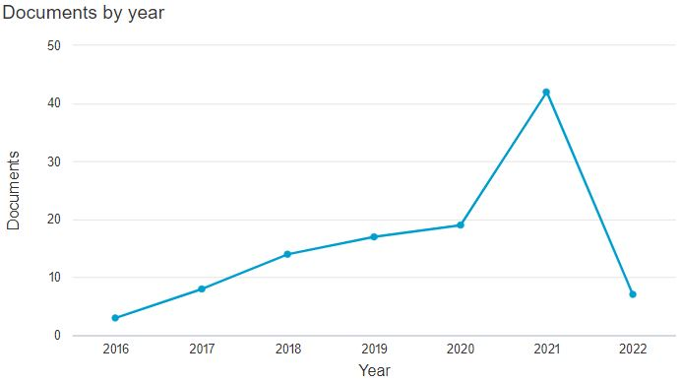
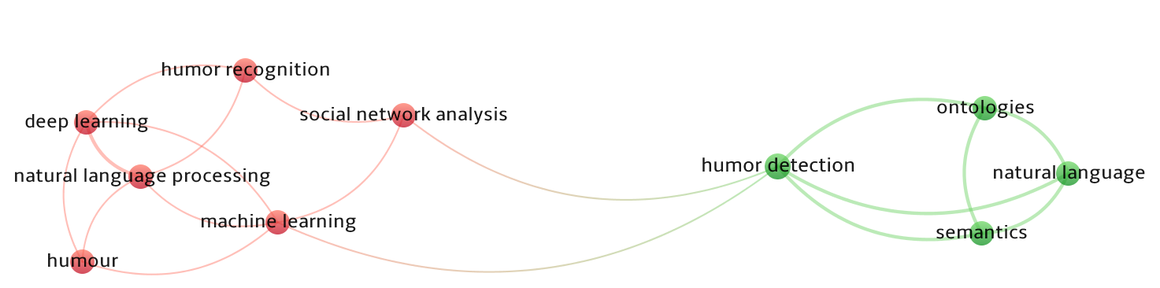
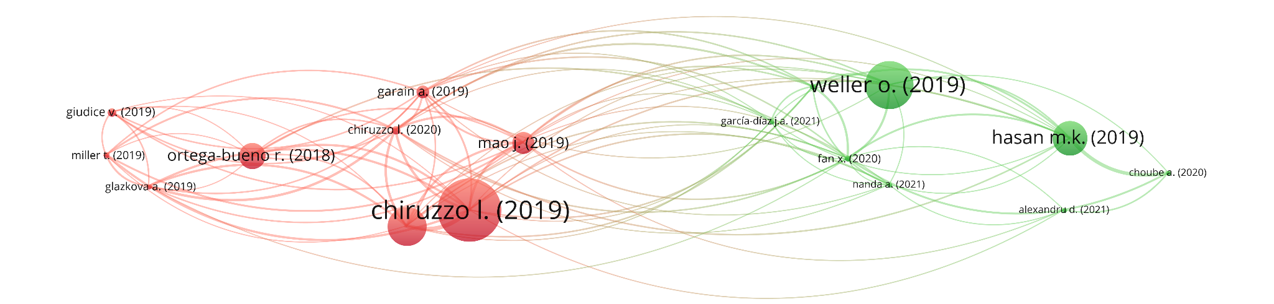
SLR: Data analysis

Slide 5
Basic concepts
Humor
Natural language processing
Techniques used
Humor detection

Slide 6
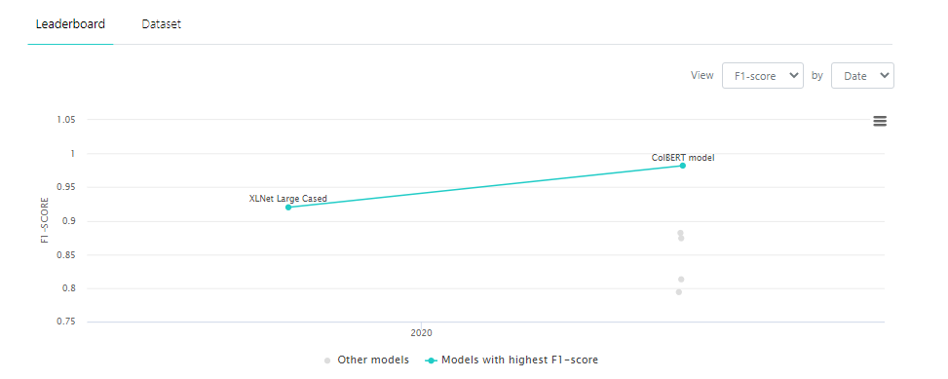
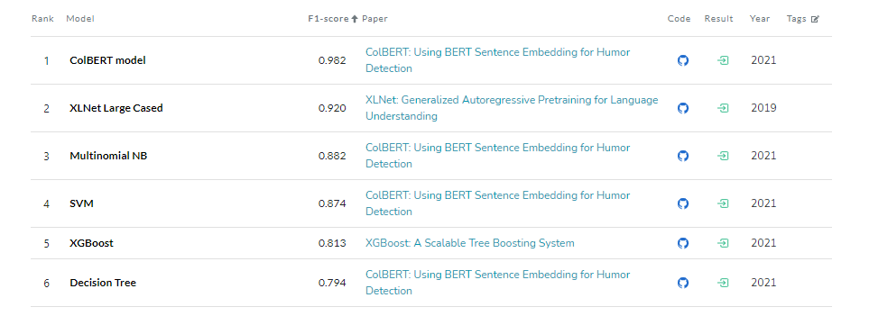
Case of Study
Data
Decision
01
Data set constructed by the authors containing phrases potentially containing humor
Detection in short texts based on the general linguistic structure of humor.
02
04
Insight
Info
03
The approach uses BERT model to encode text into a few sentence embeddings which enter into an eight-layered neural network.
The phrases in the dataset are classified by humorous content

Slide 7
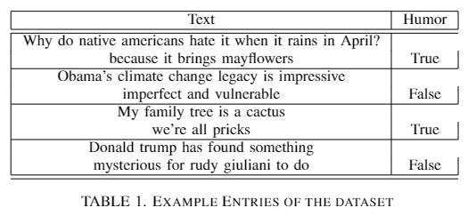
Dataset
Data characteristics
It has two columns: ”text” and ”humor”
Over 200k entries, no duplicates and no missing data.
Column “text” contains the strings
Column “humor” (where the possible values are ”True” or ”False”), indicating for each row if the sentence present in the text variable is humorous.
50%
50%
True
False

Slide 8
References
B. Kitchenham, O. Pearl Brereton, D. Budgen, M. Turner, J. Bailey, and S. Linkman, “Systematic literature reviews in software engineering – A systematic literature review,” 2008, doi: 10.1016/j.infsof.2008.09.009.
“What makes us laugh? Investigations into Automatic Humor Classification - ACL Anthology.” https://aclanthology.org/W18-1101/ (accessed Apr. 17, 2022).
A. Jaiswal, M. Monika, A. Mathur, P. Prachi, and S. Mattu, “Automatic Humour Detection in Tweets using Soft Computing Paradigms,” Proc. Int. Conf. Mach. Learn. Big Data, Cloud Parallel Comput. Trends, Prespectives Prospect. Com. 2019, pp. 172–176, Feb. 2019, doi: 10.1109/COMITCON.2019.8862259.
G. G. Chowdhury, “Natural language processing,” Annu. Rev. Inf. Sci. Technol., vol. 37, pp. 51–89, 2003, Accessed: Apr. 17, 2022. [Online]. Available: http://eprints.cdlr.strath.ac.uk/2611/.
R. Mihalcea and C. Strapparava, “Making Computers Laugh: Investigations in Automatic Humor Recognition,” Accessed: Apr. 17, 2022. [Online]. Available: http://www.mutedfaith.com/funny/life.htm.
M. K. Hasan et al., “UR-FUNNY: A Multimodal Language Dataset for Understanding Humor,” EMNLP-IJCNLP 2019 - 2019 Conf. Empir. Methods Nat. Lang. Process. 9th Int. Jt. Conf. Nat. Lang. Process. Proc. Conf., pp. 2046–2056, 2019, doi: 10.18653/V1/D19-1211.
Annamoradnejad and G. Zoghi, “ColBERT: Using BERT Sentence Embedding for Humor Detection,” Apr. 2020, Accessed: Apr. 17, 2022. [Online]. Available: http://arxiv.org/abs/2004.12765.
F. Shatnawi, M. Abdullah, and M. Hammad, “MLEngineer at SemEval2020 Task 7: BERT-Flair based Humor Detection Model (BFHumor),” 14th Int. Work. Semant. Eval. SemEval 2020 - co-located 28th Int. Conf. Comput. Linguist. COLING 2020, Proc., pp. 1041–1048, 2020, doi: 10.18653/V1/2020.SEMEVAL-1.136.
Devlin, J., Chang, M. W., Lee, K., Toutanova, K. (2018). Bert: Pretraining of deep bidirectional transformers for language understanding. arXiv preprint arXiv:1810.04805.
Annamoradnejad, I., Zoghi, G. (2020). Colbert: Using bert sentence embedding for humor detection. arXiv preprint arXiv:2004.12765.

Slide 9


