Slide 1
第三次作业
冉津豪
21210240095@m.fudan.edu.cn

Slide 2
整体分析
不要重复压缩，三道题目，每道题目提交一个压缩包；
压缩包内容仅需要.cpp .h文件即可，不要提交项目配置文件；
请按照原格式输入输出；

Slide 3
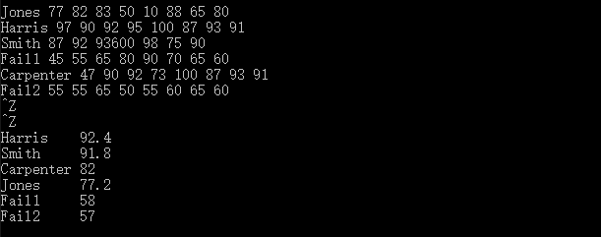
第一题-问题1
未按要求输出

Slide 4
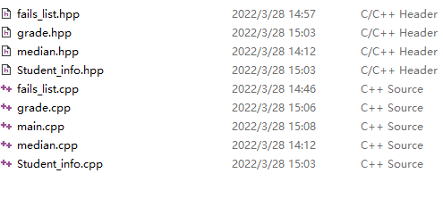
第一题-问题2
错误使用.hpp文件格式

Slide 5
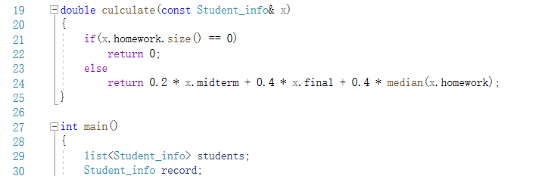
第一题-问题3
main.cpp中与grade函数冗余

Slide 6
第一题-问题4
#include "fails_list.cpp"
改为
多重符号定义问题
list<Student_info> extract_fails(list<Student_info>& stu);

Slide 7
第一题-部分参考代码
//main.cpp
#include"Student_info.h"
#include"grade.h"
...
list<Student_info> extract_fails(list<Student_info>& students); //在此声明即可；
int main() {
list<Student_info> Students, fail;
Student_info record;
string::size_type maxlen = 0;
while (read(cin, record)) {
maxlen = max(maxlen, record.name.size());
Students.push_back(record);
}
Students.sort(compare);
fail = extract_fails(Students);

Slide 8
//输出名字和成绩
cout << "passing students records:" << endl;
list<Student_info>::const_iterator iter = Students.begin();
while (iter != Students.end()) {
cout << (*iter).name << string(maxlen + 1 - (*iter).name.size(), ' ');
double final_grade = grade(*iter);
streamsize prec = cout.precision();
cout << setprecision(3) << final_grade << setprecision(prec) << endl;
++iter;
}
cout << "failing students records:" << endl;
iter = fail.begin();
while (iter != fail.end()) {
cout << (*iter).name << string(maxlen + 1 - (*iter).name.size(), ' ');
double final_grade = grade(*iter);
streamsize prec = cout.precision();
cout << setprecision(3) << final_grade << setprecision(prec) << endl;;
++iter;
}
return 0;
}

Slide 9
// fails_list.cpp
#include<list>
#include"Student_info.h"
#include"grade.h"
using std::list;
bool fgrade(const Student_info& s) {
return grade(s) < 60;
}
list<Student_info> extract_fails(list<Student_info>& students) {
list<Student_info> fail;
list<Student_info>::iterator iter = students.begin();
while (iter != students.end()) {
if (fgrade(*iter)) {
fail.push_back(*iter);
iter = students.erase(iter);
}
else {
++iter;
}
}
return fail;
}

Slide 10
第二题-问题1
cout << "random integer vector 1:" << endl;
while (cin >> num) {
if (cin.get() == '\n')
break;
else
vec1.push_back(num);
}
部分数据需要随机生成

Slide 11
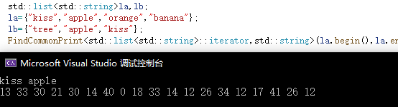
第二题-问题2
未按要求输出

Slide 12
第二题-参考代码
//main.cpp
#include"find.h"
#include<vector>
#include<iostream>
#include<string>
#include<algorithm>
#include<list>
using std::vector;
using std::string;
using std::list;
using std::cin;
using std::cout;
using std::endl;

Slide 13
void test_interger() {
// 整数
vector<int> vec1, vec2, vec3;
cout << "Random integer vector 1:" << endl;
for (int i = 0; i < 10; i++) {
vec1.push_back(rand() % 20);
}
print_elements(vec1.begin(), vec1.end());
cout << "Random integer vector 2:" << endl;
for (int i = 0; i < 10; i++) {
vec2.push_back(rand() % 20);
}
print_elements(vec2.begin(), vec2.end());
find_same_elements(vec1.begin(), vec1.end(), vec2.begin(), vec2.end(), vec3);
cout << "Vector in common:" << endl;
print_elements(vec3.begin(), vec3.end());
}

Slide 14
void test_string() {
string x;
list<string> list1, list2, list3;
cout << "Enter some words for string list 1:" << endl;
while (cin >> x) {
list1.push_back(x);
}
cin.clear();
cout << "Enter some words for string list 2:" << endl;
while (cin >> x) {
list2.push_back(x);
}
cin.clear();
find_same_elements(list1.begin(), list1.end(), list2.begin(), list2.end(), list3);
cout << "List in common:" << endl;
print_elements(list3.begin(), list3.end());
}
int main() {
test_interger();
test_string();
return 0;
}

Slide 15
// find.h
#ifndef GUARD_find_h
#define GUARD_find_h
#include<iostream>
#include<algorithm>
template <class In>
void print_elements(In begin, In end) {
while (begin != end) {
std::cout << *begin << " ";
begin++;
}
std::cout << std::endl;
}

Slide 16
template<class In, class Out>
void find_same_elements(In begin1, In end1, In begin2, In end2, Out& same_list) {
while (begin1 != end1) {
if (find(begin2, end2, *begin1) != end2) {
same_list.push_back(*begin1);
}
begin1++;
}
}
#endif

Slide 17
另一种实现方式：
template<class In,class Out>
void find_same_elements(In begin1,In end1,In begin2,In end2,Out same_list){
while(begin1 != end1){
if(find(begin2, end2, *begin1) != end2){
*same_list++ = *begin1;
}
begin1++;
}
}
测试函数中调用分别为：
find_same_elements(vec1.begin(), vec1.end(), vec2.begin(), vec2.end(), back_inserter(vec3));
find_same_elements(list1.begin(), list1.end(), list2.begin(), list2.end(), back_inserter(list3));

Slide 18

第三题-问题1
string rand_string(int n)
{
string str;
char c;
int j;
for (j = 0;j != n;j++)
{
c = 'a' + rand() % 26;
str.push_back(c);
}
return str;
}
void create_vecs(vector<string>& v1)
{
int n,i;
for (i = 0;i != 10;i++)
{
n = rand() % 10;
v1.push_back(rand_string(n));
}
}
单个字符串随机长度可为0导致的空字符串

Slide 19
第三题-参考代码
//main.cpp
#include"functions.h“
#include …
void test_integer() {
vector<int> ivec;
int sum1 = 0;
for (int i = 0; i < 10; i++) {
ivec.push_back(rand() % 100);
}
cout << "the integer list:" << endl;
output(ivec.begin(), ivec.end());
cout << endl;
cout << "the sum of the integer list:" << accumulate(ivec.begin(), ivec.end(), sum1) << endl;
cout << "the max element in the integer list:" << *max_elements(ivec.begin(), ivec.end()) << endl;
cout << "the min element in the integer list:" << *min_elements(ivec.begin(), ivec.end()) << endl;
}

Slide 20
void test_double() {
vector<double> dvec;
double sum2 = 0;
for (int i = 0; i < 10; i++) {
dvec.push_back(rand() % 10000000 / 1000000.0);
}
cout << "the double list:" << endl;
output(dvec.begin(), dvec.end());
cout << endl;
cout << "the sum of the double list:" << accumulate(dvec.begin(), dvec.end(), sum2) << endl;
cout << "the max element in the double list:" << *max_elements(dvec.begin(), dvec.end()) << endl;
cout << "the min element in the double list:" << *min_elements(dvec.begin(), dvec.end()) << endl;
}
void test_string() {
list<string> svec;
string sum3, temp;
for (int i = 0; i < 10; i++) {
temp = "";
for (int j = 0; j < rand() % 10 + 1; j++) {
temp.push_back(rand() % 26 + 'a');
}
svec.push_back(temp);
}

Slide 21
cout << "the string list:" << endl;
output(svec.begin(), svec.end());
cout << endl;
cout << "the sum of the string list:" << accumulate(svec.begin(), svec.end(), sum3) << endl;
cout << "the max element in the string list:" << *max_elements(svec.begin(), svec.end()) << endl;
cout << "the min element in the string list:" << *min_elements(svec.begin(), svec.end()) << endl;
}
int main() {
test_integer();
test_double();
test_string();
return 0;
}

Slide 22
// functions.h
#ifndef GUARD_functions_h
#define GUARD_functions_h
#include<iostream>
template<class In, class X>
X accumulate(In begin, In end, X& x) {
while (begin != end) {
x = x + *begin;
begin++;
}
return x;
}
template<class In>
In max_elements(In begin, In end) {
In max = begin;
while (begin != end) {
if (*begin > *max)
max = begin;
begin++;
}
return max;
}

Slide 23
template<class In>
In min_elements(In begin, In end) {
In min = begin;
while (begin != end) {
if (*begin < *min)
min = begin;
begin++;
}
return min;
}
template<class In>
void output(In begin, In end) {
while (begin != end) {
std::cout << *begin << " ";
begin++;
}
}
#endif

Slide 24
ICE3-参考代码
#include"selectSort.h"
#include<algorithm>
#include<vector>
#include<list>
#include<string>
#include<iostream>
#include<iterator>
using std::vector;
using std::list;
using std::string;
using std::cout;
using std::ostream_iterator;
using std::endl;
vector<int> test_vector(int n) {
vector<int> vec1;

Slide 25
for (int i = 0; i < n; i++) {
vec1.push_back(rand() % 100);
}
cout << "random int vector";
copy(vec1.begin(), vec1.end(), ostream_iterator<int>(cout, " "));
cout << endl;
selectSort(vec1.begin(), vec1.end());
return vec1;
}
list<double> test_list(int n) {
list<double> list1;
for (int i = 0; i < n; i++) {
list1.push_back(rand() % 1000000 / 1000.0);
}
cout << "random double list";
copy(list1.begin(), list1.end(), ostream_iterator<double>(cout, " "));
cout << endl;
selectSort(list1.begin(), list1.end());
return list1;
}

Slide 26
string test_string(int n) {
string str1;
for (int i = 0; i < n; i++) {
str1.push_back(rand() % 26 + 'A');
}
cout << "random string:";
copy(str1.begin(), str1.end(), ostream_iterator<char>(cout));
cout << endl;
selectSort(str1.begin(), str1.end());
return str1;
}

Slide 27
int main() {
//生成随机数，表示测试数据个数
int n = rand() % 10 + 10;
cout << n << " random data:" << endl;
vector<int> vec1 = test_vector(n);
list<double> list1 = test_list(n);
string str1 = test_string(n);
//输出结果
cout << "The sorted data:" << endl << "sorted int vector:";
copy(vec1.begin(), vec1.end(), ostream_iterator<int>(cout, " "));
cout << endl << "sorted double list:";
copy(list1.begin(), list1.end(), ostream_iterator<double>(cout, " "));
cout << endl << "sorted string:";
copy(str1.begin(), str1.end(), ostream_iterator<char>(cout));
cout << endl;
return 0;
}

Slide 28
//selectSort.h
#ifndef GUARD_selectSort_h
#define GUARD_selectSort_h
#include<algorithm>
template<class T>
void swap(T& a, T& b) {
T c(a);
a = b;
b = c;
}

Slide 29
//selectSort.h
template<class In>
void selectSort(In begin, In end) {
while (begin != end) {
In p = begin, min = begin;
p++;
while (p != end) {
if (*min > *p) {
min = p;
}
p++;
}
swap(*begin, *min);
begin++;
}
}
#endif

Slide 30
//错误示例
#ifndef GUARD_selectSort_h
#define GUARD_selectSort_h
#include<algorithm>
#include<iostream>
#include<string>
template<class In,class T>
void selectSort(In begin,In end,T type){
In flag,min;
T temp;
while(begin!=end){
In flag=begin,min=begin;
while(flag!=end){
if(*min>*flag){
min=flag;
}
flag++;
}
temp=*begin;
*begin=*min;
*min=temp;
begin++;
}
}

