Slide 1
HW4讲解
唐冰宇
21210240074@m.fudan.edu.cn

Slide 2
整体分析
每道题目提交一个压缩包
最后提醒一次，下次扣分
注意细节，做题前认真学习PPT和课本内容

Slide 3
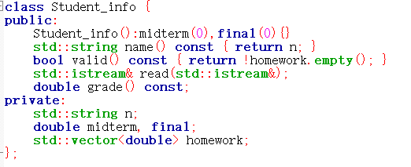

HW4-1 问题1&2
构造函数不完整/没有
未声明const

Slide 4
HW4-1 部分参考代码
//Student_info.h
#ifndef GUARD_Student_info
#define GUARD_Student_info
#include <iostream>
#include <string>
#include <vector>
class Student_info {
public:
Student_info(): midterm(0),final(0) {}
explicit Student_info(std::istream& in) {read(in);}
bool valid() const {return !homework.empty();}
double grade() const;
std::string name() const {return name;}
std::istream& read(std::istream&);
private:
std::string name;
double midterm, final;
std::vector<double> homework;
};
bool compare(const Student_info&, const Student_info&) ;
#endif

Slide 5
//Student_info.cpp
double Student_info::grade() const
{
if (!valid())
throw domain_error("student has done no homework");
return ::grade(midterm, final, homework);
}
istream& Student_info::read(istream& in) {
in >> n >> midterm >> final;
read_hw(in,homework);
return in;
}
istream& read_hw(istream& in, vector<double>& hw) {
if (in) {
hw.clear();
double x;
while (in >> x)
hw.push_back(x);
in.clear();
}
return in;
}
bool compare(const Student_info& x, const Student_info& y) {
return x.name() < y.name();
}
Notes:
声明作用域是student_info

Slide 6
//main.cpp
int main()
{
vector<Student_info> students;
Student_info record;
string::size_type maxlen = 0;
while (record.read(cin)) {
maxlen = max(maxlen, record.name().size());
students.push_back(record);
}
sort(students.begin(), students.end(), compare);
for (vector<Student_info>::size_type i = 0; i != students.size(); ++i) {
cout << students[i].name() << string(maxlen + 1 - students[i].name().size(), ' ');
try {
double final_grade = students[i].grade();
streamsize prec = cout.precision();
cout << setprecision(3) << final_grade << setprecision(prec);
} catch (domain_error e) {
cout << e.what();
}
cout << endl;
}
return 0;
}

Slide 7
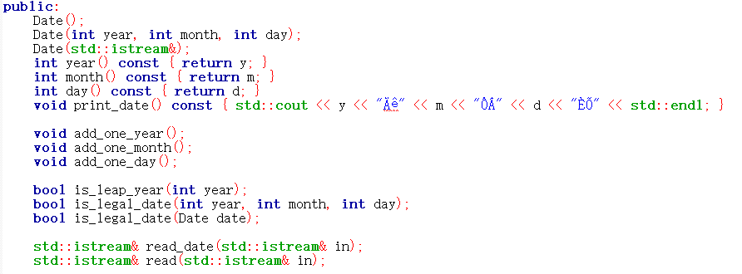
HW4-2 问题1
无explicit声明/
声明不规范
用explicit避免不自然的隐式类型转换
只能用在带一个参数的构造函数定义中

Slide 8
HW4-2 问题2&3
没有将未修改类数据属性的成员函数定义为const
将仅涉及类的实现的函数作为
公有成员

Slide 9
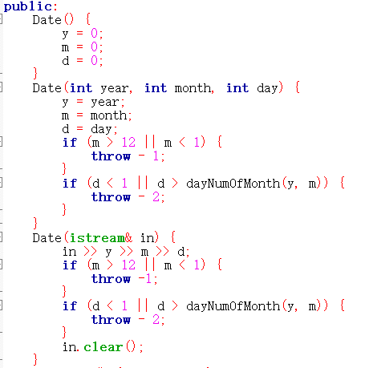
HW4-2 问题4
默认构造函数初始化未使用初始化列表，而是在函数体中赋值

Slide 10
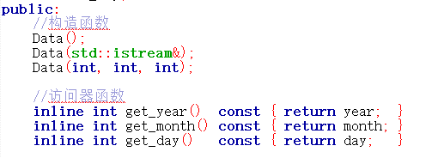
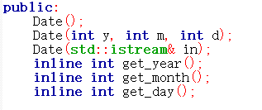

HW4-2 问题5
在class中使用inline声明内联函数（class中定义的函数默认为内联函数）

Slide 11
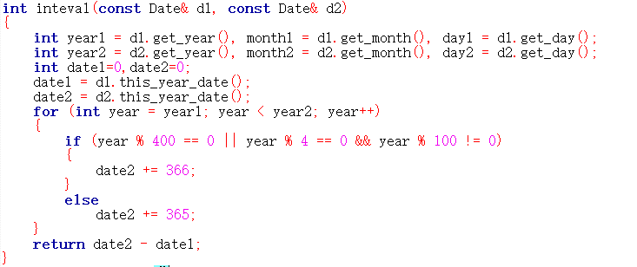
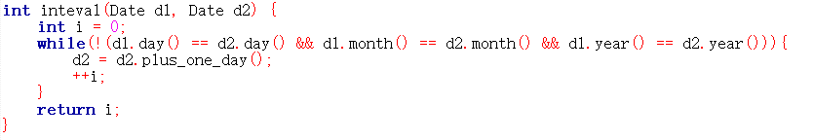
HW4-2 问题6
未考虑日期一小于日期二的情况

Slide 12
HW4-2 部分参考代码
//Date.h
class Date{
public:
Date(): year_(0), month_(0), day_(0) {}
Date(int year, int month, int day): year_(year), month_(month), day_(day) {}
explicit Date(std::istream&);
int year() const { return year_; }
int month() const { return month_; }
int day() const { return day_; }
void output() const;
void add_year();
void add_month();
void add_day();
bool vaild() const; //判断日期是否有效
int day_in_year() const; //计算是当年的第几天
private:
int year_, month_, day_;
const int days_of_month_[12] = {31, 28, 31, 30, 31, 30, 31, 31, 30, 31, 30, 31};
int days_of_month() const; //计算当月的天数
bool is_leap_year() const; //判断是否是闰年
};
int Interval(const Date& d1, const Date& d2);

Slide 13
Date.cpp
int Date::days_of_month() const {
int leap = (month_ == 2 && is_leap_year()) ? 1 : 0;
return days_of_month_[month_-1] + leap;
}
void Date::add_year() {
++year_;
if (is_leap_year() && month_ == 2 && day_ >= 29)
day_ = 28;
}
void Date::add_month() {
++month_;
if (month_ > 12) {
month_ = 1;
++year_;
}
else if (day_ > days_of_month())
day_ = days_of_month();
}
void Date::add_day() {
++day_;
if (day_ > days_of_month()) {
day_ = 1;
add_month(); }
}

Slide 14
Date.cpp
bool Date::vaild() const{
if (month_ < 1 || month_ > 12) {
cout<<"invalid month"<<endl;
return false;
}else if(day_ > days_of_month()) {
cout << "invalid day" << endl;
return false;
}
return true;
}
bool Date::is_leap_year() const{
if (year_ % 400 == 0 || (year_ % 4 == 0 && year_ % 100))
return true;
else
return false;
}
int Date::day_in_year() const {
int cnt = day_;
for (int i = 1; i < month_; ++i)
cnt += days_of_month_[i-1];
if (month_ > 2 && is_leap_year())
++cnt;
return cnt;
}

Slide 15
bool is_later(const Date& x, const Date& y) {
if (x.year() > y.year())
return true;
else if (x.year() < y.year())
return false;
if (x.month() > y.month())
return true;
else if (x.month() < y.month())
return false;
if (x.day() > y.day())
return true;
else
return false;
}
int Interval(const Date& d1, const Date& d2) {
int ans = is_later(d1, d2) ? d1.day_in_year() - d2.day_in_year() : d2.day_in_year() - d1.day_in_year();
int from = min(d1.year(), d2.year());
int to = max(d1.year(), d2.year());
for (int i = from; i < to; ++i)
ans += (i%400 == 0) || (i%4 == 0 && i%100 != 0) ? 366 : 365;
return ans;
}

Slide 16
//main.cpp
int main()
{
cout << "请输入两个日期(年月日，以空格分隔): " << endl;
Date date1(cin);
if (!date1.vaild())
return 0;
Date date2(cin);
if (!date2.vaild())
return 0;
cout << "日期一：";
date1.output();
cout << "日期二：";
date2.output();
cout << "两个日期相隔天数为: " << Interval(date1, date2) << endl;
Date tmp1 = date1; tmp1.add_day();
cout << "给日期一增加一天为: ";
tmp1.output();
Date tmp2 = date1; tmp2.add_month();
cout << "给日期一增加一月为: ";
tmp2.output();
Date tmp3 = date1; tmp3.add_year();
cout << "给日期一增加一年为: ";
tmp3.output();
return 0;
}

Slide 17
ICE4
输入n(0<n<=20), 输出如下方阵(n=4时):
1 3 4 10
2 5 9 11
6 8 12 15
7 13 14 16

Slide 18
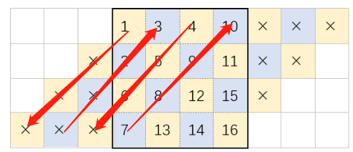
ICE4-算法
c
for (每条对角线)
行下标循环n次
if (列下标在有效范围内)
填充整数
颠倒填充方向
r
r+n
r

Slide 19
//square.h
#ifndef GUARD_square_h
#define GUARD_square_h
#include <vector>
#include <iostream>
class square {
public:
square():size(1),content(1) {}
explicit square(int s):size(s),content(s) {}
void construct();
std::ostream& output(std::ostream&);
private:
int size;
std::vector<std::vector<int>> content;
};
#endif

Slide 20
//square.cpp
void square::construct(){
bool direction = true;
for (int c = 0, i = 1; c < size * 2 - 1; ++c){
for (int r = 0; r < size; ++r){
if (c - r >= 0 && c - r < size){
if (direction) content[r].push_back(i);
else content[c - r].push_back(i);
++i;
}
}
direction = !direction;
}
}
ostream& square::output(ostream& o){
for (int r = 0; r < size; ++r){
for (int c = 0; c < size; ++c)
o << setw(4) << content[r][c];
o << endl;
}
return o;
}

