Slide 1
第五次作业
冉津豪
21210240095@m.fudan.edu.cn

Slide 2
整体分析
注意题目要求，不要遗漏；
灵活应用学习的内容，减少工作量；

Slide 3
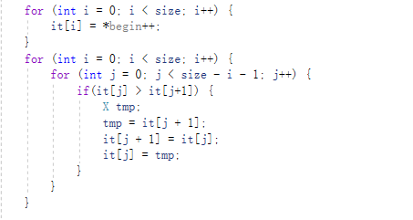
第一题-问题1
没有使用copy，sort函数，而是更复杂地手动实现复制、排序；

Slide 4
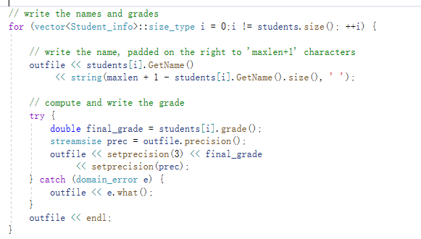
第一题-问题2
缺少输出到文件final 或者缺少控制台输出；

Slide 5
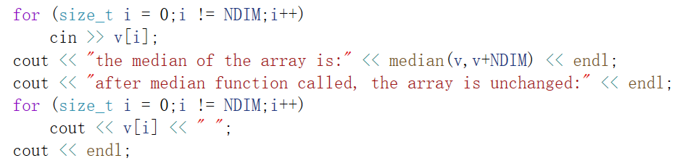
第一题-问题3
缺少随机数列验证，或者使用了手动输入数组代替了产生随机数列；

Slide 6
第一题-部分参考代码
//main.cpp
#include"Student_info.h"
#include"grade.h"
...
void random_test() {
cout << endl << "the following is the result of testing median function on array" << endl << "the random array is:" << endl;
int a[11];
for (int i = 0; i < 11; ++i)
{
a[i] = rand() % 50 + 50;
cout << a[i] << " ";
}
cout << endl << "the median of the array is:" << median(a, a + 11) << endl;
for (int i = 0; i < 11; ++i)
{
cout << a[i] << " ";
}
}
main.cpp

Slide 7
void output(std::ostream& out, vector<Student_info>& stu, int maxlen) {
for (vector<Student_info>::size_type i = 0;
i != stu.size(); ++i) {
out << stu[i].name()
<< string(maxlen + 1 - stu[i].name().size(), ' ');
try {
double final_grade = stu[i].grade();
streamsize prec = out.precision();
out << setprecision(3) << letter_grade(final_grade)
<< setprecision(prec);
}
catch (domain_error e) {
out << e.what();
}
out << endl;
}
}
main.cpp

Slide 8
int main()
{
vector<Student_info> students;
Student_info record;
string::size_type maxlen = 0;
std::ifstream infile("grades");
std::ofstream outfile("final");
while (record.read(infile)) {
maxlen = max(maxlen, record.name().size());
students.push_back(record);
}
sort(students.begin(), students.end(), compare);
output(cout, students, maxlen);
output(outfile, students, maxlen);
random_test();
return 0;
}
main.cpp

Slide 9
string letter_grade(double grade)
{
// range posts for numeric grades
static const double numbers[] = {
97, 94, 90, 87, 84, 80, 77, 74, 70, 60, 0
};
// names for the letter grades
static const char* const letters[] = {
"A+", "A", "A-", "B+", "B", "B-", "C+", "C", "C-", "D", "F"
};
// compute the number of grades given the size of the array
// and the size of a single element
static const size_t ngrades = sizeof(numbers)/sizeof(*numbers);
// given a numeric grade, find and return the associated letter grade
for (size_t i = 0; i < ngrades; ++i) {
if (grade >= numbers[i])
return letters[i];
}
return "?\?\?";
}
grade.cpp

Slide 10
template<typename T>
typename T::value_type median(T begin, T end)
{
typedef typename T::value_type value_type;
typedef vector<value_type>::size_type vec_sz;
vector<value_type> vec;
copy(begin, end, back_inserter(vec));
vec_sz size = vec.size();
sort(vec.begin(), vec.end());
vec_sz mid = size / 2;
return size % 2 == 0 ? (vec[mid] + vec[mid - 1]) / 2 : vec[mid];
}
template<typename T>
T median(T* begin, T* end)
{
typedef vector<value_type>::size_type vec_sz;
vector<T> vec;
copy(begin, end, back_inserter(vec));
vec_sz size = vec.size();
sort(vec.begin(), vec.end());
vec_sz mid = size / 2;
return size % 2 == 0 ? (vec[mid] + vec[mid - 1]) / 2 : vec[mid];
}
median.h

Slide 11
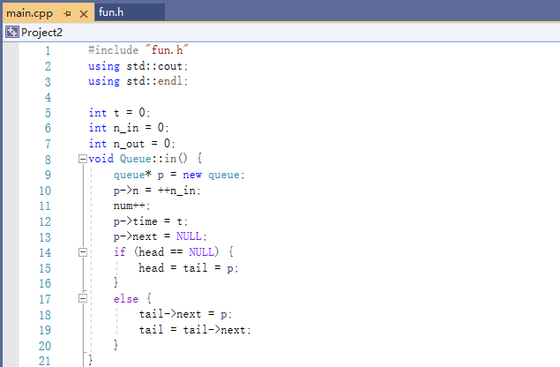
第二题-问题1
文件组织不规范

Slide 12
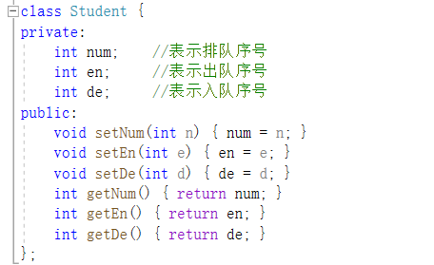
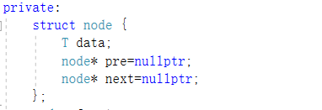
第二题-问题2
类定义结构

Slide 13
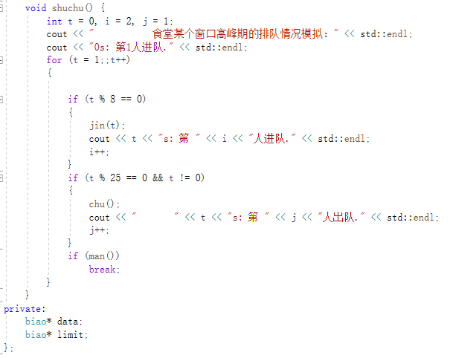
第二题-问题3
缺少函数

Slide 14
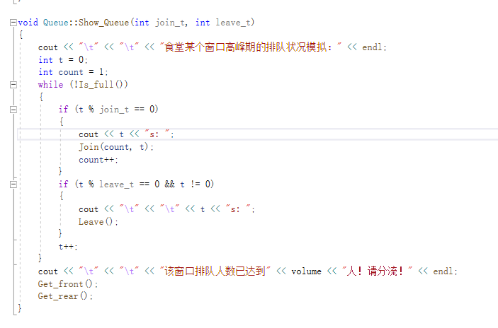
第二题-问题3
缺少函数

Slide 15
第二题-部分参考代码
int main()
{
cout << "\t\t" << "食堂某个窗口高峰期排队模拟" << endl;
Queue que;
int time = 0;
for (; !que.is_full(); time++)
{
if (time % 8 == 0)
{
que.enqueue(time);
cout << time << "s:第" << que.get_size() << "人进队。" << endl;
}
main.cpp

Slide 16
if (time != 0 && time % 25 == 0)
{
que.dequeue();
cout << "\t\t" << time << "s:第" << time / 25 << "人出队"<<endl;
}
}
cout << "\t\t" << "该窗口人数已达到50人，请分流！" << endl;
cout << "\t" << "队首人员于" << que.get_head() << "s进队" << endl;
cout << "\t" << "队尾人员于" << que.get_tail() << "s入队" << endl;
return 0;
}
main.cpp

Slide 17
#ifndef GUARD_queue_h
#define GUARD_queue_h
#include<iostream>
#include<string>
#include<vector>
struct node
{
int time;
node* next;
};
queue.h

Slide 18
class Queue {
public:
Queue() :tail(NULL), head(NULL),size(0){};
void enqueue(int);
void dequeue(void);
int get_head();
int get_tail();
bool is_empty();
bool is_full();
int get_size();
void output();
private:
node* tail;
node* head;
int size;
};
#endif
queue.h

Slide 19
#include<iostream>
#include<string>
#include<vector>
#include"queue.h"
int Queue::get_head()
{
return head->time;
}
int Queue::get_tail()
{
return tail->time;
}
bool Queue::is_empty()
{
return head == NULL;
}
queue.cpp

Slide 20
bool Queue::is_full()
{
return size == 50;
}
int Queue::get_size()
{
return size;
}
void Queue::enqueue(int n)
{
node* p = new node();
p->next = NULL;
p->time = n;
if (head == NULL)
head = tail = p;
else
tail=tail->next = p;
size++;
}
queue.cpp

Slide 21
void Queue::dequeue()
{
node* p = head->next;
delete head;
head = p;
size--;
}
void Queue::output()
{
node* p=head;
for (int i = 0; i < size; ++i)
{
std::cout << p->time << " ";
p = p->next;
}
}
queue.cpp

