Slide 1
第七次作业
冉津豪
21210240095@m.fudan.edu.cn

Slide 2
整体分析
注意题目要求，不要遗漏；
规范组织文件；

Slide 3
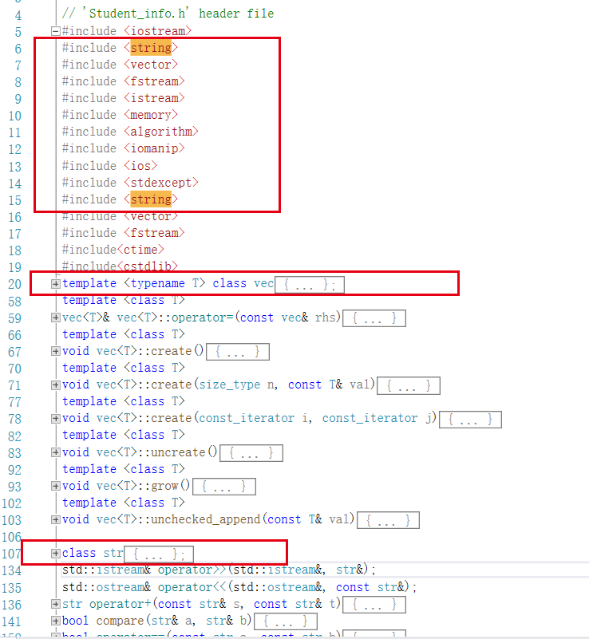



整体分析
1653374341(1)
规范组织文件

Slide 4
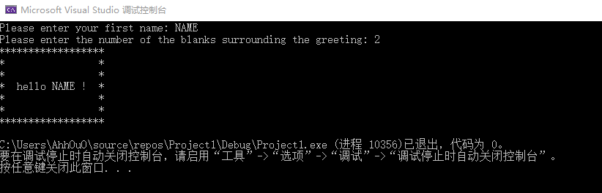
第一题-问题1
遗漏题目要求；

Slide 5

第一题-问题2
与题目输出不符；

Slide 6
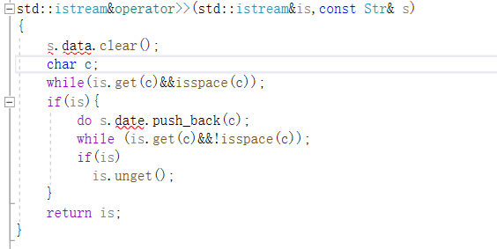
第一题-问题3
外部函数不可访问类的private成员；未使用友元函数；

Slide 7
第一题-部分参考代码
#include <iostream>
#include "Str.h"
using std::cin;
using std::cout;
using std::endl;
int main() {
cout << "please enter your first name: ";
Str name;
cin >> name;
const Str greeting = "Hello, " + name + "!";
cout << endl;
cout << "please enter the number of the blanks surrounding the greeting: ";
int pad;
cin >> pad;
const int rows = pad * 2 + 3;
const Str::size_type cols = greeting.size() + pad * 2 + 2;
cout << endl;
main.cpp

Slide 8
for (int r = 0; r != rows; ++r) {
Str::size_type c = 0;
while (c != cols) {
if (r == pad + 1 && c == pad + 1) {
cout << greeting;
c += greeting.size() - 1;
} else {
if (r == 0 || r == rows - 1 || c == 0 || c == cols - 1)
cout << "*";
else
cout << " ";
}
++c;
}
cout << endl;
}
cout << "逐个字符输出greeting(字符之间以空格分隔):" << endl;
for (Str::size_type i = 0; i != greeting.size(); ++i) {
cout << greeting[i] << " ";
}
return 0;
}
main.cpp

Slide 9
#ifndef STR_H_GUARD
#define STR_H_GUARD
#include "Vec.h"
#include <iostream>
#include <algorithm>
#include <cstring>
class Str {
friend std::istream& operator>>(std::istream&, Str&);
public:
typedef Vec<char>::size_type size_type;
Str() { }
Str(size_type n, char c): data(n, c){}
Str(const char* cp) { std::copy(cp, cp + std::strlen(cp), std::back_inserter(data)); }
template<typename In> Str(In b, In e) { std::copy(b, e, std::back_inserter(data)); }
char& operator[](size_type i) { return data[i]; }
const char& operator[](size_type i) const { return data[i]; }
size_type size() const { return data.size(); }
Str& operator+=(const Str&);
private:
Vec<char> data;
};
Str.h

Slide 10
std::ostream& operator<<(std::ostream&, const Str&);
Str operator+(const Str&, const Str&);
#endif
Str.h

Slide 11
#include <iostream>
#include <algorithm>
#include "Str.h"
#include "Vec.h"
using std::istream; using std::ostream;
using std::copy;
istream& operator>>(istream& is, Str& s) {
s.data.clear();
char c;
while (is.get(c) && isspace(c));
if (is) {
do s.data.push_back(c);
while (is.get(c) && !isspace(c));
if (is)
is.unget();
}
return is;
}
Str.cpp

Slide 12
ostream& operator<<(ostream& os, const Str& s) {
for (Str::size_type i = 0; i != s.size(); ++i)
os << s[i];
return os;
}
Str& Str::operator+=(const Str& s) {
copy(s.data.begin(), s.data.end(), std::back_inserter(data));
return *this;
}
Str operator+(const Str& s, const Str& t) {
Str r = s;
r += t;
return r;
}
Str.cpp

Slide 13
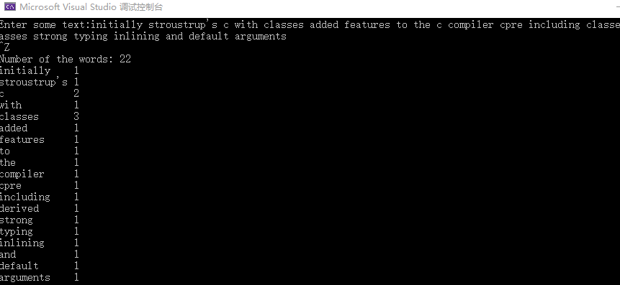
第二题-问题1
与题目输出不符；

Slide 14
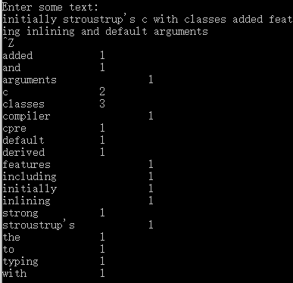
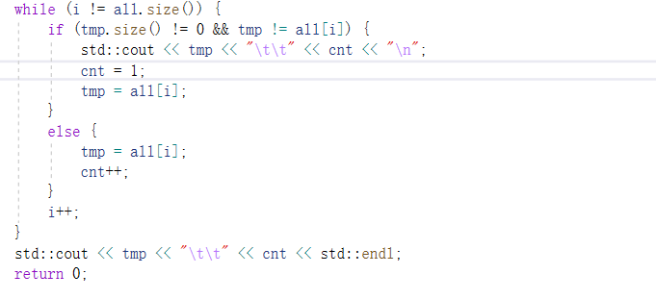
第二题-问题1
与题目输出不符；

Slide 15
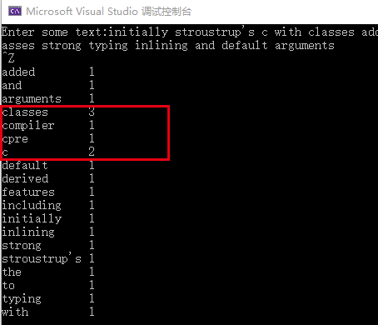
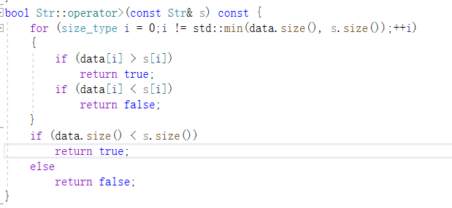
第二题-问题2
比较函数有误

Slide 16
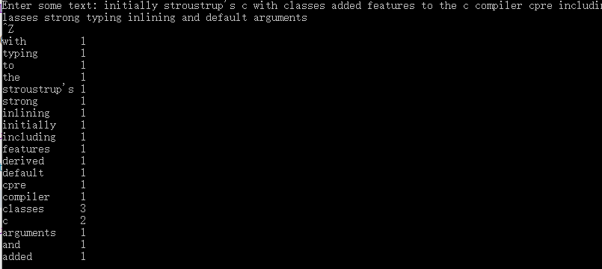
第二题-问题2
比较函数有误

Slide 17
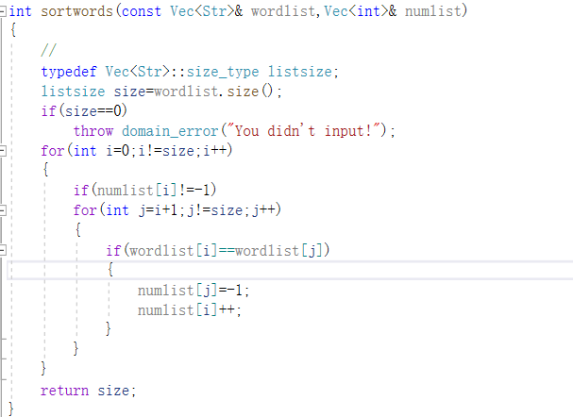
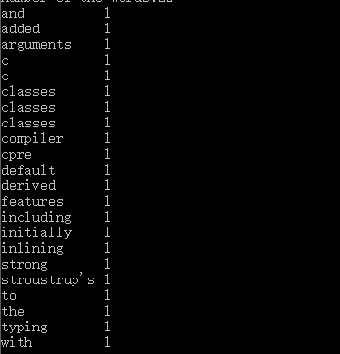
第二题-问题3
计数函数有误

Slide 18
第二题-部分参考代码
#include "Vec.h"
#include "Str.h"
#include <iostream>
#include <algorithm>
#include <iomanip>
using std::istream; using std::ostream;
using std::cout; using std::endl;
using std::cin; using std::setw;
using std::sort;
typedef typename Vec<Str>::size_type vec_sz;
typedef typename Str::size_type str_sz;
main.cpp

Slide 19
int main()
{
Str s;
Vec<Str> words;
cout << "Enter some text: ";
read_words(cin, words);
sort(words.begin(), words.end());
count_and_output(words);
return 0;
}
main.cpp

Slide 20
istream& read_words(istream& is, Vec<Str>& words) {
Str word;
if (is) {
words.clear();
while (is >> word)
words.push_back(word);
is.clear();
}
return is;
}
main.cpp

Slide 21
void count_and_output(const Vec<Str>& words) {
vec_sz sz = words.size();
str_sz maxLen = 0;
for (str_sz i = 0; i != sz; ++i) {
maxLen = std::max(maxLen, words[i].size());
}
int count = 1;
for (vec_sz i = 1; i <= sz; ++i) {
if (i < sz && words[i] == words[i - 1]) {
count++;
}
else {
cout << words[i - 1] << setw(maxLen - words[i - 1].size() + 2) << count << endl;
count = 1;
}
}
}
main.cpp

Slide 22
Str.h
………
bool operator==(const Str&, const Str&);
bool operator<(const Str&, const Str&);
………
bool operator==(const Str& s, const Str& t) {
Vec<char>::size_type i = 0;
while (i != s.size() && i != t.size() && s[i] == t[i])
++i;
return i == s.size() && i == t.size();
}
bool operator<(const Str& s, const Str& t) {
Vec<char>::size_type i = 0;
for (i = 0; i != s.size() && i != t.size() && s[i] == t[i]; ++i);
if (i == s.size())
return i != t.size();
else if (i == t.size())
return false;
else
return s[i] < t[i];
}
Str.cpp

