Slide 1
Semaphores
Questions answered in this lecture:
Review: How to implement join with condition variables?
Review: How to implement producer/consumer with condition variables?
What is the difference between semaphores and condition variables?
How to implement a lock with semaphores?
How to implement semaphores with locks and condition variables?
How to implement join and producer/consumer with semaphores?
How to implement reader/writer locks with semaphores?

Slide 2
Summary: rules of thumb for CVs
Keep state in addition to CV’s
Always do wait/signal with lock held
Whenever thread wakes from waiting, recheck state

Slide 3
Condition Variables vs Semaphores
Condition variables have no state (other than waiting queue)
Programmer must track additional state
Semaphores have state: track integer value
State cannot be directly accessed by user program, but state determines behavior of semaphore operations

Slide 4
Semaphore Operations
Allocate and Initialize
sem_t sem;
sem_init(sem_t *s, int initval) {
s->value = initval;
}
User cannot read or write value directly after initialization
Wait or Test (sometime P() for Dutch word)
Waits until value of sem is > 0, then decrements sem value
Signal or Increment or Post (sometime V() for Dutch)
Increment sem value, then wake a single waiter
wait and post are atomic

Slide 5
Join with CV vs Semaphores
CVs:
void thread_join() {
Mutex_lock(&m);// w
if (done == 0) // x
Cond_wait(&c, &m); // y
Mutex_unlock(&m); // z
}
void thread_exit() {
Mutex_lock(&m); // a
done = 1; // b
Cond_signal(&c);// c
Mutex_unlock(&m);// d
}
Sem_wait(): Waits until value > 0, then decrement
Sem_post(): Increment value, then wake a single waiter
Semaphores:
sem_t s;
sem_init(&s, ???);
Initialize to 0 (so sem_wait() must wait…)
void thread_join() {
sem_wait(&s);
}
void thread_exit() {
sem_post(&s)
}

Slide 6
Equivalence Claim
Semaphores are equally powerful to Locks+CVs
- what does this mean?
One might be more convenient, but that’s not relevant
Equivalence means each can be built from the other

Slide 7
Proof Steps
Want to show we can do these three things:
Locks
CV’s
Semaphores
Semaphores
Semaphores
Locks
CV’s

Slide 8
Build Lock from Semaphore
typedef struct __lock_t {
// whatever data structs you need go here
} lock_t;
void init(lock_t *lock) {
}
void acquire(lock_t *lock) {
}
void release(lock_t *lock) {
}
Locks
Sem_wait(): Waits until value > 0, then decrement
Sem_post(): Increment value, then wake a single waiter
Semaphores

Slide 9
Build Lock from Semaphore
typedef struct __lock_t {
sem_t sem;
} lock_t;
void init(lock_t *lock) {
sem_init(&lock->sem, ??);
}
void acquire(lock_t *lock) {
sem_wait(&lock->sem);
}
void release(lock_t *lock) {
sem_post(&lock->sem);
}
1 → 1 thread can grab lock
Locks
Sem_wait(): Waits until value > 0, then decrement
Sem_post(): Increment value, then wake a single waiter
Semaphores

Slide 10
Building CV’s over Semaphores
Possible, but really hard to do right
Read about Microsoft Research’s attempts:
http://research.microsoft.com/pubs/64242/ImplementingCVs.pdf
CV’s
Semaphores

Slide 11
Build Semaphore from Lock and CV
Typedef struct {
// what goes here?
} sem_t;
Void sem_init(sem_t *s, int value) {
// what goes here?
}
Semaphores
Sem_wait(): Waits until value > 0, then decrement
Sem_post(): Increment value, then wake a single waiter
Locks
CV’s

Slide 12
Build Semaphore from Lock and CV
Typedef struct {
int value;
cond_t cond;
lock_t lock;
} sem_t;
Void sem_init(sem_t *s, int value) {
s->value = value;
cond_init(&s->cond);
lock_init(&s->lock);
}
Semaphores
Sem_wait(): Waits until value > 0, then decrement
Sem_post(): Increment value, then wake a single waiter
Locks
CV’s

Slide 13
Build Semaphore from Lock and CV
Sem_wait{sem_t *s) {
// what goes here?
}
Sem_post{sem_t *s) {
// what goes here?
}
Semaphores
Sem_wait(): Waits until value > 0, then decrement
Sem_post(): Increment value, then wake a single waiter
Locks
CV’s

Slide 14
Build Semaphore from Lock and CV
Sem_wait{sem_t *s) {
lock_acquire(&s->lock);
// this stuff is atomic
lock_release(&s->lock);
}
Sem_post{sem_t *s) {
lock_acquire(&s->lock);
// this stuff is atomic
lock_release(&s->lock);
}
Semaphores
Sem_wait(): Waits until value > 0, then decrement
Sem_post(): Increment value, then wake a single waiter
Locks
CV’s

Slide 15
Build Semaphore from Lock and CV
Sem_wait{sem_t *s) {
lock_acquire(&s->lock);
while (s->value <= 0)
cond_wait(&s->cond);
s->value--;
lock_release(&s->lock);
}
Sem_post{sem_t *s) {
lock_acquire(&s->lock);
// this stuff is atomic
lock_release(&s->lock);
}
Semaphores
Sem_wait(): Waits until value > 0, then decrement
Sem_post(): Increment value, then wake a single waiter
Locks
CV’s

Slide 16
Build Semaphore from Lock and CV
Sem_wait{sem_t *s) {
lock_acquire(&s->lock);
while (s->value <= 0)
cond_wait(&s->cond);
s->value--;
lock_release(&s->lock);
}
Sem_post{sem_t *s) {
lock_acquire(&s->lock);
s->value++;
cond_signal(&s->cond);
lock_release(&s->lock);
}
Semaphores
Sem_wait(): Waits until value > 0, then decrement
Sem_post(): Increment value, then wake a single waiter
Locks
CV’s

Slide 17
Using Semaphores to Coordinate Access to Shared Resources
Basic idea: Thread uses a semaphore operation to notify another thread that some condition has become true
Use counting semaphores to keep track of resource state.
Use binary semaphores to notify other threads.
Two classic examples:
The Producer-Consumer Problem
The Readers-Writers Problem

Slide 18
Producer-Consumer Problem
producer
thread
consumer
thread
shared
buffer
Common synchronization pattern:
Producer waits for empty slot, inserts item in buffer, and notifies consumer
Consumer waits for item, removes it from buffer, and notifies producer
Examples
Multimedia processing:
Producer creates video frames, consumer renders them
Event-driven graphical user interfaces
Producer detects mouse clicks, mouse movements, and keyboard hits and inserts corresponding events in buffer
Consumer retrieves events from buffer and paints the display
Notes:
Close computers, etc. Ask students to sketch out the code.
Producer thread() { x = buf; … do stuff}
Consumer thread() {do stuff … buf = x; }
P -> Acquire / decrement
V -> Release / Increment

Slide 19
Producer/Consumer: Semaphores #1
Simplest case:
Single producer thread, single consumer thread
Single shared buffer with one element between producer and consumer
Requirements
Consumer must wait for producer to fill buffer
Producer must wait for consumer to empty buffer (if filled)
Requires 2 semaphores
emptyBuffer: Initialize to ???
fullBuffer: Initialize to ???
1 → 1 empty buffer; producer can run 1 time first
0 → 0 full buffers; consumer can run 0 times first
Producer
While (1) {
sem_wait(&emptyBuffer); Fill(&buffer);
sem_signal(&fullBuffer);
}
Consumer
While (1) {
sem_wait(&fullBuffer); Use(&buffer);
sem_signal(&emptyBuffer);
}

Slide 20
Producer/Consumer: Semaphores #2
Next case: Circular Buffer
Single producer thread, single consumer thread
Shared buffer with N elements between producer and consumer
Requires 2 semaphores
emptyBuffer: Initialize to ???
fullBuffer: Initialize to ???
N → N empty buffers; producer can run N times first
0 → 0 full buffers; consumer can run 0 times first
Producer
i = 0;
While (1) {
sem_wait(&emptyBuffer);
Fill(&buffer[i]);
i = (i+1)%N;
sem_signal(&fullBuffer);
}
Consumer
j = 0;
While (1) {
sem_wait(&fullBuffer);
Use(&buffer[j]);
j = (j+1)%N;
sem_signal(&emptyBuffer);
}

Slide 21
Producer/Consumer: Semaphore #3
Final case:
Multiple producer threads, multiple consumer threads
Shared buffer with N elements between producer and consumer
Requirements
Each consumer must grab unique filled element
Each producer must grab unique empty element
Why will previous code (shown below) not work???
P₁
Between 0 and n elements
C₁
•
•
•
•
•
•
•••
P_{n}
C_{m}

Slide 22
Producer/Consumer: Semaphore #3
Final case:
Multiple producer threads, multiple consumer threads
Shared buffer with N elements between producer and consumer
Requirements
Each consumer must grab unique filled element
Each producer must grab unique empty element
Why will previous code (shown below) not work???
Producer
i = 0;
While (1) {
sem_wait(&emptyBuffer);
Fill(&buffer[i]);
i = (i+1)%N;
sem_signal(&fullBuffer);
}
Consumer
j = 0;
While (1) {
sem_wait(&fullBuffer);
Use(&buffer[j]);
j = (j+1)%N;
sem_signal(&emptyBuffer);
}
Are i and j private or shared? Need each producer to grab unique buffer

Slide 23
Producer/Consumer: Multiple Threads
Final case:
Multiple producer threads, multiple consumer threads
Shared buffer with N elements between producer and consumer
Requirements
Each consumer must grab unique filled element
Each producer must grab unique empty element
Producer
While (1) {
sem_wait(&emptyBuffer);
myi = findempty(&buffer);
Fill(&buffer[myi]);
sem_signal(&fullBuffer);
}
Consumer
While (1) {
sem_wait(&fullBuffer);
myj = findfull(&buffer);
Use(&buffer[myj]);
sem_signal(&emptyBuffer);
}
Are myi and myj private or shared? Where is mutual exclusion needed???

Slide 24
Producer/Consumer: Multiple Threads
Consider three possible locations for mutual exclusion
Which work??? Which is best???
Producer #1
sem_wait(&mutex);
sem_wait(&emptyBuffer);
myi = findempty(&buffer);
Fill(&buffer[myi]);
sem_signal(&fullBuffer);
sem_signal(&mutex);
Consumer #1
sem_wait(&mutex);
sem_wait(&fullBuffer);
myj = findfull(&buffer);
Use(&buffer[myj]);
sem_signal(&emptyBuffer);
sem_signal(&mutex);
Problem？
Deadlock at mutex (e.g., consumer runs first; won’t release mutex)

Slide 25
Producer/Consumer: Multiple Threads
Consider three possible locations for mutual exclusion
Which work??? Which is best???
Producer #2
sem_wait(&emptyBuffer);
sem_wait(&mutex);
myi = findempty(&buffer);
Fill(&buffer[myi]);
sem_signal(&mutex);
sem_signal(&fullBuffer);
Consumer #2
sem_wait(&fullBuffer);
sem_wait(&mutex);
myj = findfull(&buffer);
Use(&buffer[myj]);
sem_signal(&mutex);
sem_signal(&emptyBuffer);
Works, but limits concurrency: Only 1 thread at a time can be using or filling different buffers

Slide 26
Producer/Consumer: Multiple Threads
Consider three possible locations for mutual exclusion
Which work??? Which is best???
Producer #3
sem_wait(&emptyBuffer);
sem_wait(&mutex);
myi = findempty(&buffer);
sem_signal(&mutex);
Fill(&buffer[myi]);
sem_signal(&fullBuffer);
Consumer #3
sem_wait(&fullBuffer);
sem_wait(&mutex);
myj = findfull(&buffer);
sem_signal(&mutex);
Use(&buffer[myj]);
sem_signal(&emptyBuffer);
Works and increases concurrency; only finding a buffer is protected by mutex;
Filling or Using different buffers can proceed concurrently

Slide 27
Producer/Consumer: Multiple Threads
How to implement with multiple producer and multiple consumers?
Producer A:
0 <- findempty
PI
An index PI allocate availble slots
0
1
2
3
4
5
6
7

Slide 28
Producer/Consumer: Multiple Threads
How to implement with multiple producer and multiple consumers?
Producer A:
0 <- findempty
Producer B:
1 <- findempty
PI
0
1
2
3
4
5
6
7

Slide 29
Producer/Consumer: Multiple Threads
How to implement with multiple producer and multiple consumers?
Producer A:
0 <- findempty
Producer B:
1 <- findempty
Producer B completes
signal(full_buffer)
PI
0
1
2
3
4
5
6
7
CI
which slot should a consumer get?
0 is incorrect
should return 1

Slide 30
Producer/Consumer: Multiple Threads
How to implement with multiple producer and multiple consumers?
Approach 1: In find full, scan the buffer to find an available one
Approach 2: Producer insert an item into a list, which is searched by consumer
PI
0
1
2
3
4
5
6
7
CI

Slide 31
Readers-Writers Problem
W₁
R₁
Read/
Write
Access
W₂
R₂
Read-only
Access
W₃
R₃
Problem statement:
Reader threads only read the object
Writer threads modify the object (read/write access)
Writers must have exclusive access to the object
Unlimited number of readers can access the object
Occurs frequently in real systems, e.g.,
Online airline reservation system
Multithreaded caching Web proxy

Slide 32
Readers/Writers Examples
W₁
R₁
W₂
R₂
W₃
R₃
W₁
R₁
W₂
R₂
W₃
R₃

Slide 33
Reader/Writer Locks
Goal: Let multiple reader threads grab lock (shared)
Only one writer thread can grab lock (exclusive)
No reader threads
No other writer threads
How to implement reader/writer lock with semaphores
rwlock_acquire_readlock
rwlock_release_readlock
rwlock_acquire_writelock
rwlock_release_writelock

Slide 34
Variants of Readers-Writers
First readers-writers problem (favors readers)
No reader should be kept waiting unless a writer has already been granted permission to use the object.
A reader that arrives after a waiting writer gets priority over the writer.
Web cache
Second readers-writers problem (favors writers)
Once a writer is ready to write, it performs its write as soon as possible
A reader that arrives after a writer must wait, even if the writer is also waiting.
Ticket reservation
Starvation (where a thread waits indefinitely) is possible in both cases.

Slide 35
Reader/Writer Locks
T1: acquire_readlock()
T2: acquire_readlock()
T3: acquire_writelock()
T2: release_readlock()
T1: release_readlock()
T4: acquire_readlock()
T5: acquire_readlock() // ???
T3: release_writelock()
// what happens???
13 void rwlock_acquire_readlock(rwlock_t *rw) {
14 //
15 }
21 void rwlock_release_readlock(rwlock_t *rw) {
22 //
23 }
rwlock_acquire_writelock(rwlock_t *rw) {
//
}
32 rwlock_release_writelock(rwlock_t *rw) {
//
}

Slide 36
Reader/Writer Locks
1 typedef struct _rwlock_t {
2 sem_t lock;
3 sem_t writelock;
4 int readers;
5 } rwlock_t;
6
7 void rwlock_init(rwlock_t *rw) {
8 rw->readers = 0;
9 sem_init(&rw->lock, 1);
10 sem_init(&rw->writelock, 1);
11 }
12

Slide 37
Reader/Writer Locks
T1: acquire_readlock()
T2: acquire_readlock()
T3: acquire_writelock()
T2: release_readlock()
T1: release_readlock()
T4: acquire_readlock()
T5: acquire_readlock() // ???
T3: release_writelock()
// what happens???
13 void rwlock_acquire_readlock(rwlock_t *rw) {
14 sem_wait(&rw->lock);
15 rw->readers++;
16 if (rw->readers == 1)
17 sem_wait(&rw->writelock);
18 sem_post(&rw->lock);
19 }
21 void rwlock_release_readlock(rwlock_t *rw) {
22 sem_wait(&rw->lock);
23 rw->readers--;
24 if (rw->readers == 0)
25 sem_post(&rw->writelock); ]
26 sem_post(&rw->lock);
27 }
rwlock_acquire_writelock(rwlock_t *rw) {
sem_wait(&rw->writelock);
}
32 rwlock_release_writelock(rwlock_t *rw) {
sem_post(&rw->writelock);
}

Slide 38
Solution to First Readers-Writers Problem
Readers:
Writers:
int readcnt; /* Initially 0 */
sem_t mutex, w; /* Both initially 1 */
void reader(void)
{
while (1) {
P(&mutex);
readcnt++;
if (readcnt == 1) /* First in */
P(&w);
V(&mutex);
/* Reading happens here */
P(&mutex);
readcnt--;
if (readcnt == 0) /* Last out */
V(&w);
V(&mutex);
}
}
void writer(void)
{
while (1) {
P(&w);
/* Writing here */
V(&w);
}
}
rw1.c
Arrivals: R1 R2 W1 R3

Slide 39
Solution to First Readers-Writers Problem
Readers:
Writers:
int readcnt; /* Initially 0 */
sem_t mutex, w; /* Both initially 1 */
void reader(void)
{
while (1) {
P(&mutex);
readcnt++;
if (readcnt == 1) /* First in */
P(&w);
V(&mutex);
/* Reading happens here */
P(&mutex);
readcnt--;
if (readcnt == 0) /* Last out */
V(&w);
V(&mutex);
}
}
void writer(void)
{
while (1) {
P(&w);
/* Writing here */
V(&w);
}
}
rw1.c
R1
Arrivals: R1 R2 W1 R3
Readcnt == 1
W == 0

Slide 40
Solution to First Readers-Writers Problem
Readers:
Writers:
int readcnt; /* Initially 0 */
sem_t mutex, w; /* Both initially 1 */
void reader(void)
{
while (1) {
P(&mutex);
readcnt++;
if (readcnt == 1) /* First in */
P(&w);
V(&mutex);
/* Reading happens here */
P(&mutex);
readcnt--;
if (readcnt == 0) /* Last out */
V(&w);
V(&mutex);
}
}
void writer(void)
{
while (1) {
P(&w);
/* Writing here */
V(&w);
}
}
R2
rw1.c
R1
Arrivals: R1 R2 W1 R3
Readcnt == 2
W == 0

Slide 41
Solution to First Readers-Writers Problem
Readers:
Writers:
int readcnt; /* Initially 0 */
sem_t mutex, w; /* Both initially 1 */
void reader(void)
{
while (1) {
P(&mutex);
readcnt++;
if (readcnt == 1) /* First in */
P(&w);
V(&mutex);
/* Reading happens here */
P(&mutex);
readcnt--;
if (readcnt == 0) /* Last out */
V(&w);
V(&mutex);
}
}
void writer(void)
{
while (1) {
P(&w);
/* Writing here */
V(&w);
}
}
W1
R2
rw1.c
R1
Arrivals: R1 R2 W1 R3
Readcnt == 2
W == 0

Slide 42
Solution to First Readers-Writers Problem
Readers:
Writers:
int readcnt; /* Initially 0 */
sem_t mutex, w; /* Both initially 1 */
void reader(void)
{
while (1) {
P(&mutex);
readcnt++;
if (readcnt == 1) /* First in */
P(&w);
V(&mutex);
/* Reading happens here */
P(&mutex);
readcnt--;
if (readcnt == 0) /* Last out */
V(&w);
V(&mutex);
}
}
void writer(void)
{
while (1) {
P(&w);
/* Writing here */
V(&w);
}
}
W1
rw1.c
R2
Arrivals: R1 R2 W1 R3
Readcnt == 1
W == 0
R1

Slide 43
Solution to First Readers-Writers Problem
Readers:
Writers:
int readcnt; /* Initially 0 */
sem_t mutex, w; /* Both initially 1 */
void reader(void)
{
while (1) {
P(&mutex);
readcnt++;
if (readcnt == 1) /* First in */
P(&w);
V(&mutex);
/* Reading happens here */
P(&mutex);
readcnt--;
if (readcnt == 0) /* Last out */
V(&w);
V(&mutex);
}
}
void writer(void)
{
while (1) {
P(&w);
/* Writing here */
V(&w);
}
}
W1
R3
rw1.c
R2
Arrivals: R1 R2 W1 R3
Readcnt == 2
W == 0
R1

Slide 44
Solution to First Readers-Writers Problem
Readers:
Writers:
int readcnt; /* Initially 0 */
sem_t mutex, w; /* Both initially 1 */
void reader(void)
{
while (1) {
P(&mutex);
readcnt++;
if (readcnt == 1) /* First in */
P(&w);
V(&mutex);
/* Reading happens here */
P(&mutex);
readcnt--;
if (readcnt == 0) /* Last out */
V(&w);
V(&mutex);
}
}
void writer(void)
{
while (1) {
P(&w);
/* Writing here */
V(&w);
}
}
W1
R3
rw1.c
Arrivals: R1 R2 W1 R3
Readcnt == 1
W == 0
R2

Slide 45
Solution to First Readers-Writers Problem
Readers:
Writers:
int readcnt; /* Initially 0 */
sem_t mutex, w; /* Both initially 1 */
void reader(void)
{
while (1) {
P(&mutex);
readcnt++;
if (readcnt == 1) /* First in */
P(&w);
V(&mutex);
/* Reading happens here */
P(&mutex);
readcnt--;
if (readcnt == 0) /* Last out */
V(&w);
V(&mutex);
}
}
void writer(void)
{
while (1) {
P(&w);
/* Writing here */
V(&w);
}
}
W1
rw1.c
Arrivals: R1 R2 W1 R3
Readcnt == 0
W == 1
R3

Slide 46
Other Versions of Readers-Writers
Shortcoming of first solution
Continuous stream of readers will block writers indefinitely
Second version
Once writer comes along, blocks access to later readers
Series of writes could block all reads
FIFO implementation
Service requests in order received
Threads kept in FIFO
Each has semaphore that enables its access to critical section

Slide 47
Solution to Second Readers-Writers Problem
Consider two aspects
Following writes can overtake reads
Block multiple reads enter concurrently into the reading area

Slide 48
How to Modify the First Version to the Second
Readers:
Writers:
int readcnt; /* Initially 0 */
sem_t mutex, w; /* Both initially 1 */
void reader(void)
{
while (1) {
P(&mutex);
readcnt++;
if (readcnt == 1) /* First in */
P(&w);
V(&mutex);
/* Reading happens here */
P(&mutex);
readcnt--;
if (readcnt == 0) /* Last out */
V(&w);
V(&mutex);
}
}
void writer(void)
{
while (1) {
P(&w);
/* Writing here */
V(&w);
}
}
rw1.c

Slide 49
Solution to Second Readers-Writers Problem
int readcnt, writecnt; // Initially 0
sem_t rmutex, wmutex, r, w; // Initially 1
void reader(void)
{
while (1) {
P(&r);
P(&rmutex);
readcnt++;
if (readcnt == 1) /* First in */
P(&w);
V(&rmutex);
V(&r);
/* Reading happens here */
P(&rmutex);
readcnt--;
if (readcnt == 0) /* Last out */
V(&w);
V(&rmutex);
}
}
void writer(void)
{
while (1) {
P(&wmutex);
writecnt++;
if (writecnt == 1)
P(&r);
V(&wmutex);
P(&w);
/* Writing here */
V(&w);
P(&wmutex);
writecnt--;
if (writecnt == 0);
V(&r);
V(&wmutex);
}
}

Slide 50
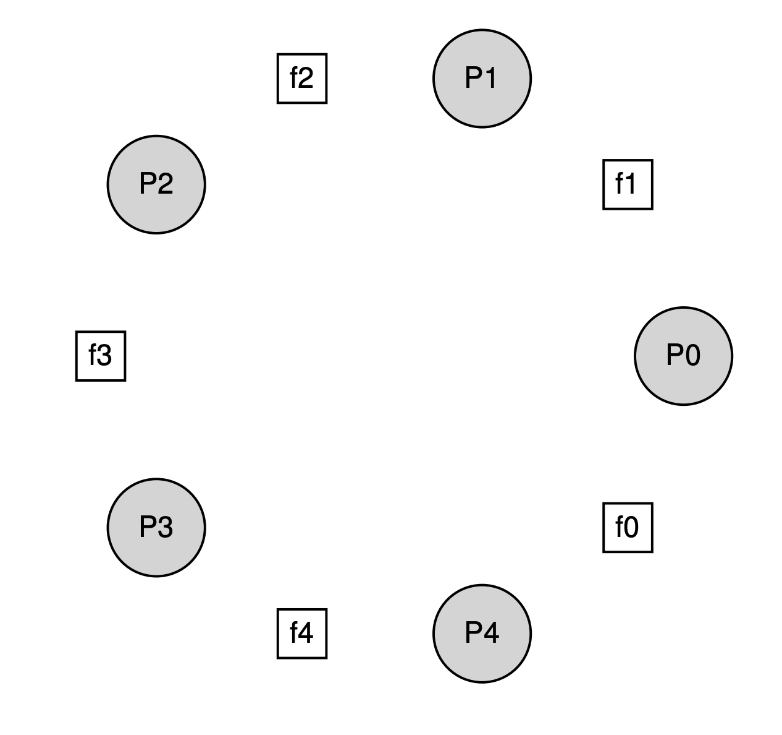
Dining Philosopher’s Problem
Problem Statement
5 philosophers on a table with 5 forks
A philosopher needs 2 forks to eat
Sometimes they think, no need for forks
Challenge: no deadlock and no philosopher starves
Each philosopher:
while (1) {
think();
get_forks(p);
eat();
put_forks(p);
}

Slide 51
First Try
void get_forks(int p) {
sem_wait(&forks[left(p)]);
sem_wait(&forks[right(p)]);
}
void put_forks(int p) {
sem_post(&forks[left(p)]);
sem_post(&forks[right(p)]);
}
Wrong and cause deadlock
If every philosopher takes their left fork simultaneously, no one can get the right fork
Deadlock!

Slide 52
Second Try: break the dependency
void get_forks(int p) {
if (p == 4) {
sem_wait(&forks[right(p)]);
sem_wait(&forks[left(p)]);
} else {
sem_wait(&forks[left(p)]);
sem_wait(&forks[right(p)]);
}
}
Cycle of waiting is broken!
More deadlocks on next lecture

Slide 53
Semaphores
Semaphores are equivalent to locks + condition variables
Can be used for both mutual exclusion and ordering
Semaphores contain state
How they are initialized depends on how they will be used
Init to 1: Mutex
Init to 0: Join (1 thread must arrive first, then other)
Init to N: Number of available resources
Sem_wait(): Waits until value > 0, then decrement (atomic)
Sem_post(): Increment value, then wake a single waiter (atomic)
Can use semaphores in producer/consumer relationships and for reader/writer locks

