Slide 1
Persistence: File System API
Questions answered in this lecture:
How to name files?
What are inode numbers?
How to lookup a file based on pathname?
What is a file descriptor?
What is the difference between hard and soft links?
How can special requirements be communicated to file system (fsync)?

Slide 2
What is a File?
Array of persistent bytes that can be read/written
File system consists of many files
Refers to collection of files
Also refers to part of OS that manages those files
Files need names to access correct one
What is the name of a file?

Slide 3
File Names
Three types of names
Unique id: inode numbers
Path
File descriptor

Slide 4
Inode Number
Each file has exactly one inode number
Inodes are unique (at a given time) within file system
Different file system may use the same number, numbers may be recycled after deletes
See inodes via “ls –i”; see them increment…

Slide 5
What does “i” stand for?
“In truth, I don't know either. It was just a term that we started to use. ‘Index’ is my best guess, because of the slightly unusual file system structure that stored the access information of files as a flat array on the disk…”
~ Dennis Ritchie
The farther of C, Key developer of Unix

Slide 6
inodes
location
size=12
0
file
location
size
1
inode number
location
size
2
file
location
size=6
3
Data
…
Meta-data

Slide 7
File API (attempt 1)
read(int inode, void *buf, size_t nbyte)
write(int inode, void *buf, size_t nbyte)
seek(int inode, off_t offset)
seek does not cause disk seek until read/write
Disadvantages?
names hard to remember
no organization or meaning to inode numbers
semantics of offset with multiple processes

Slide 8
File Names
Three types of names
Unique id: inode numbers
Path
File descriptor

Slide 9
Paths
String names are friendlier than number names
File system still interacts with inode numbers
Store path-to-inode mappings in predetermined “root” file (typically inode 2)
Directory!

Slide 10
inodes
location
size=12
0
location
size
1
inode number
location
size
2
location
size=6
3
…

Slide 11
inodes
location
size=12
0
location
size
1
inode number
location
size
“readme.txt”: 3, “hello”: 0, …
2
location
size=6
3
…

Slide 12
inodes
location
size=12
0
location
size
1
inode number
location
size
“readme.txt”: 3, “hello”: 0, …
2
location
size=6
3
…
Can not have two files with the same name

Slide 13
Paths
Generalize!
Directory Tree instead of single root directory
Only path+file name needs to be unique
/usr/dusseau/file.txt
/tmp/file.txt
Store file-to-inode mapping for each directory

Slide 14
inodes
location
size=12
0
“bashrc”: 3, …
location
size
1
inode number
location
size
“etc”: 0, …
2
location
size=6
3
# settings: …
…

Slide 15
inodes
read /etc/bashrc
location
size=12
0
“bashrc”: 3, …
location
size
1
inode number
location
size
“etc”: 0, …
2
location
size=6
3
# settings: …
…
reads: 0

Slide 16
inodes
read /etc/bashrc
location
size=12
0
“bashrc”: 3, …
location
size
1
inode number
location
size
“etc”: 0, …
2
location
size=6
3
# settings: …
…
reads: 1

Slide 17
inodes
read /etc/bashrc
location
size=12
0
“bashrc”: 3, …
location
size
1
inode number
location
size
“etc”: 0, …
2
location
size=6
3
# settings: …
…
reads: 2

Slide 18
inodes
read /etc/bashrc
location
size=12
0
“bashrc”: 3, …
location
size
1
inode number
location
size
“etc”: 0, …
2
location
size=6
3
# settings: …
…
reads: 3

Slide 19
inodes
read /etc/bashrc
location
size=12
0
“bashrc”: 3, …
location
size
1
inode number
location
size
“etc”: 0, …
2
location
size=6
3
# settings: …
…
reads: 4

Slide 20
inodes
read /etc/bashrc
location
size=12
0
“bashrc”: 3, …
location
size
1
inode number
location
size
“etc”: 0, …
2
location
size=6
3
# settings: …
…
reads: 5

Slide 21
inodes
read /etc/bashrc
location
size=12
0
“bashrc”: 6, …
location
size
1
inode number
location
size
“etc”: 0, …
2
location
size=6
3
# settings: …
…
reads: 6
Reads for getting final inode called “traversal”
Read root dir (inode and data);
read etc dir (inode and data);
read bashrc file (indode and data)

Slide 22
Directory Calls
mkdir: create new directory
readdir: read/parse directory entries
Why no writedir?
Notes:
Note you can never write to a directory directly. Because the format of the directory is considered file system meta-data, the file system considers itself responsible for the integrity of directory data; thus, you can only update a directory indirectly by, for example, creating files, directories, or other object types within it. In this way, the file system makes sure that directory contents are as expected.

Slide 23
Special Directory Entries
$ ls -la
total 728
drwxr-xr-x 34 trh staff 1156 Oct 19 11:41 .
drwxr-xr-x+ 59 trh staff 2006 Oct 8 15:49 ..
-rw-r--r--@ 1 trh staff 6148 Oct 19 11:42 .DS_Store
-rw-r--r-- 1 trh staff 553 Oct 2 14:29 asdf.txt
-rw-r--r-- 1 trh staff 553 Oct 2 14:05 asdf.txt~
drwxr-xr-x 4 trh staff 136 Jun 18 15:37 backup
…
cd /; ls -lia

Slide 24
File API (attempt 2)
pread(char *path, void *buf,
off_t offset, size_t nbyte)
pwrite(char *path, void *buf,
off_t offset, size_t nbyte)
Disadvantages?
Expensive traversal!
Goal: traverse once

Slide 25
File Names
Three types of names:
inode
path
file descriptor

Slide 26
File Descriptor (fd)
Idea:
Do expensive traversal once (open file) store inode in descriptor object (kept in memory).
Do reads/writes via descriptor, which tracks offset
Each process:
File-descriptor table contains pointers to open file descriptors
Integers used for file I/O are indexes into this table
stdin: 0, stdout: 1, stderr: 2

Slide 27
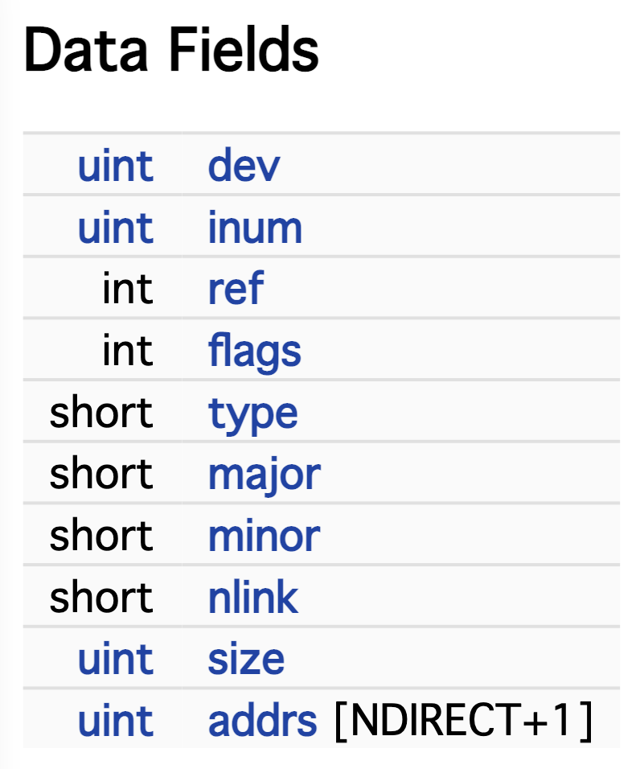
FD Table (xv6)
struct file {
...
struct inode *ip;
uint off;
};
// Per-process state
struct proc {
...
struct file *ofile[NOFILE]; // Open files
...
}

Slide 28
Code Snippet
int fd1 = open(“file.txt”); // returns 3
read(fd1, buf, 12);
int fd2 = open(“file.txt”); // returns 4
int fd3 = dup(fd2); // returns 5
One process can open a file for many times. Each open can get a fd.
Notes:
stdin: 0, stdout: 1, stderr: 2
linux系统下dup和dup2函数解析
https://cloud.tencent.com/developer/article/1958448

Slide 29
Code Snippet
fd table
0
fds
1
offset = 0
inode =
inode
2
location = …
size = …
3
4
5
“file.txt” also points here
int fd1 = open(“file.txt”); // returns 3

Slide 30
Code Snippet
fd table
0
fds
1
offset = 12
inode =
inode
2
location = …
size = …
3
4
5
int fd1 = open(“file.txt”); // returns 3
read(fd1, buf, 12);

Slide 31
Code Snippet
fd table
0
fds
1
offset = 12
inode =
inode
2
location = …
size = …
3
offset = 0
inode =
4
5
int fd1 = open(“file.txt”); // returns 3
read(fd1, buf, 12);
int fd2 = open(“file.txt”); // returns 4

Slide 32
Code Snippet
fd table
0
fds
1
offset = 12
inode =
inode
2
location = …
size = …
3
offset = 0
inode =
4
5
int fd1 = open(“file.txt”); // returns 3
read(fd1, buf, 12);
int fd2 = open(“file.txt”); // returns 4
int fd3 = dup(fd2); // returns 5

Slide 33
File API (attempt 3)
int fd = open(char *path, int flag, mode_t mode)
read(int fd, void *buf, size_t nbyte)
write(int fd, void *buf, size_t nbyte)
close(int fd)
Advantages:
string names
hierarchical
traverse once
different offsets precisely defined

Slide 34
Deleting Files
There is no system call for deleting files!
Inode (and associated file) is garbage collected when there are no references (from paths or fds)
Paths are deleted when: unlink() is called
FDs are deleted when: close() or process quits
Notes:
P507: 39.10
unlink() just takes the name of the file to be removed
Why not just remove or delete? To understand the answer to this puzzle, we must first understand more than just files, but also directories.

Slide 35
Network File System Designers
A process can open a file, then remove the directory entry for the file so that it has no name anywhere in the file system, and still read and write the file. This is a disgusting bit of UNIX trivia and at first we were just not going to support it, but it turns out that all of the programs we didn’t want to have to fix (csh, sendmail, etc.) use this for temporary files.
~ Sandberg et al.

Slide 36
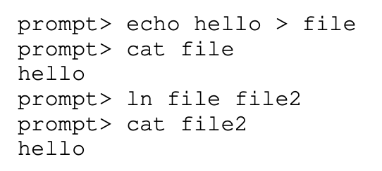
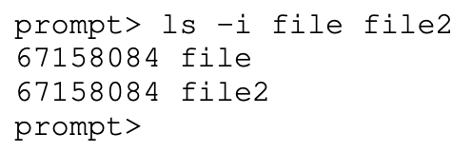
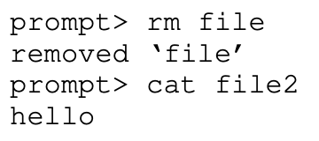
Links: Demonstrate
Show hard links: Both path names use same inode number
File does not disappear until all removed; cannot link directories
Echo “Beginning…” > file1
“ln file1 link”
“rm file1” // decreases reference count
Only when the reference count reaches zero does the file system also free the inode and related data blocks, and thus truly “delete” the file.
Notes:
only when the reference count reaches zero does the file system also free the inode and related data blocks, and thus truly “delete” the file.

Slide 37
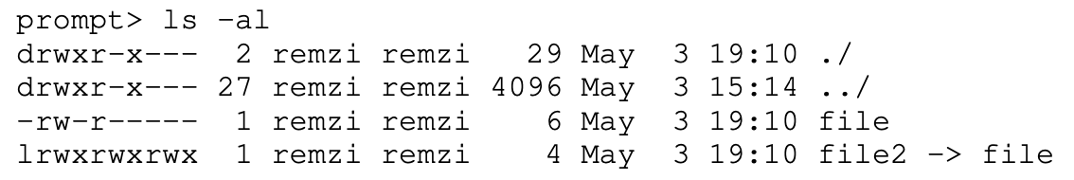
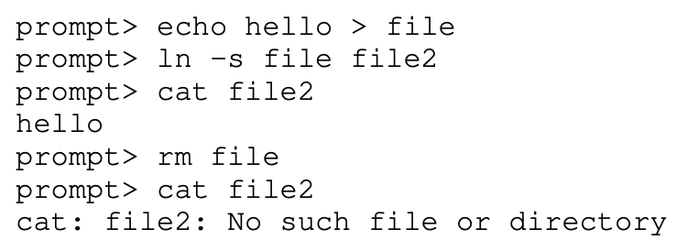
Links: Demonstrate
Soft or symbolic links: Point to second path name; can softlink to dirs
e.g., “ln –s file file2”
D1: Another file type (besides regular file and directory), 快捷方式
D2: Records the path of the file as its file data
D3: dangling reference

Slide 38
Many File Systems
Users often want to use many file systems
For example:
main disk
backup disk
Andrew File System (AFS)
thumb drives
What is the most elegant way to support this?

Slide 39
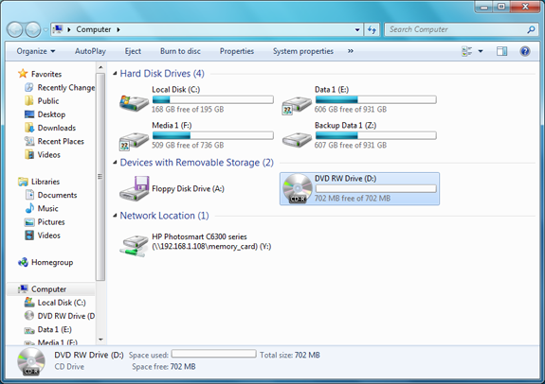
Many File Systems: Approach 1
http://www.ofzenandcomputing.com/burn-files-cd-dvd-windows7/

Slide 40
Many File Systems: Approach 2
Idea: stitch all the file systems together into a super file system!
sh> mount
/dev/sda1 on / type ext4 (rw)
/dev/sdb1 on /backups type ext4 (rw)
AFS on /home type afs (rw)

Slide 41
/
backups
home
etc
bin
bak1
bak2
bak3
tyler
.bashrc
537
/dev/sda1 on /
/dev/sdb1 on /backups
AFS on /home
p1
p2

Slide 42
Communicating Requirements: fsync
File system keeps newly written data in memory for a while
Write buffering improves performance (why?)
But what if system crashes before buffers are flushed?
If application cares:
fsync(int fd) forces buffers to flush to disk, and (usually) tells disk to flush its write cache too
Makes data durable

Slide 43
rename
rename(char *old, char *new):
deletes an old link to a file
creates a new link to a file
use “mv” command
Just changes name of file, does not move data
Even when renaming to new directory

Slide 44
inodes
location
size=12
0
location
size
1
inode number
location
size
“oldname”: 3, …
2
location
size=6
3
# settings: …
…

Slide 45
inodes
location
size=12
0
location
size
1
inode number
location
size
…
2
location
size=6
3
# settings: …
…

Slide 46
inodes
location
size=12
0
location
size
1
inode number
location
size
“newname”: 3
2
location
size=6
3
# settings: …
…

Slide 47
rename
rename(char *old, char *new):
deletes an old link to a file
creates a new link to a file
What if we crash?
FS does extra work to guarantee atomicity
the file will either has the old name and the new name if crashes
return to this issue later…

Slide 48
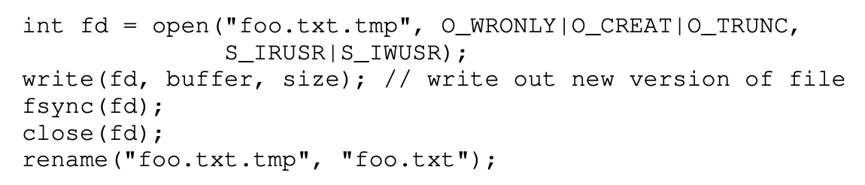
Atomic File Update
Say application wants to update file.txt atomically
If crash, should see only old contents or only new contents
1. write new data to file.txt.tmp file
2. fsync file.txt.tmp
3. rename file.txt.tmp over file.txt, replacing it
Notes:
P506:39.8

Slide 49
Summary
Using multiple types of name provides
convenience
efficiency
Mount and link features provide flexibility.
Special calls (fsync, rename) let developers communicate special requirements to file system

