Slide 1
File System Implementation
Questions answered in this lecture:
What on-disk structures to represent files and directories?
Contiguous, Extents, Linked, FAT, Indexed, Multi-level indexed
Which are good for different metrics?
What disk operations are needed for:
make directory
open file
write/read file
close file

Slide 2
Review: File Names
Different types of names work better in different contexts
inode
unique name for file system to use
records meta-data about file: file size, permissions, etc
path
easy for people to remember
organizes files in hierarchical manner; encode locality information
file descriptor
avoid frequent traversal of paths
remember multiple offsets for next read or write

Slide 3
Review: File API
int fd = open(char *path, int flag, mode_t mode)
read(int fd, void *buf, size_t nbyte)
write(int fd, void *buf, size_t nbyte)
close(int fd)

Slide 4
Implementation
1. On-disk structures
how does file system represent files, directories?
2. Access methods
what steps must reads/writes take?

Slide 5
Part 1: Disk Structures

Slide 6
Persistent Store
Given: large array of blocks on disk
Want: some structure to map files to disk blocks
D
D
D
D
D
D
D
D
D
D
D
D
D
D
D
D
0
7
8
15
D
D
D
D
D
D
D
D
D
D
D
D
D
D
D
D
16
23
24
31
D
D
D
D
D
D
D
D
D
D
D
D
D
D
D
D
32
39
40
47
D
D
D
D
D
D
D
D
D
D
D
D
D
D
D
D
48
55
56
63

Slide 7
Similarity to Memory?
Same principle: map logical abstraction to physical resource
Physical View
Process 1
Process 3
Process 2
Logical View: Address Spaces

Slide 8
Allocation Strategies
Many different approaches
Contiguous
Extent-based
Linked
File-allocation Tables
Indexed
Multi-level Indexed
Questions
Amount of fragmentation (internal and external) – freespace that can’t be used
Ability to grow file over time?
Performance of sequential accesses (contiguous layout)?
Speed to find data blocks for random accesses?
Wasted space for meta-data overhead (everything that isn’t data)?
Meta-data must be stored persistently too!

Slide 9
Internal Fragmentation
Meaning
Internal fragmentation occurs when the allocated space within a storage unit (such as a disk block or cluster) is not fully utilized by a file. This happens when the file's size is not an exact multiple of the storage unit size, leaving some space unused within the allocated unit.
Cause
File systems often allocate space in fixed-size units (like blocks or clusters). If a file's size is not a perfect multiple of the unit size, the last unit allocated to the file may have some unused space, leading to internal fragmentation.
Solution
Some file systems use dynamic block sizes or other allocation strategies to reduce the impact of internal fragmentation.
From ChatGPT 3.5

Slide 10
External Fragmentation
Meaning
External fragmentation occurs when free space in a storage medium is scattered throughout the storage area in non-contiguous chunks, making it challenging to allocate large contiguous blocks for storing files.
Cause
Files are created, deleted, and resized over time, leaving behind gaps of unused space. While the total free space may be sufficient, it is fragmented into smaller pieces, making it difficult to find a single contiguous block for storing large files.
Solution
Periodic defragmentation processes can be used to rearrange and consolidate free space, reducing external fragmentation and improving the efficiency of storage allocation.
From ChatGPT 3.5

Slide 11
Solution 1: Contiguous Allocation
Allocate each file to contiguous sectors on disk
Meta-data:
OS allocates by finding sufficient free space
Must predict future size of file; Should space be reserved?
Example: IBM OS/360
Starting block and size of file
A
A
A
B
B
B
B
C
C
C
Fragmentation (internal and external)?
Ability to grow file over time?
Seek cost for sequential accesses?
Speed to calculate random accesses?
Wasted space for meta-data?
- Horrible external fragmentation (needs periodic compaction)
- May not be able to without moving
+ Excellent performance
+ Simple calculation
+ Little overhead for meta-data

Slide 12
Solution 2: Small Fixed Number of ExtentS
Allocate multiple contiguous regions (extents) per file
Meta-data:
Small array (2-6) designating each extent
Each entry: starting block and size
A
A
A
B
B
B
B
C
C
C
D
D
A
A
A
D
B
B
B
B
C
C
C
B
B
Fragmentation (internal and external)?
Ability to grow file over time?
Seek cost for sequential accesses?
Speed to calculate random accesses?
Wasted space for meta-data?
- Helps external fragmentation
- Can grow (until run out of extents)
+ Still good performance
+ Still simple calculation
+ Still small overhead for meta-data

Slide 13
Solution 3: Linked Allocation
Allocate linked-list of fixed-sized blocks (multiple sectors)
Meta-data:
Examples: TOPS-10, Alto
Location of first block of file
Each block also contains pointer to next block
D
D
A
A
A
D
B
B
B
B
C
C
C
B
B
D
B
D
Fragmentation (internal and external)?
Ability to grow file over time?
Seek cost for sequential accesses?
Speed to calculate random accesses?
Wasted space for meta-data?
+ No external frag (use any block); internal: pointer and space in last block
+ Can grow easily
+/- Depends on data layout
- Ridiculously poor
- Waste pointer per block
Trade-off: Block size (does not need to equal sector size)
Notes:
Larger --> ??
Smaller --> ??

Slide 14
Solution 4: File-Allocation Table (FAT)
Variation of Linked allocation
Keep linked-list information for all files in on-disk FAT table
Meta-data: Location of first block of file
And, FAT table itself
Exmaples: DOS, Windows
D
D
A
A
A
D
B
B
B
B
C
C
C
B
B
D
B
D
Comparison to Linked Allocation
Same basic advantages and disadvantages
Disadvantage: Read from two disk locations for every data read
Optimization:
Cache FAT in main memory
Advantage: Greatly improves random accesses
What portions should be cached? Scale with larger file systems?
Notes:
Read from two disk locations: one for FAT, one for data

Slide 15
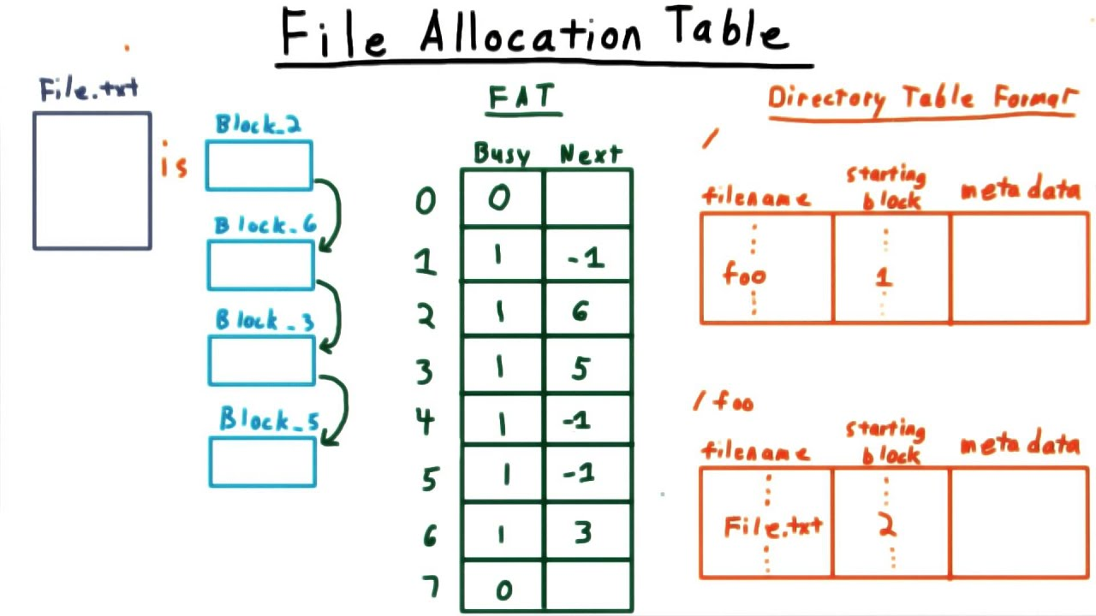
Solution4: File-Allocation Table (FAT)
https://www.youtube.com/watch?app=desktop&v=mgQtlXBxH0c

Slide 16
Solution 5: Indexed Allocation
Allocate fixed-sized blocks for each file
Meta-data:
Allocate space for ptrs at file creation time
Fixed-sized array of block pointers
D
D
A
A
A
D
B
B
B
B
C
C
C
B
B
D
B
D
Advantages
No external fragmentation
Files can be easily grown up to max file size
Supports random access
Disadvantages
Large overhead for meta-data:
Wastes space for unneeded pointers (most files are small!)

Slide 17
Inode
type
uid
rwx
size
blocks
time
ctime
links_count
addrs[N]
Assume single level (just pointers to data blocks)
What is max file size?
Assume 256-byte inodes (all can be used for pointers)
Assume 4-byte addrs
How to get larger files?
256 / 4 = 64
64 * 4K = 256 KB!

Slide 18
inode
data
data
data
data

Slide 19
inode
indirect
indirect
indirect
indirect
Indirect blocks are stored in
regular data blocks.
what if we want to
optimize for small files?

Slide 20
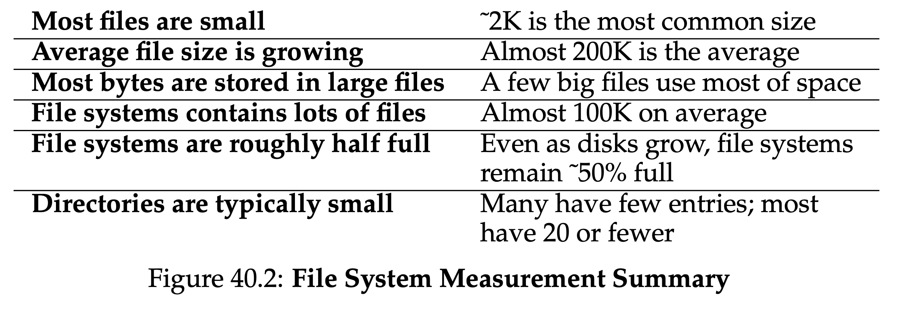
Solution 6: Multi-Level Indexing
Optimize for small files
Most files are small
Based on workloads - an important design principle

Slide 21
inode
data
data
data
indirect
Better for small files

Slide 22
Solution 6: Multi-Level Indexing
Variation of Indexed Allocation
Dynamically allocate hierarchy of pointers to blocks as needed
Meta-data: Small number of pointers allocated statically
Additional pointers to blocks of pointers
Examples: UNIX FFS-based file systems, ext2, ext3
double indirect
indirect
indirect
triple indirect

Slide 23
Solution 6: Multi-Level Indexing
double indirect
indirect
indirect
triple indirect
Comparison to Indexed Allocation
Advantage:
Does not waste space for unneeded pointers
Still fast access for small files
Can grow to what size??
Disadvantage:
Need to read indirect blocks of pointers to calculate addresses (extra disk read)
Keep indirect blocks cached in main memory

Slide 24
Solution 7: Flexible # of Extents
Dynamic multiple contiguous regions (extents) per file
Organize extents into multi-level tree structure
Each leaf node: starting block and contiguous size
Minimizes meta-data overhead when have few extents
Allows growth beyond fixed number of extents
Fragmentation (internal and external)?
Ability to grow file over time?
Seek cost for sequential accesses?
Speed to calculate random accesses?
Wasted space for meta-data?
+ Both reasonable
+ Can grow
+ Still good performance
+/- Some calculations depending on size
+ Relatively small overhead

Slide 25
Assume Multi-Level Indexing
Simple approach
More complex file systems build from these basic data structures

Slide 26
On-Disk Structures
data block
inode table
indirect block
directories
data bitmap
inode bitmap
superblock

Slide 27
FS Structs: Empty Disk
D
D
D
D
D
D
D
D
D
D
D
D
D
D
D
D
0
7
8
15
D
D
D
D
D
D
D
D
D
D
D
D
D
D
D
D
16
23
24
31
D
D
D
D
D
D
D
D
D
D
D
D
D
D
D
D
32
39
40
47
D
D
D
D
D
D
D
D
D
D
D
D
D
D
D
D
48
55
56
63
Assume each block is 4KB

Slide 28
Data Blocks
D
D
D
D
D
D
D
D
D
D
D
D
D
D
D
D
0
7
8
15
D
D
D
D
D
D
D
D
D
D
D
D
D
D
D
D
16
23
24
31
D
D
D
D
D
D
D
D
D
D
D
D
D
D
D
D
32
39
40
47
D
D
D
D
D
D
D
D
D
D
D
D
D
D
D
D
48
55
56
63
Not actual layout : Examine better layout in next lecture
Purpose: Relative number of each time of block

Slide 29
Inodes
D
D
D
I
I
I
I
I
D
D
D
D
D
D
D
D
0
7
8
15
D
D
D
D
D
D
D
D
D
D
D
D
D
D
D
D
16
23
24
31
D
D
D
D
D
D
D
D
D
D
D
D
D
D
D
D
32
39
40
47
D
D
D
D
D
D
D
D
D
D
D
D
D
D
D
D
48
55
56
63

Slide 30
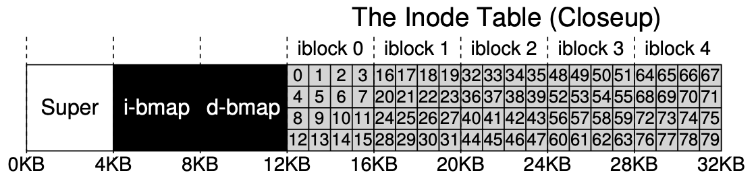
One Inode Block
inode
16
inode
17
inode
18
inode
19
Each inode is typically 256 bytes (depends on the FS, maybe 128 bytes)
4KB disk block
16 inodes per inode block.
inode
20
inode
21
inode
22
inode
23
inode
24
inode
25
inode
26
inode
27
inode
28
inode
29
inode
30
inode
31

Slide 31
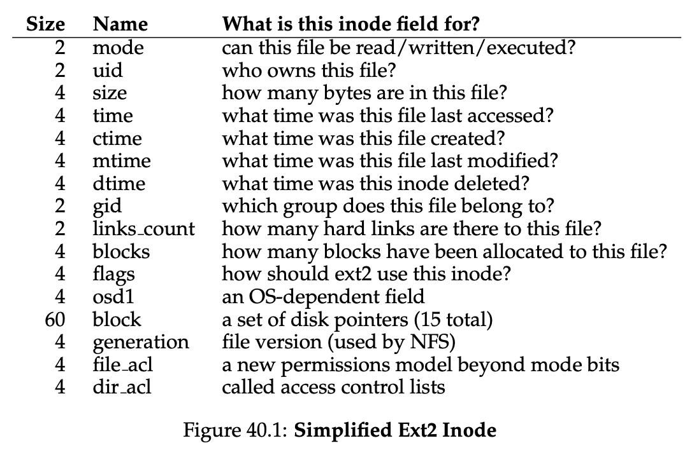
Inode
type (file or dir?)
uid (owner)
rwx (permissions)
size (in bytes)
Blocks
time (access)
ctime (create)
links_count (# paths)
addrs[N] (N data blocks)

Slide 32
Inodes
D
D
D
I
I
I
I
I
D
D
D
D
D
D
D
D
0
7
8
15
D
D
D
D
D
D
D
D
D
D
D
D
D
D
D
D
16
23
24
31
D
D
D
D
D
D
D
D
D
D
D
D
D
D
D
D
32
39
40
47
D
D
D
D
D
D
D
D
D
D
D
D
D
D
D
D
48
55
56
63

Slide 33
Assume 256 byte inodes (16 inodes/block).
What is offset for inode with number 0?
D
D
D
I
I
I
I
I
D
D
D
D
D
D
D
D
0
7
8
15
D
D
D
D
D
D
D
D
D
D
D
D
D
D
D
D
16
23
24
31
D
D
D
D
D
D
D
D
D
D
D
D
D
D
D
D
32
39
40
47
D
D
D
D
D
D
D
D
D
D
D
D
D
D
D
D
48
55
56
63

Slide 34
Assume 256 byte inodes (16 inodes/block).
What is offset for inode with number 4?
D
D
D
I
I
I
I
I
D
D
D
D
D
D
D
D
0
7
8
15
D
D
D
D
D
D
D
D
D
D
D
D
D
D
D
D
16
23
24
31
D
D
D
D
D
D
D
D
D
D
D
D
D
D
D
D
32
39
40
47
D
D
D
D
D
D
D
D
D
D
D
D
D
D
D
D
48
55
56
63

Slide 35
Assume 256 byte inodes (16 inodes/block).
What is offset for inode with number 40?
D
D
D
I
I
I
I
I
D
D
D
D
D
D
D
D
0
7
8
15
D
D
D
D
D
D
D
D
D
D
D
D
D
D
D
D
16
23
24
31
D
D
D
D
D
D
D
D
D
D
D
D
D
D
D
D
32
39
40
47
D
D
D
D
D
D
D
D
D
D
D
D
D
D
D
D
48
55
56
63

Slide 36
Directories
File systems vary
Common design: Store directory entries in data blocks
Large directories just use multiple data blocks
Use bit in inode to distinguish directories from files
Various formats could be used
lists
b-trees
Notes:
Often, file systems treat directories as a special type of file. Thus, a directory has an inode, somewhere in the inode table (with the type field of the inode marked as “directory” instead of “regular file”). The directory has data blocks pointed to by the inode (and perhaps, indirect blocks); these data blocks live in the data block region of our simple file system.

Slide 37
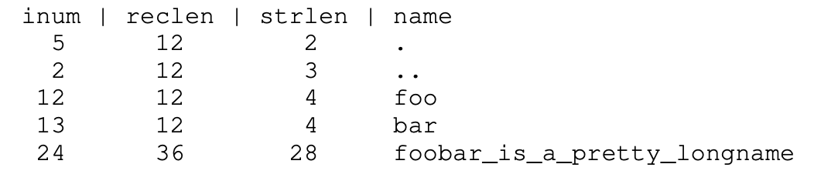
Simple Directory List Example
In this example, each entry has an inode number, record length (the total bytes for the name plus any left over space), string length (the actual length of the name), and finally the name of the entry.

Slide 38
Allocation
How do we find free data blocks or free inodes?
Free list
Bitmaps
Tradeoffs between data structures

Slide 39
Bitmaps?
D
D
D
I
I
I
I
I
D
D
D
D
D
D
D
D
0
7
8
15
D
D
D
D
D
D
D
D
D
D
D
D
D
D
D
D
16
23
24
31
D
D
D
D
D
D
D
D
D
D
D
D
D
D
D
D
32
39
40
47
D
D
D
D
D
D
D
D
D
D
D
D
D
D
D
D
48
55
56
63

Slide 40
Opportunity for Inconsistency (fsck)
D
i
d
I
I
I
I
I
D
D
D
D
D
D
D
D
0
7
8
15
D
D
D
D
D
D
D
D
D
D
D
D
D
D
D
D
16
23
24
31
D
D
D
D
D
D
D
D
D
D
D
D
D
D
D
D
32
39
40
47
D
D
D
D
D
D
D
D
D
D
D
D
D
D
D
D
48
55
56
63
i
free bitmap for inodes
d
free bitmap for data blocks

Slide 41
Superblock
Need to know basic FS configuration metadata, like:
block size
# of inodes
Store this in superblock
Notes:
The superblock contains information about this particular file system, including, for example, how many inodes and data blocks are in the file system, where the inode table begins, and so forth.
When mounting a file system, the operating system will read the superblock first, to initialize various parameters, and then attach the volume to the file-system tree.

Slide 42
Super Block
S
i
d
I
I
I
I
I
D
D
D
D
D
D
D
D
0
7
8
15
D
D
D
D
D
D
D
D
D
D
D
D
D
D
D
D
16
23
24
31
D
D
D
D
D
D
D
D
D
D
D
D
D
D
D
D
32
39
40
47
D
D
D
D
D
D
D
D
D
D
D
D
D
D
D
D
48
55
56
63
S
super block
i
free bitmap for inodes
d
free bitmap for data blocks

Slide 43
On-Disk Structures
Super Block
Data Bitmap
Data Block
directories
indirects
Inode Bitmap
Inode Table

Slide 44
Part 2 : Operations
create file
write
open
read
close

Slide 45
create /foo/bar
data
inode
root
foo/
bar
root
foo/
bitmap
bitmap
inode
inode
inode
data
data
read
read
read
read
read
write
write
read
write
write
What needs to be read and written?
Why read bar inode?
When write partial of a block, it needs to be read from disk
When write an entire block, no read is needed.

Slide 46
open /foo/bar
data
inode
root
foo
bar
root
foo
bar
bitmap
bitmap
inode
inode
inode
data
data
data
read
read
read
read
read

Slide 47
write to /foo/bar (assume file exists and has been opened)
data
inode
root
foo
bar
root
foo
bar
bitmap
bitmap
inode
inode
inode
data
data
data
read
read
write
write
write

Slide 48
read /foo/bar – assume opened
data
inode
root
foo
bar
root
foo
bar
bitmap
bitmap
inode
inode
inode
data
data
data
read
read
write

Slide 49
close /foo/bar
data
inode
root
foo
bar
root
foo
bar
bitmap
bitmap
inode
inode
inode
data
data
data
nothing to do on disk!
Each process minds its business in its file descriptor table

Slide 50
Optimization
How can we avoid this excessive I/O for basic ops?
Cache for:
reads
write buffering
Virtual memory and disk cache
static partitioning – like 10% of memory for disk cache
dynamic partitioning – page cache
page cache = virtual memory pages + file system pages

Slide 51
Write Buffering
Why does procrastination (拖延) help?
Locality
Batching
e.g., an inode with create+update can be batched
Overwrites, deletes, scheduling
Shared structs (e.g., bitmaps+dirs) often overwritten, reducing the number of writes
a temporary file does not need to be write to disk
batching leads to OS controlled scheduling
We decide: how much to buffer, how long to buffer…
tradeoffs?
modern file systems buffer writes between 5-30 seconds

Slide 52
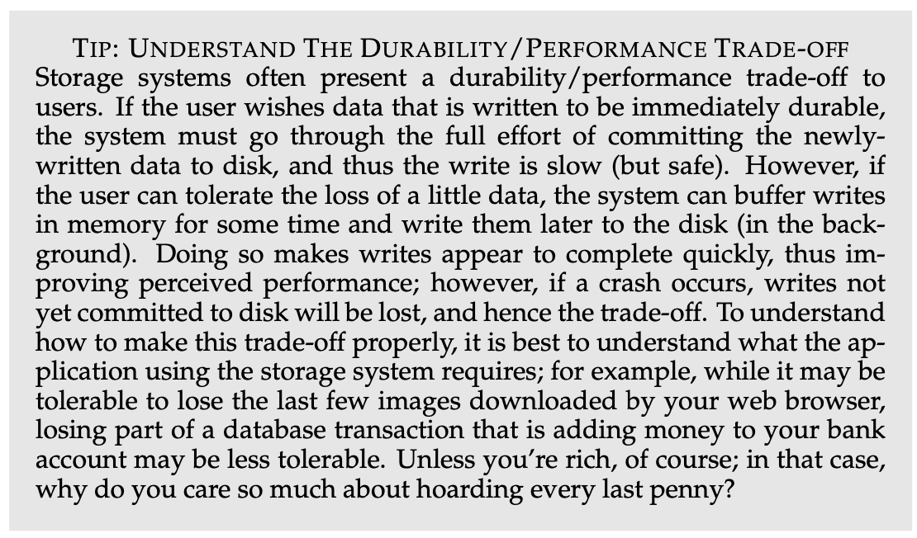
Write Buffering
Some applications (such as databases) don’t enjoy this trade-off. Thus, to avoid unexpected data loss due to write buffering, they simply force writes to disk, by calling fsync(), by using direct I/O interfaces that work around the cache, or by using the raw disk interface and avoiding the file system altogether².

Slide 53
Summary/Future
We’ve described a very simple FS.
basic on-disk structures
the basic ops
Future questions:
how to allocate efficiently to obtain good performance from disk?
how to handle crashes?

