Slide 1
Persistence: Fast File System (FFS)
Questions answered in this lecture:
How to improve performance of complex system?
Why do file systems obtain worse performance over time?
How to choose the right block size? How to avoid internal fragmentation?
How to place related blocks close to one another on disk?

Slide 2
File-System Case Studies
Local
FFS: Fast File System
LFS: Log-Structured File System
Network
NFS: Network File System
AFS: Andrew File System

Slide 3
Review: Basic Layout
super block
bit
maps
inodes
Data Blocks
0
N
inodes
data blocks
regular data
directories
indirect blocks
What is stored as a data block?

Slide 4
REVIEW: create /foo/bar
data
inode
root
foo
bar
root
foo
bitmap
bitmap
inode
inode
inode
data
data

Slide 5
[traverse]
create /foo/bar
data
inode
root
foo
bar
root
foo
bitmap
bitmap
inode
inode
inode
data
data
read
read
read
read
Verify that bar does not already exist

Slide 6
[allocate inode]
create /foo/bar
data
inode
root
foo
bar
root
foo
bitmap
bitmap
inode
inode
inode
data
data
read
read
read
read
read
write

Slide 7
[populate inode]
create /foo/bar
data
inode
root
foo
bar
root
foo
bitmap
bitmap
inode
inode
inode
data
data
read
read
read
read
read
write
read
write
Why must read bar inode?
How to initialize inode?

Slide 8
[add bar to /foo]
create /foo/bar
data
inode
root
foo
bar
root
foo
bitmap
bitmap
inode
inode
inode
data
data
read
read
read
read
read
write
read
write
write
write
Update inode (e.g., size) and data for directory

Slide 9
open /foo/bar
data
inode
root
foo
bar
root
foo
bar
bitmap
bitmap
inode
inode
inode
data
data
data
read
read
read
read
read

Slide 10
write to /foo/bar (assume file exists and has been opened)
data
inode
root
foo
bar
root
foo
bar
bitmap
bitmap
inode
inode
inode
data
data
data
read
read
write
write
write

Slide 11
append to /foo/bar
data
inode
root
foo
bar
root
foo
bar
bitmap
bitmap
inode
inode
inode
data
data
data

Slide 12
append to /foo/bar (opened already)
data
inode
root
foo
bar
root
foo
bar
bitmap
bitmap
inode
inode
inode
data
data
data
read

Slide 13
[allocate block]
append to /foo/bar
data
inode
root
foo
bar
root
foo
bar
bitmap
bitmap
inode
inode
inode
data
data
data
read
read
write

Slide 14
[point to block]
append to /foo/bar
data
inode
root
foo
bar
root
foo
bar
bitmap
bitmap
inode
inode
inode
data
data
data
read
read
write
write

Slide 15
[write to block]
append to /foo/bar
data
inode
root
foo
bar
root
foo
bar
bitmap
bitmap
inode
inode
inode
data
data
data
read
read
write
write
write

Slide 16
read /foo/bar – assume opened
data
inode
root
foo
bar
root
foo
bar
bitmap
bitmap
inode
inode
inode
data
data
data
read
read
write

Slide 17
close /foo/bar
data
inode
root
foo
bar
root
foo
bar
bitmap
bitmap
inode
inode
inode
data
data
data
nothing to do on disk!

Slide 18
Review: Locality Types
D
D
address
A
A
Temporal Locality
Spatial Locality
…
address
…
C
C
B
B
time
time
Which type of locality is most interesting with a disk?
Notes:
Temporal Locality：重复访问，然后可以用Cache

Slide 19
Order Matters
Slow
Fast
…
address
…
address
time
time
Implication for organizing data on a disk?
Notes:
Access sequence和layout的order不一致，会导致很慢

Slide 20
Policy: Choose Inode, Data Blocks
S
i
d
I
I
I
I
I
D
D
D
D
D
D
D
D
0
7
8
15
D
D
D
D
D
D
D
D
D
D
D
D
D
D
D
D
16
23
24
31
Assuming all free, which should be chosen?

Slide 21
Bad File Layout
inode
0
S
i
d
I
I
I
I
I
D
D
D
D
D
D
D
D
0
7
8
15
3
2
1
D
D
D
D
D
D
D
D
D
D
D
D
D
D
D
D
16
23
24
31

Slide 22
Better File Layout
inode
0
1
2
3
S
i
d
I
I
I
I
I
D
D
D
D
D
D
D
D
0
7
8
15
D
D
D
D
D
D
D
D
D
D
D
D
D
D
D
D
16
23
24
31

Slide 23
Best File Layout
inode
0
1
2
3
S
i
d
I
I
I
I
I
D
D
D
D
D
D
D
D
0
7
8
15
D
D
D
D
D
D
D
D
D
D
D
D
D
D
D
D
16
23
24
31
Can’t do this for all files ☹

Slide 24
Fast File System: FFS (1980’s)

Slide 25
System Building
Beginner’s approach
1. get idea
2. build it!
Pro approach
1. identify existing state of the art
2. measure it, identify and understand problems
3. get idea (solutions often flow from deeply understanding problem)
4. build it!
measure then build

Slide 26
Measure Old FS
State of the art: original UNIX file system
super block
inodes
Data Blocks
0
N
Free lists are embedded in inodes, data blocks
Data blocks are 512 bytes
Measure throughput for whole sequential file reads/writes
Compare to theoretical max, which is…
Old UNIX file system: achieved only 2% of potential. Why?
disk bandwidth

Slide 27
Measurement 1: Aging?
What is performance before/after aging?
New FS: 17.5% of disk bandwidth
Few weeks old: 3% of disk bandwidth
Problem: FS is becomes fragmented over time
Free list makes contiguous chunks hard to find
Hacky Solutions:
Occassional defrag of disk
Keep freelist sorted

Slide 28
Measurement 2: Block Size?
How does block size affect performance?
Try doubling it!
Result: Performance more than doubled
Why double the performance?
Logically adjacent blocks not physically adjacent
Only half as many seeks+rotations now required
Why more than double the performance?
Smaller blocks require more indirect blocks
Notes:
One other problem: the original block size was too small (512 bytes). Thus, transferring data from the disk was inherently inefficient. Smaller blocks were good because they minimized internal fragmentation (waste within the block), but bad for transfer as each block might require a posi- tioning overhead to reach it.

Slide 29
Old FS Summary
Free list becomes scrambled → random allocations
Small blocks (512 bytes)
Blocks laid out poorly
long distance between inodes/data
related inodes not close to one another
Which inodes related?
Result: 2% of potential performance! (and worse over time)
Inodes in same directory (ls –l)
Problem: old FS treats disk like RAM!

Slide 30
Solution: a disk-aware
Primary File System Design Questions:
Where to place meta-data and data on disk?
How to use big blocks without wasting space?

Slide 31
Placement Technique 1: Bitmaps
super block
bitmaps
inodes
Data Blocks
0
N
Use bitmaps instead of free list
Provides better speed, with more global view
Faster to find contiguous free blocks

Slide 32
Placement Technique 2: Groups
fast
super block
bitmaps
inodes
Data Blocks
0
N
before: whole disk
How to keep inode close to data?

Slide 33
Technique 2: Groups
slow
super block
bitmaps
inodes
Data Blocks
0
N
before: whole disk
How to keep inode close to data?

Slide 34
Technique 2: Groups
slower
super block
bitmaps
inodes
Data Blocks
0
N
before: whole disk
How to keep inode close to data?

Slide 35
Technique 2: Groups
slowest
super block
bitmaps
inodes
Data Blocks
0
N
before: whole disk
How to keep inode close to data?

Slide 36
Technique 2: Groups
super block
bitmaps
inodes
Data Blocks
0
N
before: whole disk
How to keep inode close to data?

Slide 37
Technique 2: Groups
S
B
I
D
S
B
I
D
S
B
I
D
…
0
group 1
G
group 2
2G
group 3
3G
How to keep inode close to data?
Answer: Use groups across disks; Try to place inode and data in same group
Minimize seek latency

Slide 38
Technique 2: Groups
fast
fast
fast
S
B
I
D
S
B
I
D
S
B
I
D
…
0
group 1
G
group 2
2G
group 3
3G
strategy: allocate inodes and data blocks in same group.

Slide 39
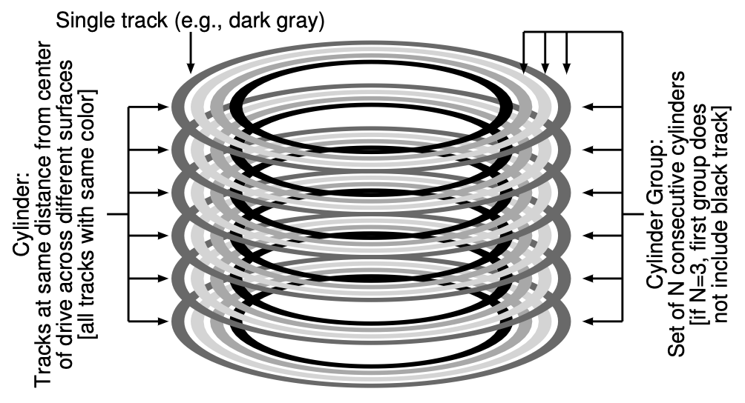
Groups
In FFS, groups were ranges of cylinders
called cylinder group
In ext2-4, groups are ranges of blocks
called block group

Slide 40
Placement Technique 3: Super Rotation
S
B
I
D
S
B
I
D
S
B
I
D
…
0
group 1
G
group 2
2G
group 3
3G
Is it useful to have multiple super blocks?
Yes, if some (but not all) fail.
Notes:
FFS keeps a copy of the super block (S) in each group for reliability reasons. The super block is needed to mount the file system; by keeping multiple copies, if one copy becomes corrupt, you can still mount and access the file system by using a working replica.

Slide 41
Problem
Old FS: All super-block copies are on the top platter.
Correlated failures! What if top platter dies?
solution: for each group, store super-block at different offset

Slide 42
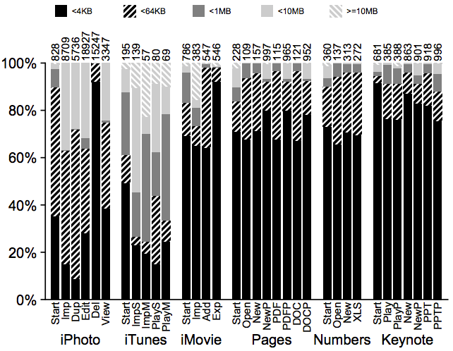
Technique: Larger Blocks
Observation: Doubling block size for old FS over doubled performance
Why not make blocks huge?
Most file are very small, even today!

Slide 43
Larger Blocks
Lots of waste due to internal fragment in most blocks
Time vs. Space tradeoffs…
Notes:
Percent：waste percent in one block due to internal fragment

Slide 44
Solution: Fragments
Hybrid – combine best of large blocks and best of small blocks
Use large block when file is large enough
Introduce “fragment” for files that use parts of blocks
Only tail of file uses fragments

Slide 45
Fragment Example
Block size = 4096
Fragment size = 1024
bits: 0000 0000 1111 0010
blk1 blk2 blk3 blk4
Whether addr refers to block or fragment is inferred by file offset
What about when files grow?
Must copy fragments to new block if no room to grow

Slide 46
file, size 5KB
file, size 2KB
AAAA
B
A
B

Slide 47
file, size 6KB
file, size 2KB
AAAA
B
A
B
A
append A to first file

Slide 48
file, size 6KB
file, size 2KB
AAAA
B
A
B
A

Slide 49
file, size 7KB
file, size 2KB
AAAA
B
A
B
A
A
append A to first file
Not allowed to use fragments across multiple blocks!
What to do instead?

Slide 50
file, size 8KB
file, size 2KB
AAAA
B
B
AAAA
append A to first file, copy fragments to new block

Slide 51
Optimal Write Size
Writing less than a block is inefficient
Solution: new API exposes optimal write size

Slide 52
Smart Policy
S
B
I
D
S
B
I
D
S
B
I
D
…
0
group 1
G
group 2
2G
group 3
3G
Where should new inodes and data blocks go?

Slide 53
Strategy
Put related pieces of data near each other
Rules:
1. Put directory entries near directory inodes.
2. Put inodes near directory entries.
3. Put data blocks near inodes.
Sound good?
Problem: File system is one big tree
All directories and files have a common root.
All data in same FS is related in some way
Trying to put everything near everything else doesn’t make any choices!

Slide 54
Revised Strategy
Put more-related pieces of data near each other
Put less-related pieces of data far from each other
FFS developers used their best judgement

Slide 55
Where to cut the tree and start
growing into another group?
B1
B2
file inode
inode
dir data
B3
many
break
B1
dir inode
pointer
B2
related
FFS puts dir inodes in a new group
“ls” is fast on directories with many files.

Slide 56
Preferences
File inodes: allocate in same group with dir
Dir inodes: allocate in new group with fewer used inodes than average group
First data block: allocate near inode
Other data blocks: allocate near previous block

Slide 57
Problem: Large Files
Single large file can fill nearly all of a group
Undesirable:
Displaces data for many small files
Prevents subsequent related files from being placed within this block group
Hurt file-access locality
Solution?
It is OK to have multiple seeks in reading a large file

Slide 58
Large files: where to cut the tree and start
growing into another group?
B1
B2
file inode
break
B3
B3
inode
dir data
Ind
many
break
B4
B1
dir inode
pointer
B2
related
Define “large” as requiring an indirect block
Starting at indirect (e.g., after 48 KB) put blocks in a new block group.

Slide 59
Preferences
File inodes: allocate in same group with dir
Dir inodes: allocate in new group with fewer used inodes than average group
First data block: allocate near inode
Other data blocks: allocate near previous block
Large file data blocks: after 48KB, go to new group. Move to another group (w/ fewer than avg blocks) every subsequent 1MB.

Slide 60
Group Descriptor (aka Summary Block)
How does file system know which new group to pick?

Slide 61
Group Descriptor (aka Summary Block)
How does file system know which new group to pick?
super block
sum-
mary
bitmaps
inodes
Data Blocks
0
G
Tracks number of free inodes and data blocks in this group

Slide 62
Conclusion
First disk-aware file system
Bitmaps
Locality groups
Rotated superblocks
Large blocks
Fragments
Smart allocation policy
FFS inspired modern files systems, including ext2 and ext3
FFS also introduced several new features:
long file names
atomic rename
symbolic links

Slide 63
Advice
All hardware is unique
Treat disk like disk!
Treat flash like flash!
Treat random-access memory like random-access memory!

