Slide 1
Persistence: Crash Consistency
Questions answered in this lecture:
What benefits and complexities exist because of data redundancy?
What can go wrong if disk blocks are not updated consistently?
How can file system be checked and fixed after crash?
How can journaling be used to obtain atomic updates?
How can the performance of journaling be improved?

Slide 2
Data Redundancy
Definition: if A and B are two pieces of data, and knowing A eliminates some or all values B could be, there is redundancy between A and B
RAID examples:
mirrored disk (complete redundancy)
parity blocks (partial redundancy)
File system examples:
Superblock: field contains total blocks in FS
Inodes: field contains pointer to data block
Is there redundancy between these two types of fields? Why or why not?

Slide 3
File System Redundancy Example
Superblock: field contains total number of blocks in FS
DATA = N
Inode: field contains pointer to data block; possible DATA?
DATA in {0, 1, 2, …, N - 1}
Pointers to block N or after are invalid!
Total-blocks field has redundancy with inode pointers

Slide 4
Question for You…
Give examples of redundancy in FFS (or files system in general)
Inode file size AND inode/indirect pointers
file size (#-blocks) can be calculated with pointers
Data bitmap AND inode pointers
Data bitmap AND group descriptor
(tracks free inodes and data blocks for fast location)
Dir entries AND inode link count
…
Notes:
这里的file size是指 #-blocks，不是指文件的实际大小

Slide 5
Pros and Cons of Redundancy
Redundancy may improve:
reliability
RAID-5 parity
Superblocks in FFS
performance
RAID-1 mirroring (reads)
FFS group descriptor
FFS bitmaps
Redundancy hurts:
capacity
consistency
Redundancy implies certain combinations of values are illegal
Illegal combinations: inconsistency

Slide 6
Consistency Examples
Assumptions:
Superblock: field contains total blocks in FS.
DATA = 1024
Inode: field contains pointer to data block.
DATA in {0, 1, 2, …, 1023}
Scenario 1: Consistent or not?
Superblock: field contains total blocks in FS.
DATA = 1024
Inode: field contains pointer to data block.
DATA = 241
Consistent
Scenario 2: Consistent or not?
Superblock: field contains total blocks in FS.
DATA = 1024
Inode: field contains pointer to data block.
DATA = 2345
Inconsistent

Slide 7
Why is consistency challenging?
File system may perform several disk writes to redundant blocks
If file system is interrupted between writes, may leave data in inconsistent state
What can interrupt write operations?
power loss
kernel panic
reboot

Slide 8
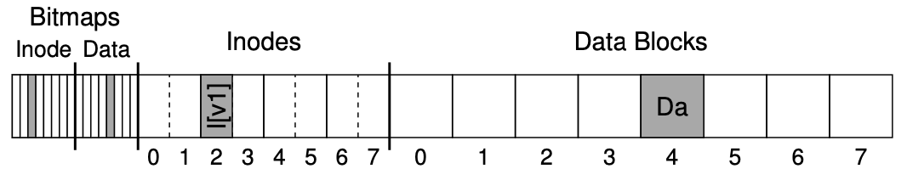
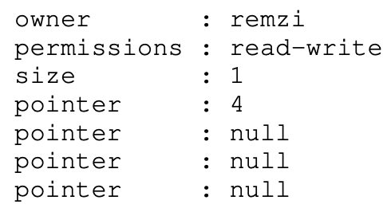
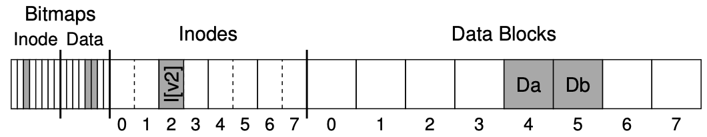
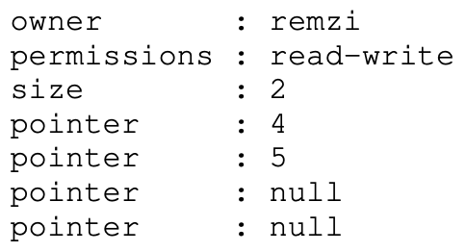
Example
File system is appending to a file and must update:
inode
data bitmap
data block
Append “Db”
Notes:
Section 42.1

Slide 9
Question for You…
File system is appending to a file and must update:
inode
data bitmap
data block
What happens if crash after only updating some blocks?
a) data:
b) inode:
c) bitmap:
d) bitmap and inode:
e) data and inode:
f) bitmap and data:
nothing bad, but fail to update
point to garbage, another file may use
lost block , no file will access the data block
point to garbage, data is not updated
another file may use, because bitmap is not set
lost block, no file will access the data block
Notes:
lost block = space leak

Slide 10
How can file system fix Inconsistencies?
Solution #1:
FSCK = file system checker
Strategy:
After crash, scan whole disk for contradictions and “fix” if needed（事后补救，a lazy appoach）
Keep file system off-line until FSCK completes
For example, how to tell if data bitmap block is consistent?
Read every valid inode+indirect block If pointer to data block, the corresponding bit should be 1; else bit is 0

Slide 11
Fsck Checks
Hundreds of types of checks over different fields…
Do superblocks match?
Do directories contain “.” and “..”?
Do number of dir entries equal inode link counts?
Do different inodes ever point to same block?
…
How to solve problems?

Slide 12

Link Count (example 1)
Dir Entry
inode
link_count = 1
Dir Entry
How to fix to have consistent file system?

Slide 13
Link Count (example 1)
Dir Entry
inode
link_count = 2
Simple fix!
Dir Entry

Slide 14
Link Count (example 2)
inode
link_count = 1
no dir entry point to it
How to fix???

Slide 15
Link Count (example 2)
Dir Entry
fix!
inode
link_count = 1
ls -l /
total 150
drwxr-xr-x 401 18432 Dec 31 1969 afs/
drwxr-xr-x. 2 4096 Nov 3 09:42 bin/
drwxr-xr-x. 5 4096 Aug 1 14:21 boot/
dr-xr-xr-x. 13 4096 Nov 3 09:41 lib/
dr-xr-xr-x. 10 12288 Nov 3 09:41 lib64/
drwx------. 2 16384 Aug 1 10:57 lost+found/
...
Notes:
Under root dir creating a new dir “lost+found”

Slide 16
Data Bitmap
inode
link_count = 1
block
(number 123)
data bitmap
0011001100
How to fix?
for block 123

Slide 17
Data Bitmap
inode
link_count = 1
block
(number 123)
data bitmap
0011001101
Simple fix!
for block 123

Slide 18
Duplicate Pointers
inode
link_count = 1
block
(number 123)
inode
link_count = 1
How to fix????
Notes:
这种情况导致的原因可能是：
1）data bitmap出错了，导致两个文件分配到了同一个data block
2）其中文件更新时（本来是要move data，更新data bitmap的），但还没来得及更新其pointer，就crash了

Slide 19
Duplicate Pointers
inode
link_count = 1
block
(number 123)
copy
inode
link_count = 1
block
(number 789)

Slide 20
Duplicate Pointers
inode
link_count = 1
block
(number 123)
inode
link_count = 1
block
(number 789)
Simple fix!
But is this correct?

Slide 21
Bad Pointer
inode
link_count = 1
9999
super block
tot-blocks=8000
How to fix???
Notes:
A pointer is considered “bad” if it obviously points to something outside its valid range, e.g., it has an address that refers to a block greater than the parti- tion size. In this case, fsck can’t do anything too intelligent; it just removes (clears) the pointer from the inode or indirect block.

Slide 22
Bad Pointer
inode
link_count = 1
Simple fix! (But is this correct?)
super block
tot-blocks=8000

Slide 23
Problems with fsck
Problem 1:
Not always obvious how to fix file system image
Don’t know “correct” state, just consistent one
Easy way to get consistency: reformat disk!

Slide 24
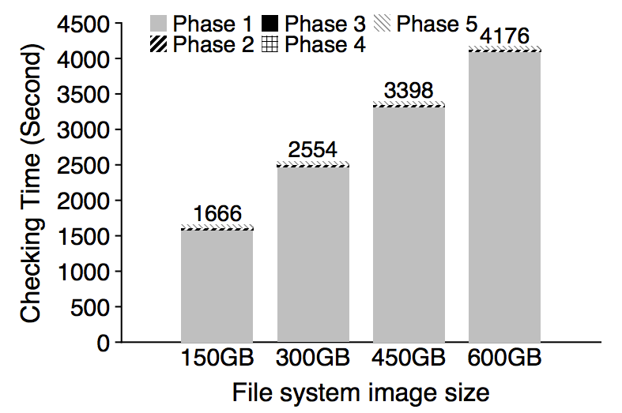
Problem 2: fsck is very slow
Checking a 600GB disk takes ~70 minutes
ffsck: The Fast File System Checker
Ao Ma, EMC Corporation and University of Wisconsin—Madison; Chris Dragga, Andrea C. Arpaci-Dusseau, and Remzi H. Arpaci-Dusseau, University of Wisconsin—Madison

Slide 25
Consistency Solution #2: Journaling
Goals
Ok to do some recovery work after crash, but not to read entire disk
Don’t move file system to just any consistent state, get correct state
Strategy
Atomicity
Definition of atomicity for concurrency
operations in critical sections are not interrupted by operations on related critical sections
Definition of atomicity for persistence
collections of writes are not interrupted by crashes; either (all new) or (all old) data is visible

Slide 26
Consistency vs Correctness
Say a set of writes moves the disk from state A to B
empty
all states
consistent states
A
B
fsck gives consistency
Atomicity gives A or B.

Slide 27
Journaling General Strategy
Never delete ANY old data, until, ALL new data is safely on disk
Ironically, adding redundancy to fix the problem caused by redundancy.
aka. WAL (Write-Ahead Log) 偷师数据库☺
FSCK (事后补救) -> Journaling (事前预防，事后恢复)
More active approach
Examples: Linux ext3, ext4, IBM’s JFS, SGI’s XFS, Windows NTFS

Slide 28
Fight Redundancy with Redundancy
Want to replace X with Y. Original:
DISK
X
redundant
f(X)

Slide 29
Fight Redundancy with Redundancy
Want to replace X with Y. Original:
DISK
Good time to crash?
X
f(X)
good time to crash

Slide 30
Fight Redundancy with Redundancy
Want to replace X with Y. Original:
DISK
Good time to crash?
Y
f(X)
bad time to crash

Slide 31
Fight Redundancy with Redundancy
Want to replace X with Y. Original:
DISK
Good time to crash?
Y
f(Y)
good time to crash

Slide 32
Fight Redundancy with Redundancy
Want to replace X with Y. With journal:
DISK
Good time to crash?
X
f(X)
good time to crash

Slide 33
Fight Redundancy with Redundancy
Want to replace X with Y. With journal:
DISK
X
f(X)
good time to crash
Y

Slide 34
Fight Redundancy with Redundancy
Want to replace X with Y. With journal:
DISK
X
f(X)
good time to crash
Y
f(Y)

Slide 35
Fight Redundancy with Redundancy
Want to replace X with Y. With journal:
DISK
Y
f(X)
good time to crash
Y
f(Y)

Slide 36
Fight Redundancy with Redundancy
Want to replace X with Y. With journal:
DISK
Y
f(Y)
good time to crash
Y
f(Y)

Slide 37
Fight Redundancy with Redundancy
Want to replace X with Y. With journal:
DISK
Y
f(Y)
good time to crash
f(Y)

Slide 38
Fight Redundancy with Redundancy
Want to replace X with Y. With journal:
DISK
Y
f(Y)
good time to crash

Slide 39
Fight Redundancy with Redundancy
Want to replace X with Y. With journal:
DISK
Y
f(Y)
With journaling, it’s always a good time to crash!

Slide 40
Question for You…
Develop algorithm to atomically update two blocks: Write 10 to block 0; write 5 to block 1
Assume these are only blocks in file system…
Time | Block 0 | Block 1 | extra | extra | extra
1 | 12 | 3 | 0 | 0 | 0
2 | 12 | 5 | 0 | 0 | 0
3 | 10 | 5 | 0 | 0 | 0
don’t crash here!
Wrong algorithm leads to inconsistency states (non-atomic updates)

Slide 41
Initial Solution: Journal New Data
Time | Block 0 | Block 1 | 0’ | 1’ | valid
1 | 12 | 3 | 0 | 0 | 0
2 | 12 | 3 | 10 | 0 | 0
3 | 12 | 3 | 10 | 5 | 0
4 | 12 | 3 | 10 | 5 | 1
5 | 10 | 3 | 10 | 5 | 1
6 | 10 | 5 | 10 | 5 | 1
7 | 10 | 5 | 10 | 5 | 0
Crash here? → Old data
Crash here? →New data
Note: Understand behavior if crash after each write…
Recovery: replay the transactions commited, but not checkpointed (redo logging)

Slide 42
Initial Solution: Journal New Data
Usage Scenario:
Block 0 stores Alice’s bank account; Block 1 stores Bob’s bank account;
transfer $2 from Alice to Bob
void update_accounts(int cash1, int cash2) {
write(cash1 to block 2) // Alice backup
write(cash2 to block 3) // Bob backup
write(1 to block 4) // backup is safe
write(cash1 to block 0) // Alice
write(cash2 to block 1) // Bob
write(0 to block 4) // discard backup
}
void recovery() {
if(read(block 4) == 1) {
write(read(block 2) to block 0) // restore Alice
write(read(block 3) to block 1) // restore Bob
write(0 to block 4) // discard backup
}
}

Slide 43
Terminology
Extra blocks are called a “journal”
The writes to the jounral are a “journal transaction”
The last valid bit written is a “journal commit block”

Slide 44
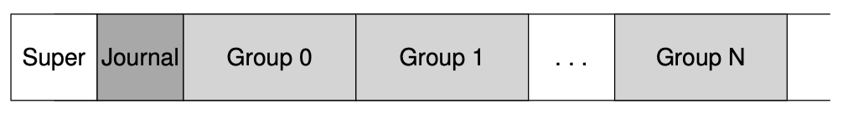
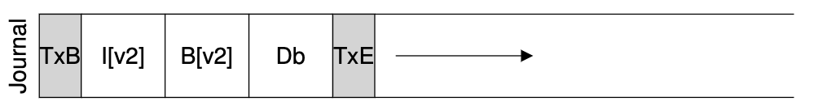
Data Journaling
File system is appending to a file and must update:
Append “Db”
journal commit block

Slide 45
Problem with Initial Approach: Journal Size
…
0
N-1
N
2N-1
2N
Disadvantages?
slightly < half of disk space is usable
transactions copy all the data (1/2 bandwidth!)

Slide 46
Optimizations
1. Reuse small area for journal
2. Barriers
3. Checksums
4. Circular journal
5. Logical journal

Slide 47
Opt #1: Reuse Small Area for Journal
Still need to first write all new data elsewhere before overwriting new data
Goal:
Reuse small area as backup for any block
How?
Store block numbers in a transaction header

Slide 48
Opt #1: Reuse Small Area for Journal
journal
5,2
A
B
0
0
1
2
3
4
5
6
7
8
9
10
11
12
TxB
TxE
journal commit block
transaction: write A to block 5; write B to block 2

Slide 49
Opt #1: Reuse Small Area for Journal
journal
B
A
5,2
A
B
1
0
1
2
3
4
5
6
7
8
9
10
11
12
transaction: write A to block 5; write B to block 2
Checkpoint: Writing new data to in-place locations
Notes:
Checkpoint的作用：
1）checkpoint之后（commit block归0），可以复用原来的Journal或Transaction所占用的空间
2）在recovery时，避免重放所有的log，只需重放checkpoint之后的log即可

Slide 50
Opt #1: Reuse Small Area for Journal
journal
B
A
5,2
A
B
0
0
1
2
3
4
5
6
7
8
9
10
11
12

Slide 51
Opt #1: Reuse Small Area for Journal
journal
B
A
5,2
A
B
0
0
1
2
3
4
5
6
7
8
9
10
11
12
transaction: write C to block 4; write T to block 6

Slide 52
Opt #1: Reuse Small Area for Journal
journal
B
A
4,6
A
B
0
0
1
2
3
4
5
6
7
8
9
10
11
12
transaction: write C to block 4; write T to block 6

Slide 53
Opt #1: Reuse Small Area for Journal
journal
B
A
4,6
C
B
0
0
1
2
3
4
5
6
7
8
9
10
11
12
transaction: write C to block 4; write T to block 6

Slide 54
Opt #1: Reuse Small Area for Journal
journal
B
A
4,6
C
T
0
0
1
2
3
4
5
6
7
8
9
10
11
12
transaction: write C to block 4; write T to block 6

Slide 55
Opt #1: Reuse Small Area for Journal
journal
B
C
A
T
4,6
C
T
1
0
1
2
3
4
5
6
7
8
9
10
11
12
transaction: write C to block 4; write T to block 6
Checkpoint: Writing new data to in-place locations

Slide 56
Opt #1: Reuse Small Area for Journal
journal
B
C
A
T
4,6
C
T
0
0
1
2
3
4
5
6
7
8
9
10
11
12
transaction: write C to block 4; write T to block 6

Slide 57
Optimizations
1. Reuse small area for journal
2. Barriers
3. Checksums
4. Circular journal
5. Logical journal

Slide 58
Correctness depends on Ordering
journal
B
C
A
T
4,6
C
T
0
0
1
2
3
4
5
6
7
8
9
10
11
12
transaction: write C to block 4; write T to block 6
write order: 9, 10, 11, 12, 4, 6, 12
Need ordering to guarantee correctness!
But enforcing total ordering is inefficient. Why?
Random writes (especially with multiple blocks)
Instead: Use barriers w/ disk cache flush at key points (when??)

Slide 59
Opt #2: Barriers (to Enforce Ordering)
journal
B
C
A
T
4,6
C
T
0
0
1
2
3
4
5
6
7
8
9
10
11
12
transaction: write C to block 4; write T to block 6
write order: 9,10,11 | 12 | 4,6 | 12
Use barriers at key points in time:
1) Before journal commit, ensure journal transaction entries complete
2) Before checkpoint, ensure journal commit complete
3) Before free journal, ensure in-place updates (checkpoint) complete
Notes:
Aside: Forcing Writes to Disk (P563)

Slide 60
Optimizations
1. Reuse small area for journal
2. Barriers
3. Checksums
4. Circular journal
5. Logical journal

Slide 61
Opt #3: Checksums
journal
B
C
A
T
4,6
C
T
0
0
1
2
3
4
5
6
7
8
9
10
11
12
write order: 9,10,11 | 12 | 4,6 | 12
barrier to enforce ordering
Issue transactional write in two steps
Step 1: Journal write (9, 10, 11)
Step 2: Journal commit (12)
Problem: Bad Performance for Step 2 (Journal commit)
How can we get rid of barrier between (9, 10, 11) and 12 ???
Notes:
P564，Aside: Optimizing Log Writes
You may have noticed a particular inefficiency of writing to the log. Namely, the file system first has to write out the transaction-begin block and contents of the transaction; only after these writes complete can the file system send the transaction-end block to disk. The performance impact is clear, if you think about how a disk works: usually an extra rotation is incurred (think about why).
12前有了barrier后，虽然可以enforce ordering以保证正确性（correctness），但Block 12的写是低效的，因为不能和前面的9，10，11完成sequential write，而是要等待它们都写完，这时可能磁头已经转过去了，错过了12的写，所以要等转一圈以后才能写12了。

Slide 62
Opt #3: Checksums
journal
B
C
A
T
4,6
C
T
(ck)
0
1
2
3
4
5
6
7
8
9
10
11
12
write order: 9,10,11,12 | 4,6 | 12
In last transaction block, store checksum of rest of transaction
12 = Cksum(9, 10, 11)
Pros: write the entire transaction at once (sequential write), without incurring a wait
During recovery: If checksum does not match transaction, treat as not valid
Example: Linux ext4

Slide 63
Optimizations
1. Reuse small area for journal
2. Barriers
3. Checksums
4. Circular journal
5. Logical journal

Slide 64
Write Buffering Optimization
Note: after journal write, there is no rush to checkpoint
If system crashes, still have persistent copy of written data!
Journaling is sequential, checkpointing is random
Solution? Delay checkpointing for some time
Difficulty: need to reuse journal space
Solution: keep many transactions for un-checkpointed data in a circular buffer
Notes:
Making The Log Finite (P566)
书上提出的方案是：Journal Superblock

Slide 65
Opt #4: Circular Journal
T1
T2
T3
T4
Journal:
0
128 MB
Keep data also in memory until checkpointed on disk
Notes:
“Keep data also in memory”是为了在checkpoint时再去读磁盘上的Journal，减少Disk IO

Slide 66
Opt #4: Circular Journal
T2
T3
T4
Journal:
0
128 MB
checkpoint and cleanup

Slide 67
Opt #4: Circular Journal
T5
T2
T3
T4
Journal:
0
128 MB
transaction!

Slide 68
Opt #4: Circular Journal
T5
T3
T4
Journal:
0
128 MB
checkpoint and cleanup

Slide 69
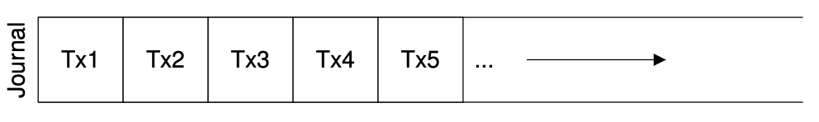
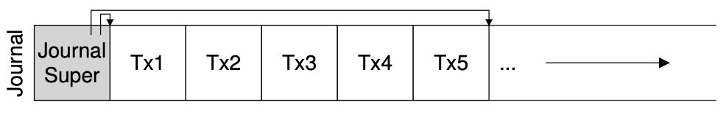
Opt #4: Circular Journal
Journal Superblock: mark oldest and newest non-checkpointed transactions in the log

Slide 70
Optimizations
1. Reuse small area for journal
2. Barriers
3. Checksums
4. Circular journal
5. Logical journal

Slide 71
Physical Journal (Physical Logging)
TxB
length=3
blks=4,6,1
0000000000
0000000000
0000000000
0000100000
inode
…
addr[?]=521
data block
TxE
(checksum)
Notes:
P562

Slide 72
Physical Journal (Physical Logging)
TxB
length=3
blks=4,6,1
0000000000
0000000000
0000000000
0000100000
inode
…
addr[?]=521
data block
TxE
(checksum)
Actual changed data is much smaller!

Slide 73
Opt #5: Logical Journal
TxB
length=1
list of
changes
TxE
(checksum)
Logical journals record changes to bytes, not contents of new blocks
On recovery: Need to read existing contents of in-place data and (re-)apply changes

Slide 74
Optimizations
1. Reuse small area for journal
2. Barriers
3. Checksums
4. Circular journal
5. Logical journal

Slide 75
File System Integration
FS
Journal
Scheduler
Disk

Slide 76
How to avoid writing all disk blocks Twice?
Write twice: data + journal
half of peak bandwidth for sequential write
Observation: given that most I/O traffic to the disk is data, not writing data twice substantially reduces the I/O load of journaling
Strategy: journal all metadata (Metadata Journling), including:
superblock, bitmaps, inodes, indirects, directories
For regular data, write it back whenever convenient. Of course, files may contain garbage.
Notes:
P567 Metadata Journling

Slide 77
Writeback Journal
journal
bitmap
inode
B
I
?
0
0
1
2
3
4
5
6
7
8
9
10
11
12
transaction: append to inode I
B: bitmap, I: inode

Slide 78
Writeback Journal
journal
B
I
?
TxB
B’
I’
0
0
1
2
3
4
5
6
7
8
9
10
11
12
transaction: append to inode I
TxB: transaction begin
TxE: transaction end

Slide 79
Writeback Journal
journal
B
I
?
TxB
B’
I’
TxE
0
1
2
3
4
5
6
7
8
9
10
11
12
transaction: append to inode I

Slide 80
Writeback Journal
journal
B
I’
?
TxB
B’
I’
TxE
0
1
2
3
4
5
6
7
8
9
10
11
12
transaction: append to inode I

Slide 81
Writeback Journal
journal
B’
I’
?
TxB
B’
I’
TxE
0
1
2
3
4
5
6
7
8
9
10
11
12
transaction: append to inode I
What if we crash now? Solutions?
I points to garbage data;
cannot recover as not being journaled

Slide 82
Ordered Journaling
Still only journal metadata
But write data before the transaction
Rule: “write the pointed-to object before the object that points to it”
No leaks of sensitive data!

Slide 83
Ordered Journaling
journal
B
I
?
0
0
1
2
3
4
5
6
7
8
9
10
11
12
transaction: append to inode I

Slide 84
Ordered Journaling
#1: Data write
journal
B
I
D
0
0
1
2
3
4
5
6
7
8
9
10
11
12
transaction: append to inode I
What happens if crash now?
B (bitmap) indicates D currently free
I (inode) does not point to D;
Lose D, but that might be acceptable

Slide 85
Ordered Journaling
#2: Journal metadata write
journal
B
I
D
TxB
I’
B’
0
0
1
2
3
4
5
6
7
8
9
10
11
12
transaction: append to inode I

Slide 86
Ordered Journaling
#3: Journal commit
journal
B
I
D
TxB
I’
B’
TxE
0
1
2
3
4
5
6
7
8
9
10
11
12
transaction: append to inode I

Slide 87
Ordered Journaling
#4: Checkpoint metadata
journal
B
I’
D
TxB
I’
B’
TxE
0
1
2
3
4
5
6
7
8
9
10
11
12
transaction: append to inode I

Slide 88
Ordered Journaling
#4: Checkpoint metadata
journal
B’
I’
D
TxB
I’
B’
TxE
0
1
2
3
4
5
6
7
8
9
10
11
12
transaction: append to inode I

Slide 89
Ordered Journaling
#5: Free
journal
B’
I’
D
TxB
I’
B’
0
0
1
2
3
4
5
6
7
8
9
10
11
12
transaction: append to inode I

Slide 90
Ordered Journaling
Steps:
Data write
Journal metadata write
Journal commit
Checkpoint metadata
Free the transaction in journal
3 modes in Linux Ext3
Data
Ordered
Unordered (data can be written at any time)
1 & 2 can issue write concurrently

Slide 91
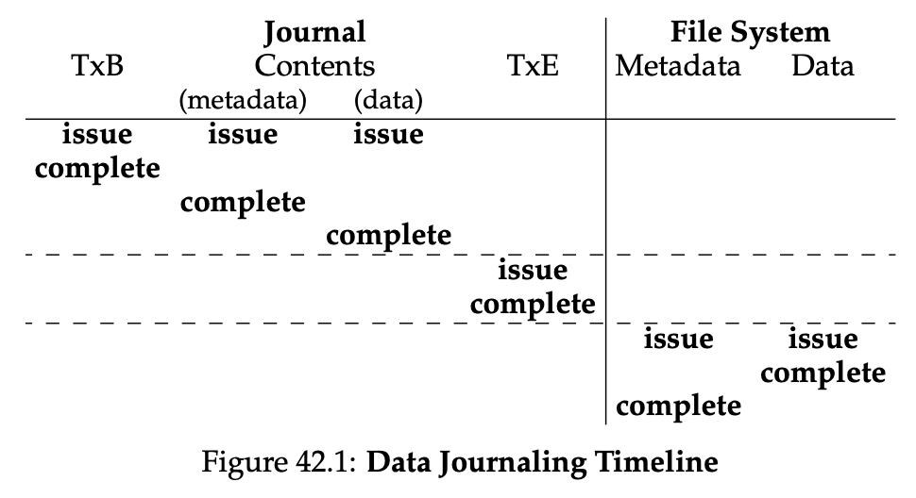
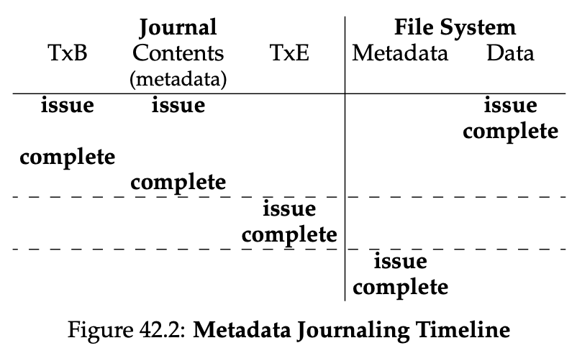
Data Journaling v.s. Ordered Journaling
t

Slide 92
Conclusion
Most modern file systems use journals
ordered-mode for meta-data is popular (Linux ext3, Windows NTFS, SGI’s XFS)
FSCK is still useful for weird cases
bit flips
FS bugs
Some file systems don’t use journals, but still (usually) write new data before deleting old (copy-on-write file systems, e.g., Sun’s ZFS)
Idea: This technique never overwrites files or directories in place; rather, it places new updates to previously unused locations on disk.
copy-on-write -> log-structured file system (LFS)

