Slide 1
Persistence: Log-Structured FS (LFS)
Questions answered in this lecture:
Besides Journaling, how else can disks be updated atomically?
Does on-disk log help performance of writes or reads?
How to find inodes in on-disk log?
How to recover from a crash?
How to garbage collect dead information?

Slide 2
File-System Case Studies
Local
FFS: Fast File System
LFS: Log-Structured File System
Network
NFS: Network File System
AFS: Andrew File System

Slide 3
General Strategy for Crash Consistency
Never delete ANY old data, until ALL new data is safely on disk
Implication: At some point in time, all old AND all new data must be on disk
Two techniques popular in file systems:
1. journal new info, then overwrite old info with new info in place
2. copy-on-write: write new info to new location, discard old info

Slide 4
Review: Journal New, Overwrite In-Place
12
5
...
...
In-place file data
Journal

Slide 5
Review: Journal New, Overwrite In-Place
12
5
10
...
file data
Journal
Imagine journal header describes in-place destinations

Slide 6
Review: Journal New, Overwrite In-Place
12
5
10
7
file data
Journal
Imagine journal commit block designates transaction complete

Slide 7
Review: Journal New, Overwrite In-Place
10
5
10
7
file data
Journal
Perform checkpoint to in-place data when transaction is complete

Slide 8
Review: Journal New, Overwrite In-Place
10
7
10
7
file data
Journal

Slide 9
Review: Journal New, Overwrite In-Place
10
7
file data
Journal
Clear journal commit block to show checkpoint complete

Slide 10
TODAY: Write New, Discard Old
12
5
...
...
file data
Make a copy-on-write (COW)

Slide 11
TODAY: Write New, Discard Old
12
5
10
...
file data

Slide 12
TODAY: Write New, Discard Old
12
5
10
7
file data

Slide 13
TODAY: Write New, Discard Old
12
5
10
7
file data

Slide 14
TODAY: Write New, Discard Old
10
7
file data
Obvious advantage?
Only write new data once instead of twice

Slide 15
LFS Performance Goal
Motivation:
FS performance is largely determined by write performance
Growing gap between sequential and random I/O performance
FFS incurs many short seeks and rotational delays (small random IO)
RAID 4 and RAID-5 especially bad with small random writes
Idea: use disk purely sequentially
Easy for writes to use disk sequentially – why?
Can do all writes near each other to empty space – new copy
Works well with RAID-5 (large sequential writes)
Hard for reads – why?
The desired block to be read may be anywhere on disk (workload dependent, ad-hoc)
Maybe not be too bad if disk reads are slow
Memory sizes are growing (cache more reads)

Slide 16
LFS Strategy
File system buffers writes in main memory until “enough” data
How much is enough?
Enough to get good sequential bandwidth from disk (MB)
Write buffered data sequentially to new segment on disk
Never overwrite old info: old copies left behind

Slide 17
Write Buffering
Why: simply writing to disk in sequential order is not enough to achieve peak performance
In-between the two writes, unfortunately, the disk has rotated
You have to wait before commiting the second write
Solution: Write Buffering
Before writing to the disk, LFS keeps track of updates in memory;
when it has received a sufficient number of updates, it writes them to disk all at once, thus ensuring efficient use of the disk.
Segment
The large chunk of updates LFS writes at one time is referred to by the name of a segment.

Slide 18
Big Picture
segment
buffer:
disk:

Slide 19
Big Picture
buffer:
disk:

Slide 20
Big Picture
buffer:
disk:

Slide 21
Big Picture
buffer:
disk:

Slide 22
Big Picture
buffer:
disk:
S0
S1
S2
S3
segments

Slide 23


How much to buffer? (Segment Size)
Assume:
Posistion Time: T_{posistion} (seconds)
Disk Transfer Rate: R_{peak} (MB/s)
Write Size: D (MB)
Solution:
Write Time: T_{Write}
Effective rate of writing: R_{effictive}
Fraction of the peak rate: F = R_{effictive} / R_{peak}

Slide 24
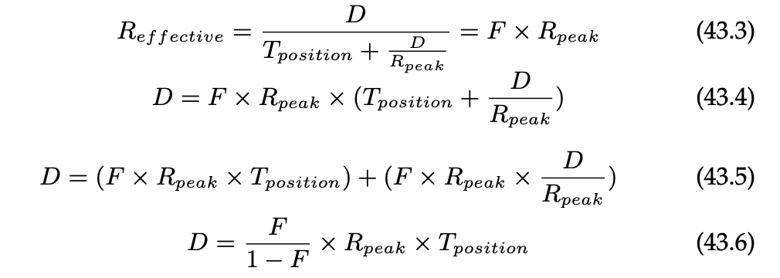
How much to buffer? (Segment Size)
Solution:
Example:
Assume positioning time = 10 milliseconds, peak transfer rate = 100 MB/s
If we want an effective bandwidth of 90% of peak (F = 0.9), then D=9MB

Slide 25
Data Structures (attempt 1)
S0
S1
S2
S3
What data structures from FFS can LFS remove?
allocation structs: data + inode bitmaps
What type of name is much more complicated?
Inodes are no longer at fixed offset
Use current offset on disk instead of table index for name
Note: when update inode, inode number changes!!

Slide 26
Attempt 1
Overwrite data in /file.txt
I2
Dir
I9
D
D’
root inode
root directory entries
file inode
file data
How to update Inode 9 to point to new D’ ???

Slide 27
Attempt 1
Overwrite data in /file.txt
I2
Dir
I9
D
D’
Can LFS update Inode 9 to point to new D’?
NO! This would be a random write

Slide 28
Attempt 1
Overwrite data in /file.txt
I2
Dir
I9
D
D’
I9'
Dr’
I2'
old
new
Must update all structures in sequential order to log

Slide 29
Attempt 1: Problem w/ Inode Numbers
I2
Dir
I9
D
D’
I9'
Dr’
I2'
Problem: For every data update, must propagate updates all the way up directory tree to root
Why? When inode copied, its location (inode number) changes
Solution: Keep inode numbers constant; don’t base name on offset
FFS found inodes with math. How now?

Slide 30
Data Structures (attempt 2)
What data structures from FFS can LFS remove?
allocation structs: data + inode bitmaps
What type of name is much more complicated?
Inodes are no longer at fixed offset
Use imap structure to map: inode number => inode location on disk

Slide 31
Where to keep Imap?
table of millions of
entries
imap: inode number => inode location on disk
disk:
imap
S0
S1
S2
S3
segments
Where can imap be stored? Dilemma:
1. imap too large to keep in memory
2. don’t want to perform random writes for imap
Solution:
Write imap in segments
Keep pointers to pieces of imap in memory

Slide 32
Solution: Imap in Segments
memory:
ptrs to
imap pieces
disk:
S0
S1
S2
S3
segments
Solution:
Write imap in segments
Keep pointers to pieces of imap in memory
Keep recent accesses to imap cached in memory

Slide 33
Example Write
disk:
…
data
inode
imap
Solution:
Write imap in segments
Keep pointers to pieces of imap in memory
Keep recent accesses to imap cached in memory

Slide 34
create /foo/bar in FFS
data
inode
root
foo
bar
root
foo
bitmap
bitmap
inode
inode
inode
data
data
(read)
(read)
(read)
(read)
read
write
read
write
write
write

Slide 35
create /foo/bar in LFS
data
inode
root
foo
bar
root
foo
bitmap
bitmap
inode
inode
inode
data
data
(read)
(read)
(read)
(read)
read
write
read
write
write
write
Most data structures same in LFS as FFS!
Use imap to find location of root and foo inodes
Update imap with new locations for foo and bar inodes

Slide 36
Other Issues
Crashes
Garbage Collection

Slide 37
Crash Recovery
What data needs to be recovered after a crash?
Need imap (lost in volatile memory)
Naive approach?
Scan entire log to reconstruct pointers to imap pieces. Slow!
Better approach?
Store the imap pointers on disk
Occasionally checkpoint to known on-disk location the pointers to imap pieces
How often to checkpoint?
Checkpoint often: random I/O
Checkpoint rarely: lose more data, recovery takes longer
Example: checkpoint every 30 secs

Slide 38
Checkpoint
memory:
ptrs to
imap pieces
new write
after last
checkpoint
checkpoint
disk:
S0
S1
S2
S3
log tail after last
checkpoint
Crash!

Slide 39
Reboot
memory:
ptrs to
imap pieces
checkpoint
disk:
S0
S1
S2
S3
log tail after last
checkpoint

Slide 40
Reboot
memory:
ptrs to
imap pieces
get pointers
from checkpoint
checkpoint
disk:
S0
S1
S2
S3
log tail after last
checkpoint

Slide 41
Reboot
memory:
ptrs to
imap pieces
get pointers by scanning after tail
→ Roll forward
checkpoint
disk:
S0
S1
S2
S3
log tail after last
checkpoint

Slide 42
Checkpoint Summary
Checkpoint occasionally (e.g., every 30s)
Upon recovery:
read checkpoint to find most imap pointers and segment tail
find rest of imap pointers by reading past tail
What if crash during checkpoint?

Slide 43
Checkpoint Strategy
Have two checkpoint regions
Only overwrite one checkpoint at a time
Use checksum/timestamps to identify newest checkpoint
disk:
???
v2
S0
S1
S2
S3
writing

Slide 44
Checkpoint Strategy
Have two checkpoint regions
Only overwrite one checkpoint at a time
Use checksum/timestamps to identify newest checkpoint
disk:
v3
v2
S0
S1
S2
S3

Slide 45
Checkpoint Strategy
Have two checkpoint regions
Only overwrite one checkpoint at a time
Use checksum/timestamps to identify newest checkpoint
disk:
v3
???
S0
S1
S2
S3
writing

Slide 46
Checkpoint Strategy
Have two checkpoint regions
Only overwrite one checkpoint at a time
Use checksum/timestamps to identify newest checkpoint
disk:
v3
v4
S0
S1
S2
S3

Slide 47
Checkpoint Strategy
Have two checkpoint regions
Only overwrite one checkpoint at a time
Use checksum/timestamps to identify newest checkpoint
disk:
???
v4
S0
S1
S2
S3
writing

Slide 48
Checkpoint Strategy
Have two checkpoint regions
Only overwrite one checkpoint at a time
Use checksum/timestamps to identify newest checkpoint
disk:
v5
v4
S0
S1
S2
S3

Slide 49
Other Issues
Crashes
Garbage Collection

Slide 50
What to do with old data?
Old versions of files -> garbage
Approach 1: garbage is a feature!
Keep old versions in case user wants to revert files later
Versioning file systems
Example: Dropbox, Word
Approach 2: garbage collection…

Slide 51
Garbage Collection
Need to reclaim space:
1. When no more references (any file system)
2. After newer copy is created (COW file system)
LFS reclaims segments (not individual inodes and data blocks)
Want future overwrites to be to sequential areas
Tricky, since segments are usually partly valid
Some files have newer versions that are written in other segments

Slide 52
Garbage Collection
60%
10%
95%
35%
disk segments:
USED
USED
USED
USED
FREE
FREE

Slide 53
Garbage Collection
60%
10%
95%
35%
disk segments:
USED
USED
USED
USED
FREE
FREE

Slide 54
Garbage Collection
60%
10%
95%
35%
95%
disk segments:
USED
USED
USED
USED
USED
FREE
compact 2 segments to one
When move data blocks, copy new inode to point to it
When move inode, update imap to point to it

Slide 55
Garbage Collection
10%
95%
95%
disk segments:
FREE
USED
USED
FREE
USED
FREE
release input segments

Slide 56
Garbage Collection
General operation: Pick M segments, compact into N (where N < M).
Mechanism: How does LFS know whether data in segments is valid?
Policy: Which segments to compact?

Slide 57
Garbage Collection Mechanism
Is an inode the latest version?
Check imap to see if this inode is pointed to
Fast!
Is a data block the latest version?
Scan ALL inodes to see if any point to this data
Very slow!
How to track information more efficiently?
Segment summary lists inode and data offset corresponding to each data block in segment (reverse pointers)

Slide 58
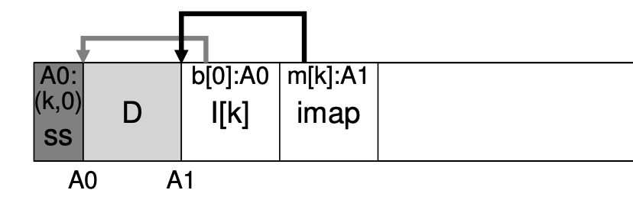
Block Liveness
am i alive?
disk:
…
:D
…
SS
…
Address A
SS
Segment summary

Slide 59
Block Liveness
am i alive?
disk:
…
:D
…
SS
…
lookup A to find
inode number N
offset T
SS
Segment summary

Slide 60
Block Liveness
imap
am i alive?
lookup imap to find where is inode N
read N from disk
disk:
…
:D
…
SS
…
inode
Notes:
imap in memory, which include the “latest” inode N

Slide 61
Block Liveness
imap
Using offset T, look in inode to see where the Tth block is on disk
am i alive?
disk:
…
:D
…
SS
…
inode
D’

Slide 62
Block Liveness
imap
am i alive?
disk:
…
:’(
…
SS
…
inode
D’
Nope!

Slide 63
Garbage Collection
General operation: Pick M segments, compact into N (where N < M).
Mechanism: How does LFS know whether data in segments is valid? [segment summary]
Policy: Which segments to compact?
clean most empty first
clean coldest (ones undergoing least change)
more complex heuristics…

Slide 64
Conclusion
Journaling: Put final location of data wherever file system chooses (usually in a place optimized for future reads)
LFS: Puts data where it’s fastest to write (assume future reads cached in memory)
Other COW(Copy-On-Write) file systems: WAFL, ZFS, btrfs
In DB, shadow paging, LSM-Tree

